Slide 1







Planning for the Caregiver
Resources and Supports
Chelsea B. Crittle, PhD.
Aging Division Director
March 20, 2025

Slide 2



Objectives
  Provide the Administration for Community Living's (ACL) definition of "Family Caregiver."
  Explain the role and responsibilities of the Area Agency on Aging.
  Discuss current resources and support available to family caregivers.

Slide 3
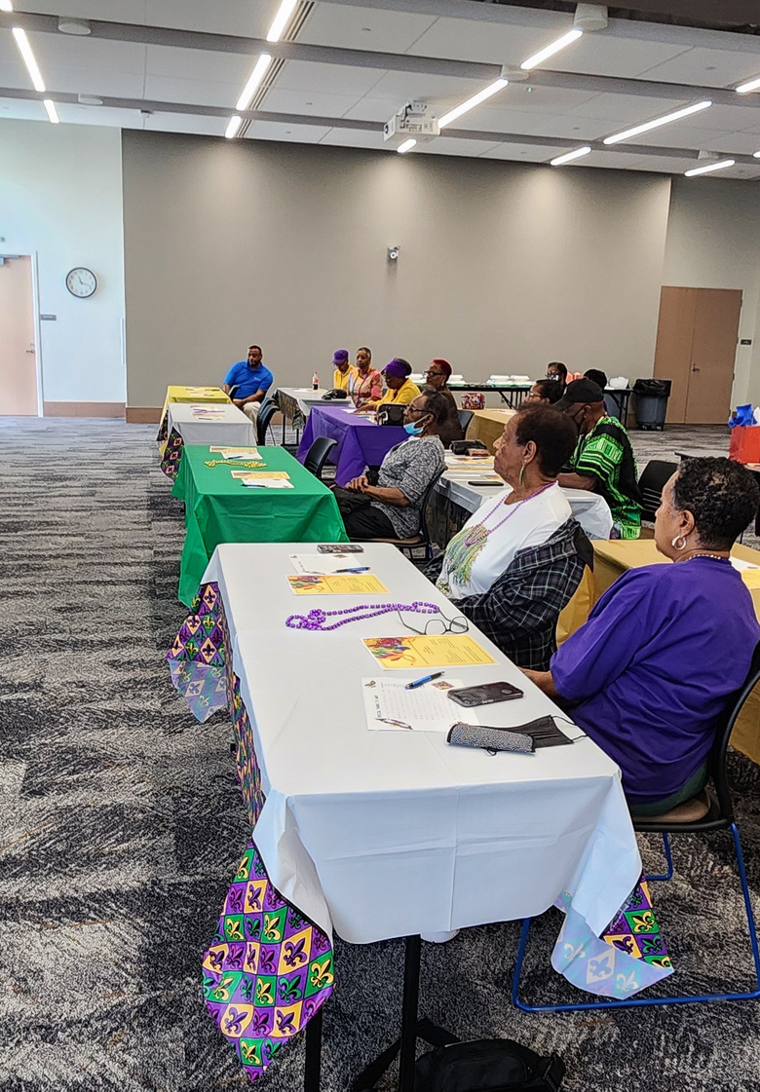



  Famous Quote by Mrs. Rosalynn Carter, former First Lady of the United States of America
There are only four kinds of people in this world:
Those who have been caregivers;
Those who are currently caregivers;
Those who will be caregivers; and
Those who will need caregivers.

Slide 4



The Department of Health and Human Services – Administration for Community Living – Federal Register Vol. 89, No.31
Final Rule/ February 14, 2024
Definition of ‘‘family caregiver’’ and "older relative caregiver"
To include the following subsets: adult family members or other individuals who are caring for an older individual, adult family members or other individuals who are caring for an individual of any age with Alzheimer’s disease or a related disorder with neurological and organic brain dysfunction, and ‘‘older relative caregivers."
With this inclusive approach to defining ‘‘family caregiver,’’ Administration on Community Living (ACL) included those populations specified in the National Family Caregiver Support Program, as set forth in Title III, part E of the Act. For example, this includes unmarried partners, friends, or neighbors caring for an older adult.
The term "older relative caregiver” means a person who is at least 55 years old who lives with a child or person with a disability for whom they are the primary caregiver and to whom they provide informal care.

Slide 5
Background
Congress passed the Older American Act (OAA) in 1965 to expand and enhance community social services for older persons.
The Act created the Administration on Aging (AoA) within the Department of Health and Human Services (HHS), to serve as the principal agency designated to carry out the provisions of the OAA and as the Federal focal point on matters concerning older persons.
Title III of the OAA authorizes grants to State Agencies on Aging (State agencies), who in turn provide funding to Area Agencies on Aging (AAAs or area agencies) to serve as advocates on behalf of older persons and create comprehensive and coordinated community-based continuums of services and supports.
The OAA was passed in 1965 as a vested authority for carrying out the purposes of the Act, including through the issuance of regulations, and the Assistant Secretary for Aging (then the Commissioner for Aging). Since its initial passage, the OAA has been amended a total of eighteen times.
The National Family Caregiver Support Program under Title III and Native American Caregiver Support Program under Title VI were authorized by the 2000 amendments (Pub. L. 106– 501)

Slide 6
Area Agency on Aging
AAAs are a nationwide network of public or private nonprofit agencies designated by a state to address the needs and concerns of all older person at the regional and local levels.
AAA’s coordinate and offer services that help older adults remain in their homes, aided by home and community -based services.
AAAs were formerly established in the 1973 Older Americans Act (OAA) as the “on the ground” organizations charged with helping vulnerable older adults live with independence and dignity.
Approximately 622 AAAs in the United States.

Slide 7
Area Agency on Aging
Mississippi has a total of 10 AAA’s.
Experts in all aspects of aging.
Assists older adults and caregivers looking for information and resources.
Mississippi AAA’s partners and receives funding from the Mississippi Department of Human Services/Division of Aging and Adult Services, Mississippi State Department of Health, Mississippi Department of Mental Health, Division of Medicaid, Mississippi Department of Employment Security, etc.

Slide 8
Area Agency on Aging
AAAs create new services to fill gaps;
Creating a service means writing grants or seeking resources;
Fundraising;
Collaborating with other agencies to provide the service;
Coordinating the new service with existing programs;
Inform seniors and the community about the availability of the new services.
Advocates on behalf of older adults and caregivers.

Slide 9
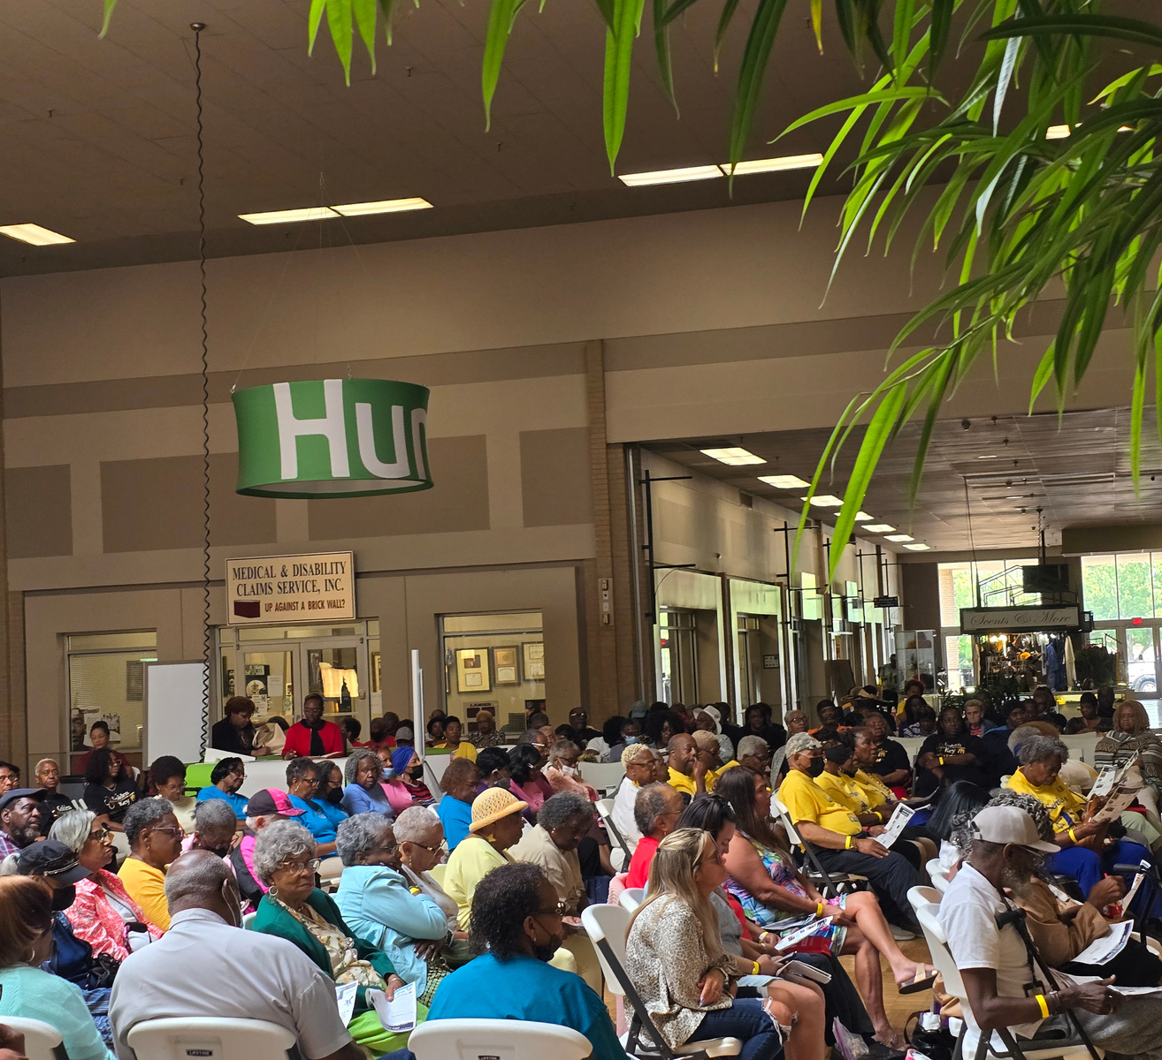
Area Agency on Aging
Services FY 2025
  Adult Day Care
  Case Management
  Congregate Meals
  Home-Delivered Meals
  Home-Delivered Meals “Pay as you go Program”
  Conduct Elderly Abuse Prevention Workshops
  Lifeline Units
  Disease Prevention and Health Promotion Programs
  Information and Referral
  Sponsor the “Santa for Seniors” Program
  National Family Caregiver Support Program
  Nursing Home Ombudsman Program
  Information and Referral, Outreach Program
  Purchase Grab bars, Mobility Aids, Smoke Detectors for Seniors
  State Health Insurance Program (SHIP)
  Transportation
  Respite Services, In-Home and Adult Day Care Centers
  Legal Assistance
  Community Transition Services Program/Veteran’s Directed Care Program
  Caregiver Connection Support Group
  Mississippi Access to Care Centers (MAC Centers)/ Help Me Grow Program
  Emergency Transitions Services Program

Slide 10
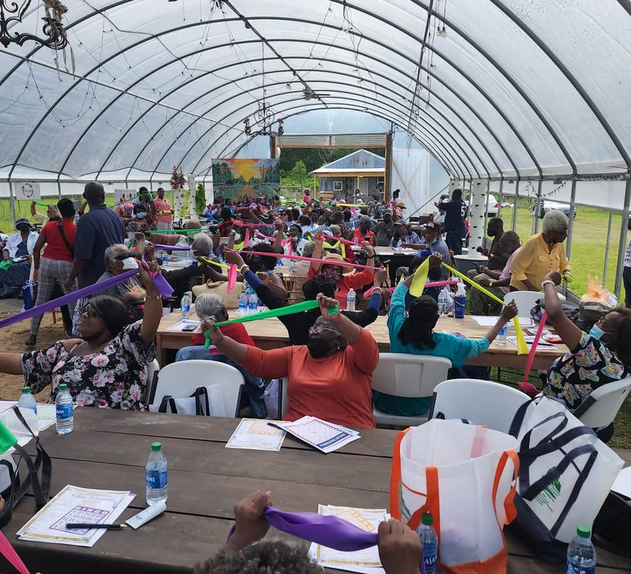
Area Agency on Aging
Services FY 2025
Eligibility
  All services require that the individual be 60 years and older.
  Each individual is screened for services by a qualified assessor utilizing the State’s Consumer information form (CIF).
  Clients receive a score which indicates need for certain critical services. All services are classified as either Level I (0-21) or Level II (22 and above).

Slide 11


Homemaker Services
Area Agency on Aging
Services FY 2025
  Offers assistance with light housekeeping, laundry, meal planning, and food preparation. ​
Ombudsman Program
  Ombudsmen visit licensed nursing homes and personal care homes to investigate, verify, and work to resolve complaints by or on behalf of residents of long-term care facilities about care, services, financial assistance, rights, and other concerns affecting their dignity and well-being.​
Nutrition Programs
  The Older Adult Nutrition Program provides nutritionally balanced meals to older individuals in a variety of settings including congregate facilities such as senior centers; or by home-delivery to older individuals who are homebound due to illness, disability, or geographic isolation
State Health Insurance Program (SHIP)
  This service is a counseling program designed to provide answers to questions regarding Medicare, Medicaid, medigap insurance, and any other public benefits.

Slide 12
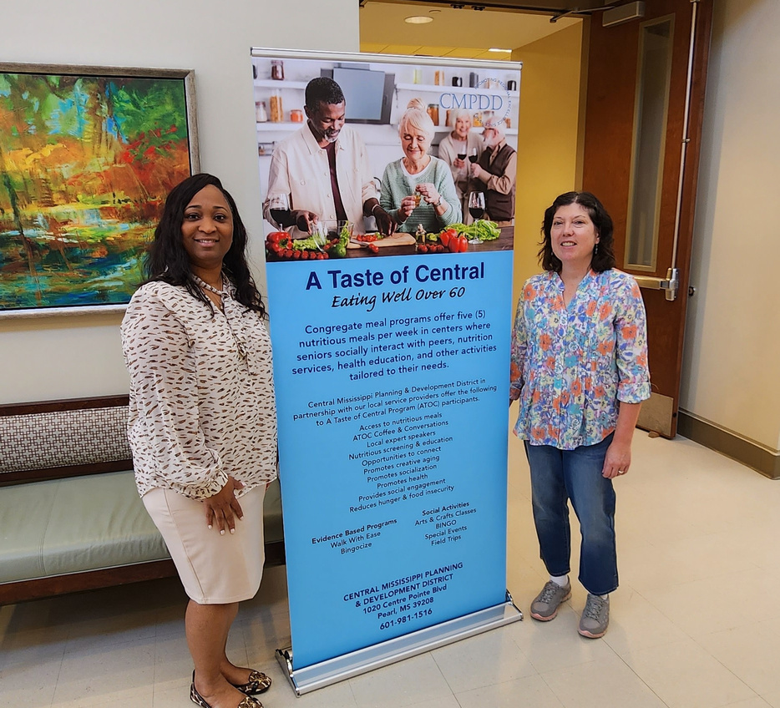
Emergency Transition Services
Area Agency on Aging
Services FY 2025
  Emergency Transitions Support (ETS)Program provides meals and homemaker services during the first 3 weeks following discharge from hospital to home and nursing home-to-home.​
Case Management
  Provides a comprehensive assessment by which an individual’s needs for services are determined, arranges for those services in an organized and coordinated manner. ​
Senior Community Services Employment Program (SCSEP)
  Eligible workers are placed in community service jobs and paid minimum wages while receiving training for unsubsidized jobs.
Respite Services
  This service provides temporary relief time to a primary caregiver of an ill, frail, infirm, functionally impaired older individual or an individual suffering from dementia.

Slide 13
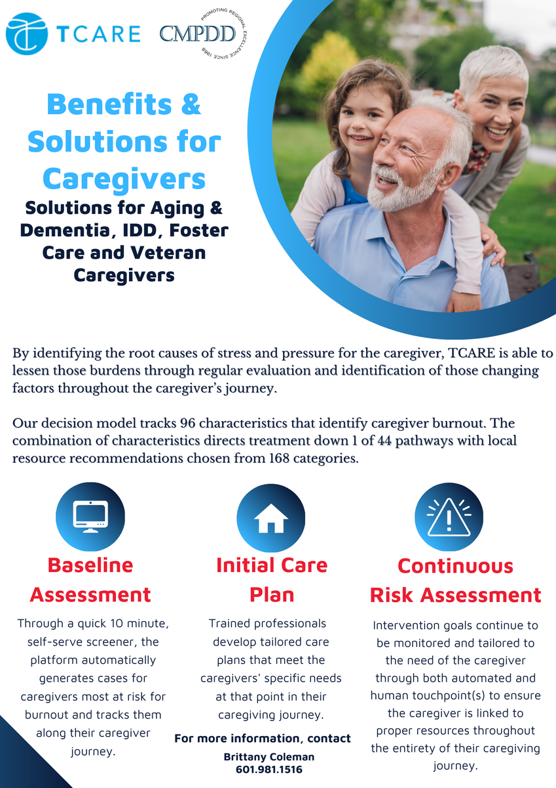
TCARE Program
  The primary purpose of TCARE® is to effectively target support services to the specific needs of the caregiver and in this way maximize the impact of supports and services for caregivers. The TCARE® assessment process identifies current caregiver strengths, resources and sources of stress and offers guidance to care managers for identifying the goals for intervention, strategies, and support services (and resources) that are most suitable for a particular caregiver.
  Fully trained TCARE Specialist that serve as the care manager for caregivers.
    Responsible for administering the full assessment, and delivery of the care plan on a continuous basis.
    Care plans are individually customized.

Slide 14
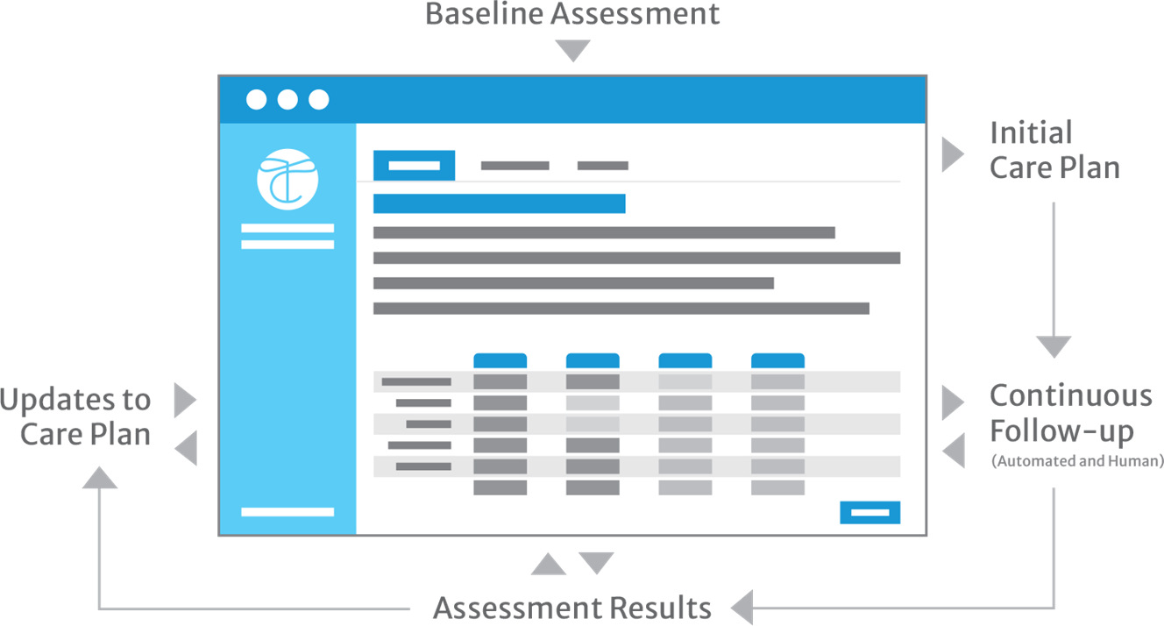
TCARE Platform

Slide 15
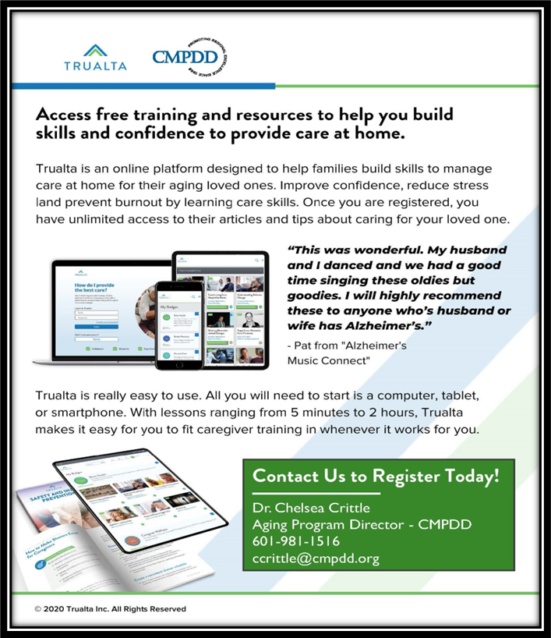


Slide 16
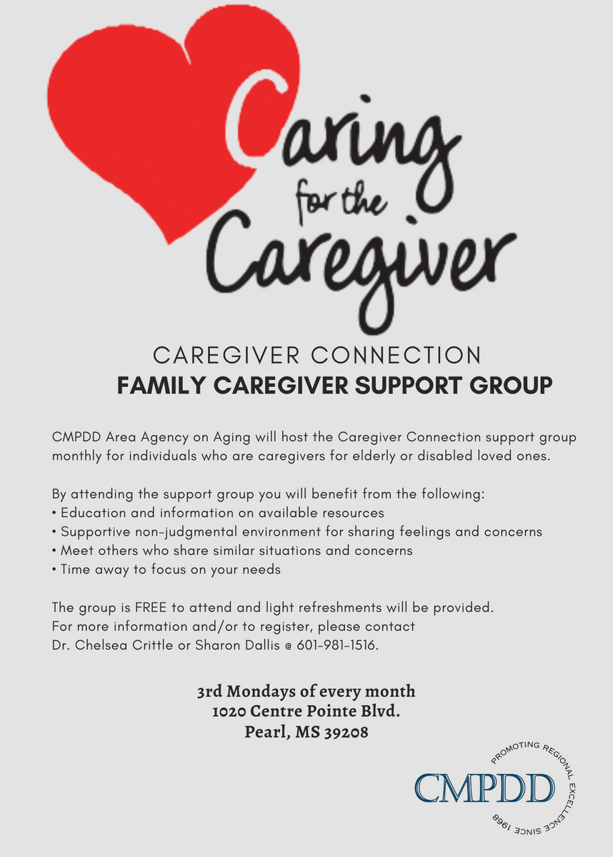
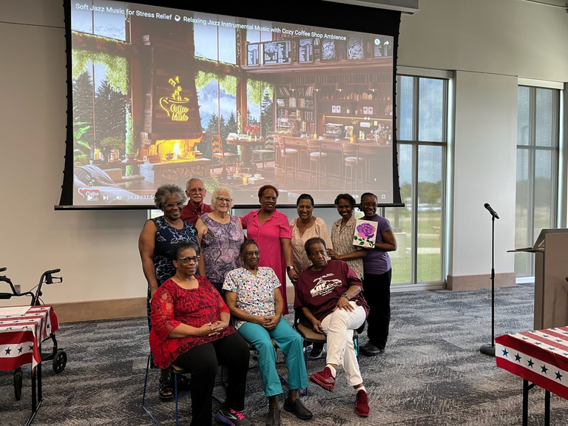
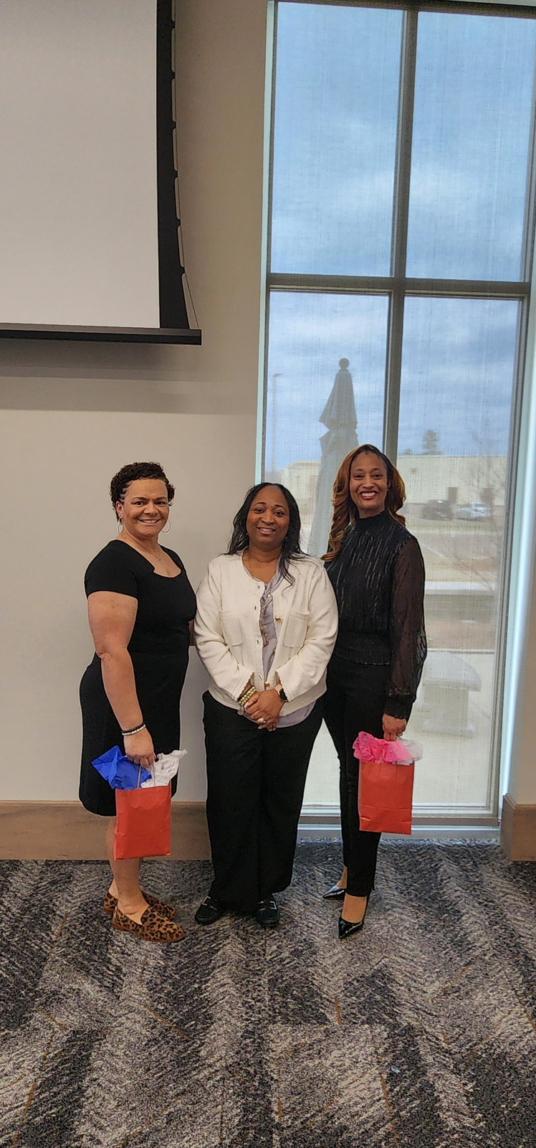
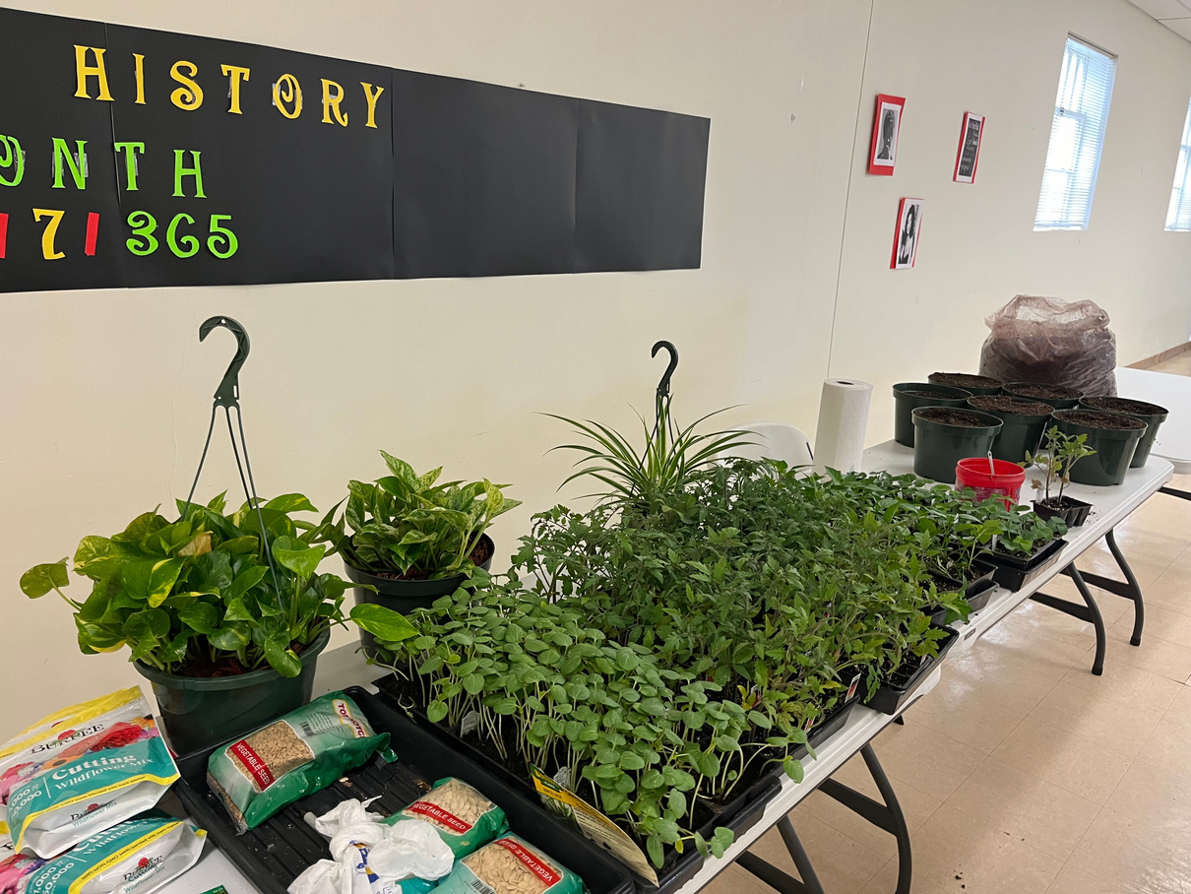
CMPDD Caregiver Groups

Slide 17
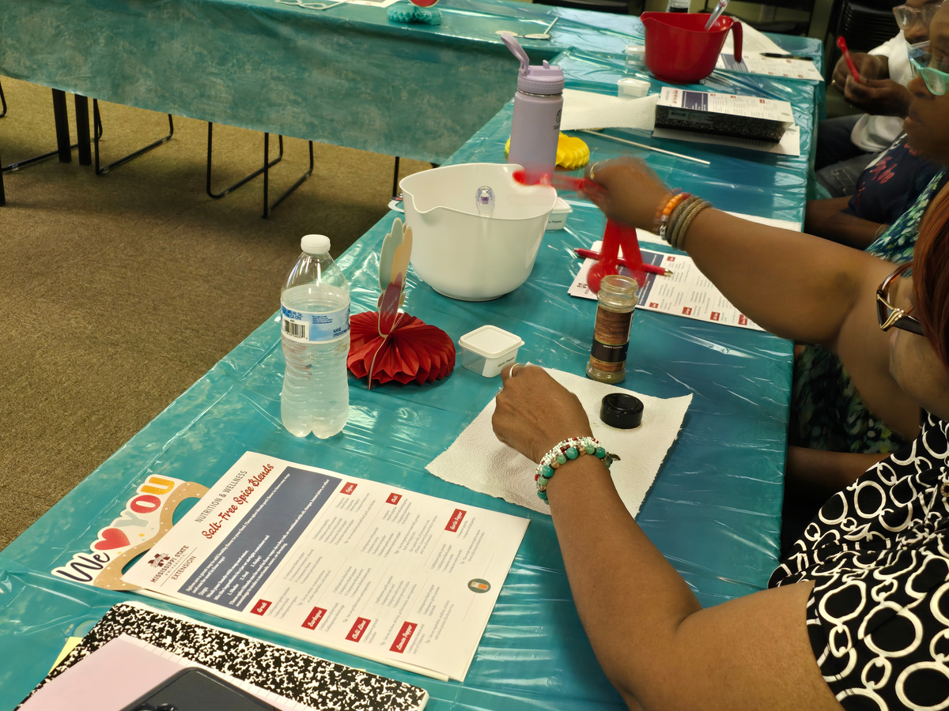
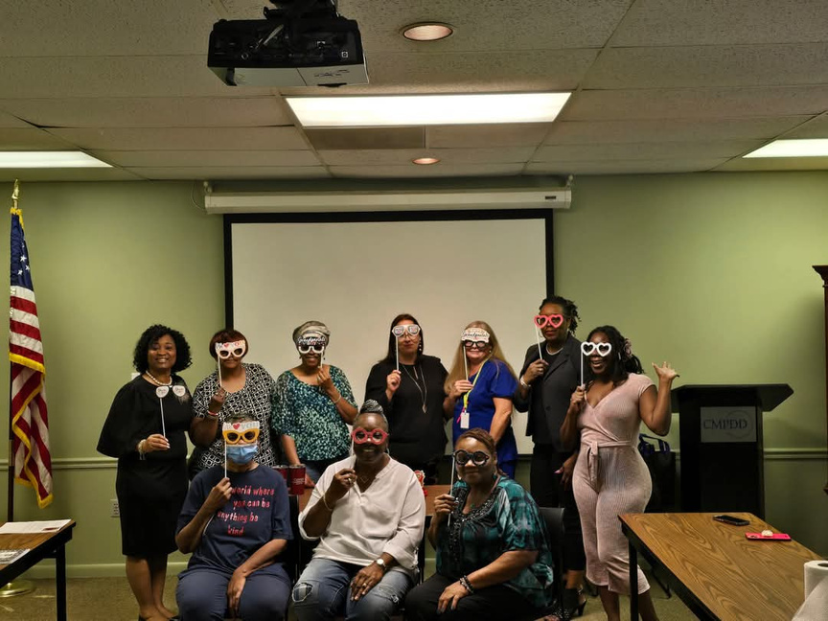

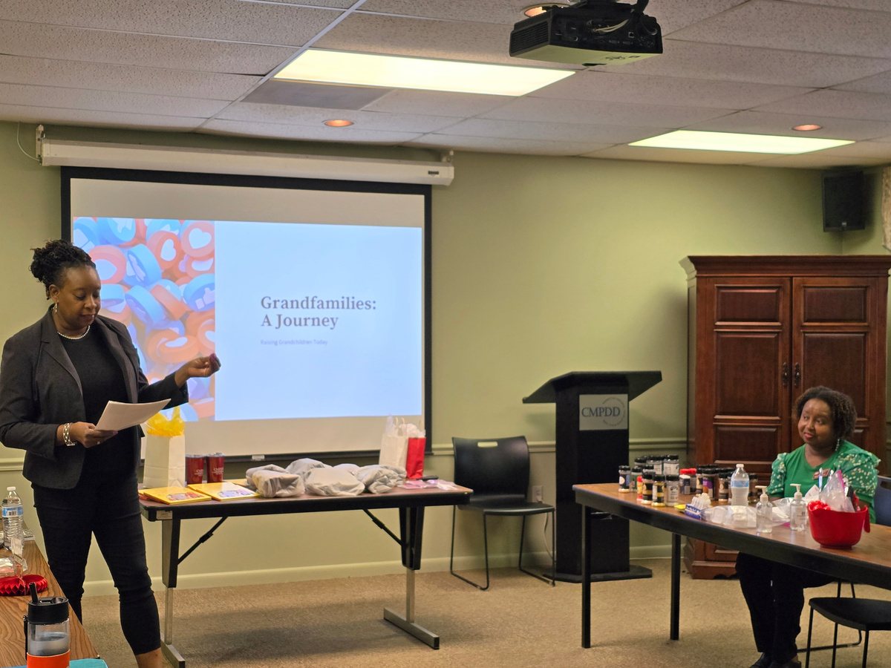

CMPDD Caregiver Groups

Slide 18
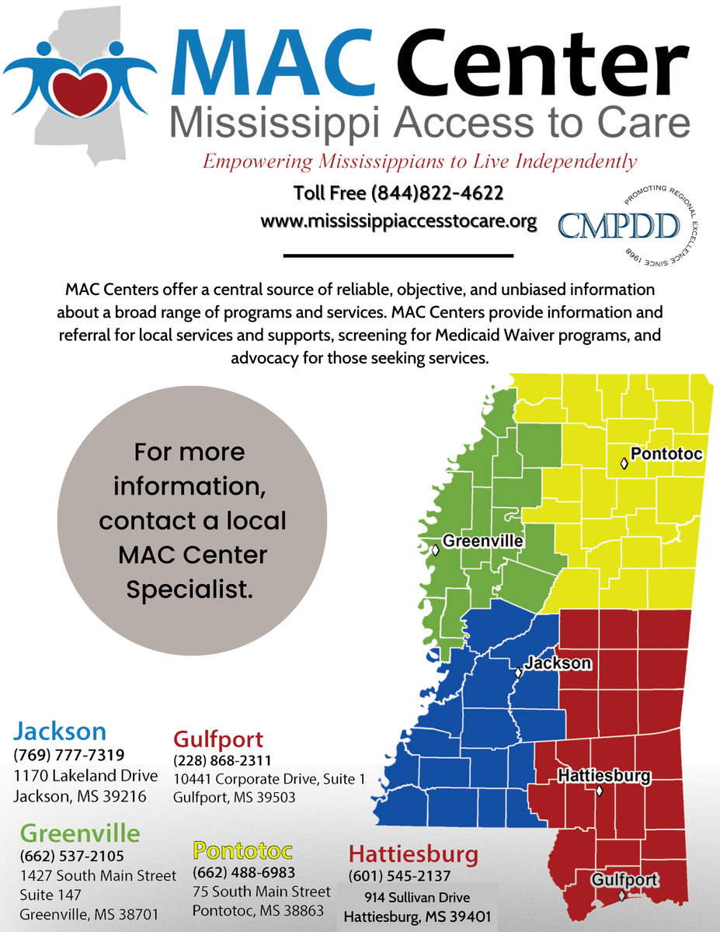
Mississippi Access to Care (MAC) Centers
  MAC Centers are welcoming and accessible places where people can obtain information and assistance in locating long-term care services or applying for benefits.
  MAC Centers serve the elderly, disabled, those individuals' family members and representatives, or any person seeking assistance with long-term care.
  They provide Information & Referral to needed services and supports, Person Centered counseling, and screening for Medicaid waivers.

Slide 19
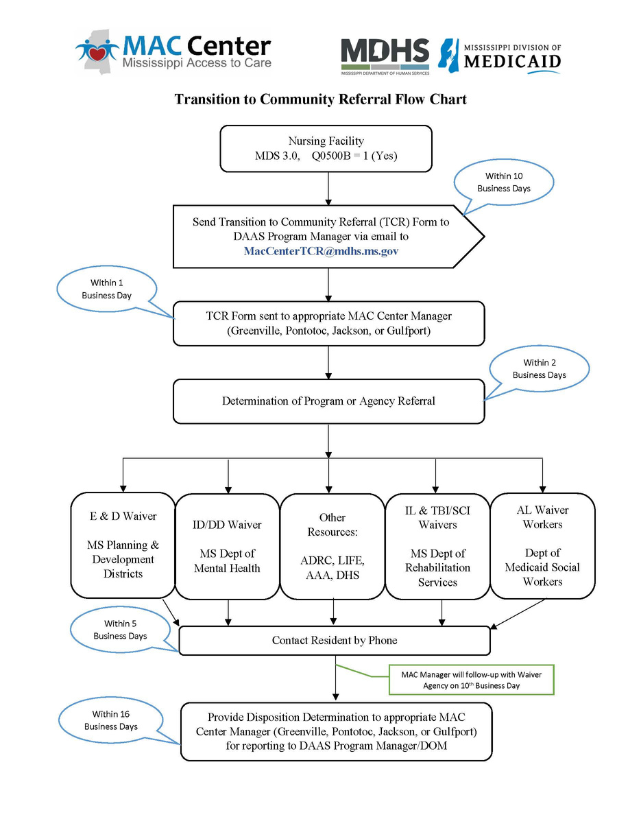
Mississippi Access to Care (MAC) Centers
  MAC Centers are the designated Local Contact Agency to support the resident’s expressed interest in being transitioned from the nursing facility to community living.
  MAC Centers will assess the need, screen for appropriate services, and provide information and referral for local services and supports.
  The MAC Center will contact the Referral Agency to provide information regarding the individual and services and/or support needed for the individual’s transition to community. ​

Slide 20
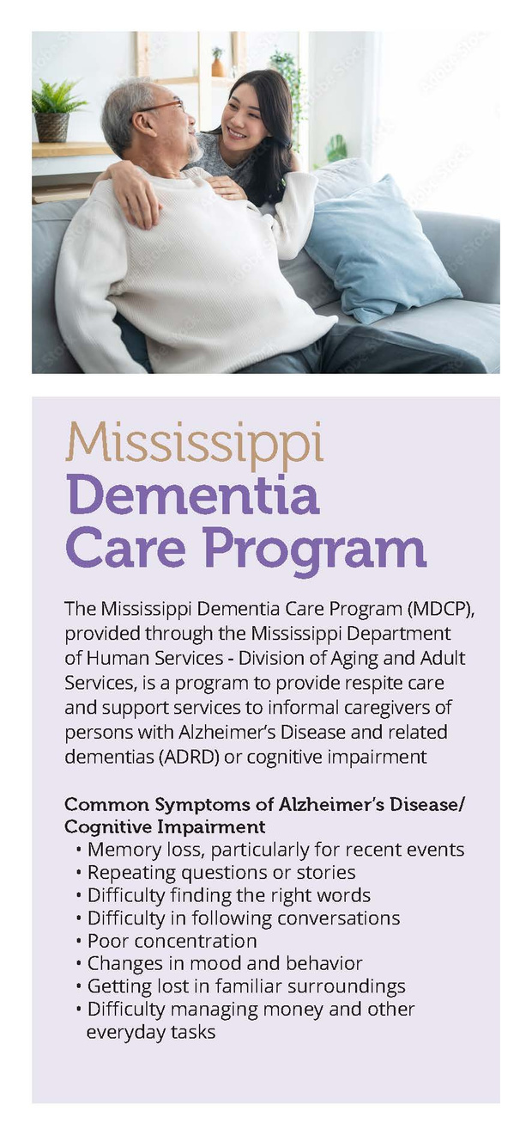
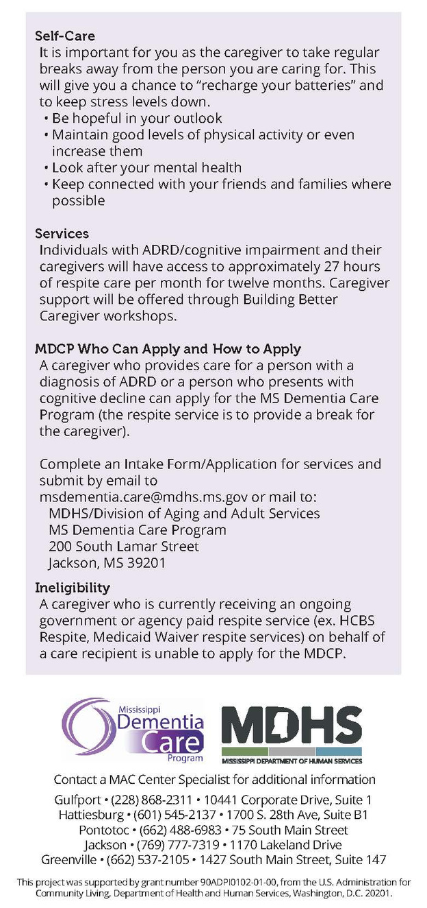

Mississippi Dementia Care Program
  The MDCP is a pilot program within the Mississippi Department of Human Services/Division of Aging and Adult Services (MDHS/DAAS) and will provide respite services for 120 informal caregivers of individuals with ADRD for a 12-month period. The program is designed to assist informal caregivers by supplying temporary support to provide a brief period of relief or rest from caregiving responsibilities.
  MAC Center staff will be able to assist with application completion and submit to MDCP email address.
  This program is currently at capacity; waitlist is available.

Slide 21
Elderly & Disabled Waiver
  Eligibility for the Elderly & Disabled Waiver is limited to age 21 years old and older who, but for the provision of such services, would require the level of care provided in a nursing facility.
  It is a statewide program, operated by the Division of Medicaid.
  Within broad Federal guidelines, States can develop home and community-based services (HCBS) waivers to meet the needs of people who prefer to receive long-term care services and supports in their home or community, rather than in an institutional setting. These 1915(c) waiver programs can provide a combination of standard medical services and non-medical services in order for persons to remain in a home or community-based setting
  E&D Waiver covered services are case management, adult day care, home delivered meals, personal care services, in-home respite, institutional respite, expanded home health, and Community Transition Services.

Slide 22
Contact
Mississippi Access to Care Center (MAC Center)
Toll-free: 844-822-4MAC (4622)
Website: www.mississippiaccesstocare.org
Office of Long-Term Care, MS Division of Medicaid
Toll-free: 800-421-2408
Phone: 601-359-6141
Website: http://medicaid.ms.gov

Slide 23
Additional Home & Community Based Waivers
Assisted Living Waiver
  Office of Long-Term, Mississippi Division of Medicaid, (800)-421-2408
  Mississippi Access to Care Center, (844)-822-4622
Independent Living Waiver/Traumatic Brain Injury&Spinal Cord Waiver
  Mississippi Department of Rehabilitation Services, (800)-443-1000
  Office of Long-Term, Mississippi Division of Medicaid, (800)-421-2408
  Mississippi Access to Care Center, (844)-822-4622
Intellectual/Developmental Disabilities Waiver
  Mississippi Department of Mental Health, (877)-210-8513
  Office of Long-Term, Mississippi Division of Medicaid, (800)-421-2408
  Mississippi Access to Care Center, (844)-822-4622

Slide 24


Additional Resources
Caregiver Support
• AARP Mississippi: https://states.aarp.org/mississippi/
• Tips for Caregivers and Families of Persons with Dementia: https://www.alzheimers.gov/life-with-dementia/tips-caregivers
• ALZConnected: https://alzconnected.org/
• Caregiving (Alzheimer’s Association): https://www.alz.org/help-support/caregiving
• Alzheimer’s Caregiving (National Institute on Aging): https://www.nia.nih.gov/health/alzheimers/caregiving
• National Caregiving Foundation: www.caregivingfoundation.org
• Family Caregiver Alliance: www.caregiver.org
• National Family Caregivers Association: www.thefamilycaregiver.org
• Today’s Caregiver: www.caregiver.com
Local Services
•Alzheimer’s Association MS Chapter: https://www.alz.org/ms | 769-230-0611
•Community Resource Finder: https://www.communityresourcefinder.org/
•The MIND Center: www.umc.edu/mindcenter | mindclinic@umc.edu | 601-496-MIND (6463)
•Mississippi Access to Care (MAC) Center: www.mississippiaccesstocare.org | 844-822-4MAC(4622)
•Mississippi State Department of Health: https://msdh.ms.gov/page/43,0,430,1053.html
•Mississippi Aging and Adult Services: 800-948-3090
•Mississippi Area Agencies on Aging https://www.mdhs.ms.gov/adults-seniors/area-agencies-on-aging/
•Mississippi State Agency Services for Older Adults Reference: https://www.umc.edu/mindcenter/files/MS-State-Agency-Services-for-Older-Adults.pdf
Find Local Support Groups
•Alzheimer’s Association: https://www.alz.org/ms/helping_you
•The MIND Center: www.umc.edu/mindcenter

Slide 25

Thank You
Any questions?
Chelsea B. Crittle, PhD
Aging Division Director
ccrittle@cmpdd.org
www.cmpdd.org
(601)-981-1516

