Slide 1

Huntington’s Disease Care in Mississippi:
The Challenge and the Hope on the Horizon
Juebin Huang, MD, PhD
Professor of Neurology
Director of Clinical Research, Department of Neurology
Director, HDSA Center of Excellence at UMMC
University of Mississippi Medical Center

Slide 2
Neurodegenerative Disorders (NDDs)
Neurodegeneration refers progressive loss of selectively vulnerable brain cells (neurons) from brain and other parts of the nervous system.
The collapse of the structure and function of the nervous system, which are unable to efﬁciently regrow themselves, result in the breakdown of the core communicative circuitry, culminating in impaired memory, cognition, behavior, sensory, and/or motoric function.
NDDs are a heterogeneous group of neurological diseases adversely affecting the lives of millions of people worldwide.
Alzheimer’s disease and Parkinson’s disease are the most common neurodegenerative diseases.
In the United States, as many as 6.2 million people may have Alzheimer’s disease. Nearly a million Americans are living with Parkinson’s disease.

Slide 3
Common Neurodegenerative Disorders
  Primarily affecting memory and thinking:
    Alzheimer disease (AD)
    Frontotemporal dementia (FTD)
    Dementia with Lewy bodies (DLB)
  Primarily affecting motor function:
    Parkinson disease (PD)
    Huntington disease (HD)
    Amyotrophic lateral sclerosis (ALS)
Notes:
Diagnostic terminology:
Dementia with Lewy Bodies
Diffuse Lewy body disease
Lewy body variant of AD
Lewy body dementia
Senile dementia of Lewy body type
AD with incidental Lewy bodies
AD plus Parkinson’s disease

Slide 4
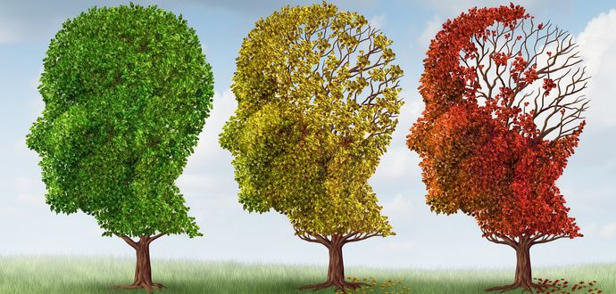
Mild Cognitive Impairment (MCI)
Memory and thinking difficulty NOT severe enough to interfere with normal daily functioning.
Normal Cognition
Dementia
Memory and thinking difficulty severe enough to interfere with normal daily functioning.

Slide 5
MCI &Dementia
Alzheimer’s disease(AD) (account for 50-70% of dementia cases)
Other degenerative dementias
  Dementia with Lewy Bodies (DLB)
  Parkinson’s disease dementia (PDD)
  Frontotemporal dementia (FTD)
  Corticobasal degeneration (CBD)
  Progressive supranuclear palsy (PSP)
Non-progressive dementias
  Traumatic brain injury (TBI)
  Vascular dementia (VaD)
Reversible dementias
  depression
  Multiple medical conditions
  Metabolic problems
  Medication side effects
  Infections
  Normal pressure hydrocephalus (NPH)

Slide 6
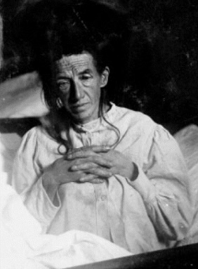
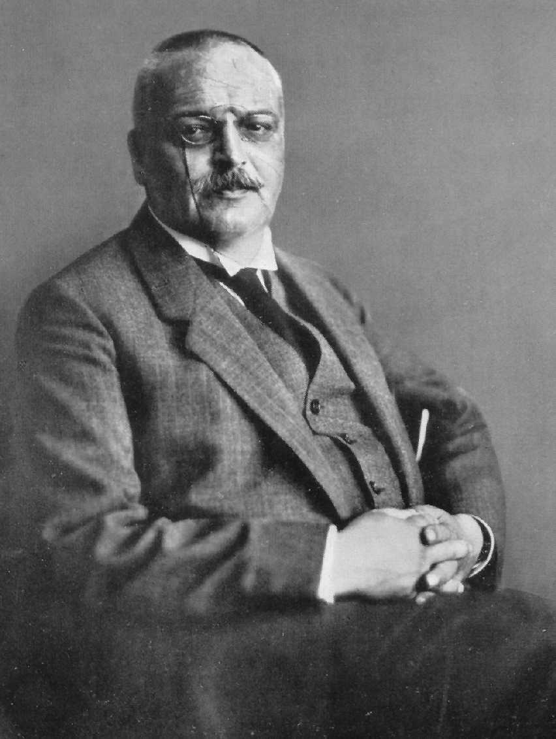
What’s Alzheimer’s Disease (AD)?
In 1906, Dr. Alzheimer reported a 51-year-old female patient with rapidly failing memory, confusion, disorientation, trouble expressing her thoughts and unfounded suspicions about her family and the hospital staff.
He did autopsy of this patient’s brain which showed dramatic shrinkage, widespread dead and dying cells, and two microscopic deposits he’d never seen before:
  Plaques: dense deposits outside the nerve cells;
  Tangles: twisted bands of fibers inside the nerve cells.
This mysterious disorders soon entered the medical literature as “Alzheimer disease”.
Alois Alzheimer (1864~1915)

Slide 7

Alzheimer’s Disease
Stage
Mild Moderate
Severe
-Memory loss
-Language Problems
-Anxiety, depression
-Diminished judgment
-Behavioral, personality
changes
-Hallucination, delusion
-Long-term memory affected
-Wandering, agitation,
aggression, confusion
-Require assistance w/ADL
-Gait disturbance, incontinence,
-motor deficit, dysphagia
-Bedridden
-Seizure can occur
-Unable to perform ADL
-Placement in long-term care needed
Symptoms

Slide 8
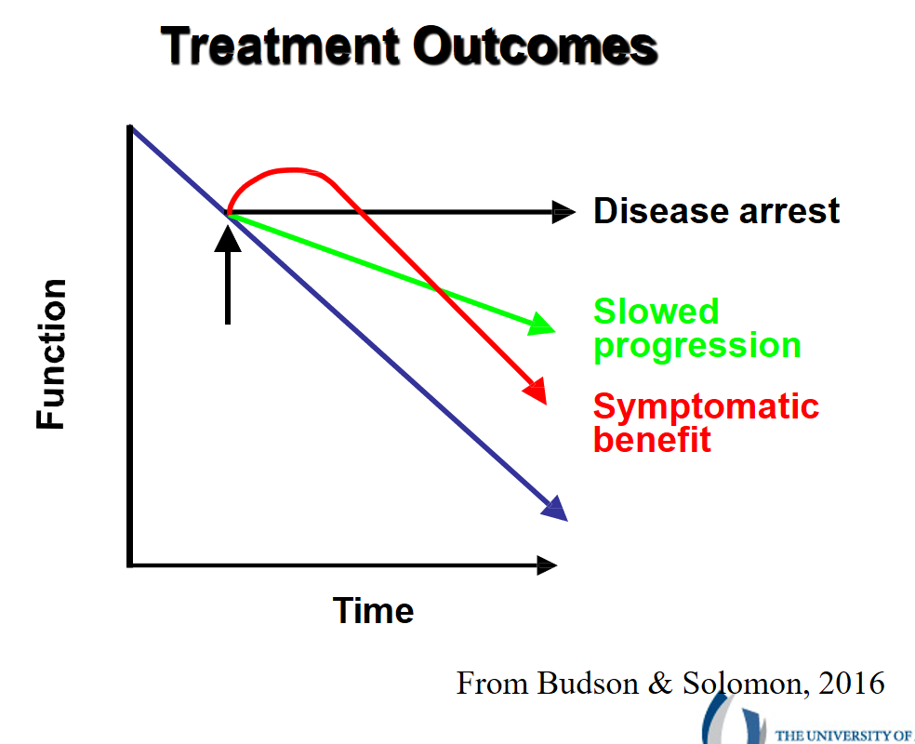
Alzheimer’s Disease Treatment
Symptomatic treatment:
  Acetylcholinesterase Inhibitors:
    Donepezil (Aricept)
    Rivastigmine (Exelon)
    Galantamine (Razadyne)
  NMDA receptor antagonist:
    Memantine (Namenda)
Disease modifying treatment:
Anti-amyloid monoclonal antibodies infusion:
  Lecanemab (Leqembi) (FDA approved July 2023)
  Donanemab (Kisunla) (FDA approved July 2024)

Slide 9
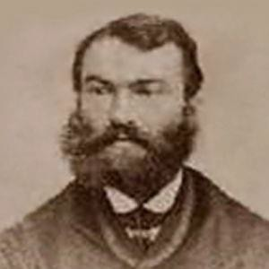
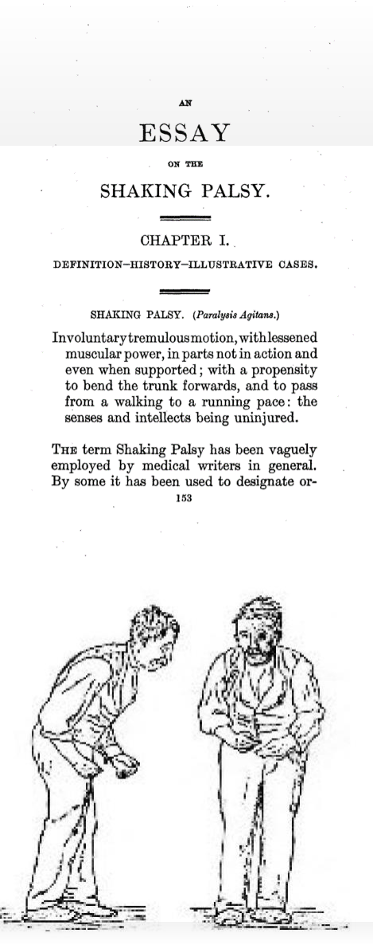
Parkinson’s Disease (PD)
First described by British doctor James Parkinson in 1817.
Identified its major symptoms and called it “the shaking palsy”.
Progressive, chronic, neurodegenerative disease.
Slow, selective loss of brain cells that produce dopamine.

Slide 10
Symptoms of PD
Motor Symptoms
Tremor
Stiffness
Slowness
Balance and walking difficulty
Non-Motor Symptoms
Loss of smell
Constipation
Depression/anxiety
Sleep disturbance
Blood pressure fluctuation
Hallucination/paranoid
Cognitive difficulty

Slide 11
Treatment of Parkinson’s Disease
pharmacological
  Increase dopamine release or replace dopamine in order to restore dopamine level.
  Inhibit dopamine breakdown.
  Activate dopamine receptors.
Surgical
  DBS, focused ultrasound
Non-pharmacological
  Education
  Exercise

Slide 12
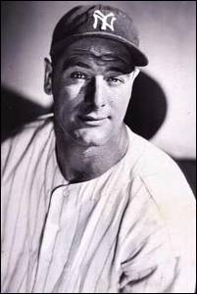
Amyotrophic Lateral Sclerosis (ALS)
Also know as Lou Gehrig's Disease. Named after the New York Yankees baseball star who played first base and was diagnosed with the disease in 1939.
Symptoms:
  Increasing muscle weakness
  Difficulty speaking
  Trouble swallowing
  Problems with breathing
  Muscle twitching and cramping
  Muscle atrophy/wasting
  Muscle spasm/spasticity
Treatment is very limited.
Prognosis is very poor.

Slide 13
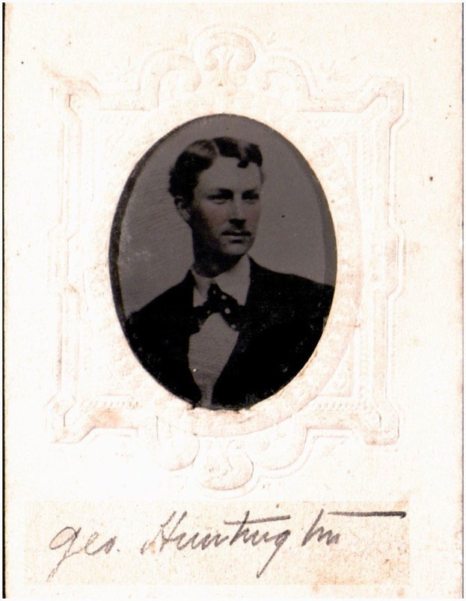
Huntington’s Disease (HD)
Named after Dr. George Huntington (1850-1916), a third generation family physician that had lived alongside families with a disorder he called “hereditary chorea” in Long Island, NY since the end of the 18th century.
Hereditary disorder that causes the breakdown of nerve cells in multiple areas of the brain.
Approximately 30,000 people with in US live with HD. 150,000 at-risk.
HD symptoms do not usually start until adulthood – 30’s and 50’s is most common.

Slide 14
Who Gets HD?
HD is caused by genetic mutation resulting trinucleotide (CAG) expansions within the Huntingtin gene (Htt).
It runs in the family with a pattern of inheritance called autosomal dominant.
Both males and females can be affected. Both males and females can pass HD to their children.
If a person has HD, there is a 50% risk for each of their children.

Slide 15
Symptoms of HD
The 3 Ms
Disinhibition Depressed mood Suicide: 5-10 % Euphoria Irritability (possible aggression)
Repetitive thoughts Delusions (false belief) Hypersexuality Hallucinations
Chorea (fast dance-like involuntary movements) Dystonia (slow involuntary movements causing abnormal postures) Stiffness/Rigidity
Gait imbalance, falls Slurred speech Swallowing difficulties
Motor
Executive dysfunction (poor planning, difficulty organizing, poor flexibility to adapt to alternatives, slow thinking process)
Memory loss
Verbal fluency problems Disorientation, getting lost Judgement problems Impaired decision making
Mood
(psychiatric)
Memory (Cognitive)

Slide 16
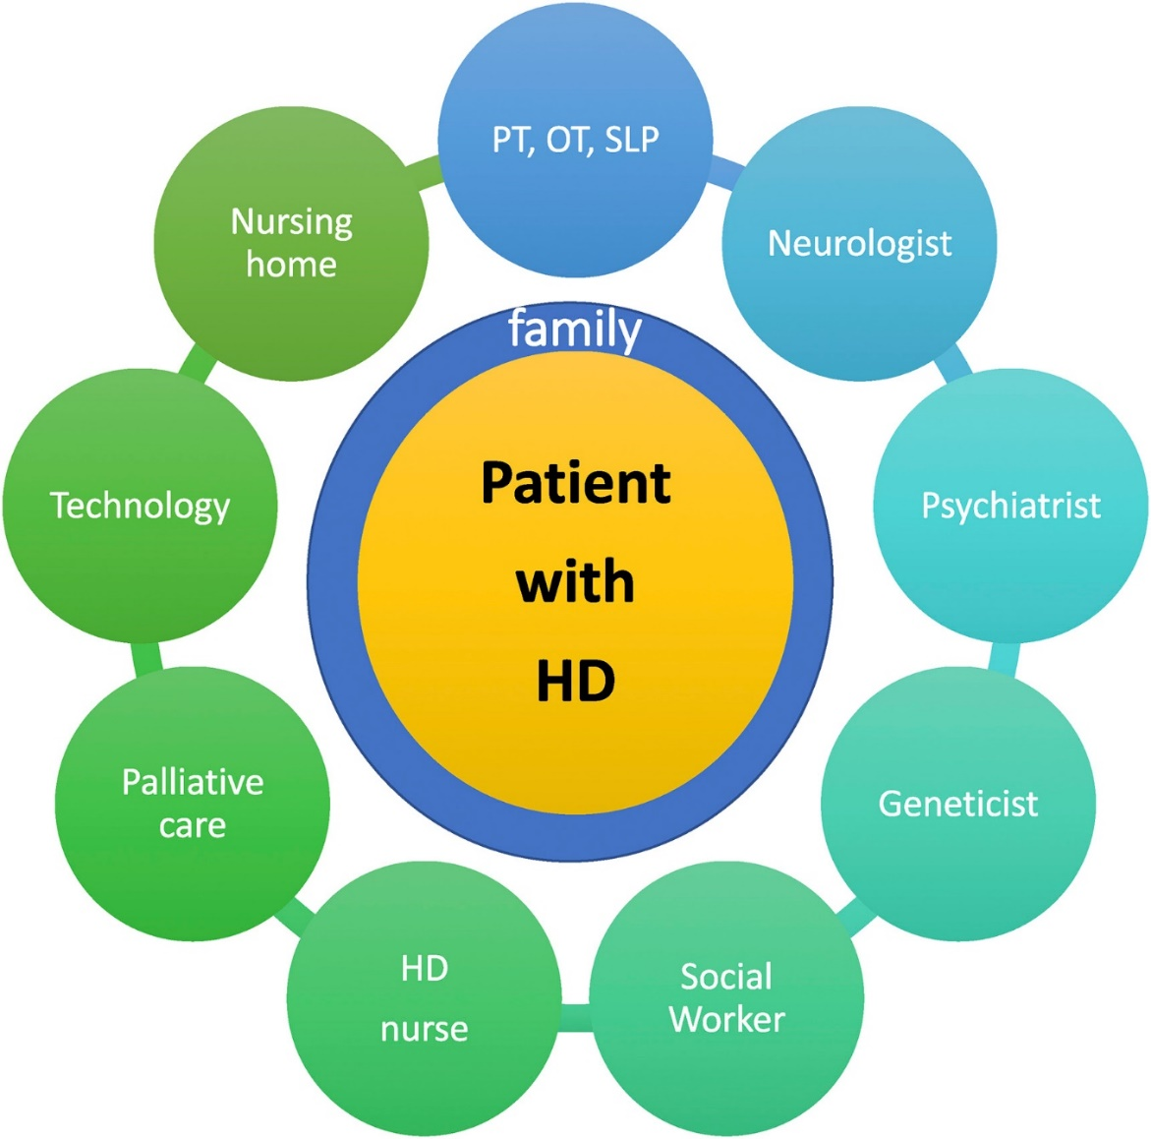
Care for HD

Slide 17
HD Research in the 2020s
We are hopeful that research will lead to meaningful treatments in the near future.
Much progress has been made.
Gene Therapy is an area of active research.

Slide 18




Slide 19

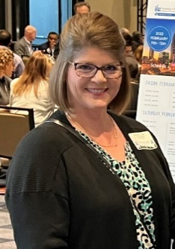

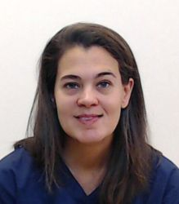
HDSA Center of Excellence at UMMC Riverchase Medical Suites
2550 Flowood Dr, Flowood, MS 39232
Phone: +1 601-984-5500
Monthly HD Clinic: 4th Tuesday morning
Clinic Director
Juebin Huang, MD
Care Coordinator
Alisa Burr, LPN
Social Worker
Sue Ann Meng, LCSW
Social Worker
Erin Pitman, LCSW
https://hdsa.org/hdsa-center-of-excellence-at-university-of-mississippi-medical-center/

Slide 20

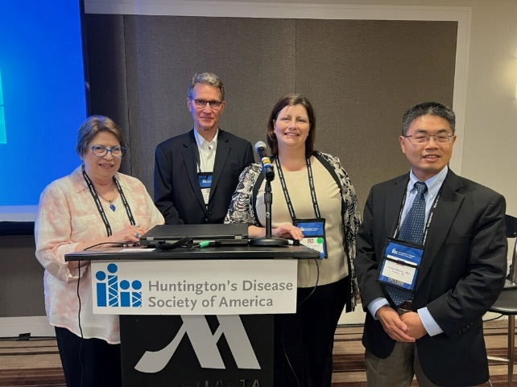
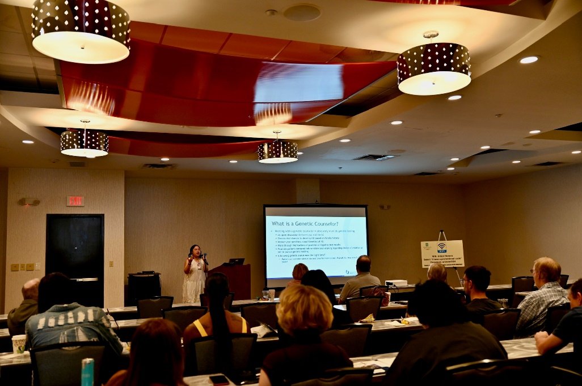


Slide 21
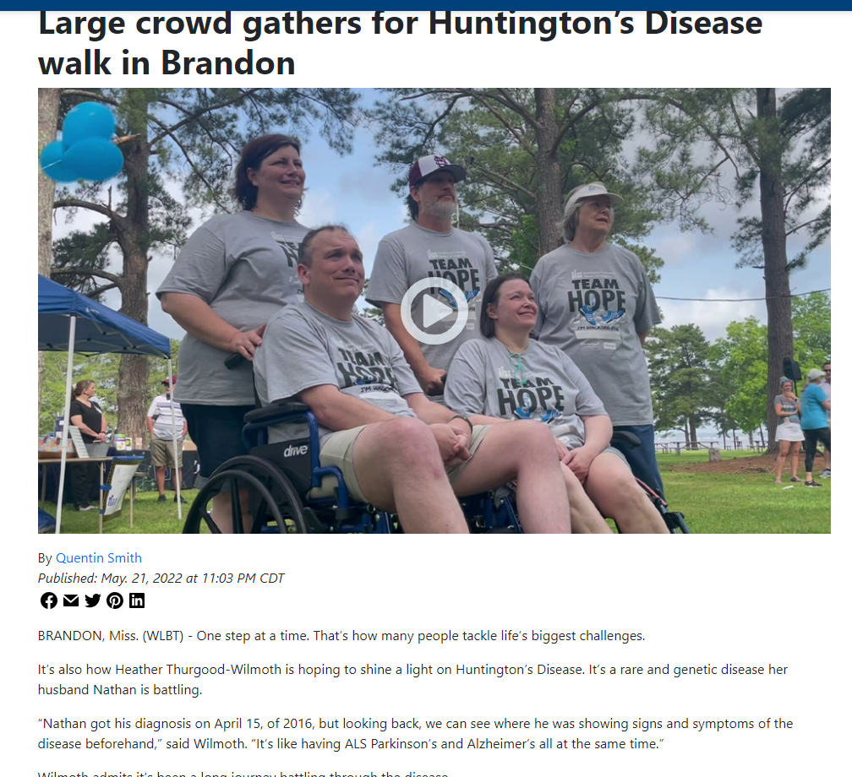
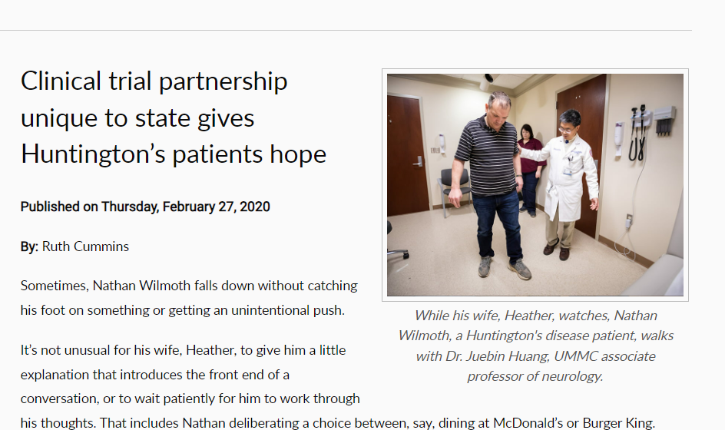
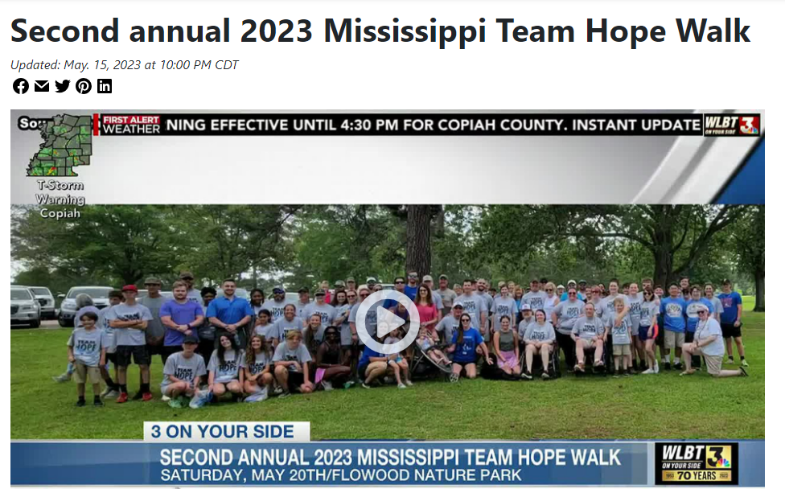

Slide 22


Slide 23


Slide 24
Resources and Support Services
National / Local/ Online
Alzheimer’s Association (AA)
Parkinson Disease Foundation (PDF)
Michael J. Fox Foundation (MJFF)
The ALS Association
Huntington’s Disease Society of America (HDSA)
Local:
The MIND center Caregiver University
The Mississippi Access to Care (MAC) Center
Senior centers
Exercise programs
Rehabilitation centers

Slide 25
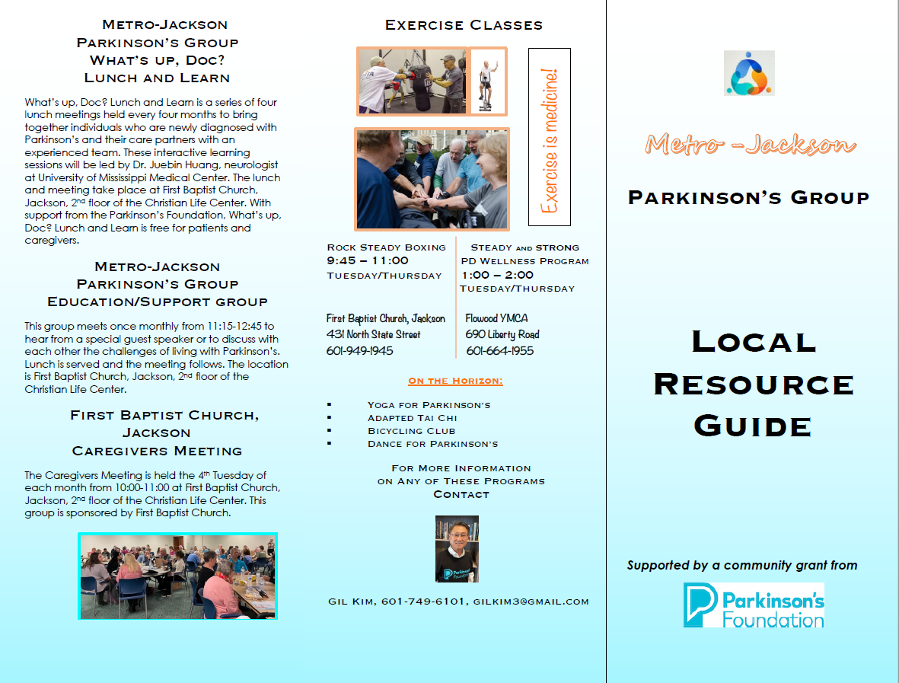
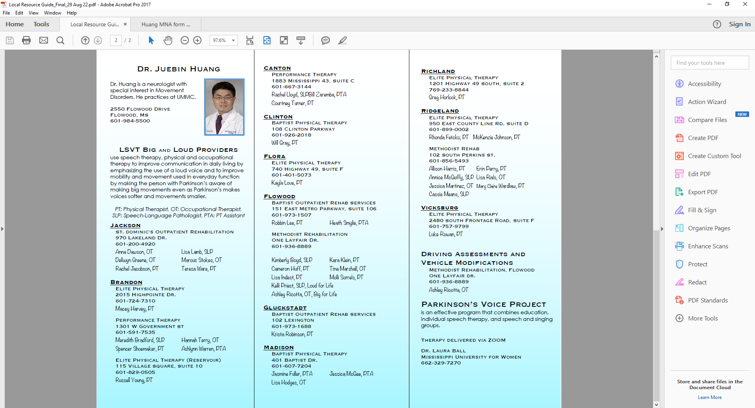

Slide 26

jhuang@umc.edu

