Slide 1
Mississippi Health Ambassadors
Thomas Dobbs, MD, MPH
2/20/2024

Slide 2
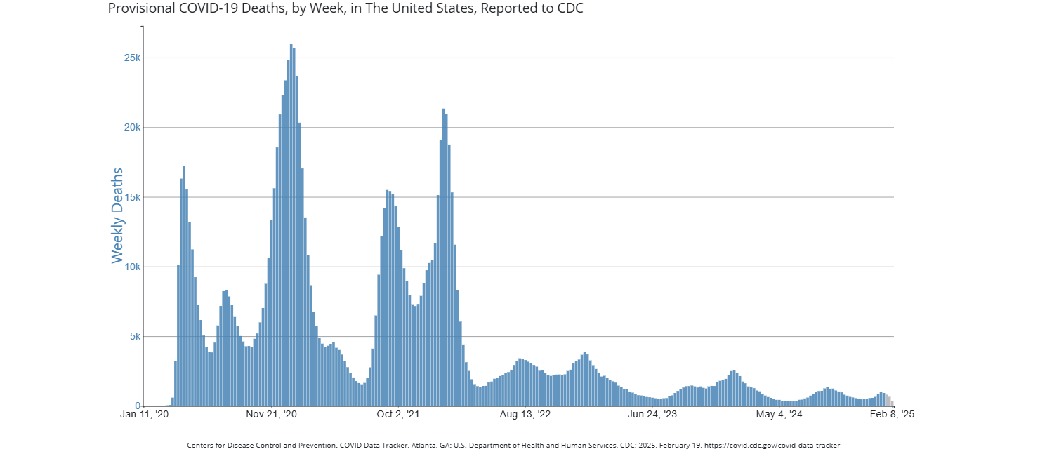

Slide 3
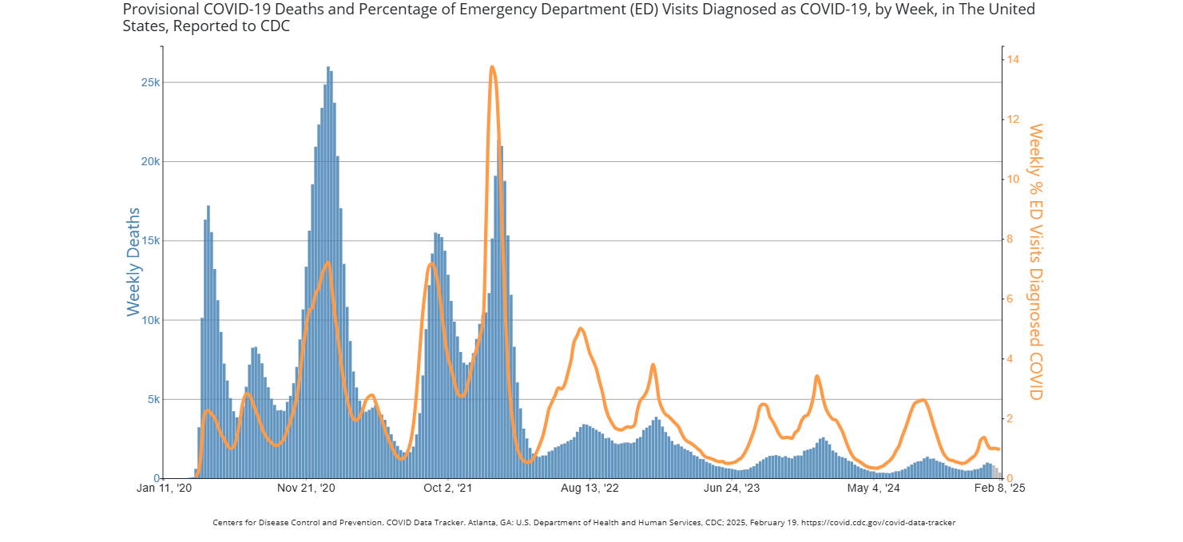

Slide 4
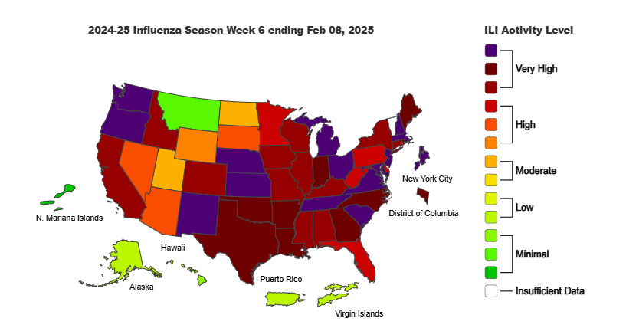

Slide 7
2024-2025 Flu Season
Vaccine “match”
  H1N1 100% good match
  H3N2 51% good match
  Flu B – all samples good match
Antivirals effective
  Oseltamivir
  Peramivir
  Zanamivir
  Baloxavir

Slide 8
