Slide 1


Slide 2





Slide 3


Slide 5
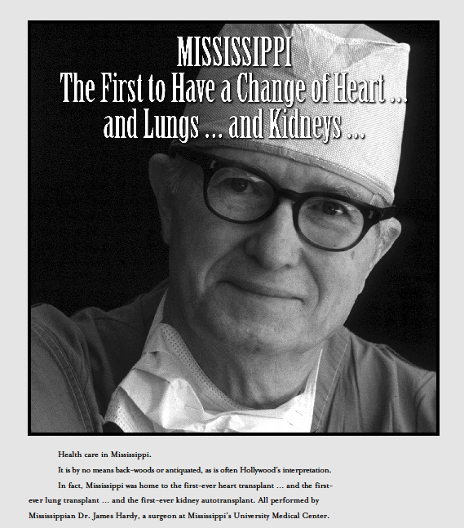

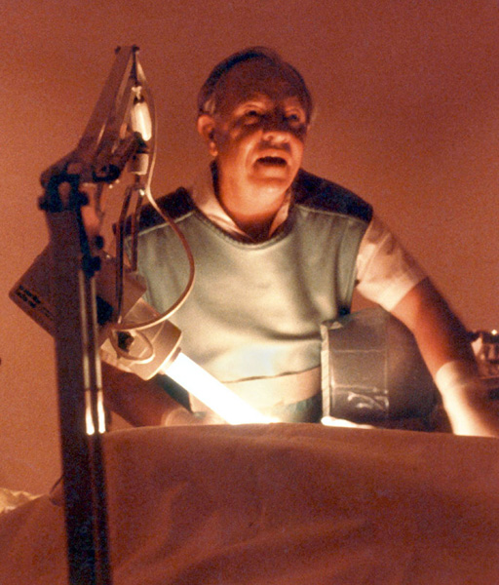

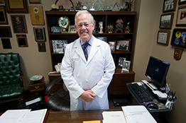
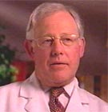

Slide 7
The History

Slide 8

The Social Determinants of Health Disproportionately Affect Mississippi’s Health
Access
to Care
Health
Literacy
Education
Geography
Race &
Culture
Poverty
Systems
of Care

Slide 10

All Mississippians living healthier, longer lives due to a thriving public health effort that is supported by active and committed citizens and organizations.
Shared Public Health Agenda
Improve Access to Care
Create a Culture of Health
Improve Infant Health
Reduce Rates of Chronic Disease
Increase Educational Attainment
Reduce Poverty
Improve Sexual Health
Improve Mental Health
Address Social Determinants of Health
Strengthen Public Health Infrastructure
Improve Health Status and Reduce Health Disparities
Notes:
This slide shows the priorities identified by the State Health Assessment and Improvement Committee – using the data from the State Health Assessment.
As you can see some are quite broad. It will be important as we develop a state health improvement plan to focus initially on priorities that we can change in an evidence based collaborative way, to show we can improve health in the state.

Slide 11
SYSTEMS OF CARE
Trauma
STEMI
Stroke
Only State in United States with 3 Systems of Care Plans

Slide 12
STEMI Care System
Mississippi State Board of Health
Approved Care Plan:
June 2011

Slide 13

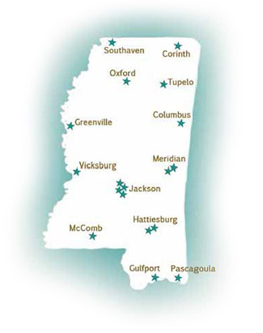
Baptist Memorial Hospital – Desoto
Baptist Memorial Hospital – Golden Triangle
Baptist Memorial Hospital – North Mississippi
Delta Regional Medical Center
North Mississippi Medical Center
Magnolia Regional Health Center
Central Mississippi Medical Center
Jeff Anderson Regional Medical Center
Mississippi Baptist Medical Center
River Region Medical Center
Rush Health Systems
St. Dominic Hospital
The University of Mississippi Medical Center
Forrest General Hospital
Gulfport Memorial Hospital
Singing River Health System
Southwest Mississippi Regional Medical Center
Wesley Medical Center

Slide 14
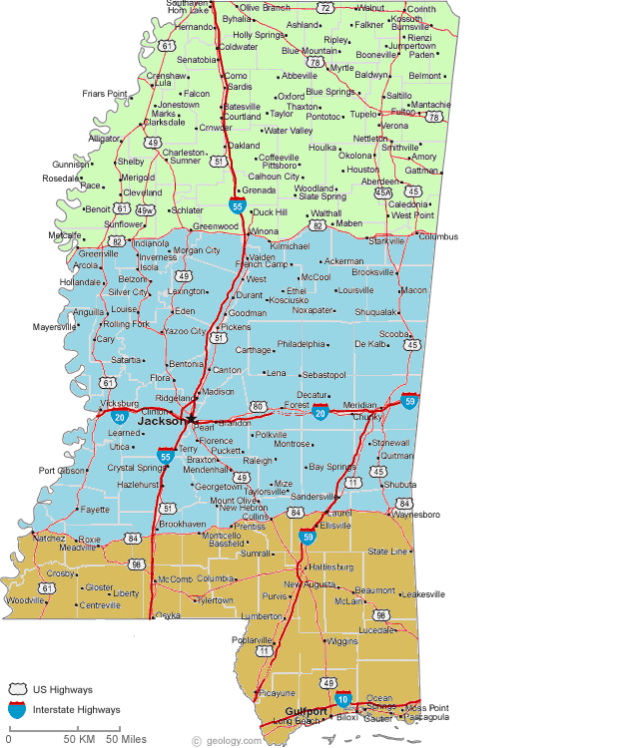
North
Central
South
- 19 Primary PCI
- 72 Non PCI

Slide 15
60 Mile Radius

Slide 16
In-Hospital Mortality

Slide 17



2013 Mississippi Code, Title 41, Chapter 63, § 41-63-9
DATA
To Ultimately Improve Care in Mississippi STEMI Network
Notes:
2013 Mississippi Code
Title 41 - PUBLIC HEALTH
Chapter 63 - EVALUATION AND REVIEW OF PROFESSIONAL HEALTH SERVICES PROVIDERS
§ 41-63-9 - Discoverability and admissibility into evidence of proceedings and records of review committees

Slide 19


Advances
In Structural Heart Disease

Slide 20
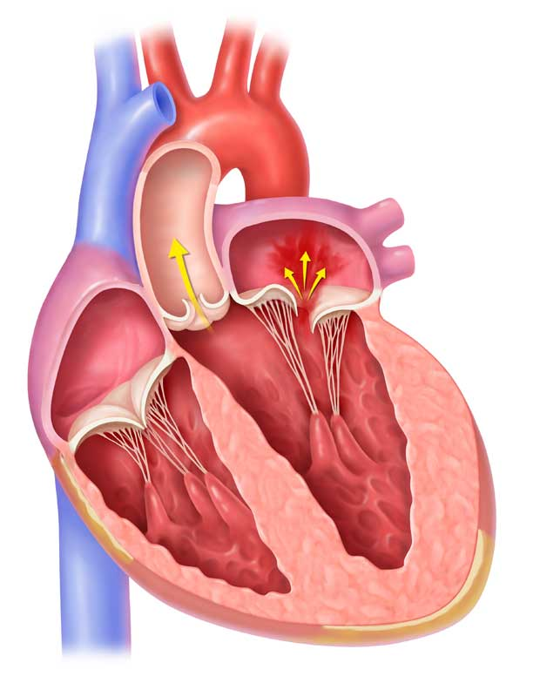
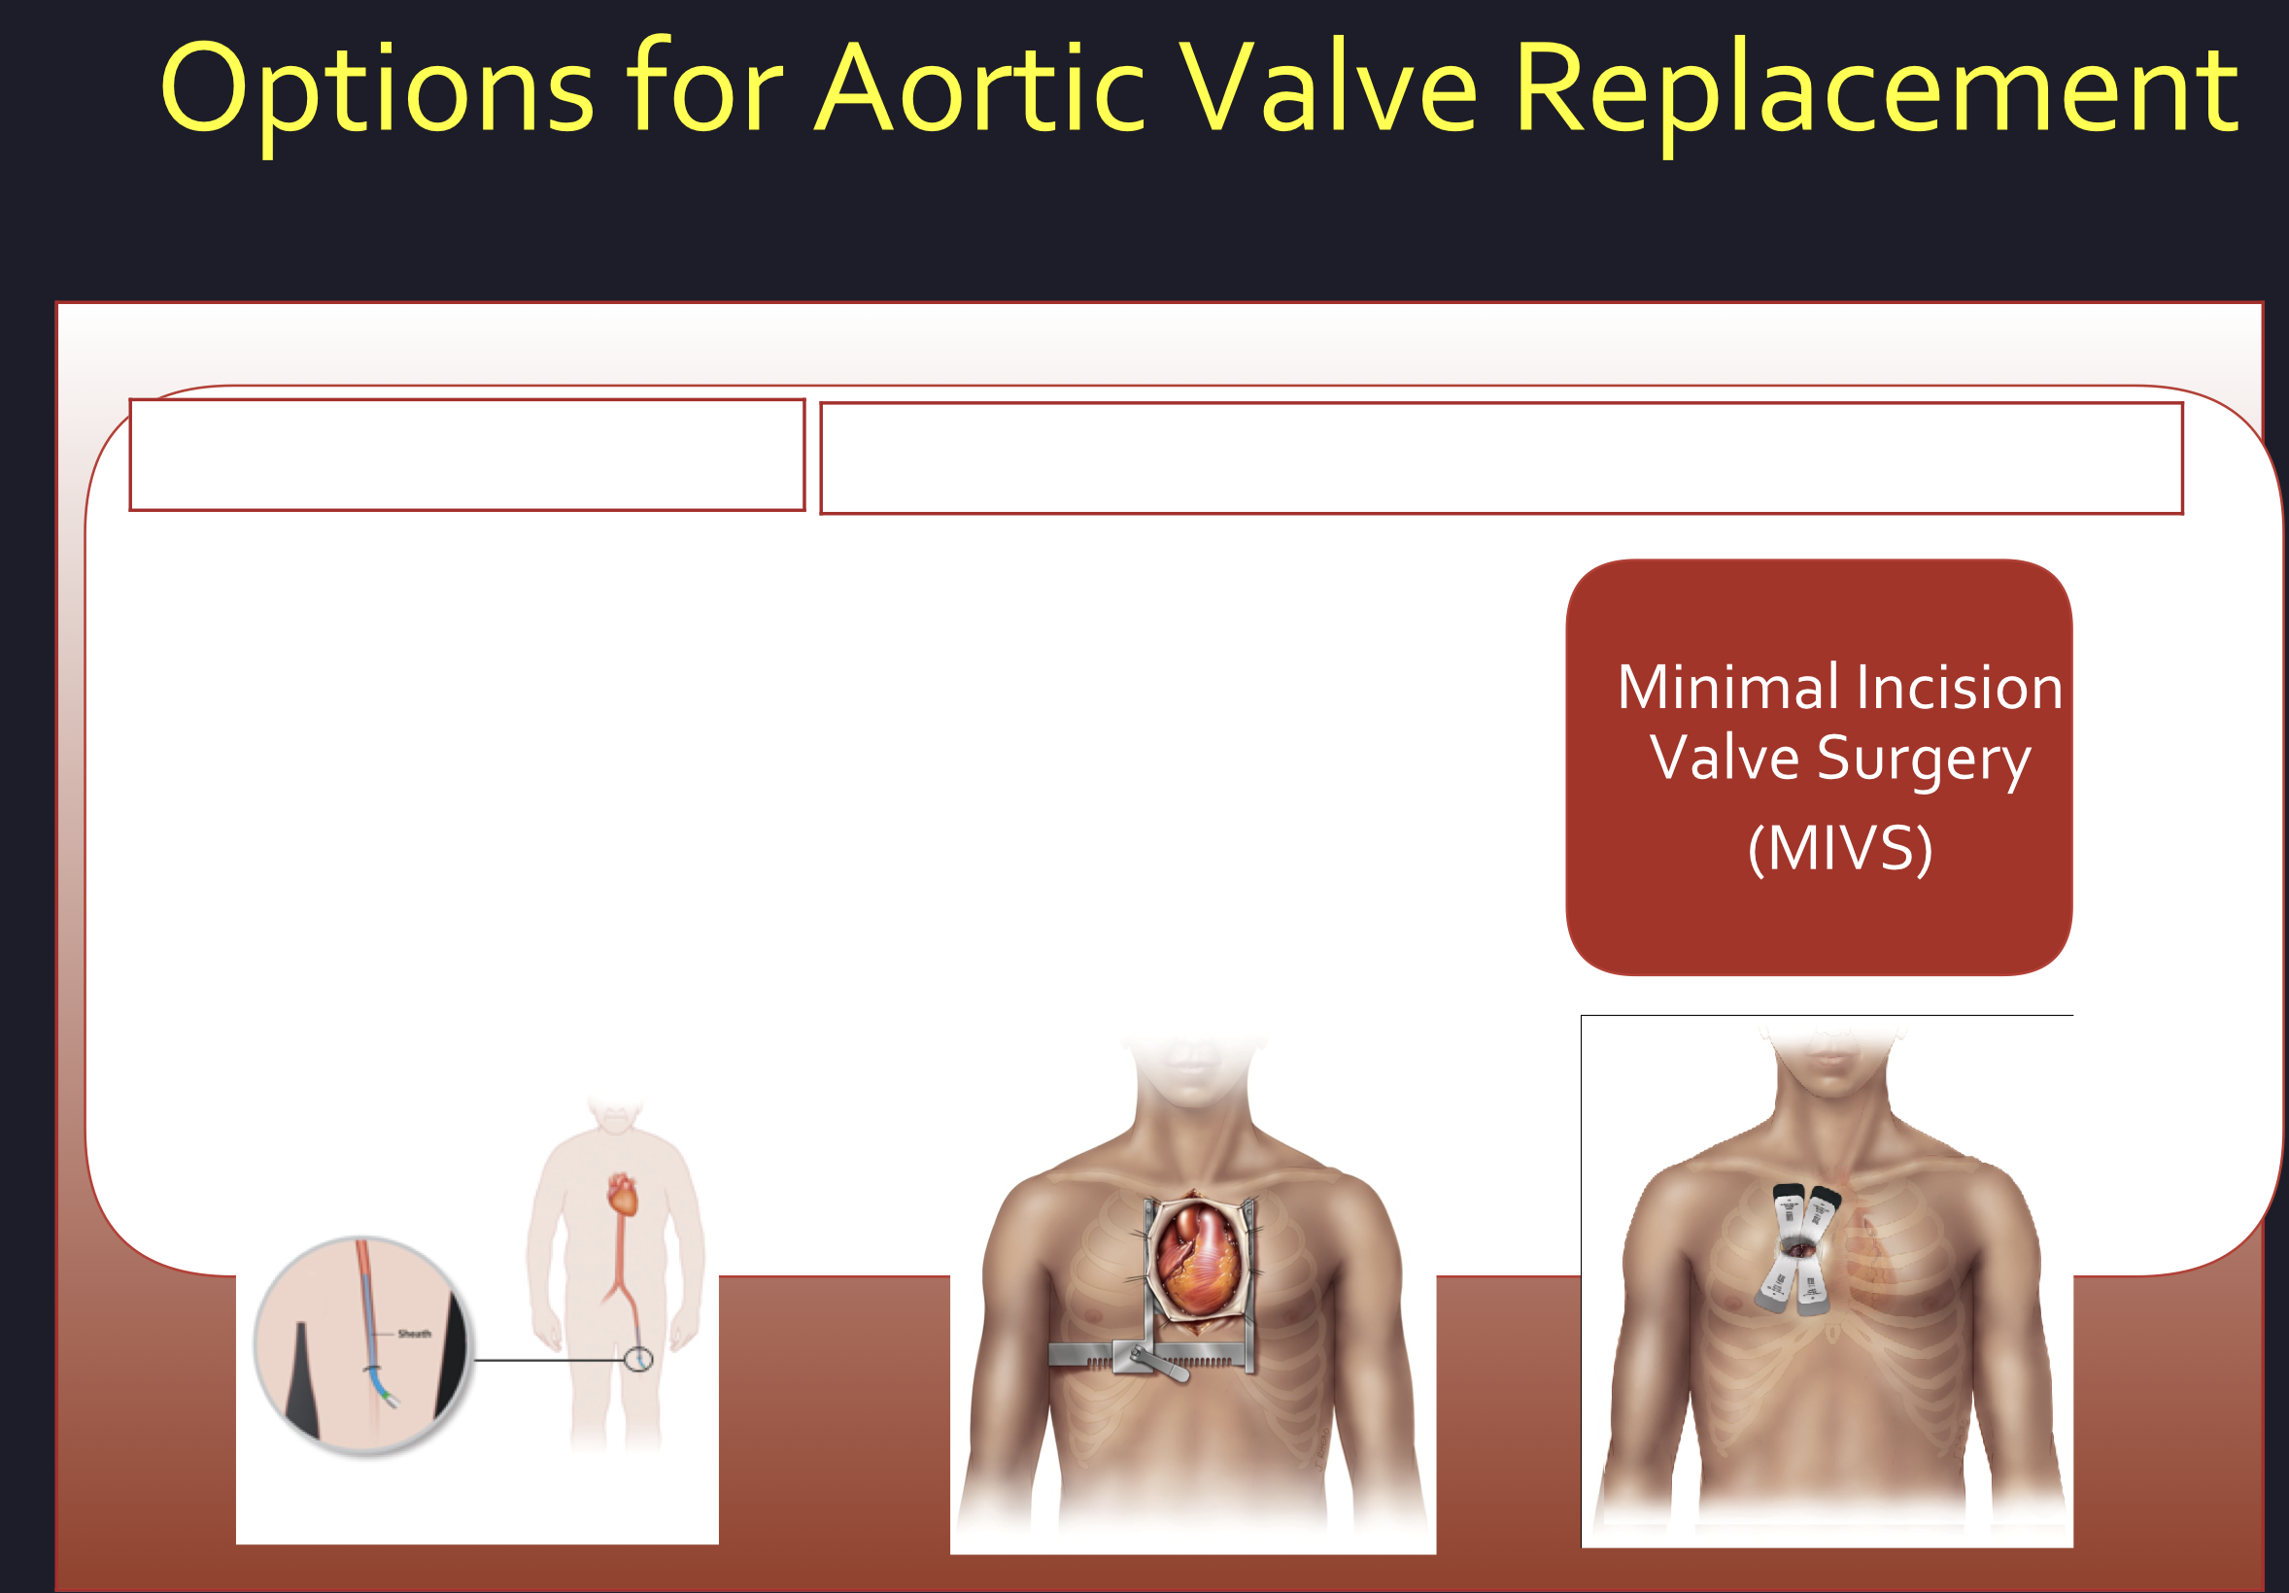
Aortic
Valve

Slide 21
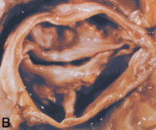
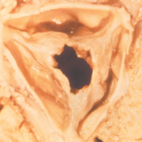
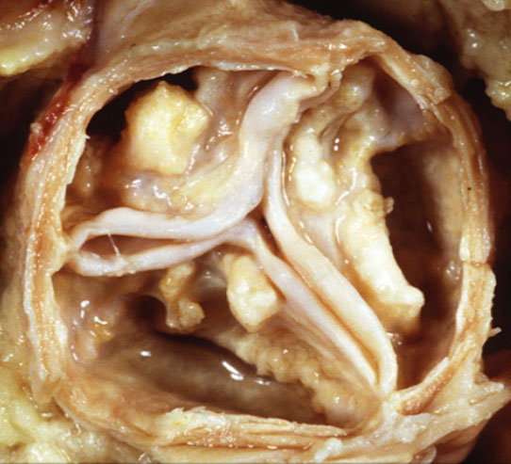
What Causes Aortic Stenosis in Adults?
Less Common
More Common
Congenital Abnormality
Rheumatic
Fever
Age-Related Calcific Aortic Stenosis
Images courtesy of John Webb, MD at St. Paul’s Hospital and Renu Virmani, MD at the CVPath Institute
Notes:
Aortic valve stenosis — or aortic stenosis — occurs when the heart's aortic valve narrows. This narrowing prevents the valve from opening fully, which obstructs blood flow from your heart into your aorta and onward to the rest of his / her body. Usually when aortic valve stenosis becomes severe and symptomatic, the native valve should be replaced. Left untreated, aortic valve stenosis may lead to sudden death.

Slide 22
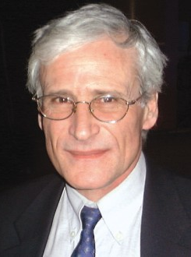
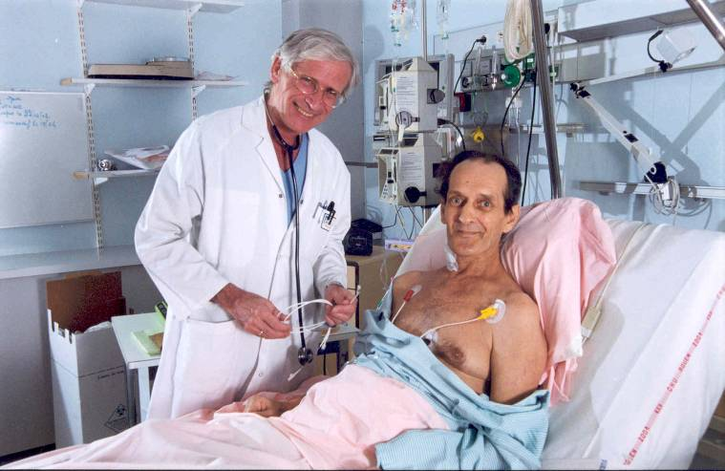
Alain Cribier: First Human Transcatheter
Valve Replacement (2002)
Notes:
Mirroring the fruitful collaborative efforts that produced the Starr-Edwards mechanical and Carpentier-Edwards bioprosthetic valves, the achievement of the first clinically successful percutaneous aortic heart valve replacement involved several individuals. Dr. Alain Cribier first recognized the need for a percutaneous solution to severe aortic stenosis after his pioneering efforts in developing balloon aortic valvuloplasty were met with mid-term outcomes that were less than satisfactory.
Many reasons were given to argue why transcatheter heart valve implantation for severe aortic stenosis should not be attempted. These included bulky leaflet calcification predisposing to coronary artery obstruction or liberating a lethal dose of cerebral embolic debris; noncompliant leaflets and annulus promoting irregular valve expansion with poor leaflet coaptation; and, asymmetric calcium deposits exacerbating paravalvular leakage.
Hence, the cardiology and cardiac surgery community took a keen interest when Dr. Alain Cribier, Rouen, France, performed the first successful TAVR on April 16, 2002, in a 57-year-old man with severe calcific AS. The presence of cardiogenic shock (systolic blood pressure 80 mm Hg and ejection fraction 14%) and subacute leg ischemia (status post aorto-bifemoral bypass) excluded the patient from conventional AVR.
The valved stent was a tri-leaflet bovine pericardial valve mounted on a balloon-expandable stainless steel frame (length 14 mm, o.d. 21-23 mm), and was the archetype of the Edwards SAPIEN transcatheter heart valve.
A percutaneous, antegrade transseptal approach was employed through the right femoral vein using a 24 Fr sheath. Dr. Cribier used BAV as an integral step in the TAVR procedure to achieve pre-dilation of the stenotic aortic valve and facilitate accurate transcatheter valve position. Immediate valve assessment demonstrated a mean gradient of 9 mm hg, and a valve area of 1.6 cm2.
Two years later, Dr. Cribier published a series of six patients with severe aortic stenosis treated between April 2002 and August 2003. The bovine pericardial valve was successfully implanted in five of six patients, with no residual gradient, a mean valve area of 1.7 cm2, and no cases of coronary artery obstruction. With Dr. Cribier’s successful clinical series, a new era of TAVR was born.

Slide 23
Mitral Valve

Slide 24
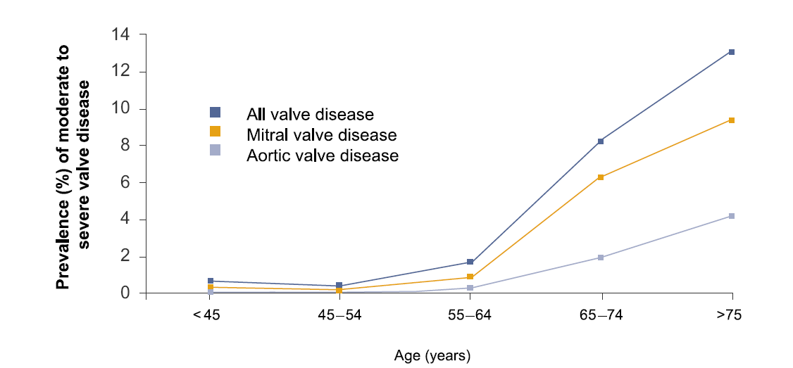
Mitral regurgitation (MR) is the most common type of heart valve disease in the US

Slide 25
MR Progresses to Heart Failure
Increasing Mitral Regurgitation
1 year mortality
up to
57%
Dilation of
Left Ventricle
Increase Load/Stress
Dysfunction
of Left Ventricle
Muscle Damage/Loss

Slide 26
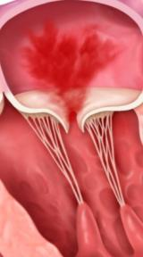

Slide 28
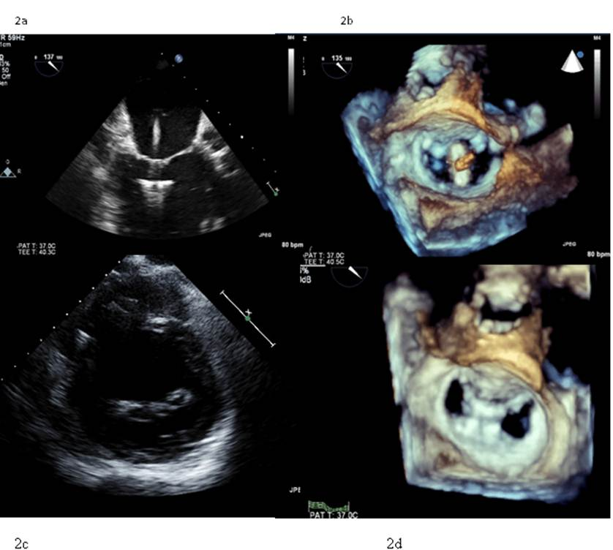

Slide 29
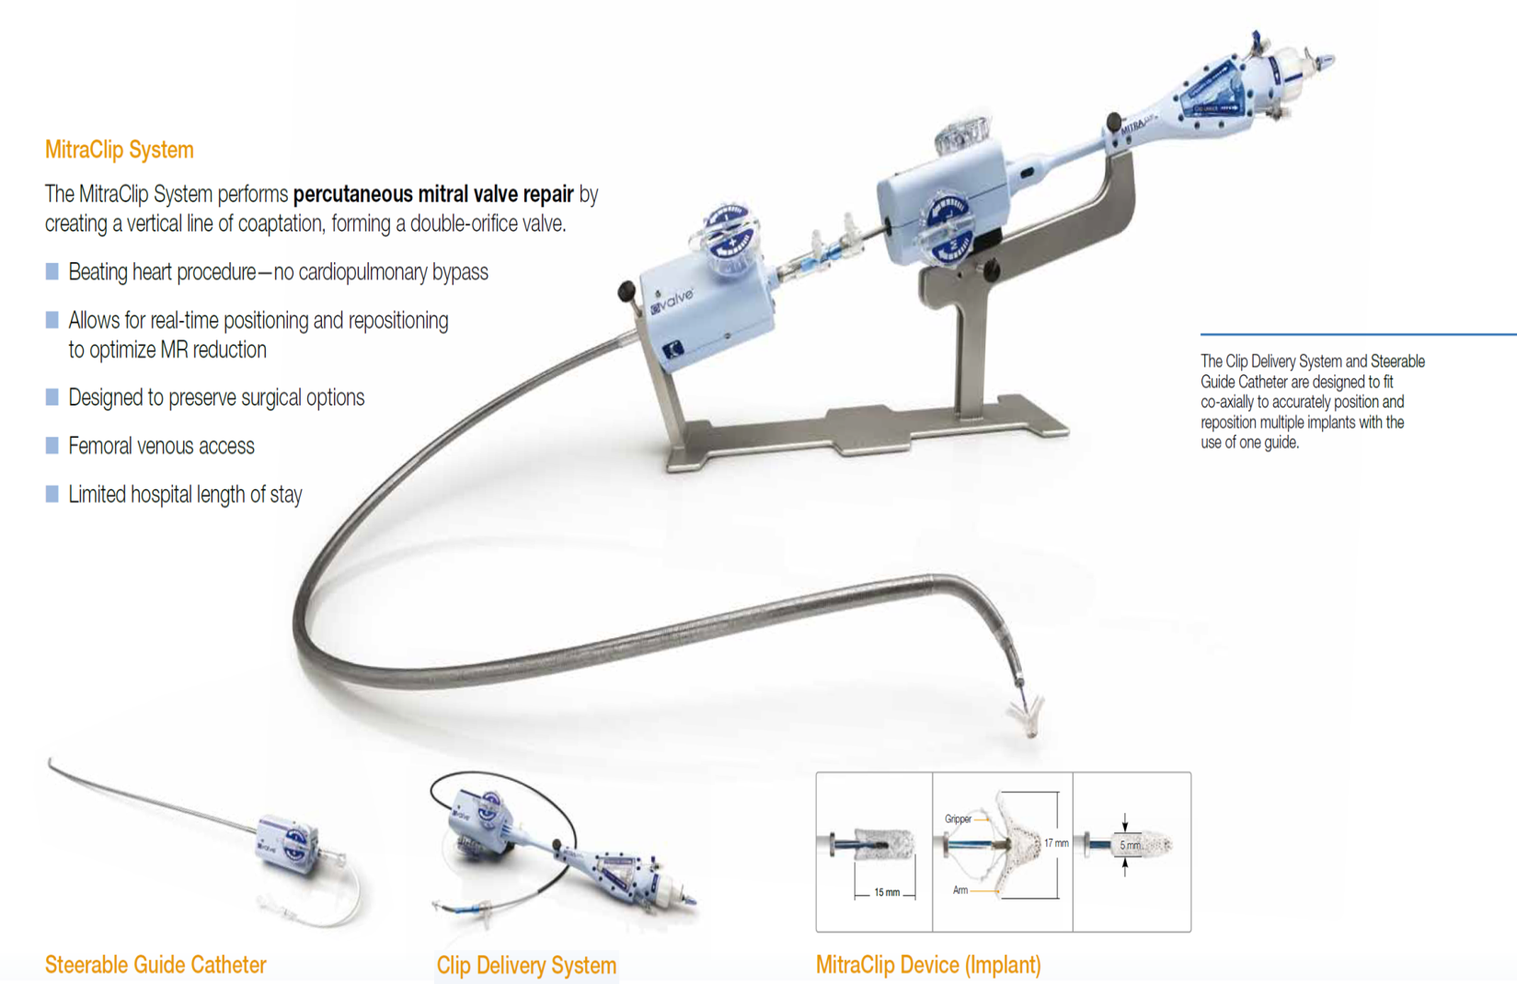
MitraClip® System

Slide 30
Successful Outcomes for Patients and Centers
Post-procedure Impact of MitraClip Therapy
    73% reduction in hospitalization rate
Low Hospital Length of
Stay vs. surgery

Slide 31
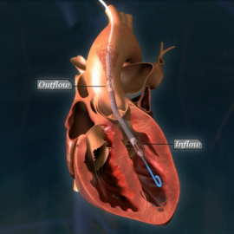
Left Ventricular Support during High Risk PCI

Slide 32
Agenda
A growing problem – Atrial Fibrillation
Watchman Patient Selection
Building a Successful Program
Reimbursement
Economics
Notes:
80-90 500000, 650,000

Slide 33
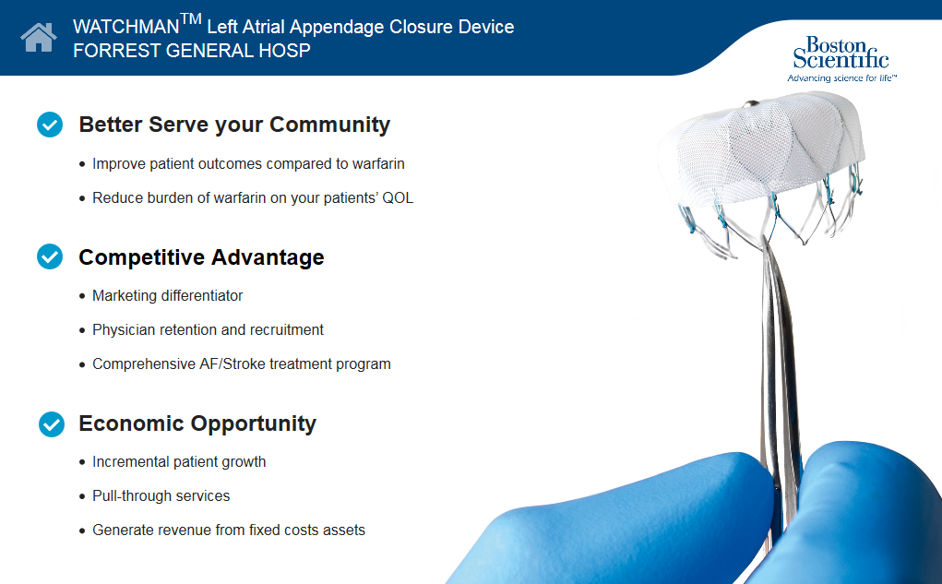

Slide 34
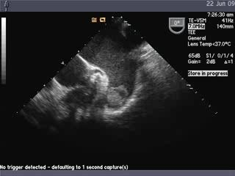
Connection Between Non-Valvular AF-Related Stroke and the Left Atrial Appendage
AF Creates Environment for Thrombus Formation in Left Atrium
Stasis-related LA thrombus is a predictor of TIA¹ and ischemic stroke².
In non-valvular AF, >90% of stroke-causing clots that come from the left atrium are formed in the LAA³.
1. Stoddard et al. Am Heart J. (2003)
2. Goldman et al. J Am Soc Echocardiogr (1999)
3 Blackshear JL. Odell JA., Annals of Thoracic Surg (1996)

Slide 35
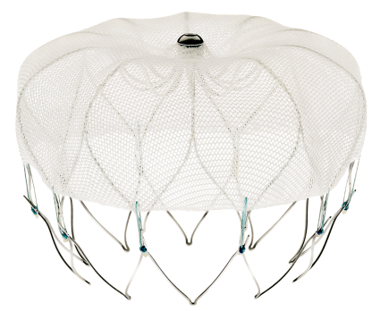
WATCHMAN™ Left Atrial Appendage Closure (LAAC) Device Overview
160 Micron Membrane
Nitinol Frame
Radially expands to maintain position in LAA
Available sizes:
  21, 24, 27, 30, 33 mm (diameter)
10 Active fixation anchors around device perimeter engage LAA tissue for stability and retention
Features an intra-LAA design to avoid contact with Left Atrial wall
160 Micron Membrane
Polyethylene terephthalate (PET) cap
Designed to block emboli from exiting the LAA
Anchors
Designed specifically for the left atrial appendage
SH-230506-AD June15
Notes:
Speaker Notes:
Constructed of a nitinol frame that radially expands to maintain position in the LAA, the WATCHMAN Device comes in five sizes to accommodate various patient anatomies. Ten fixation anchors around the perimeter of the device are designed to engage LAA tissue for stability.
The nitinol frame is covered by a polyethylene terephthalate (PET) cap designed to block emboli from exiting the LAA. Over time, tissue grows over the face of the PET cap.
The WATCHMAN Device is designed specifically for the left atrial appendage. Featuring an intra-LAA design to avoid contact with the left atrial wall, the WATCHMAN Device is engineered to (1) conform to the unique anatomy of the LAA to reduce embolization risk and (2) minimize the surface area facing the left atrium to reduce the risk of post-implant thrombus formation.

Slide 36
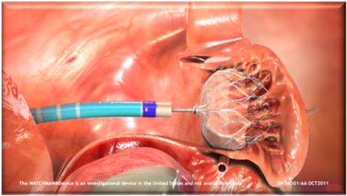
WATCHMAN™ Left Atrial Appendage Closure (LAAC) Device Procedure
One-time implant that does not need to be replaced
Performed in a cardiac cath lab/EP suite, does not need hybrid OR
Performed by a Heart Team
  EP/IC or EP&IC, TEE, General Anesthesia, Surgical Back-up, WATCHMAN Clinical Specialist
Transfemoral Access: Catheter advanced to the LAA via the femoral vein (Does not require open heart surgery)
General anesthesia (typical)
1 hour procedure (typical)
1 night hospital stay (typical)
SH-230506-AD June15
Notes:
Speaker Notes:
The WATCHMAN Device implant procedure is typically performed under general anesthesia in a catheterization laboratory setting using a standard transseptal technique. The procedure usually lasts about an hour and the patient is typically in the hospital for 24 hours following the procedure.

Slide 37
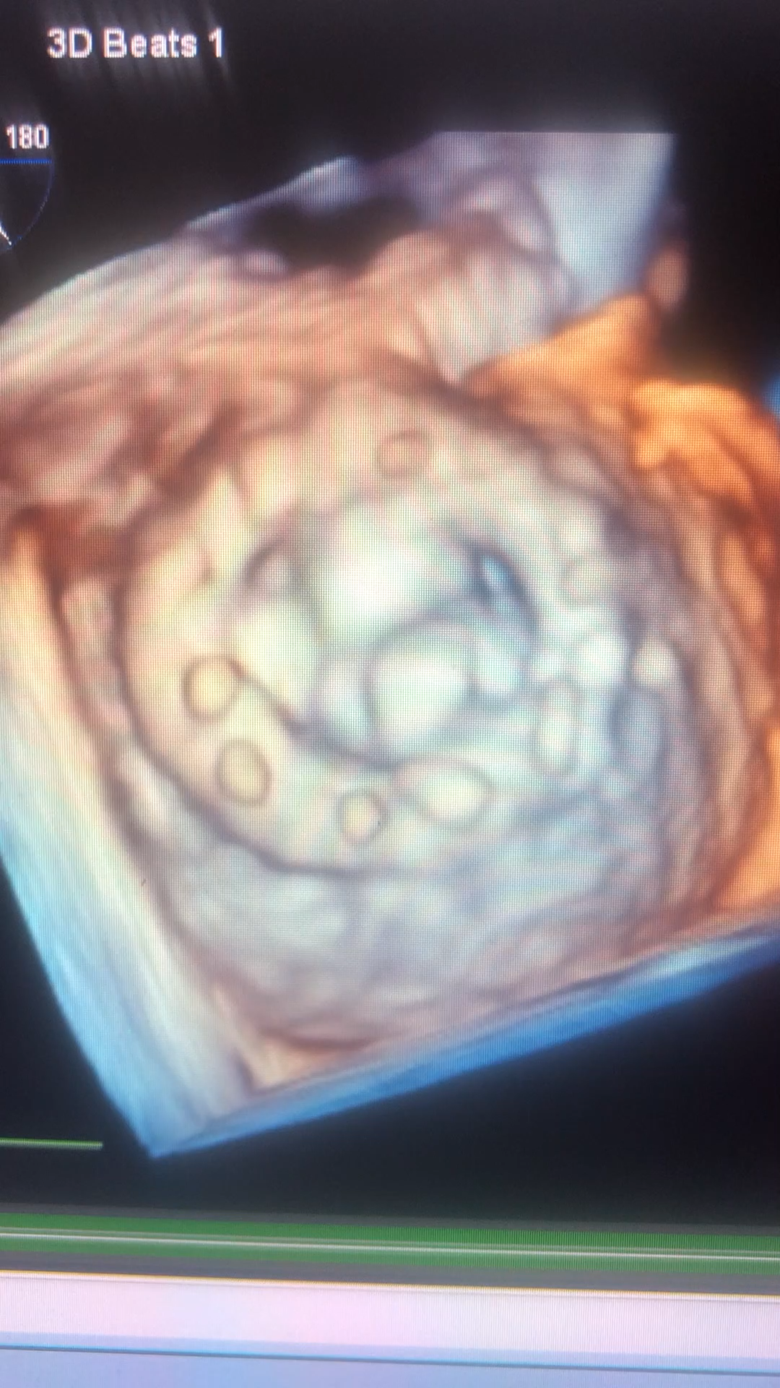

Slide 38
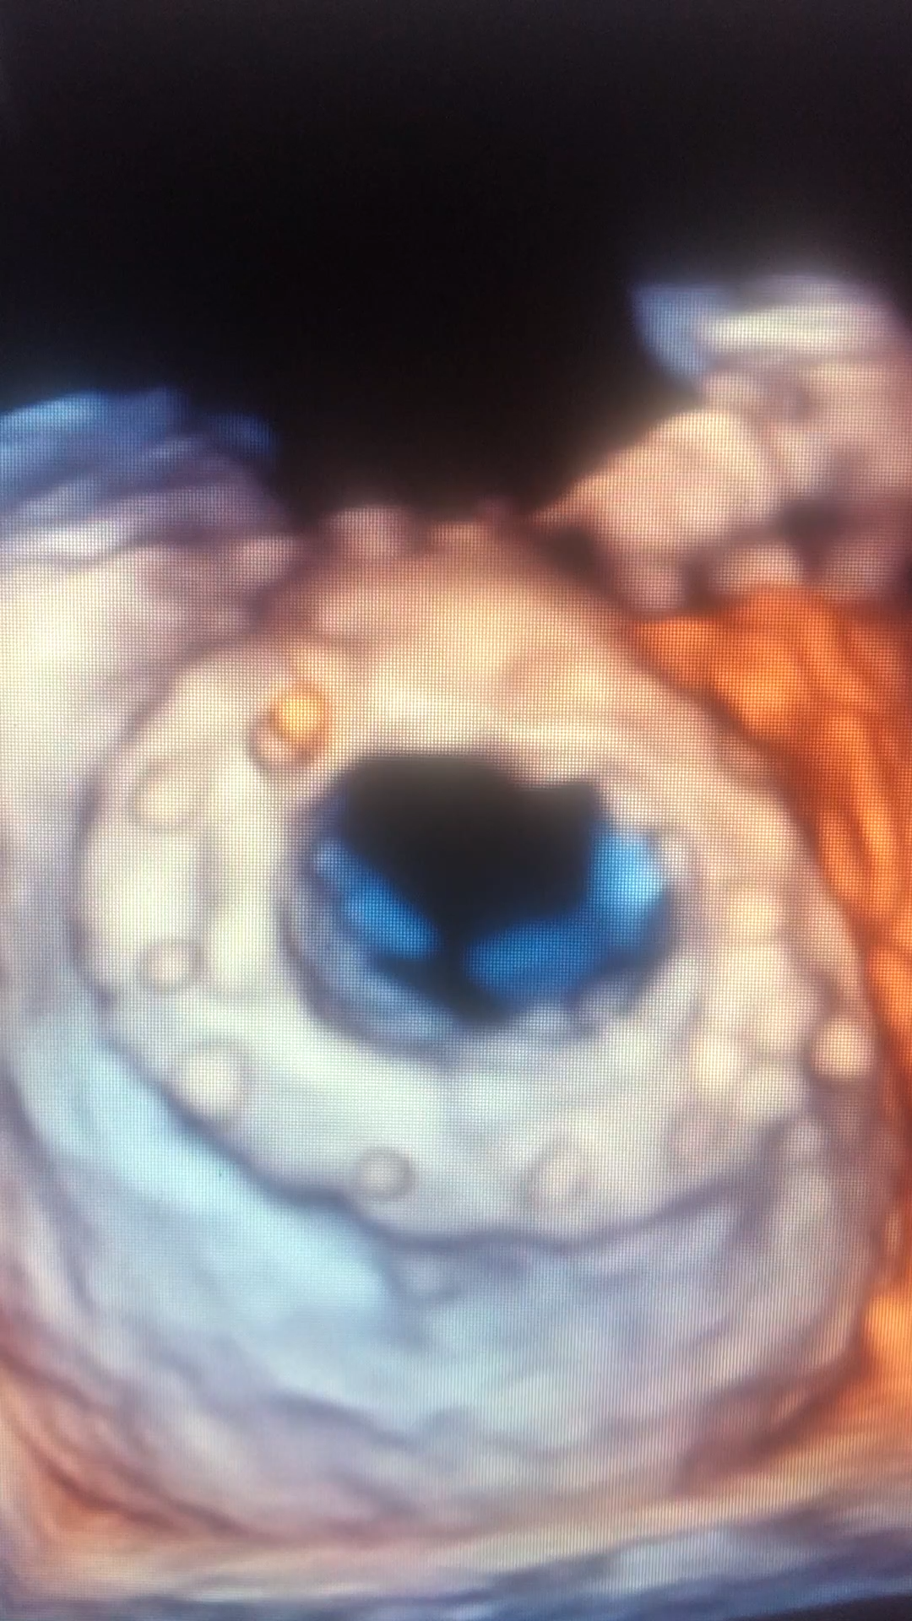

Slide 39


Slide 40
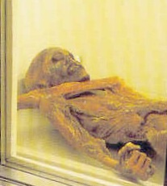

Slide 41


Slide 42
