Slide 1
Lung Cancer Screening
By: Jonathan Hontzas, DNP, NP-C, TTS
Director, ACT Center for Tobacco Treatment, Education, and Research; Lung Cancer Screening Services
Cancer Center and Research Institute
Assistant Professor
School of Population Health

Slide 2
Cancer Statistics: MS

Slide 3
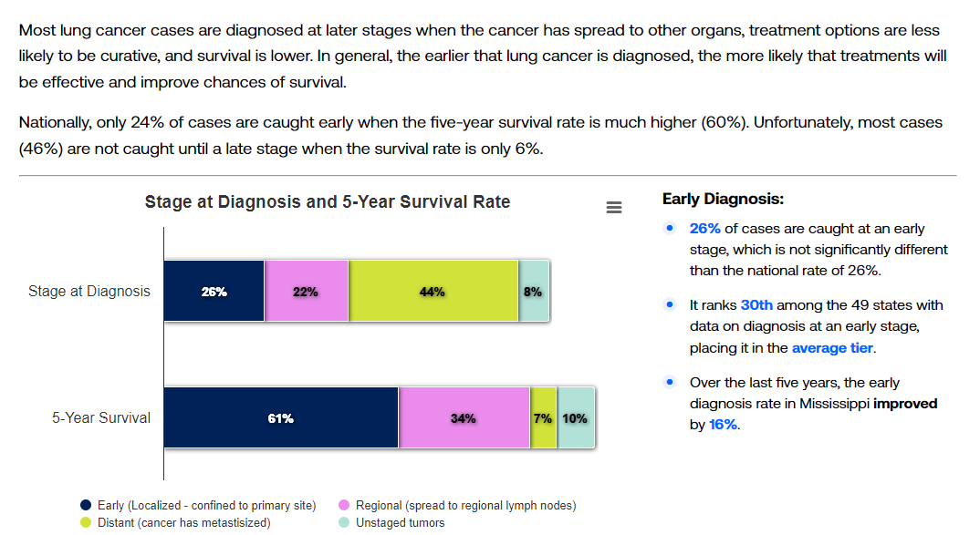
Lung Cancer

Slide 4
Survival
The overall lung cancer five-year survival rate is 18.6%.
-Colorectal 64.5%, breast 89.6%, and prostate 98.2%
The five-year survival for localized disease is 61%, but only 26% are diagnosed with local disease. When there is metastasis at initial presentation the survival rate drops to 7%.
Over half of all those diagnosed with lung cancer die within one year of diagnosis
Lung cancer kills more than colon, breast, and prostate combined

Slide 5
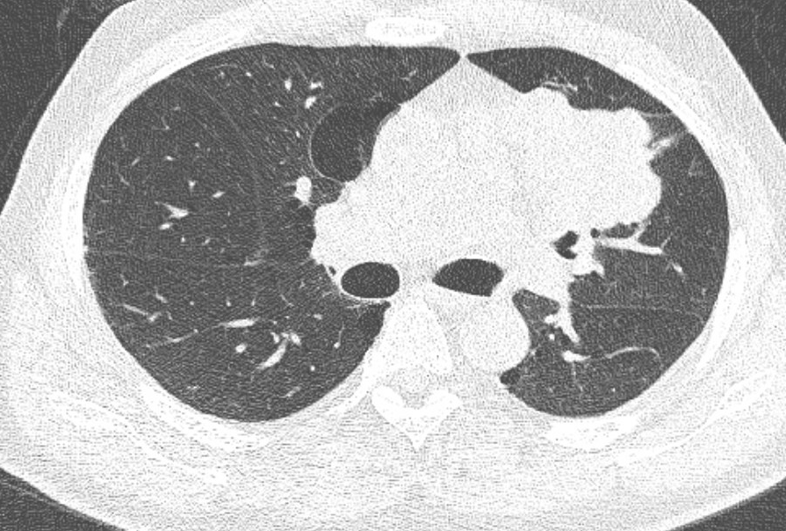
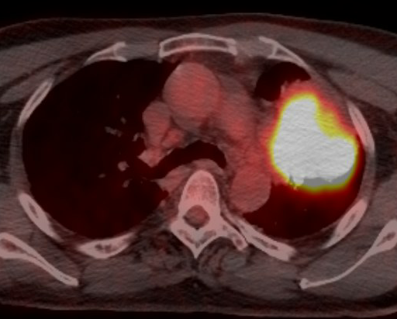
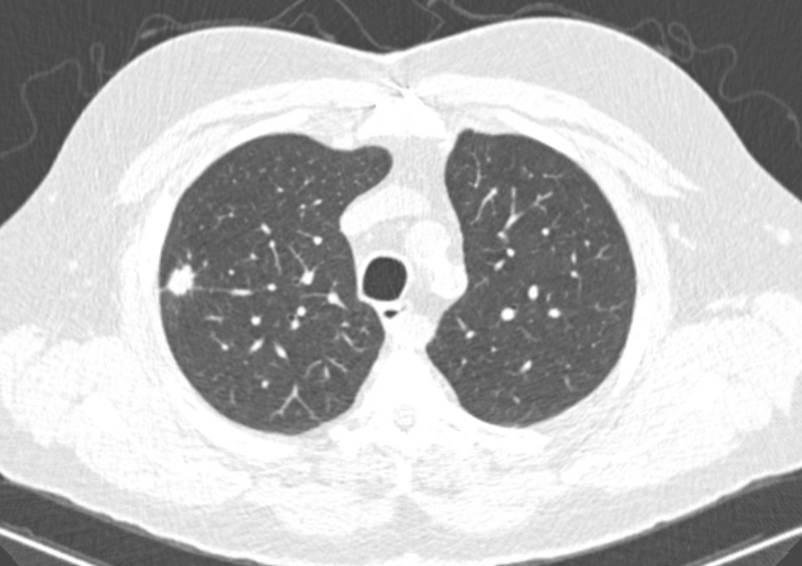
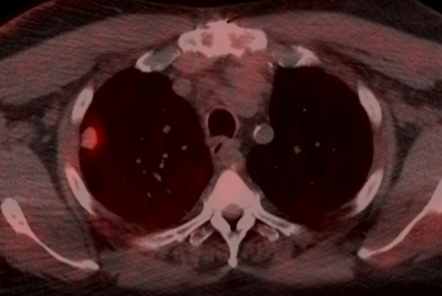
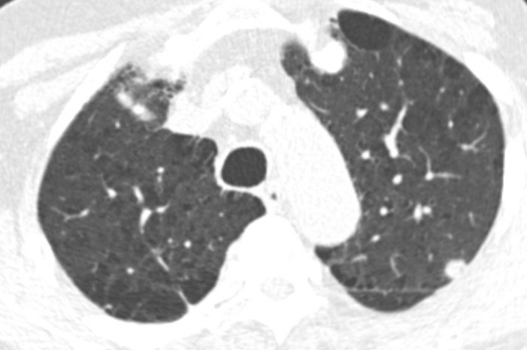
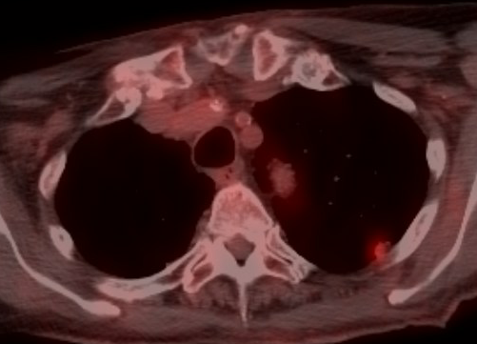
Survival

Slide 6
The National Lung Screening Trial
Sought to compare the mortality benefit when using low-dose computed tomography (70-90% less radiation vs standard Ct) vs standard x-ray
Enrolled 53,454 patients from 2002-2004
Participants randomly assigned to undergo three annual screenings with a LDCT or single-view chest XR

Slide 7
Findings: Published in 2011
Rate of adherence more than 90%
Lung cancer incident rate: 693 cancers in the LDCT group and 416 in the XR group
  407 stage 1, 51 stage 2, 126 stage 3, and 95 stage 4 in LDCT group
  153 stage 1, 33 stage 2, 107 stage 3, and 117 stage 4 for XR group
Relative reduction in mortality from lung cancer with LDCT screening of 20% and all-cause mortality reduction of 6.7%

Slide 8
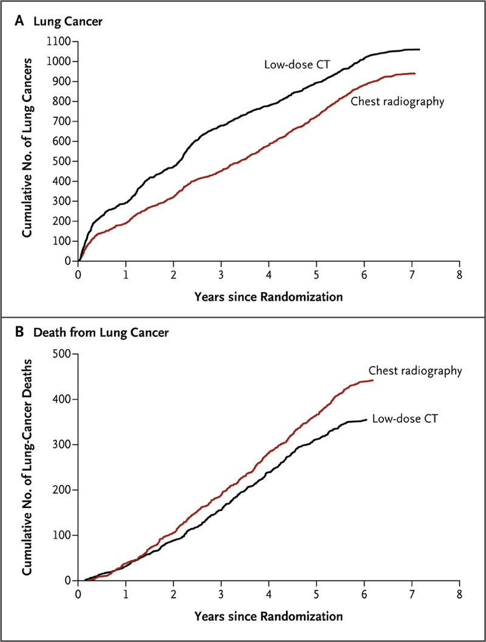

Slide 9
Nelson Trial
Sought to confirm NLST results supporting use of LDCT, but without CXR
Enrolled 15,789 patients over ten years
Screened at year 1, year 3, and year 5.5 or no screening
Followed participants for ten years

Slide 10
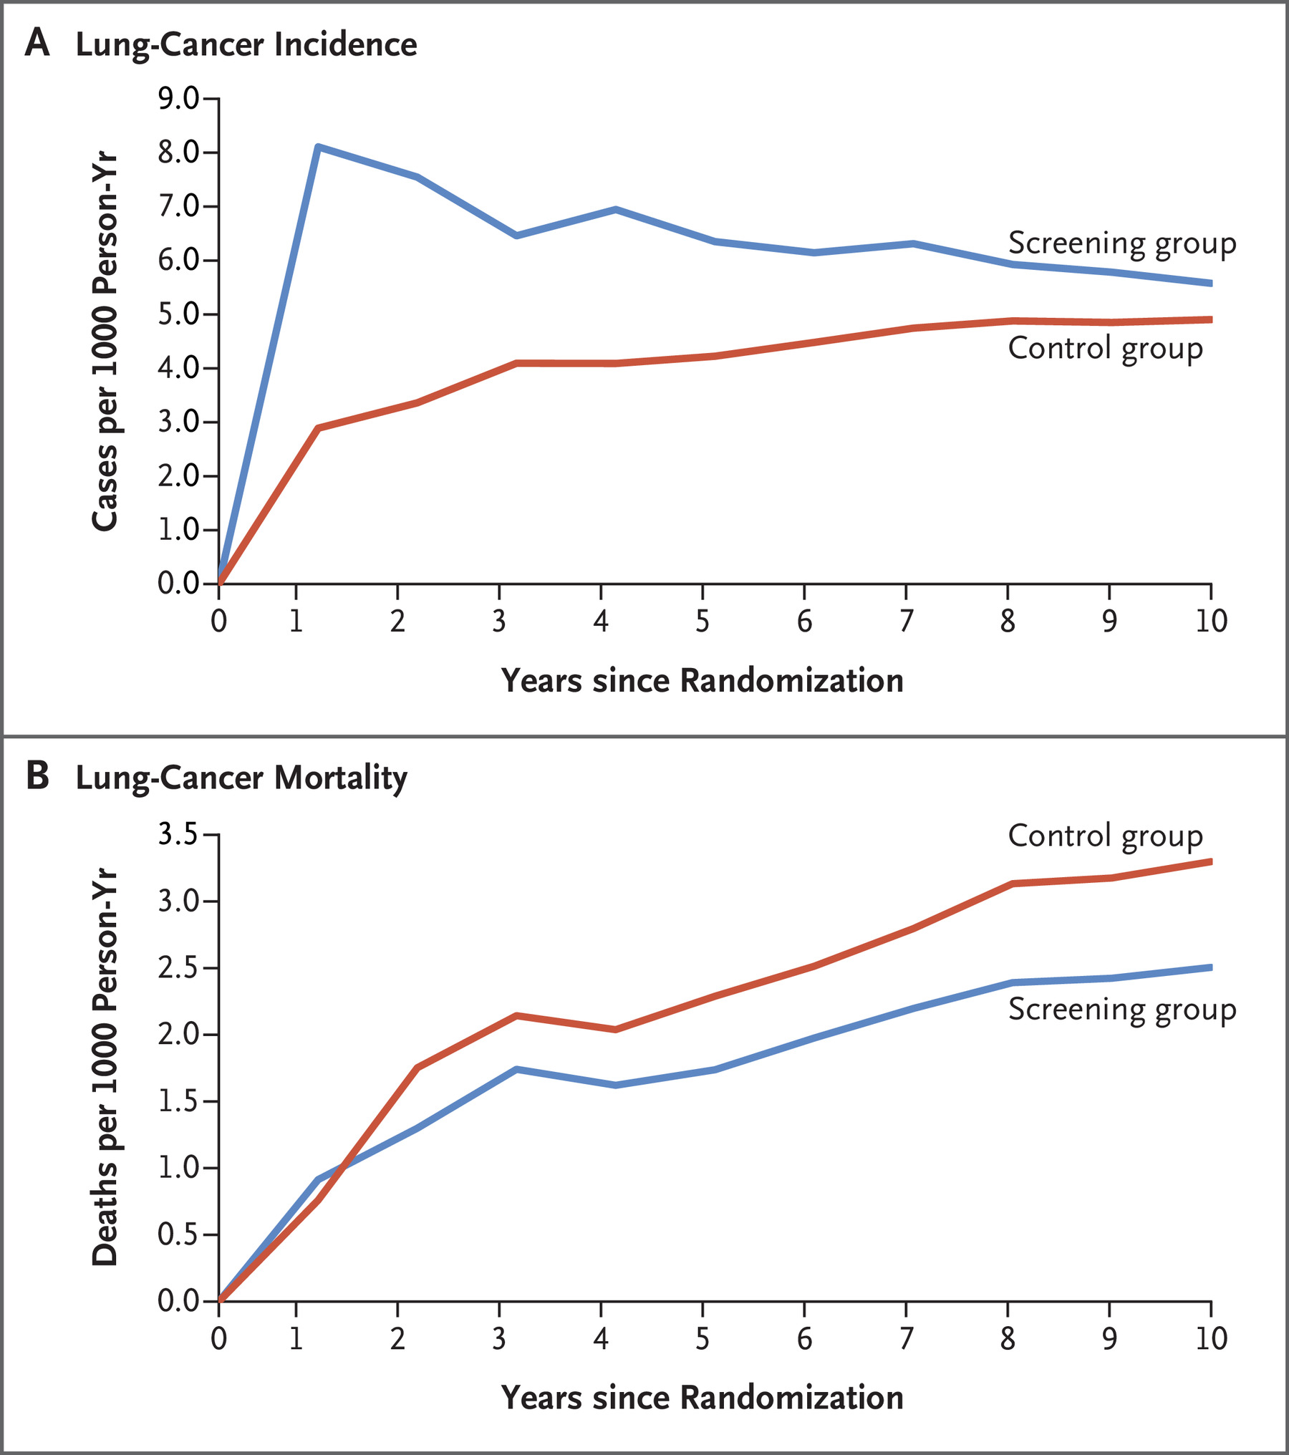
Findings: Published in 2020
Rate of adherence 90%
Incident rate: 210 in LDCT group and 160 in control group
  Mortality reduction of 24% in men and 33% in females

Slide 11
U.S. Preventive Task Force
In 2013, a B recommendation was issued for annual lung cancer screening in those aged 55-80 with at least 30 pack years that are current smokers or have quit within the past 15 years.
In 2021, this was re-visited with the new determination issuing a B recommendation, but updated the eligibility criteria: Ages 50-80 with 20 pack years in current smokers or former that have quit within 15 years

Slide 12
Coverage
Medicare
  Covers ages 50-77 with 20 pack years or who are former smokers that quit within 15 years. Patients must be asymptomatic.
  Requires shared-decision making visit for initial screening
    Discuss risks/benefits, determine eligibility, use of decision-making-aid, counseling on smoking cessation, and counseling on the importance of adhering to annual screening
    All components must be documented for coverage. Billable code is: G0296
    No longer requires uploading of certain criteria to the ACR’s LCSR
  Not subject to co-pay, deductible, or other. 100% coverage.
  Z87.891 for former smokers and F17.21 for current
Medicaid
  Sporadic coverage. Expansion states required to cover and do, but states that did not expand are hit or miss. MS does cover.
Private Insurers
  Coverage is there, but may have different slightly different eligibility criteria and CPT codes
  BCBS uses z12.2

Slide 13
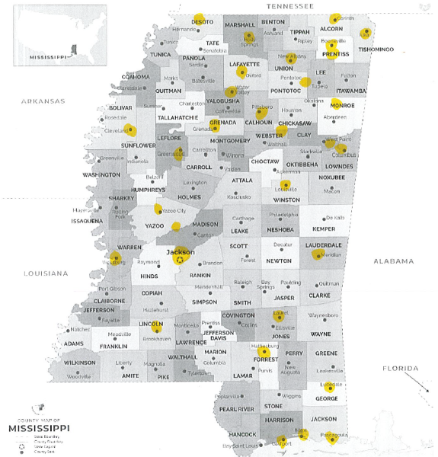

Slide 14
State of Lung Cancer Screening

Slide 15
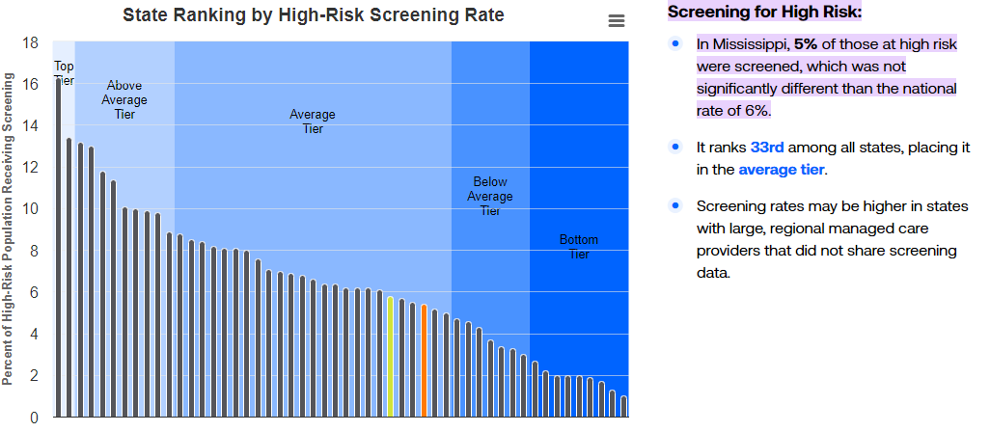
MS Lung Cancer Screening Rates

Slide 16
Types of Screening Programs
Centralized
  Eligible patients referred to lung screening program. Usually lead by a thoracic oncology team consisting of pulmonary, oncology, thoracic surgery, etc.
  Thoracic team performs SDM visit, reviews imaging, follow-up, etc.
De-centralized
  Any provider can order LDCT and is responsible for SDM, imaging, and follow-up
Hybrid
  Combination of the above: Usually the initial LDCT ordered by anyone and subsequent exams done by a dedicated thoracic team

Slide 17

MS Lung Cancer Roundtable
“The Mississippi Lung Cancer Roundtable (MSLCRT) is a collaborative of lung cancer survivors, caregivers, healthcare systems, clinicians, public health practitioners, advocates and other partners who work together to fight lung cancer by engaging in research and projects to build health equity across the lung cancer continuum.”

Slide 18
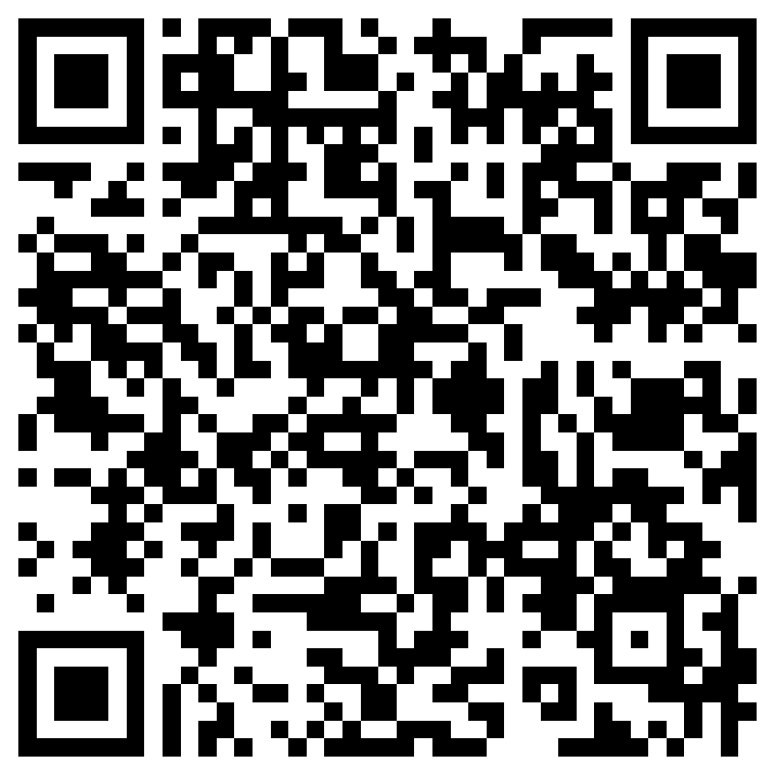
MSLCRT
Work Groups
  Recruitment, outreach, and engagement
  Lung Cancer Screening
  Tobacco Cessation and Treatment
  Survivorship
  Team-Based Care
Anyone can join the work groups

Slide 19
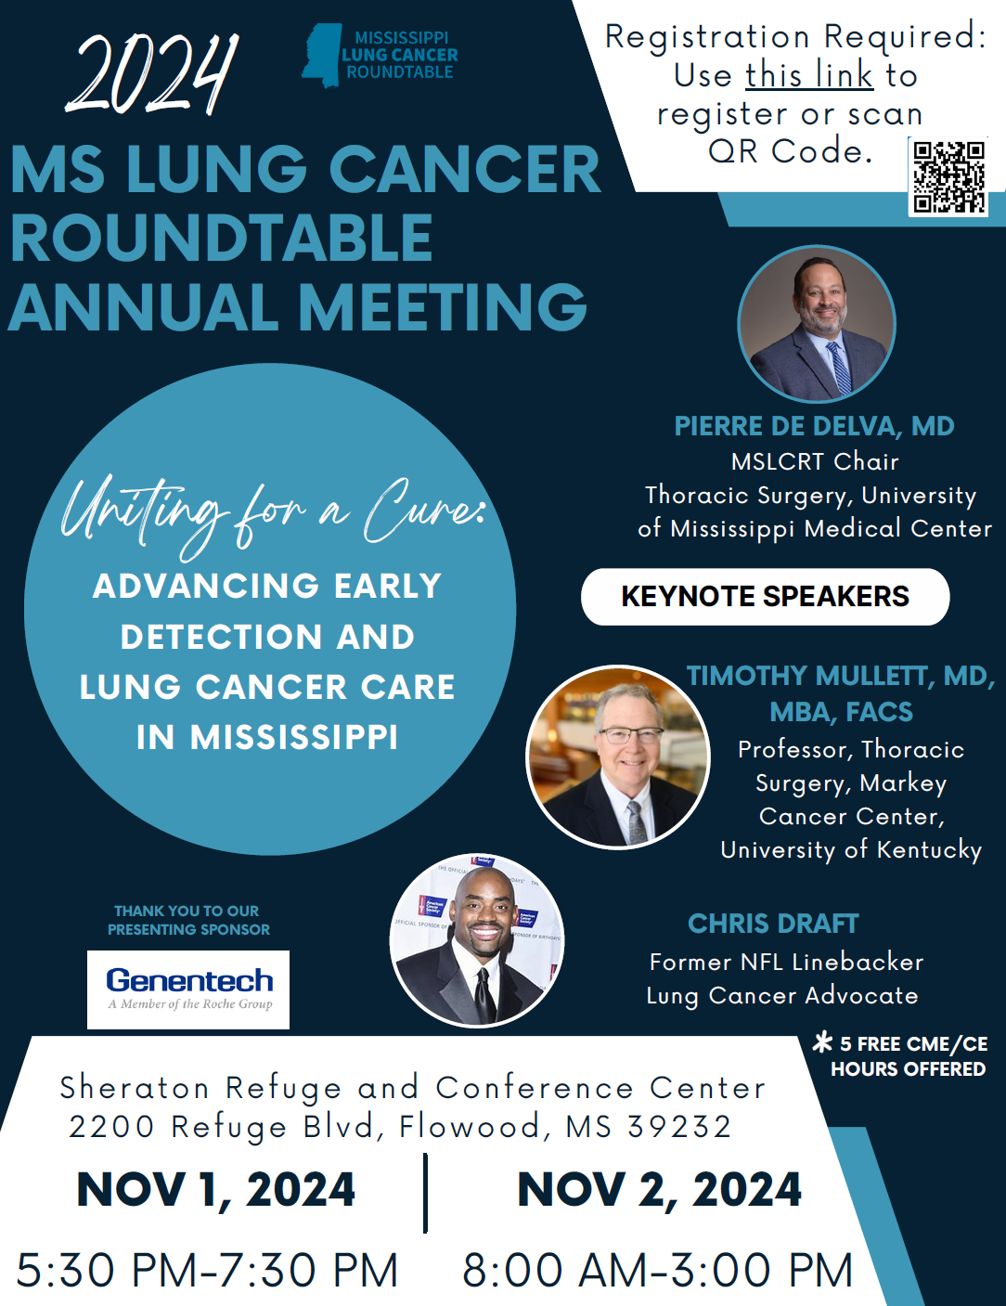

Slide 20

Quality Implementation of Lung Cancer Screening (QUILS)
2014 Kentucky LEADS Collaborative: Education, Survivorship Care, and Prevention/Early Detection
  Kentucky has the highest lung cancer incidence and mortality rates in the US
  Implementation of QUILS metric system and robust community outreach efforts
  2nd highest rate of lung cancer screening in the US
University of Kentucky Markey Cancer Center and University of Colorado Cancer Center
  4-year $6.8m grant through the Bristol Myers Squibb Foundation
  Nevada and MS chosen
UMMC/MSLCRT Led Efforts
  MS received nearly $1.8m through UMMC
  Focus on improving access, quality, and uptake while reducing health disparities.
  Partnership with 6 sites that will receive funding and QUILS system
  Full-time Program manager and Outreach Coordinator

Slide 21
Questions?
jhontzas@umc.edu
601-815-1412
www.act2quit.org
Screening:
  601-984-LUNG; Option 1
  Fax; 601-815-5986

Slide 22
References
1. USCS Data Visualizations [Internet]. Gis.cdc.gov. 2021 [cited 12 May 2021]. Available from: https://gis.cdc.gov/Cancer/USCS/DataViz.html
2. Lung Cancer Fact Sheet [Internet]. Lung.org. 2021 [cited 12 May 2021]. Available from: https://www.lung.org/lung-health-diseases/lung-disease-lookup/lung-cancer/resource-library/lung-cancer-fact-sheet
3. Lung Cancer Risk Factors | Smoking & Lung Cancer [Internet]. Cancer.org. 2021 [cited 12 May 2021]. Available from: https://www.cancer.org/cancer/lung-cancer/causes-risks-prevention/risk-factors.html
4. Reduced Lung-Cancer Mortality with Low-Dose Computed Tomographic Screening | NEJM [Internet]. New England Journal of Medicine. 2021 [cited 12 May 2021]. Available from: https://www.nejm.org/doi/full/10.1056/NEJMoa1102873
5. Reduced Lung-Cancer Mortality with Volume CT Screening in a Randomized Trial | NEJM [Internet]. New England Journal of Medicine. 2021 [cited 12 May 2021]. Available from: https://www.nejm.org/doi/full/10.1056/NEJMoa1911793
6. Recommendation: Lung Cancer: Screening | United States Preventive Services Taskforce [Internet]. Uspreventiveservicestaskforce.org. 2021 [cited 12 May 2021]. Available from: https://www.uspreventiveservicestaskforce.org/uspstf/recommendation/lung-cancer-screening
7. Decision Memo for Screening for Lung Cancer with Low Dose Computed Tomography (LDCT) (CAG-00439N) [Internet]. Cms.gov. 2021 [cited 12 May 2021]. Available from: https://www.cms.gov/medicare-coverage-database/details/nca-decision-memo.aspx?NCAId=274

Slide 23
References
8. Uptake of lung cancer screening is exceedingly low [Internet]. Mdedge.com. 2021 [cited 12 May 2021]. Available from: https://www.mdedge.com/chestphysician/article/166457/lung-cancer/uptake-lung-cancer-screening-exceedingly-low#:~:text=Uptake%20of%20lung%20cancer%20screening%20is%20exceedingly%20low.,meeting%20of%20the%20American%20Society%20of%20Clinical%20Oncology.
9. Lei F, Lee E. Barriers to Lung Cancer Screening With Low-Dose Computed Tomography. Oncology Nursing Forum. 2019;:E60-E71.
10. [Internet]. Acr.org. 2021 [cited 12 May 2021]. Available from: https://www.acr.org/-/media/ACR/Files/RADS/Lung-RADS/LungRADSAssessmentCategoriesv1-1.pdf

