Slide 1
Mississippi Health Ambassadors
Thomas Dobbs, MD, MPH
8/15/2024

Slide 2
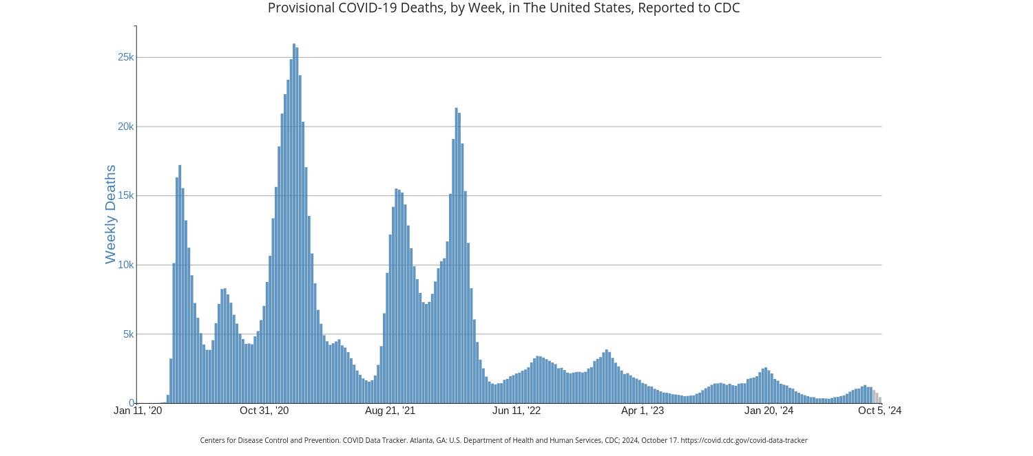
COVID Update

Slide 3
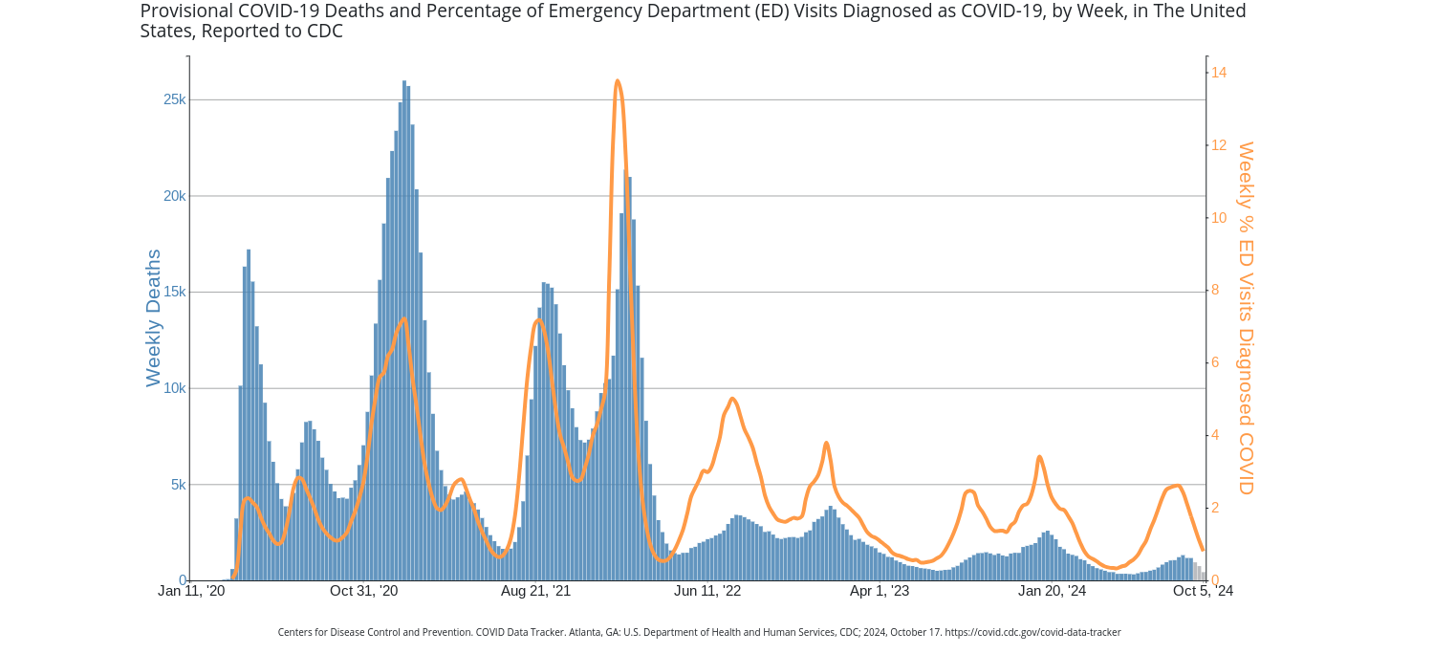

Slide 4
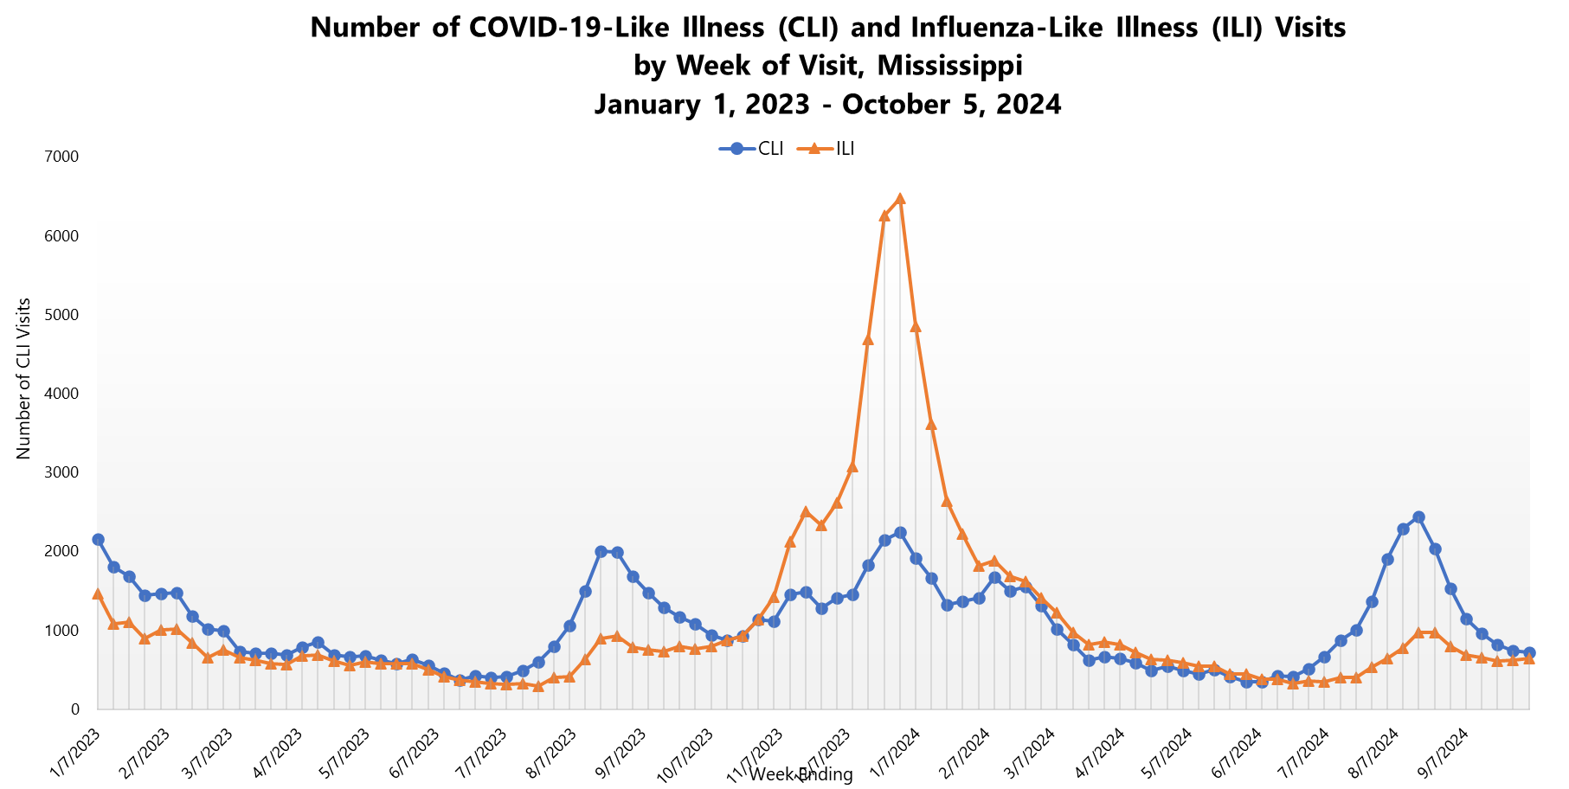

Slide 5
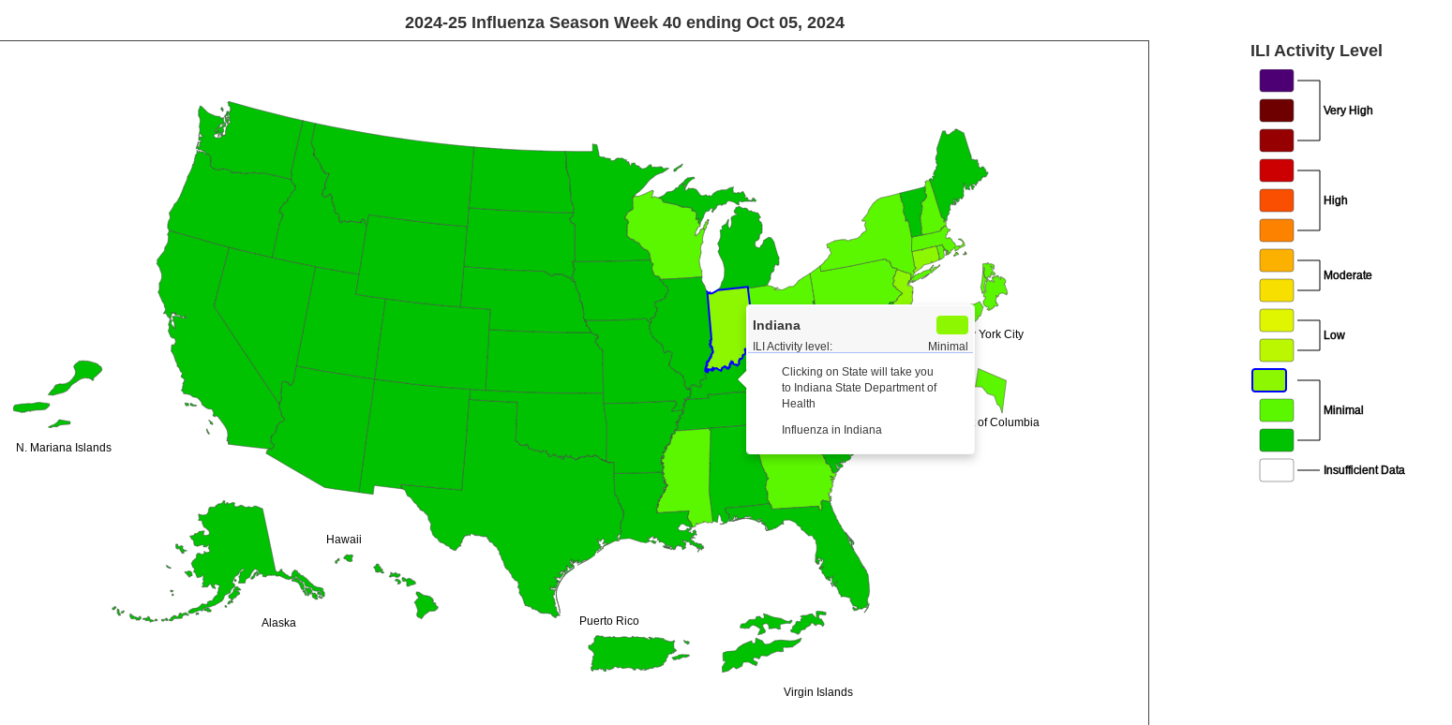

Slide 6
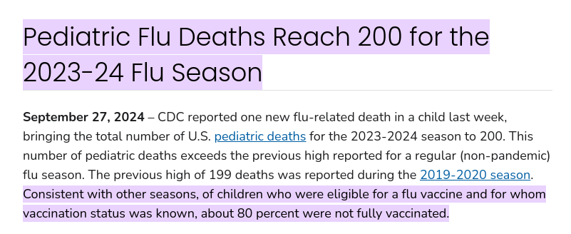
Vaccine Recommendations
COVID Vaccines
  Pfizer/Moderna - available for 6 and older
  Novavax – 12 and older
  Highly recommended for those 65+ or chronic medical issues
Flu Vaccines
  Recommended 6 months and older
  High dose recommended for 65+ or with certain immunosuppression

Slide 7
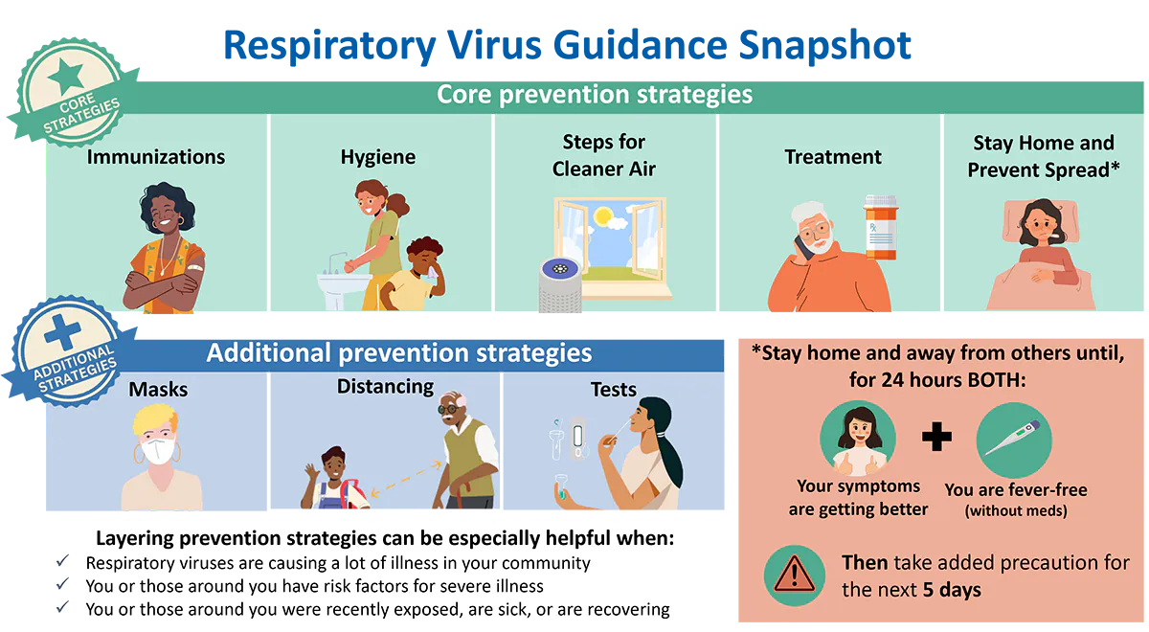
New Isolation Guidelines from CDC

Slide 8
Cancer Screening
What is cancer screening?
Why is it important?
Does it save lives?
What cancers can we screen for?
Is it cost effective?

Slide 9

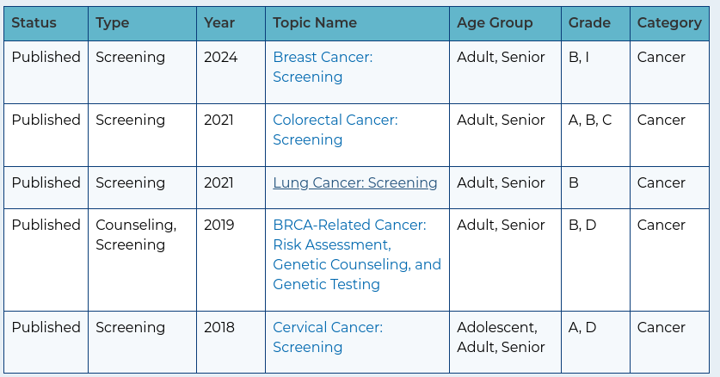
What Cancers Can We Effectively Screen For?
Breast Cancer
Cervical Cancer
Colorectal Cancer
Lung Cancer

Slide 10
Effectiveness of Cancer Screening
Since 1991 – saved 12-14 million person-years of life
Saved $6.5 Trillion
But, if we did it better...
A 10% increase in screening could save and additional
  1,010 from lung cancer
  10,070 from colon cancer
  1,790 from breast cancer
  1,710 from cervical cancer

Slide 11
How are we doing?
Breast | 76% of eligible people are up to date with screening
Cervical | 73% of eligible people are up to date with screening
Colorectal | 69% of eligible people are up to date with screening
Lung | 13% of eligible people are up to date with screening

Slide 12
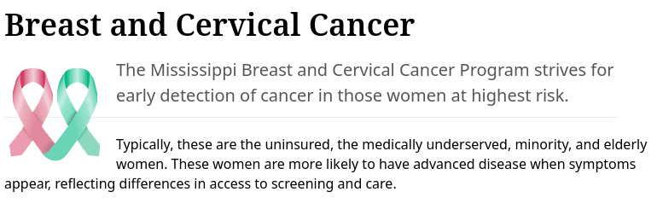
Phone: 601 576-7466
Website: https://msdh.ms.gov/page/41,0,103.html

