Slide 1
Arthritis – An Overview
Hanan Ibrahim M.D
Assistant Professor of Rheumatology
UMMC – Rheumatology
June 20th, 2024

Slide 2
Disclosure
None

Slide 3
Presentation Outlook
What is Arthritis ?
Types of Arthritis
Who is at risk of developing Arthritis
How to treat ?
When to seek medical help

Slide 4
Definitions
Arthritis the medical term : Inflammation of a joint – inflammation equals; pain, redness, swelling and increased cell delivery to the joint
Arthritis the popular (non-medical term) people use it to indicate a joint pain

Slide 5
Why is it important to talk about Arthritis
Arthritis is the leading cause of disability in the US
Arthritis affects nearly 60 million adults and hundreds of thousands of children.
Over 100 types of arthritis and related conditions damage the joints and often other organs.
Some types of Arthritis are preventable and can be slowed down
Arthritis therapy can cost a lot and has its complications

Slide 6
Is every joint pain joint inflammation
No
Joint pain can be caused by a lot of things

Slide 7
What causes joint pain
I like to classify joint pain into :
Joint pain secondary to a systemic acute event; flu, surgery
Joint infection (prosthetic joint, trauma)
Mechanical joint inflammation (Osteoarthritis)
Crystals-related inflammation – ex; gout
Autoimmune inflammation – ex; RA

Slide 8
Osteoarthritis – Mechanical Arthritis
Other terms: Age-related, wear and tear,bone on bone arthritis
The most common cause of arthritis
OA is painful and challenging daily
Usually affects people above the age of 50 years
Can affect younger population – sports, trauma, other joint-related conditions

Slide 9
Causes of Osteoarthritis
To understand it; understand pressure points
Loss of space between 2 bones
Loss of the nice cushiony cartilage
Loss of the gel material
Most common affected joints; Hips, Knees, Spine, shoulder, and thumbs
Can it affect other joints? Yes, depending on pressure

Slide 10
Causes of Osteoarthritis
Age.
Joint injury.
Overuse.
Obesity.
Musculoskeletal abnormalities.
Weak muscles.
Genetics.
Gender. Women are more likely to develop OA.
Environmental Factors. occupation, presence or absence of prior joint injury, sex hormones, and bone density.

Slide 11
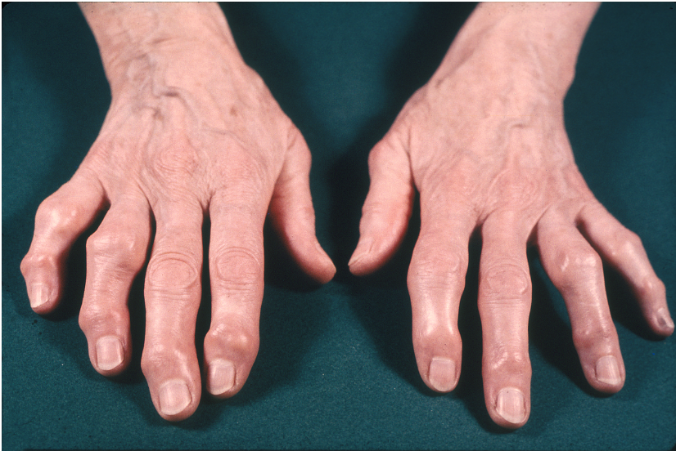
Let's see some images

Slide 12
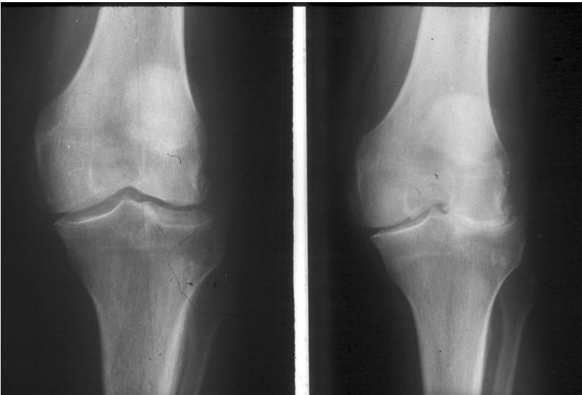
Xrays – Sitting vs Standing views

Slide 13
Symptoms
Pain in the joint
Pain is worse with/after activity and better with rest
Pain can be accompanied by swelling and redness
Pain gets better with massage, warm water
Pain is worse after sitting for a long-time (early morning)
Stiffness for few minutes in the morning
Might improve with OTC medications; ex; Tylenol

Slide 14
How is it diagnosed ?
The story
Clinical exam by your provider
X-rays can help if needed
For surgery sometimes a CT scan or an MRI might help planning

Slide 15
What to do ?
Prevent Prevent Prevent
Slow the progression
Medical treatment

Slide 16
Prevention
Stay healthy – easier said than done
Physical activity / therapy
Avoid obesity and unhealthy lifestyle
Avoid excessive smoking – promotes inflammation

Slide 17
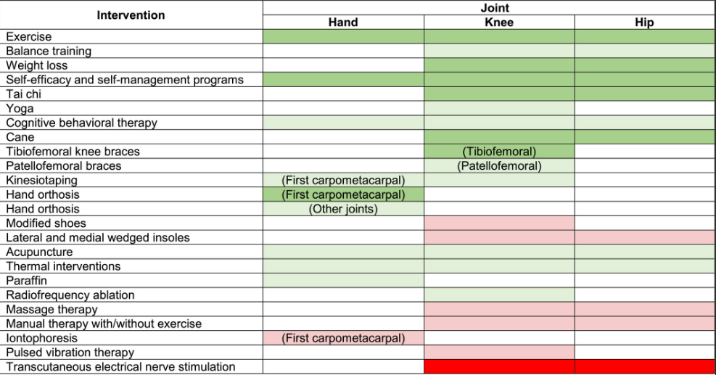
American College of Rheumatology

Slide 18
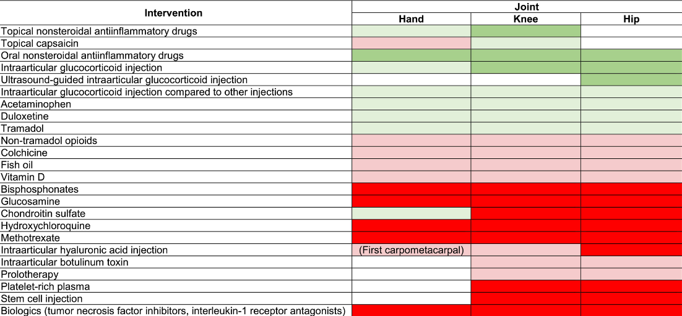

Slide 19
Reach out to
Your PCP
Community Rheumatologist
Sports Medicine physician
Orthopedics physician
Physical therapist and occupational therapist

Slide 20
Crystal induced arthritis
Gout or Pseudogout

Slide 21
What is it ?
Salts that crystalize inside a joint
Uric acid : Gout
Calcium based : Pseudogout

Slide 22
Gout
Uric Acid; natural chemicals found in every cell of your body and in many foods, especially red meat, organ meats, certain seafoods, sugary sodas and beer.
When uric acid builds up, either because the kidneys don’t excrete it the way they should or from consuming too many from a high-purine diet, it can form needle-like crystals that lodge in joints, causing sudden, severe pain and swelling.

Slide 23
Gout Attacks
Pain usually peaks after 12 to 24 hours (Big toe)
Slowly go away on their own
You may have only one gout attack in your lifetime or one every few years.
Recurrent gout attacks that aren’t treated may involve more joints, last longer, and become increasingly severe over time.
A high uric acid level doesn’t mean you have gout

Slide 24
Diagnosis
Your provider will either clinically diagnose it
Might need fluid removal from joint and testing under the microscope

Slide 25
Treatment
Prevent ; Low purine diet
The water to fire method
Acute inflammation – anti-inflammation medication (water) ex; Colchicine
Clear the ashes – urate lowering therapy ex; Allopurinol

Slide 26
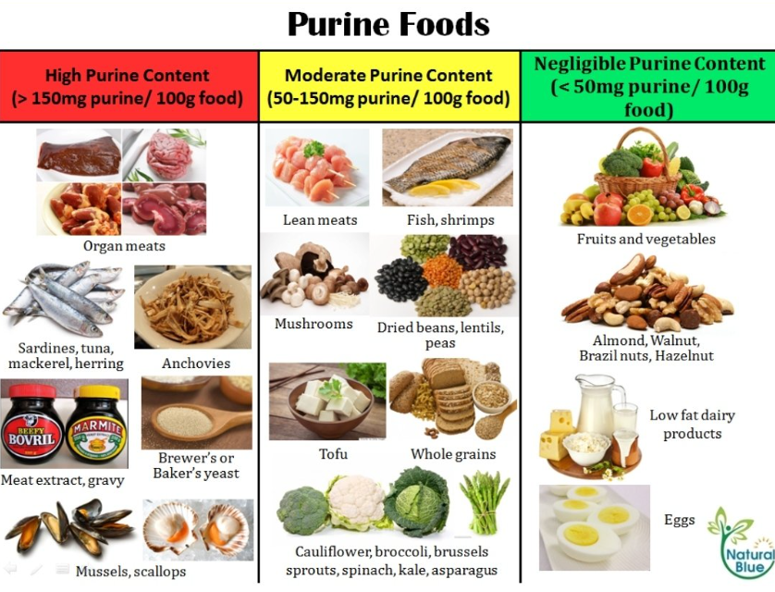
Low Purine Diet

Slide 27
Autoimmune Arthritis
More than 100 types
Most Common is; Rheumatoid Arthritis
Other; Psoriatic Arthritis, Reactive, associated with other autoimmune diseases.

Slide 28
What is Autoimmune mean ?
Your immune system is made up of organs and cells meant to protect your body from bacteria, parasites, viruses and cancer cells.
An autoimmune disease is the result of the immune system accidentally attacking your body instead of protecting it.
It's unclear why your immune system does this.
Can affect younger population especially females

Slide 29
Symptoms
Joints pain that are recurrent for a long time
Pain with redness and swelling along with tenderness
Stiffness in the AM for a longer time
Activity might help reduce the pain
OTC pain meds don’t work
Other systemic symptoms; Fevers, Rash, eye inflammation..etc

Slide 30
Can you prevent ?
Yes! New Data is promising
Avoid triggers; Smoking, unprotected sun exposure, mental health (Anxiety)
Stay healthy; core training, anti-inflammatory diet

Slide 31
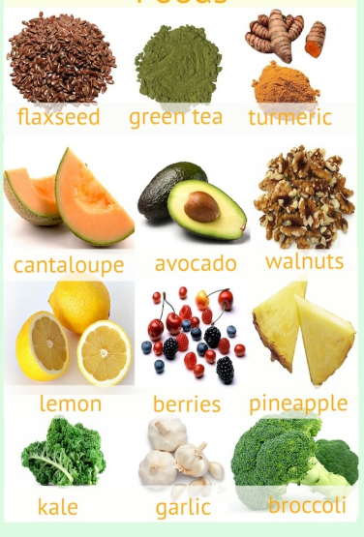
Anti-inflammatory food

Slide 32
Diagnosis
You will need a Rheumatologist on your team
Seek help early to prevent irreversible complications
Diagnosis: Story, Clinical exam, Blood tests, imaging (x-rays, MRIs..)

Slide 33
Treatment
Those diseases are chronic
But controllable
You should not live with debilitating pain
Treatment is a journey
You will try multiple therapies before you find what works with your immune system best

Slide 34
Therapy
Stay active
Medications that aim to reduce and break the auto-inflammation circle
Medications that suppress the immune system or slow it down
Names; Chemotherapy, immunotherapy biological therapy
Your provider will ensure you are infection free before starting any therapy
Therapy can cost a lot and thus you and your provider will work with your insurance to make sure you get the best treatment plan
Be prepared to have a lifelong relationship with your Rheumatologist as you will see them every 3-6 months

Slide 35
Summary
Arthritis – joints pain, could be due to inflammation
A lot of causes
Most important and common one is Osteoarthritis due to mechanical inflammation
Prevention is key
Stay active, eat healthy and avoid smoking
Seek help early

Slide 36
Questions
Thank you ..
Hanan Ibrahim M.D
Assistant Professor of Rheumatology
UMMC – Rheumatology

