Slide 1
Brief COVID-19 and Avian Influenza Update
Paul Byers, MD
May 16, 2024

Slide 2
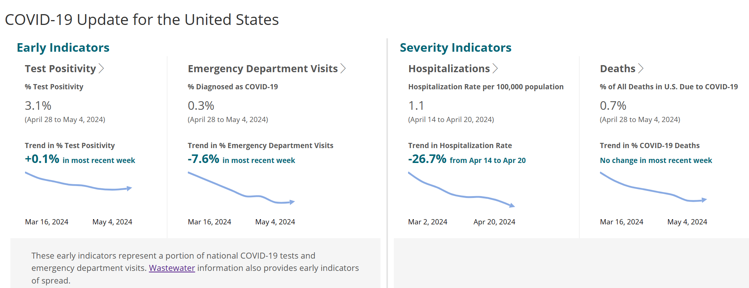
COVID-19 Update

Slide 3
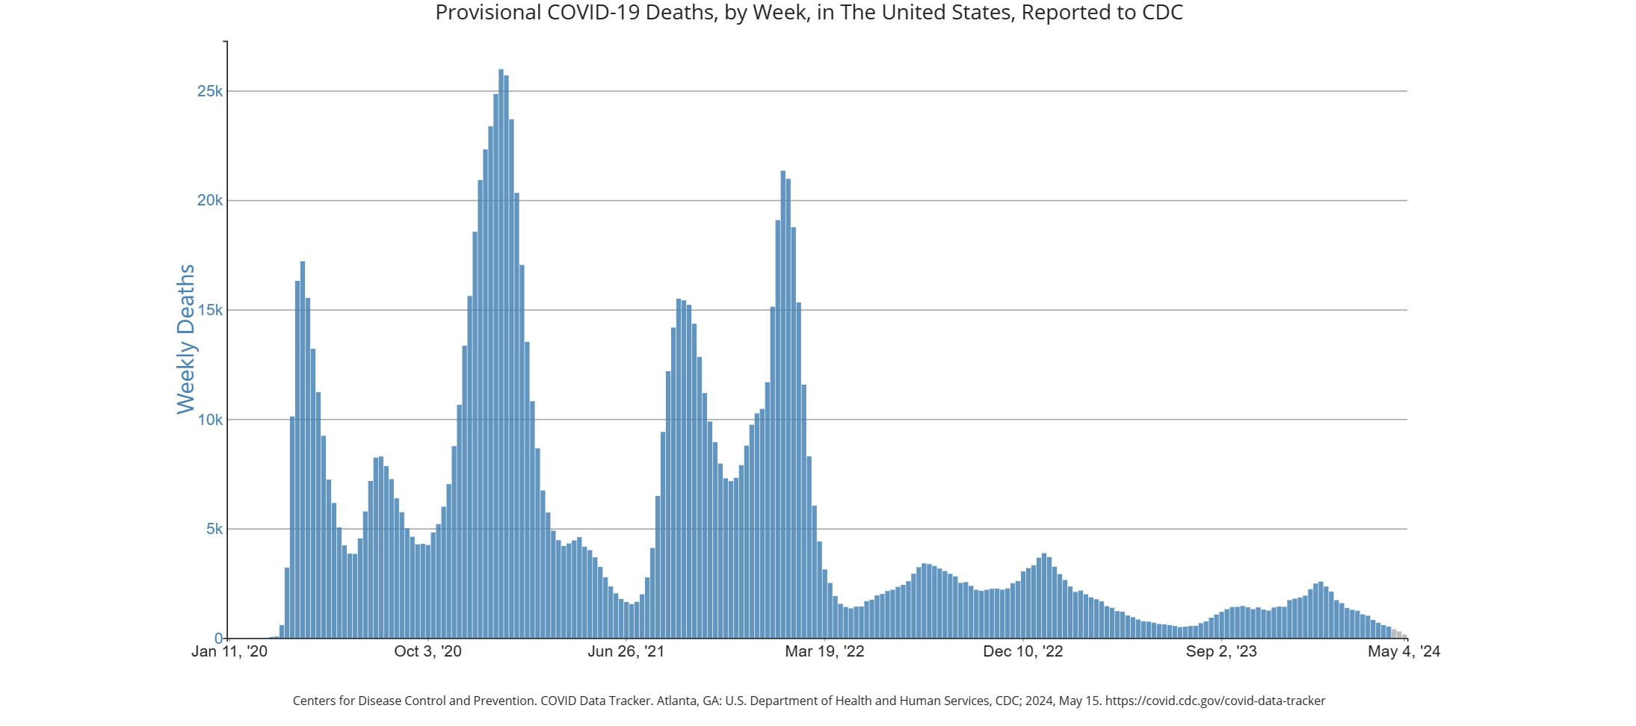

Slide 4
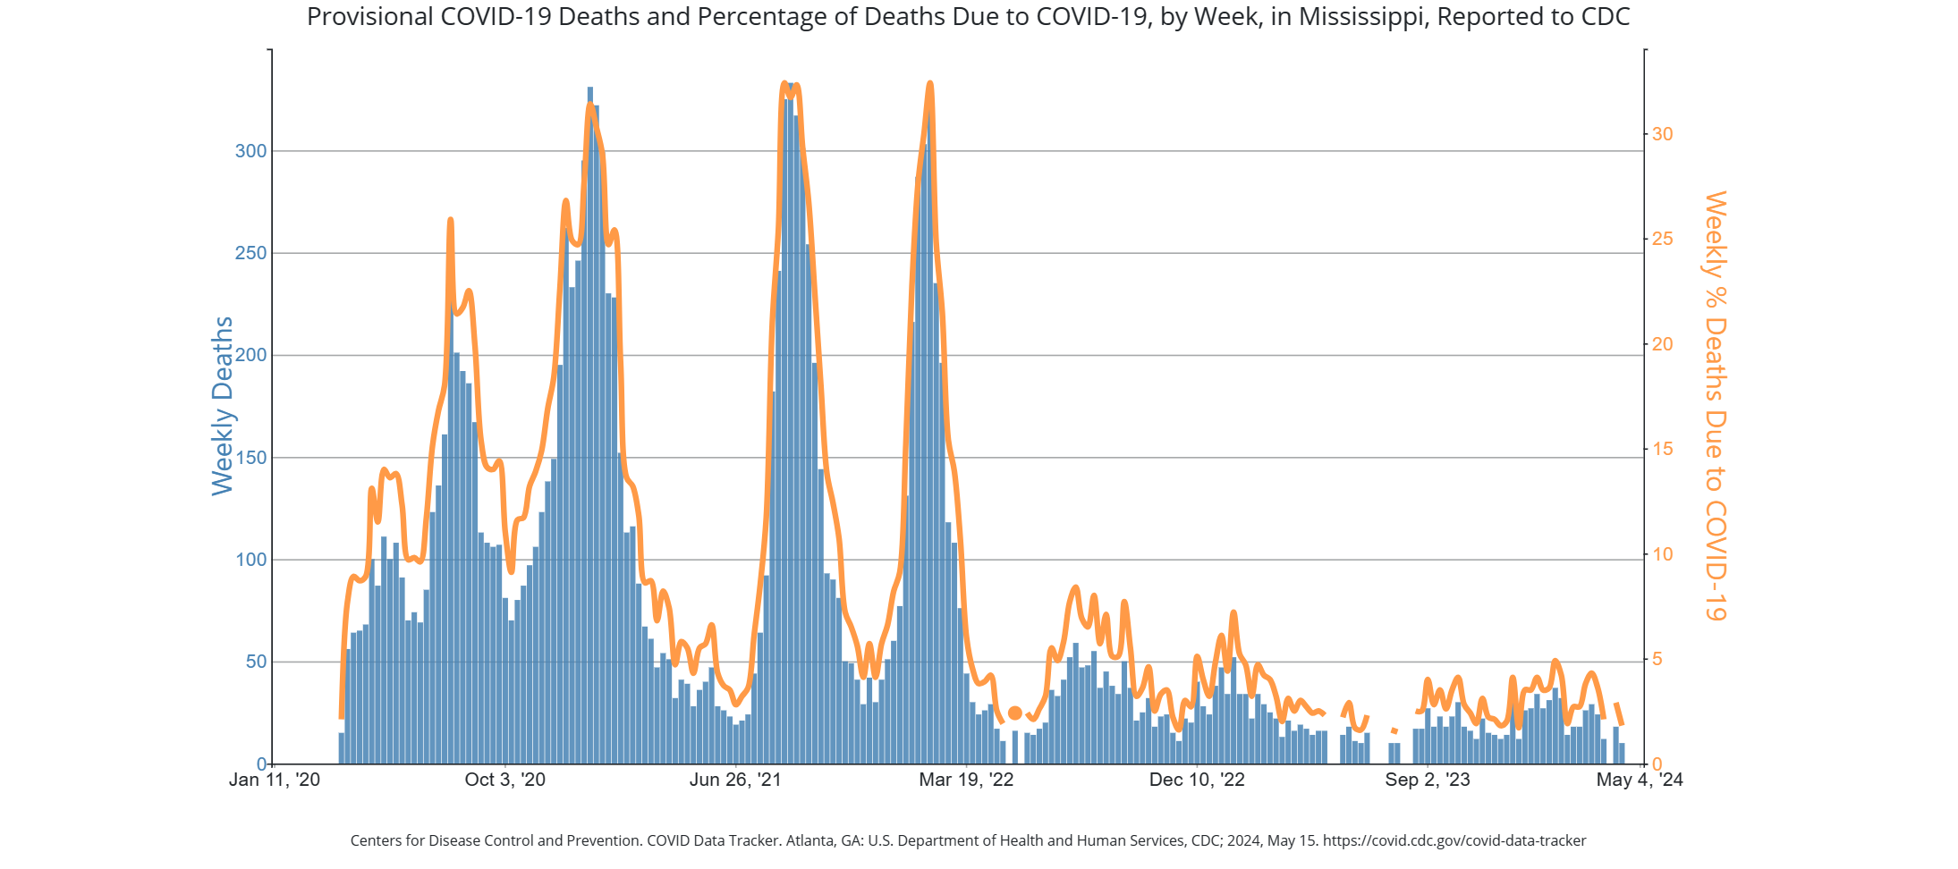

Slide 5
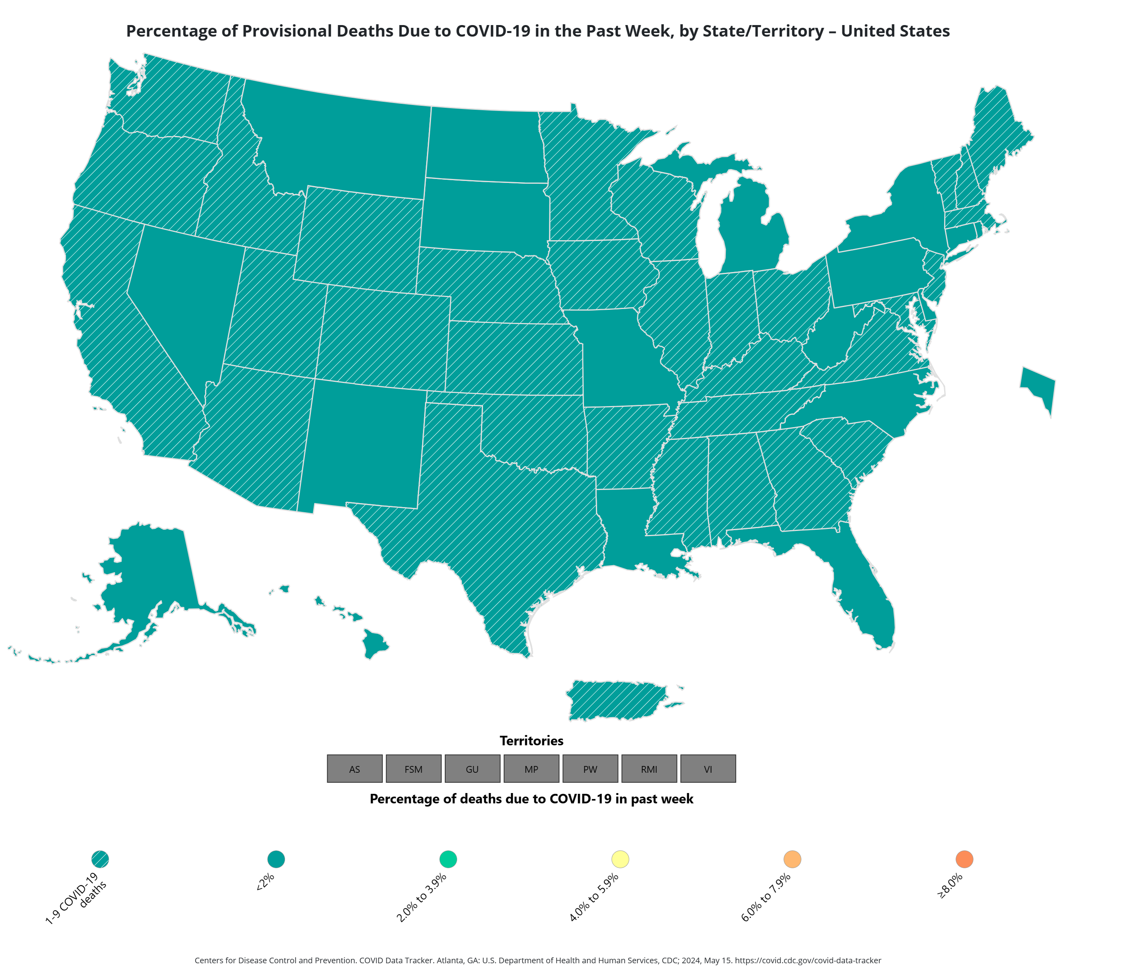

Slide 6
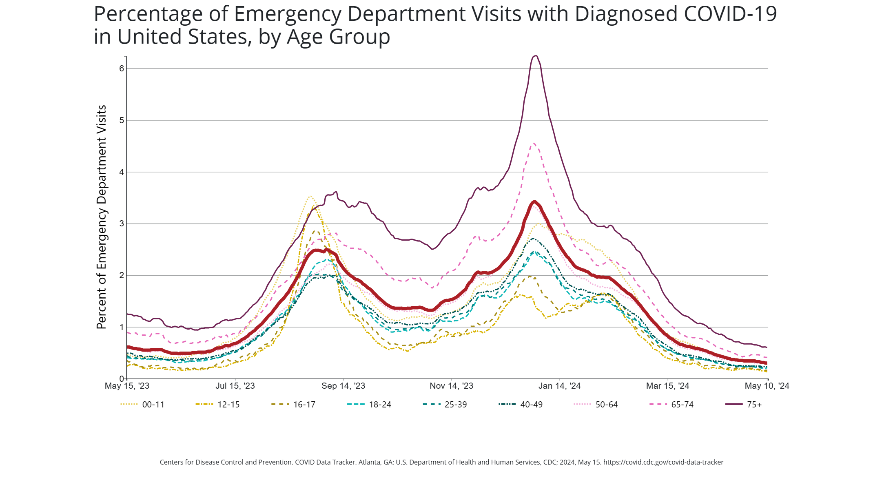

Slide 7
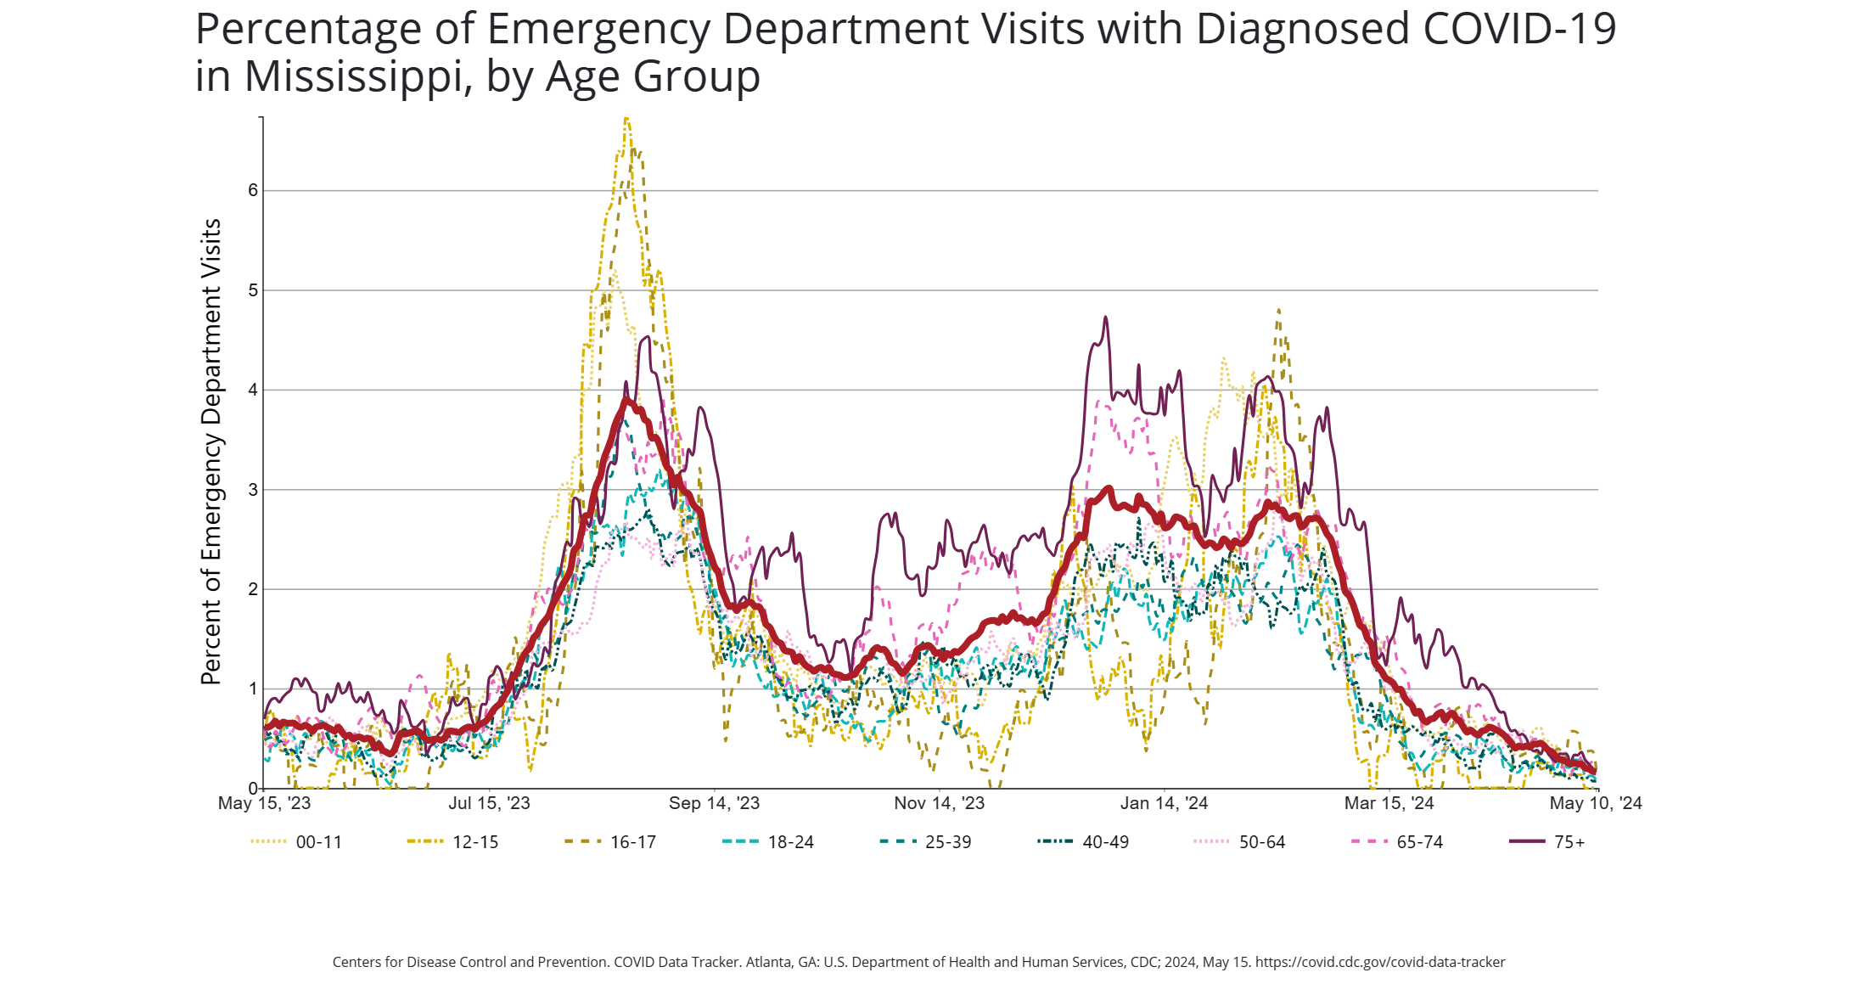

Slide 8
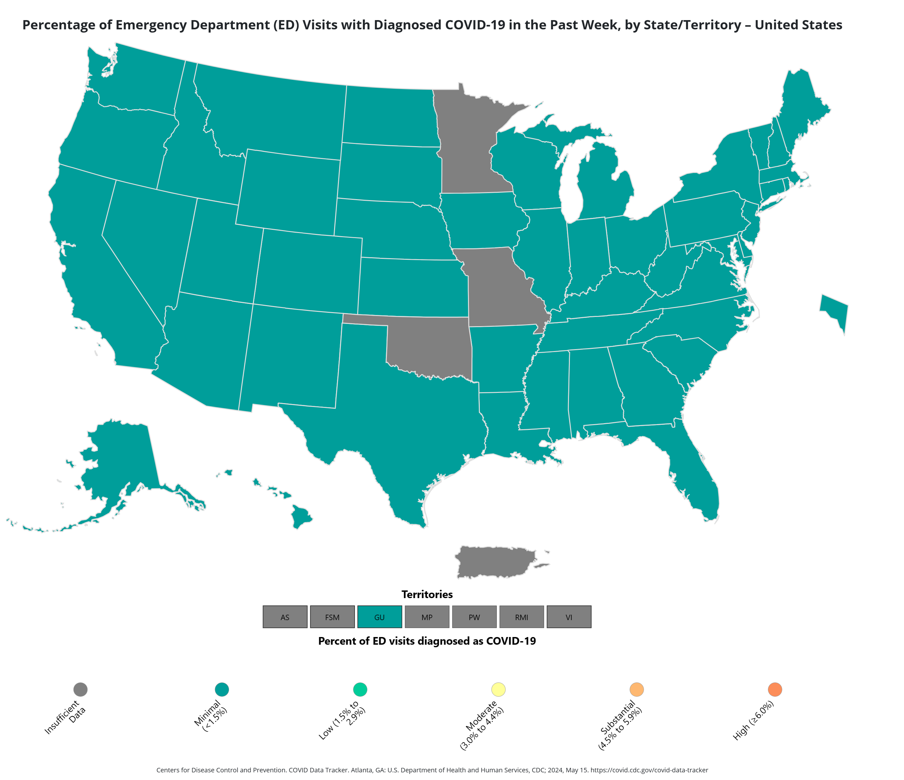

Slide 9
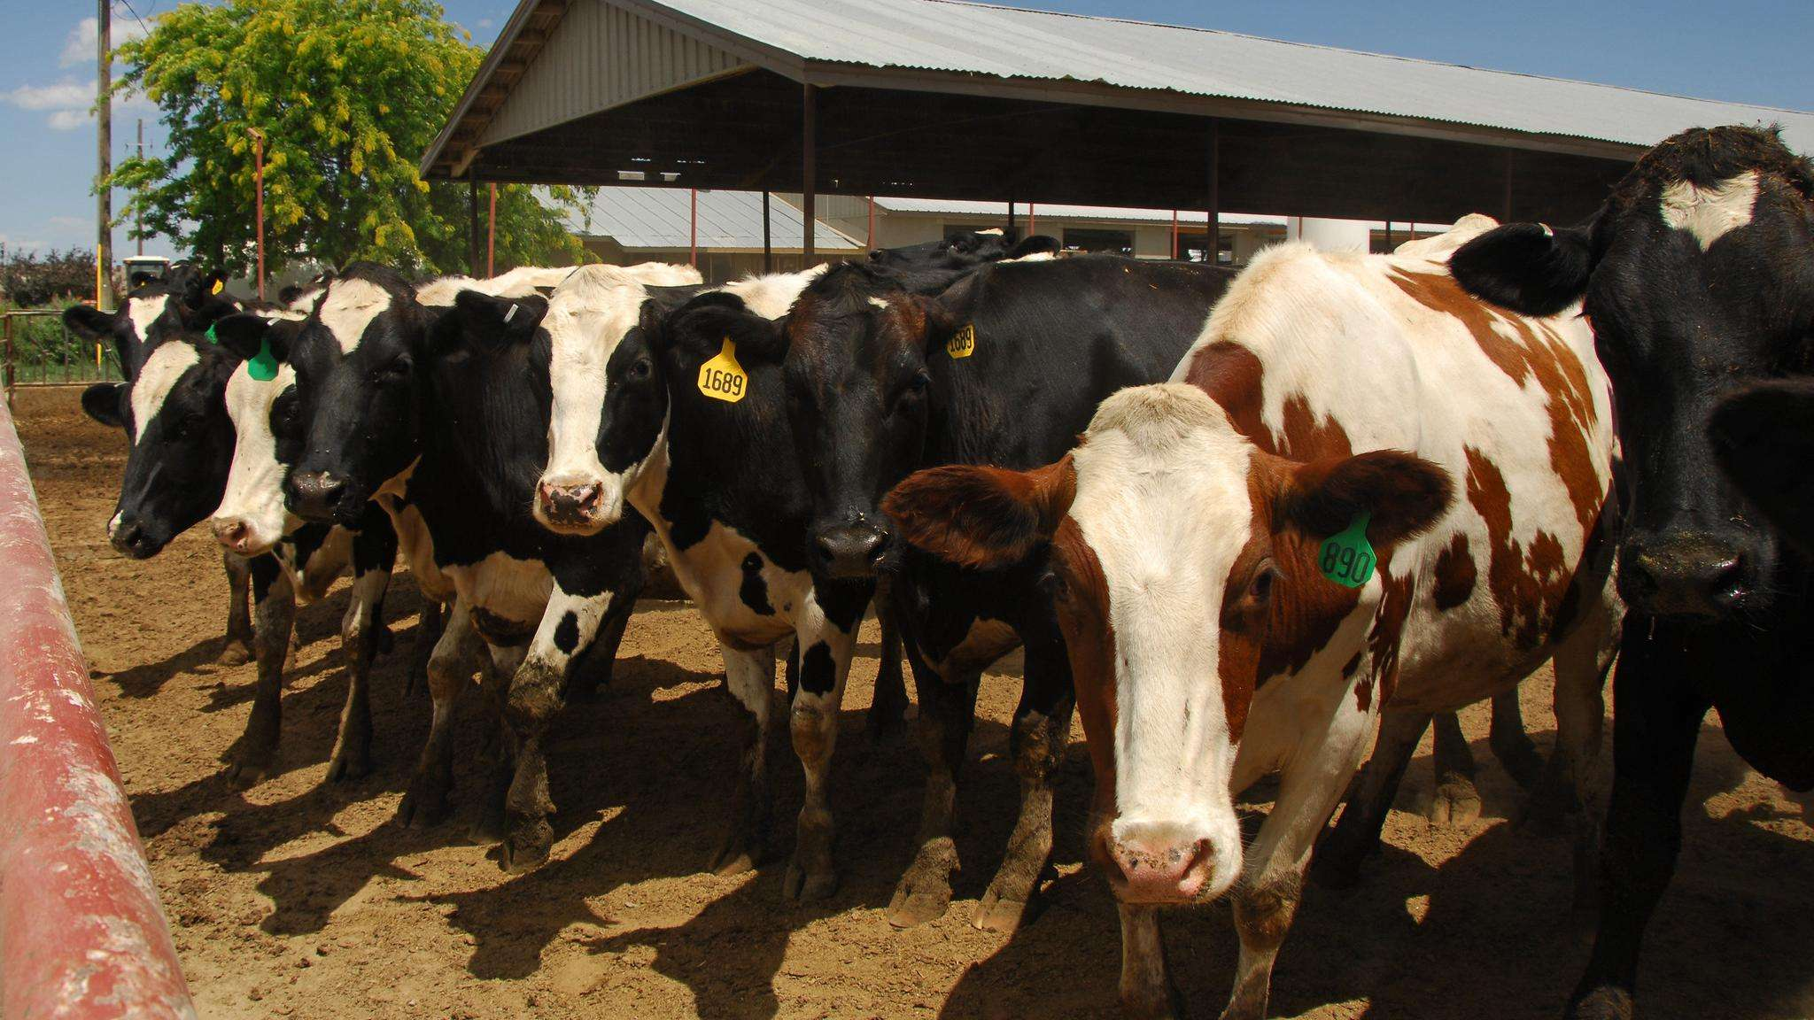
Highly Pathogenic Avian Influenza (HPAI) Detections in Livestock

Slide 10
Highly Pathogenic Avian Influenza (HPAI)
Sporadic human infections with highly pathogenic avian influenza A(H5N1) virus have been reported in 23 countries over more than 20 years.
HPAI A(H5N1) viruses have spread widely among wild birds worldwide since 2020–2021, resulting in outbreaks in poultry and other animal
Most human infections with H5N1 virus have occurred after unprotected exposures to sick or dead infected poultry. Wide clinical spectrum with case fatality of more than 50%
Recently, HPAI A(H5N1) viruses were identified in dairy cows, and in unpasteurized milk samples, in multiple U.S. states
In March 2024, there was a reported case of HPAI A(H5N1) virus infection in a dairy farm worker in Texas.

Slide 11
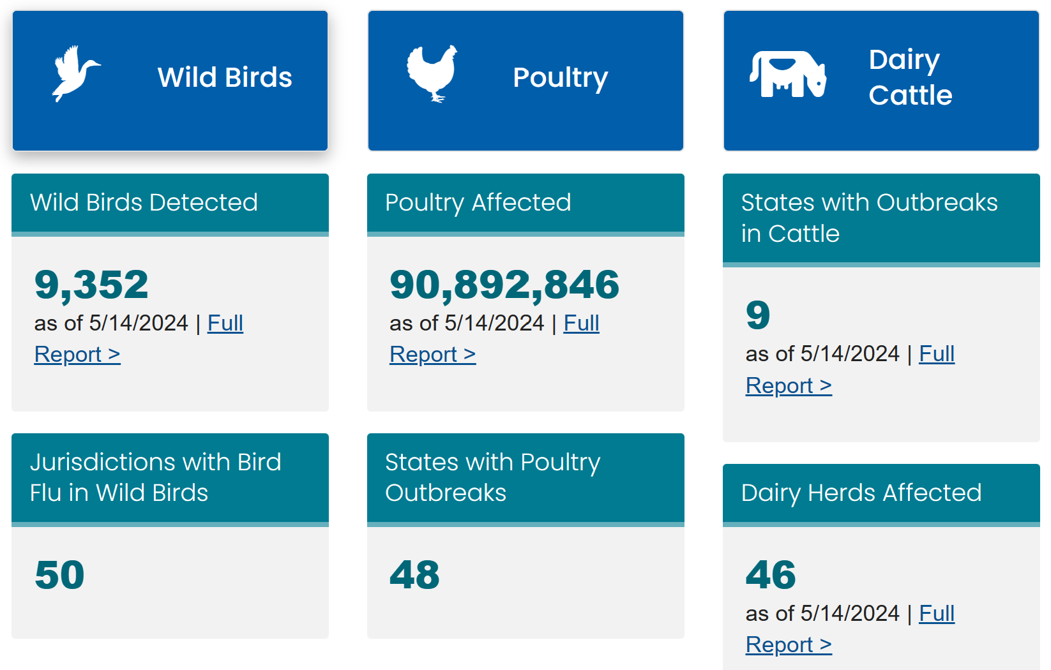
Current Situation

Slide 12
Current Situation
H5N1 bird flu is widespread in wild birds worldwide and is causing outbreaks in poultry and U.S. dairy cows with one recent human case in a U.S. dairy worker.
While the current public health risk is low, CDC is watching the situation carefully and working with states to monitor people with animal exposures.

Slide 13
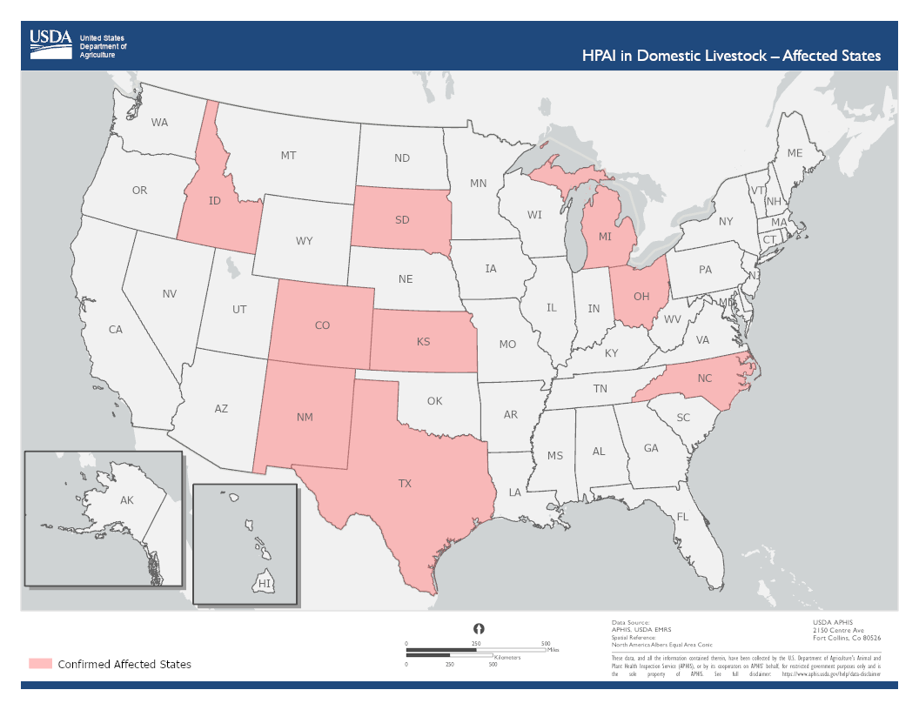

Slide 14
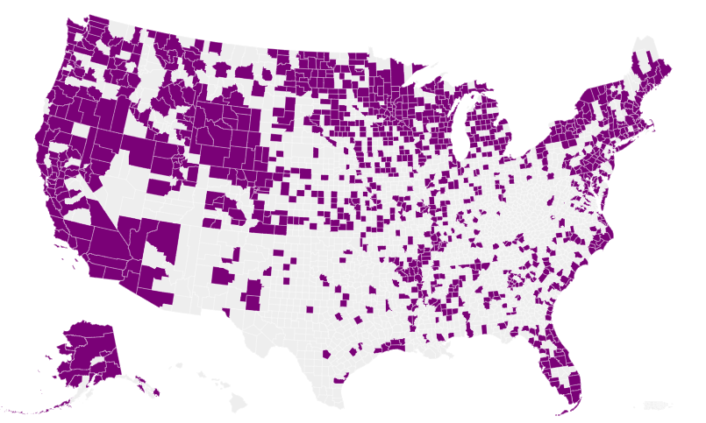
Counties with Infected Wild Birds

Slide 15
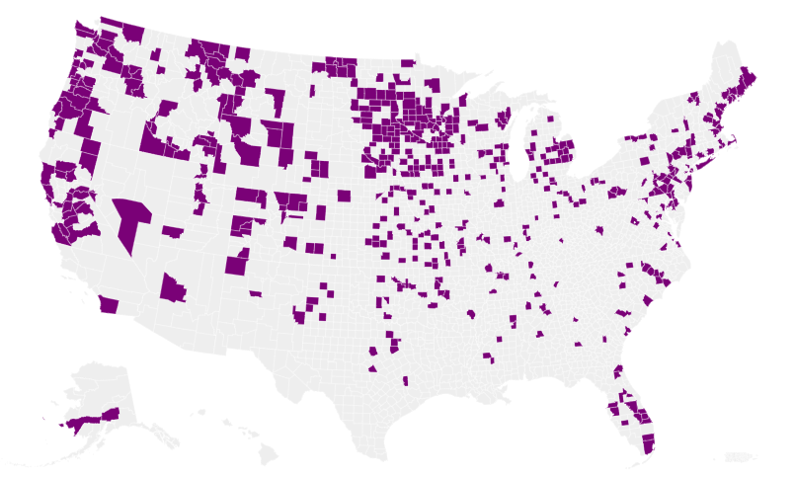
H5N1 Bird Flu Detections across the United States (Backyard and Commercial)

Slide 16
What does all this mean?
The wide geographic spread of HPAI A(H5N1) viruses in wild birds, poultry, and some other mammals, including in cows, could create additional opportunities for people to be exposed to these viruses.
The current risk to people is low.
Job related or recreational exposures to infected birds or other animals (including cows) constitutes the greatest risk to people

Slide 17
Recommendations for the Public
People should avoid unprotected (not using respiratory or eye protection) exposures to sick or dead animals including wild birds, poultry, other domesticated birds, and other wild or domesticated animals, as well as with animal feces, litter, or materials contaminated by birds or other animals with suspected or confirmed HPAI A(H5N1) virus infection.
People should not prepare or eat uncooked or undercooked food or related uncooked food products, such as unpasteurized (raw) milk, or raw cheeses, from animals with suspected or confirmed HPAI A(H5N1) virus infection (avian influenza or bird flu).

Slide 18
Stay Tuned…….Questions??

