Slide 1
COVID-19 Update and Review of H5N1 Flu in the U.S.
Thomas Dobbs

Slide 2
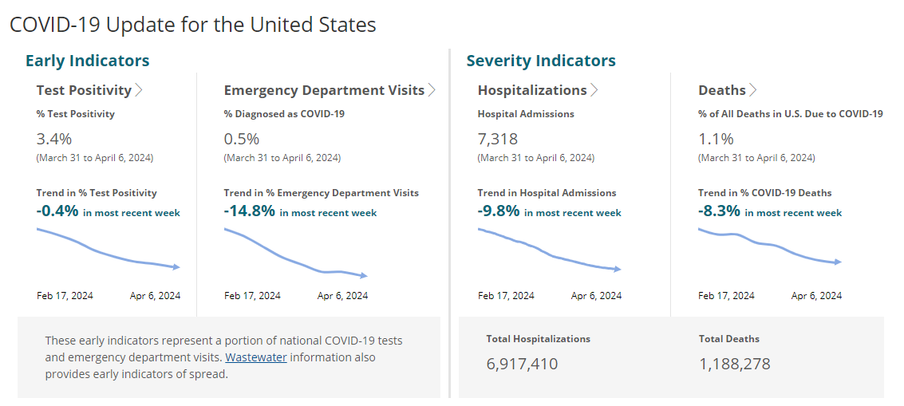

Slide 3
Key Messages
COVID is still here, but declining fortunately… for now
Vaccination Everyone > 4 years of age recommended
> 11 years old
  1 updated vaccine (Pfizer, Moderna)
  1 updated Novavax (2 if never vaccinated before)
Updated vaccines available since Sept 12, 2023. So if you haven’t gotten the vaccine since Sept… you are due

Slide 4
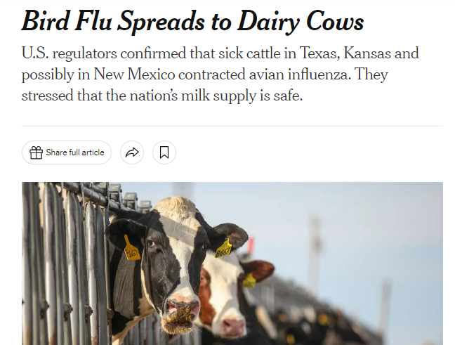

Slide 5
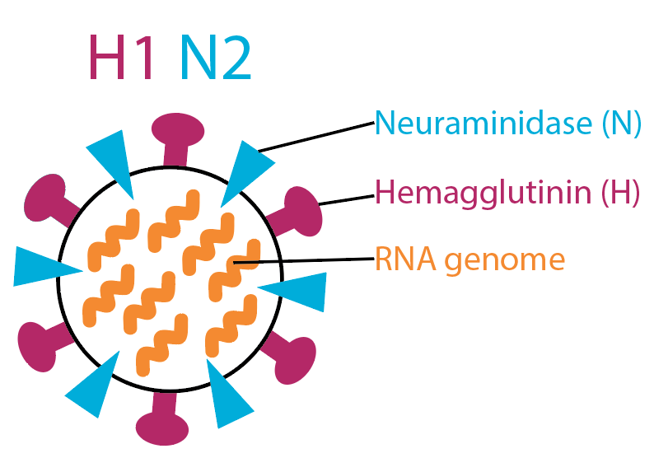

Slide 6
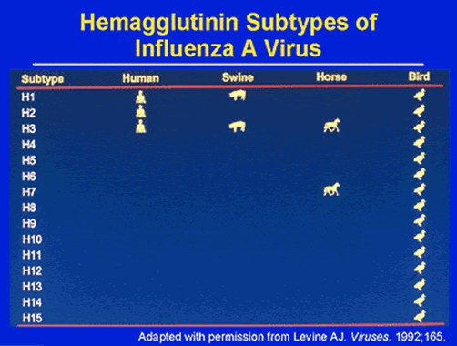

Slide 7
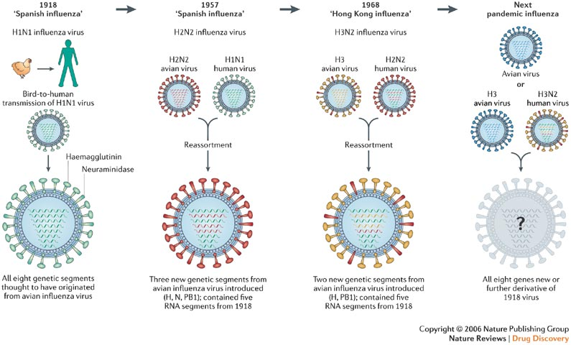
De Clercq Nature Reviews Drug Discovery 5, 1015–1025 (December 2006) | doi:10.1038/nrd2175

Slide 8
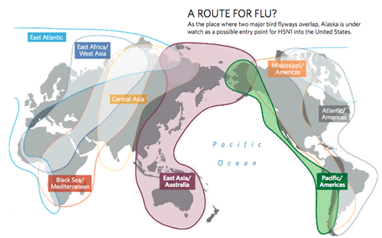

Slide 9
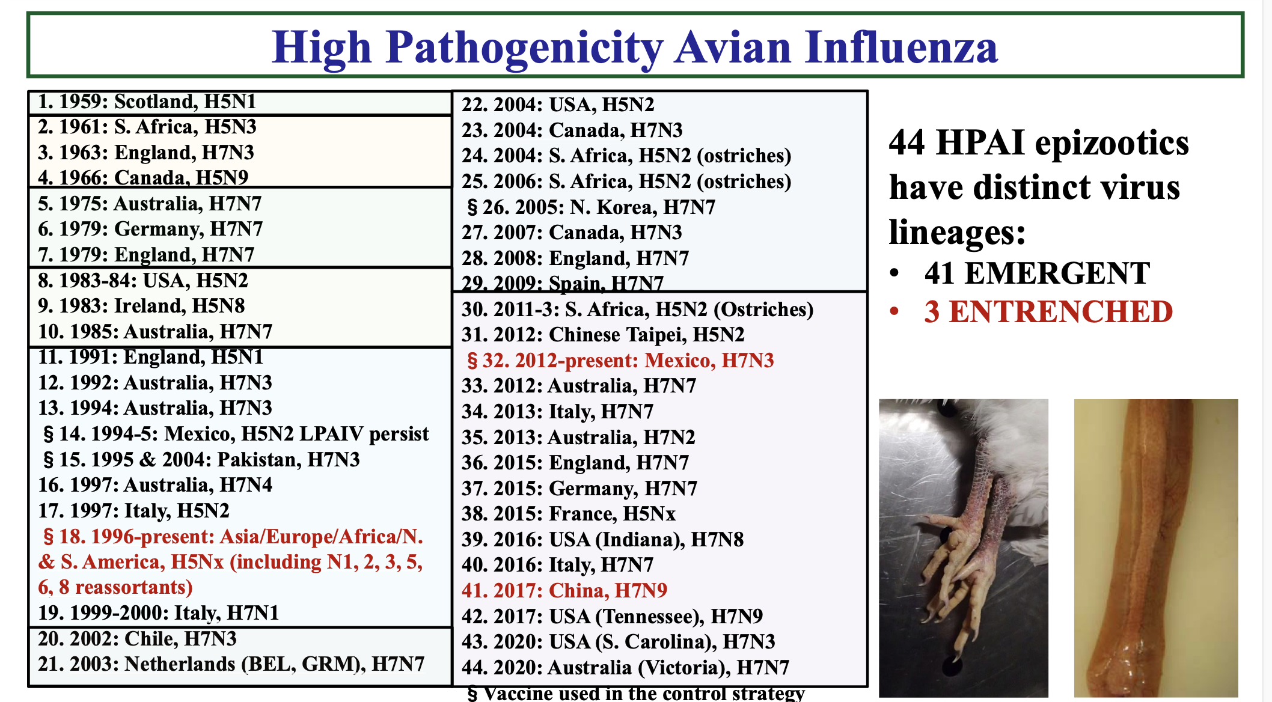

Slide 10
Highly Pathogenic Avian Influenza (HPAI)
Typically Influenza A (H5 or H7)
Most H5 or H7 are low pathogenic
HPAI lead to mortality in chickens ~90-100%
Variably pathogenic to wild water fowl
Spread from wild birds to domestic
Rare human transmission – especially H5N1 and H7N9

Slide 11
Human H5N1
2003 – 2024 > 889 human infections primarily in Asia
52% mortality (of those diagnosed)
Highest mortality rate in 10-19 year age range
Most linked to contact with infected poultry
Rare reports of human – human transmission

Slide 12
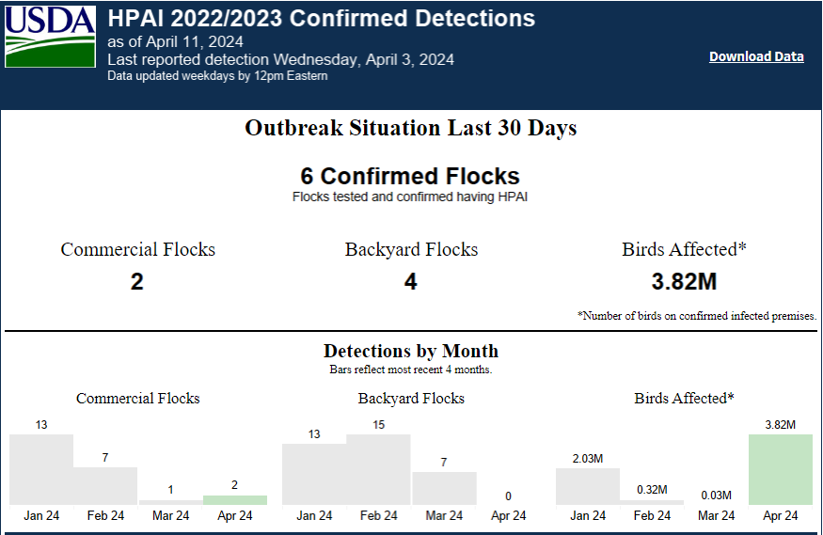

Slide 13
Current H5N1 in the U.S.
March 29, 2024 – H5N1 in dairy herds in Texas (7), Kansas (2) and Michigan
Now seen in Ohio, Idaho and New Mexico
None in MS yet
Suspected infection via migratory birds
Same clade infecting wild birds and domestic chickens

Slide 14
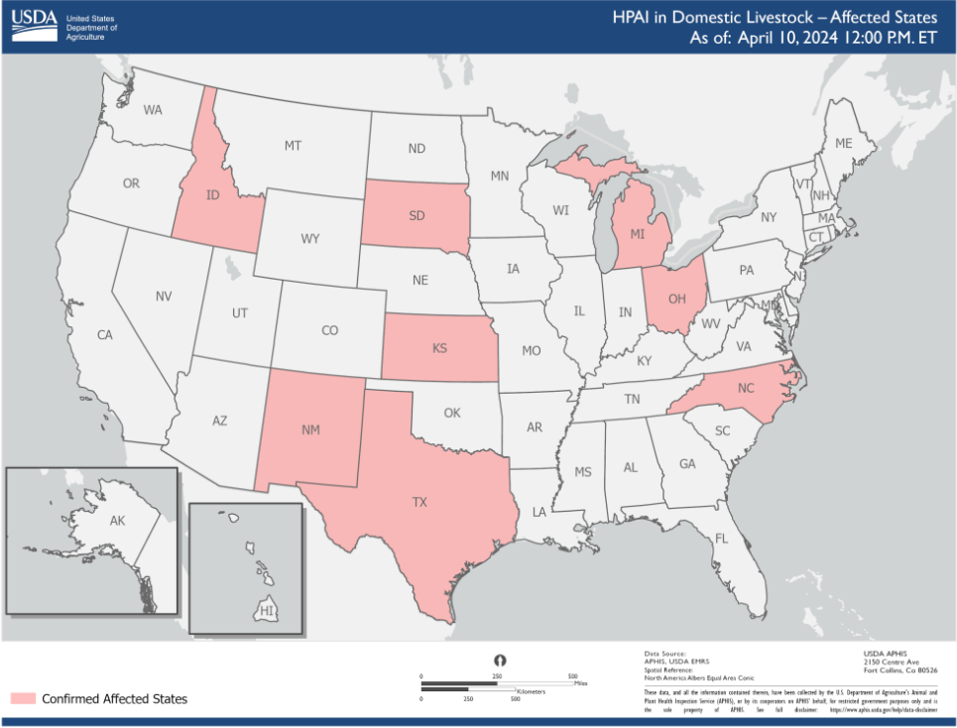

Slide 15
Current H5N1 in the U.S.
4/1/2024 - Texas reports human case of H5N1
Adult working at a dairy farm, exposed to infected cows
Conjunctivitis
Isolated and started on oseltamivir
Genetic shift identified that facilitates human infection but not transmission
Sequence suggests current H5N1 vaccines would be effective

Slide 16
Key Points
No immediate concern of human-human transmission
Farm workers at some risk
Shift to new human strain a possibility
Current anti-viral flu medicines should be effective
Vaccine stockpile for H5N1 exists, unclear efficacy for new strains

