Slide 1
Heart Health 101
Donald Clark III (Trey), MD MPH
Cardiologist, University Heart

Slide 2
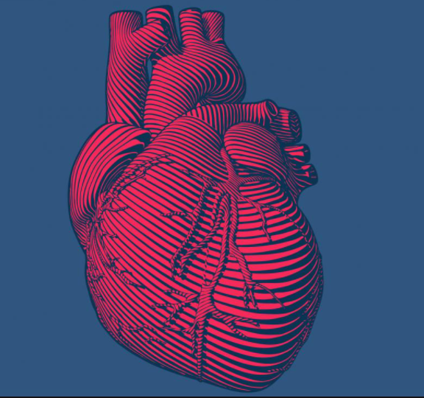
Outline
Impact of cardiovascular disease
Ways to improve heart health
Importance of prevention
Questions & discussion

Slide 3
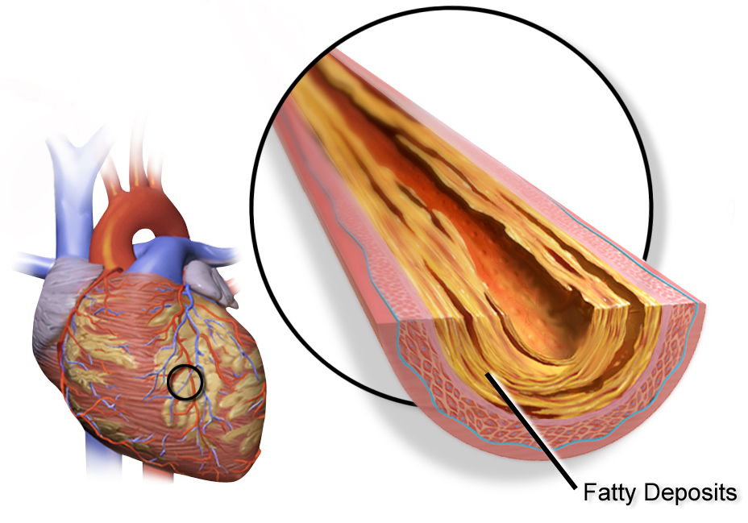
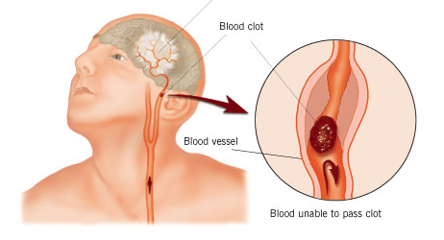
Cardiovascular Disease
Coronary artery disease
Stroke
Congestive heart failure
Peripheral vascular disease

Slide 4
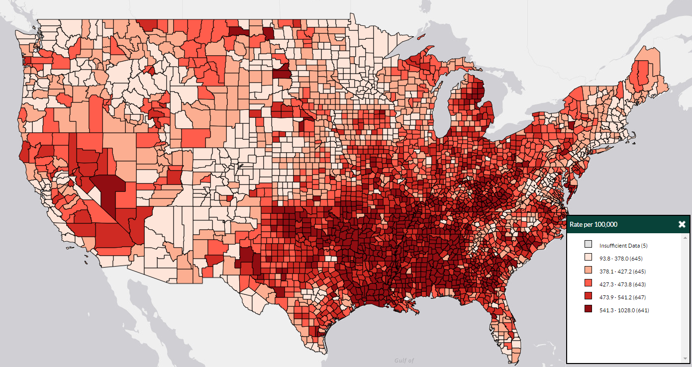
Impact
# 1 Cause of Death
1 death every 36 seconds
655,000 deaths yearly in US
1 in 4 deaths
Geographic and racial disparities
Takeaway: VERY common

Slide 5
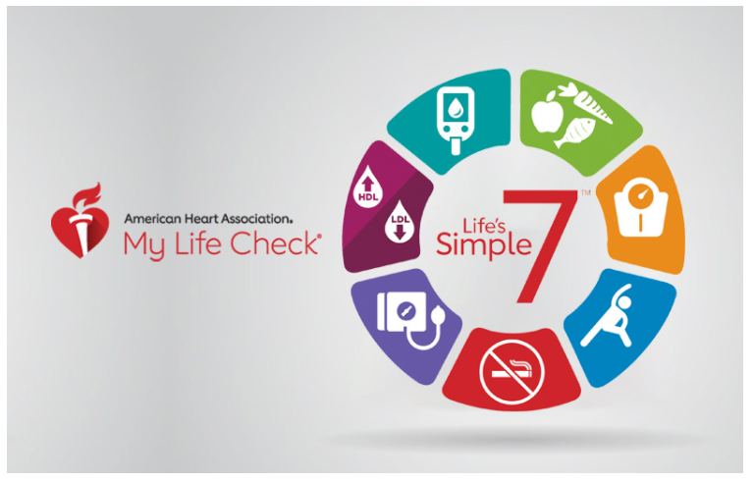
Heart Health – Life’s Simple 7

Slide 6
Life’s Simple 7

Slide 7
Manage Blood Pressure

Slide 8
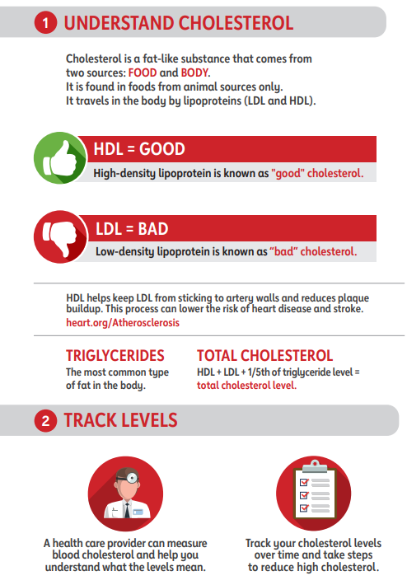
Control Cholesterol

Slide 9
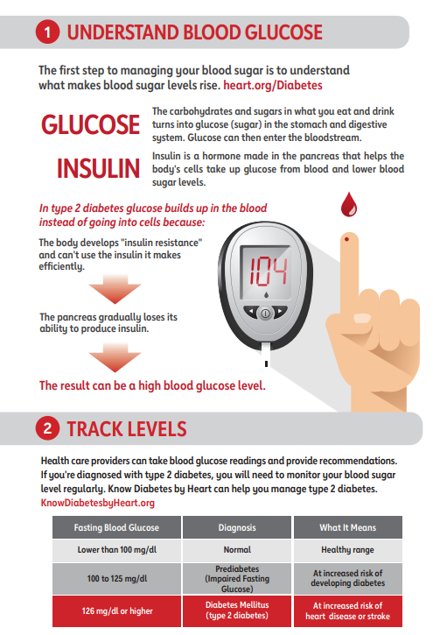
Reduce Blood Sugar

Slide 10
Life’s Simple 7

Slide 11
Get Active

Slide 12
Lose Weight

Slide 13
Eat Better

Slide 14
Stop Smoking

Slide 15
Simple 7 Summary
CV disease is highly prevalent, know your risk
Know your numbers (BP, cholesterol, blood sugar)
Simple ≠ Easy
Not “All or None” – any improvement is beneficial
Sustainability is key

Slide 16
Healthy Habits Work
50% ↓risk of heart attack
Weight control
Physical activity
Healthy diet
No smoking
DNA is not your destiny!
You are in control
Khera, et al. N Engl J Med 2016

Slide 17
What’s Your Motivation?
Live longer
5, 10, 20+ years
More time with family, friends
More time to make a positive impact
More time to enjoy retirement
Live better
Avoid disability (stroke, congestive heart failure)
Maintain independence (no medical visits, need for caregivers)
Avoid financial pitfalls ($$ hospitalizations, medications)
Feel more energetic (short and long term)

Slide 18
Donald Clark III (Trey), MD MPH
University Heart
(601) 984-5678

