Slide 1
COVID-19 Update 2/15/2024
Thomas Dobbs, MD, MPH

Slide 2
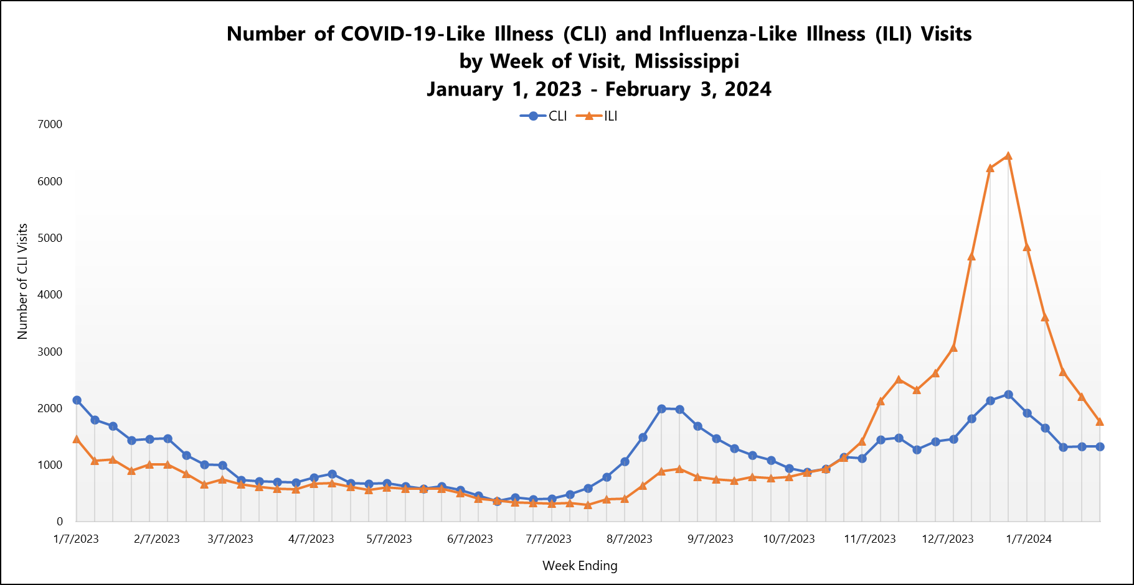

Slide 3
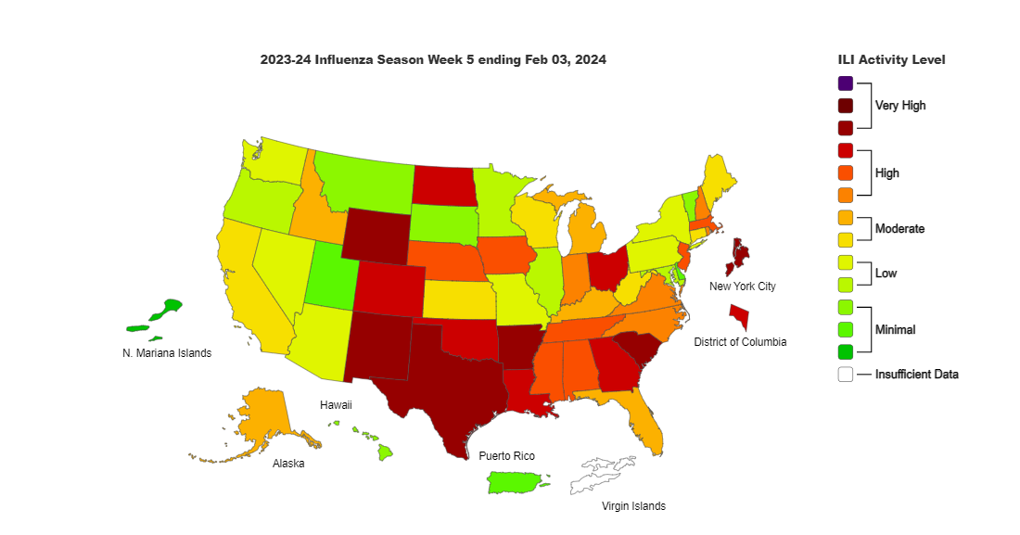

Slide 4
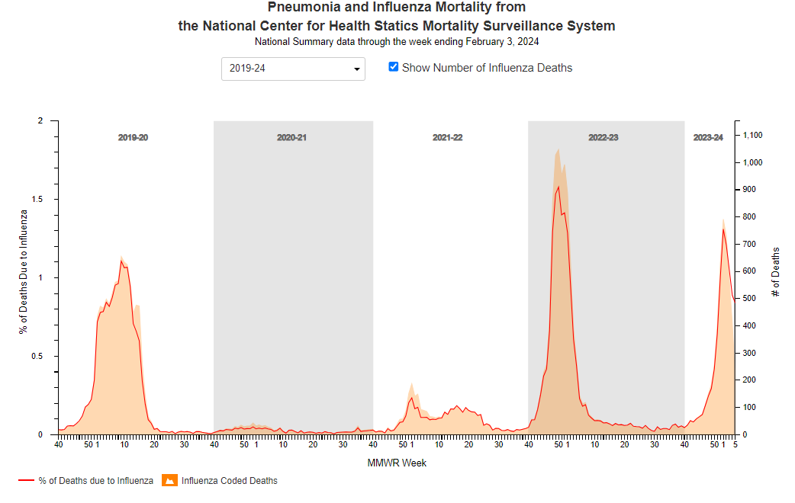

Slide 5
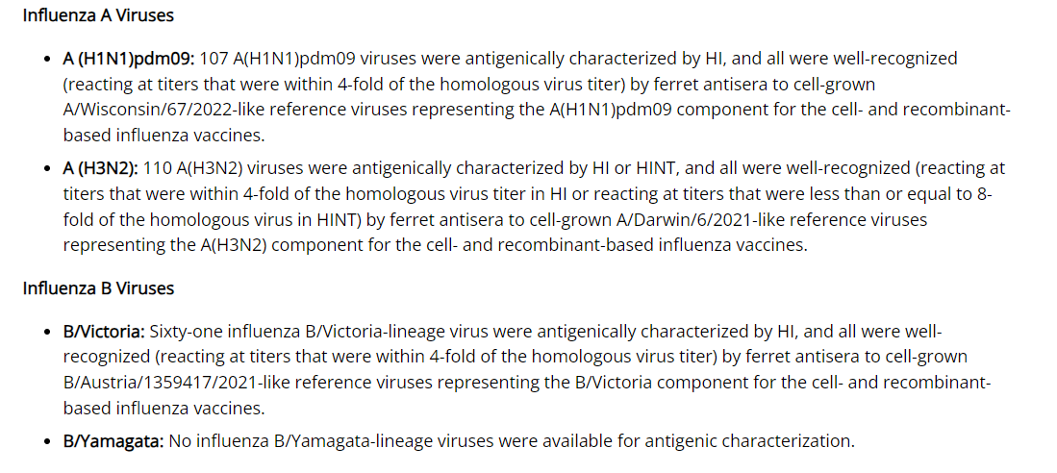

Slide 6
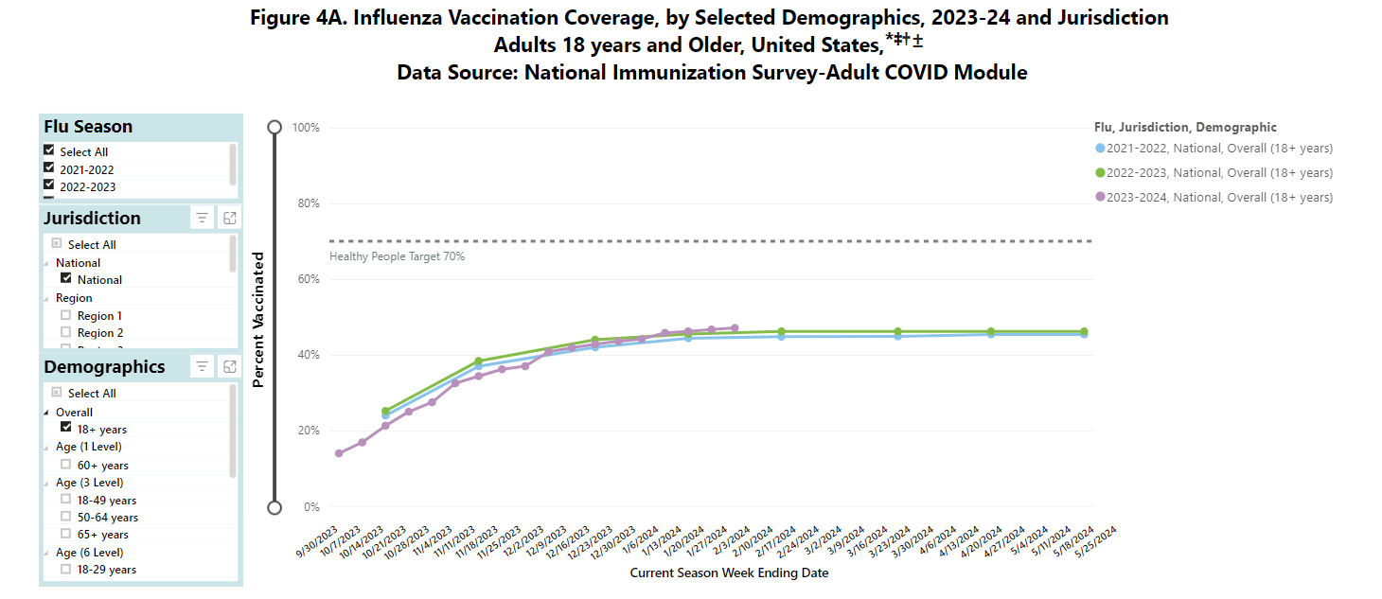

Slide 7
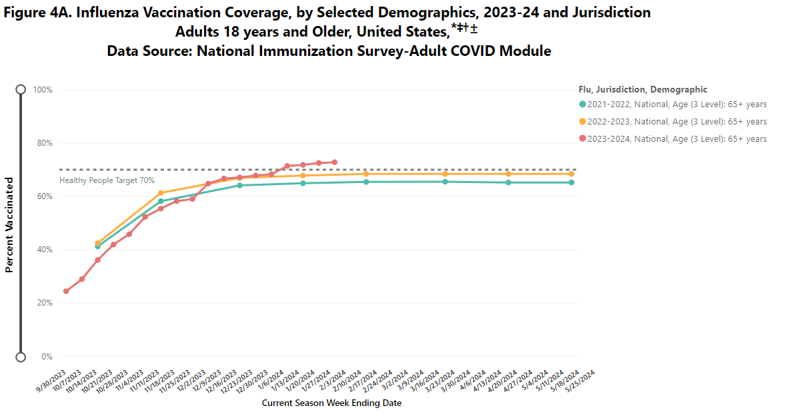

Slide 8
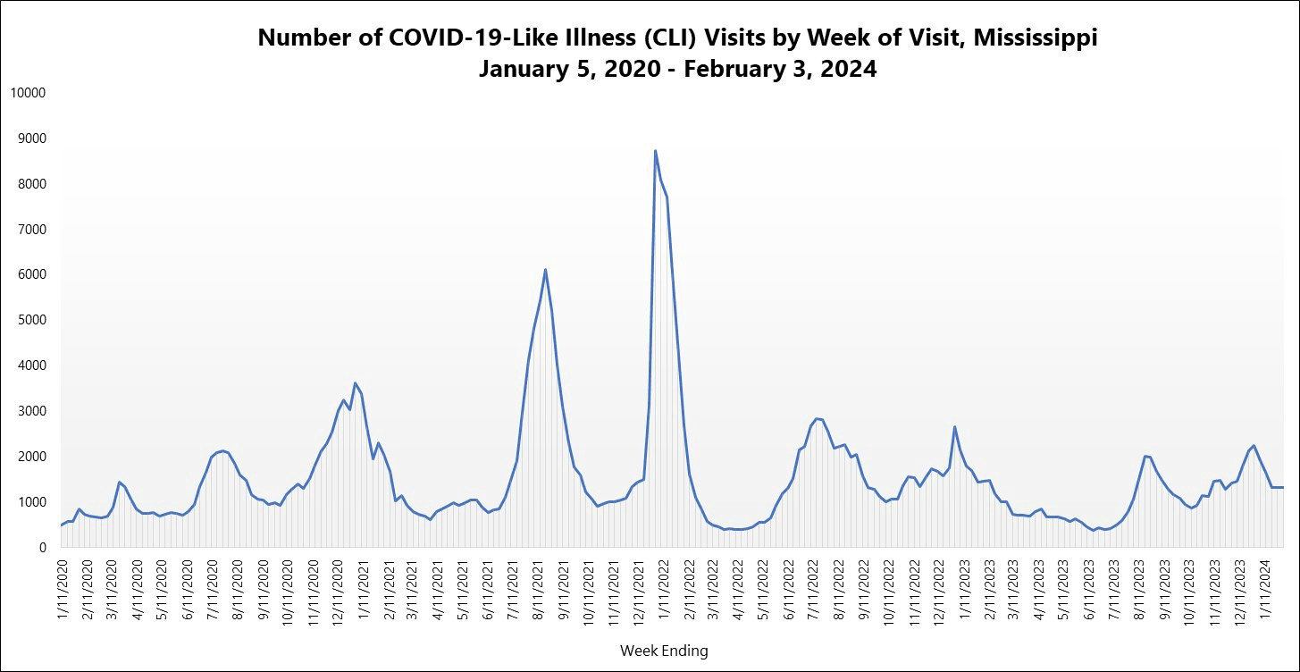

Slide 9
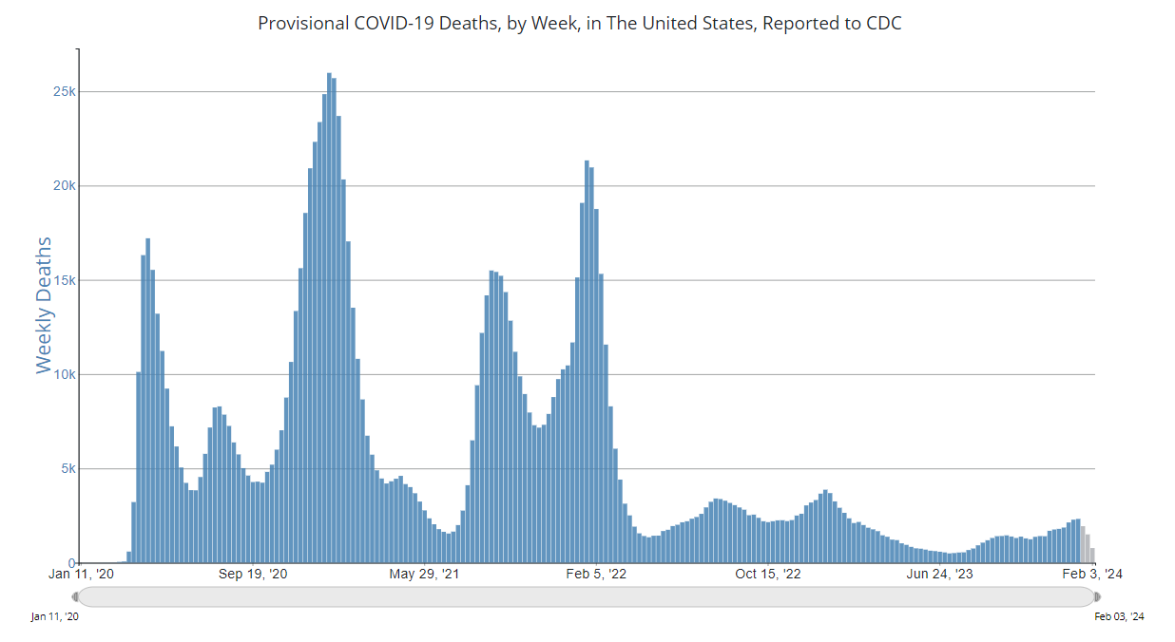

Slide 10
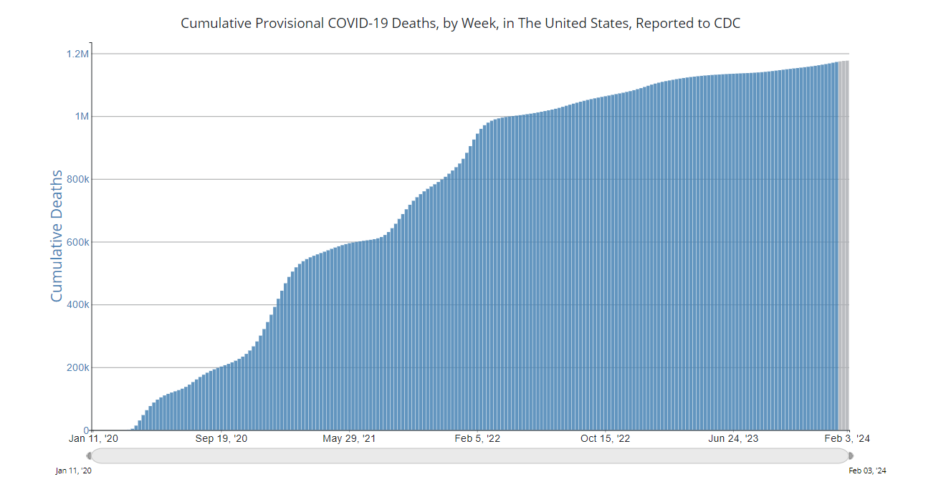

Slide 11
Key Messages
COVID is still here
Vaccination Everyone > 4 years of age recommended
> 11 years old
  1 updated vaccine (Pfizer, Moderna)
  1 updated Novavax (2 if never vaccinated before)
Updated vaccines available since Sept 12, 2023. So if you haven’t gotten the vaccine since Sept… you are due

Slide 12
If you get COVID???
People > 50, unvaccinated, or with chronic medical conditions are at higher risk from COVID
Physicians or providers can prescribe anti-COVID antiviral medications
  Paxlovid
  Remdesivir (infusion)
  Molnupiravir
Must take early - < 5 days after symptoms and the sooner the better!

