Slide 1
Textual Misconduct
“How to NOT Get in Trouble with Your Electronics”
Inv. Ashley Hannah
Cyber Crime Division
January 18,2024

Slide 2

Chief legal officer and advisor for the State of Mississippi on both civil and criminal matters.
Attorney General Lynn Fitch's responsibility is to represent public officials and governmental agencies and to issue legal opinions that interpret state law. Most importantly, she represents the people of the State of Mississippi.
Bachelor of Business Administration and a Juris Doctorate at the University of Mississippi.
She has over 30 years of both private and government law experience.

Slide 3

How can you get in trouble with your electronics?
Sexting
Cyberbullying
Meeting Strangers

Slide 4
Inappropriate Content
It’s important to avoid inappropriate content online.
You also need to refrain from posting it yourself!
You should be cautious about posting images and comments that are inappropriate such as:
  Drinking and drug use
  Hate speech
  Lewd or offensive gestures
  Profanity
  Revealing or suggestive images
  Threats

Slide 5
Inappropriate Content
Posting these things may:
  Ruin your reputation
  Get you in trouble with your parents, school, or the law
  Damage future opportunities
  Before posting ask yourself these questions:
    Who might I hurt?
    Do I like what this says about me?
    Could this get me into trouble?
    Would the adults in my life think this is inappropriate?
    How could this impact my future?

Slide 6
Online Privacy
Online information can:
  Spread quickly and to a lot of people
  Reach people that you don’t want it to
  Be permanent
  The Internet doesn’t keep things private just because you want it to. You should be careful about what you post when using apps that promise anonymity. Privacy is not guaranteed online.

Slide 7
Online Privacy
Be careful about sharing your personal information like:
  Passwords
  Home address
  Location
  Email address
  Phone numbers
  We aren’t saying that you should never share this information. There are lots of legitimate sites that require it. But once you put information online, it’s easy to lose control of who sees it and what they do with it. Revealing personal information online can make you a target for identity theft, scams, computer hacks, and other trouble.

Slide 8

What You Should Do
Have a different password for each account
Use privacy settings
Remember who you “friend”
Limit access to your location
Look for the lock symbol or “https”
Don’t share anyone else’s personal information
Don’t share passwords

Slide 9
Sexting
What is it?
  The sharing of nude or suggestive pictures and videos through text messages.
  Who’s involved?
  The Sender
  The Receiver
  The Traders and Collectors

Slide 10
Sexting
Is it against the law?
Sec. 97-5-31 Exploitation of Children- Making, receiving, or sending Child Pornography
5-40 years in prison
Could you be charged with this???

Slide 11
Some Laws
Sending, Receiving, or Making Child Pornography is a felony
Asking for nude images of children is a felony
Sending any porn to a child, either adult porn or child porn, is against the law

Slide 12
What could go wrong?
What if the pictures you sent gets sent to others?
What if that picture fell into the hands of someone who doesn’t like you?
What if the picture was found later when you were trying to get into college?
What if your parents saw the picture??

Slide 13
What could go wrong?
When the pictures are out there, can you erase them or get them back?
Could they end up on the internet being seen by thousands of people??

Slide 14
What could go wrong?
What if the person you think you’re talking to is not who they say?
Could someone lie about who they are?
Sometimes you think you’re talking to a cute guy/girl who is your age
And you’re really talking to….

Slide 15




Slide 16
What You Should Do
Don’t take images of yourself that you wouldn’t want everyone to see
Don’t forward anyone else’s image
Don’t ask or pressure anyone to share an image
Talk to an adult
Consider reporting the image to CyberTipline.org

Slide 17
What You Should Do
If a sexting image or video has been posted to a website or app, there are steps you can take to try to get it taken down.
File a complaint with the website or app.
Include your age.
Tell them it was posted without your consent.
If you are unable to report to the website, consider calling the police or filing a report at CyberTipline.org

Slide 18

Unwanted Sexual Requests
You have the right to say NO to inappropriate requests

Slide 19
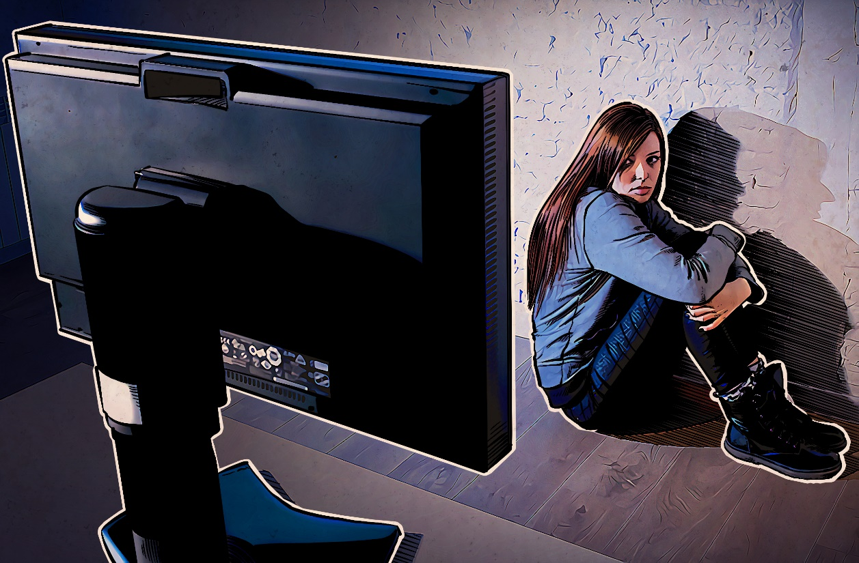
It’s not your fault
Some people are so good at manipulating teens that sometimes the teens don’t even realize they’ve been tricked.

Slide 20
How Not to Get in Trouble
Don’t give out nude images!
Don’t resend pictures of others!
Don’t ask for nude images from anyone!
Don’t share your passwords (Snapchat streaks)
If you have anything on your phone that you shouldn’t- ERASE IT!

Slide 21

What You Can Do
https://takeitdown.ncmec.org

Slide 22

Be careful about what you share
Don’t cyberbully or encourage it
Don’t request/send inappropriate content
Report inappropriate behavior

Slide 23
QUESTIONS

Slide 24

CONNECT WITH US ON SOCIAL MEDIA
Facebook - facebook.com/LynnFitchAG/
Twitter - twitter.com/LynnFitchAG
Instagram - instagram.com/LynnFitchAG
Website - https://www.ago.state.ms.us/

Slide 25
TEXTUAL MISCONDUCT
“How to Not Get in Trouble with Your Electronics”
Ashley Hannah, Cyber Crime Division
Mississippi ICAC Deputy Commander
ashley.hannah@ago.ms.gov
601-576-4266

