Slide 1
COVID-19 Update 1/18/2024
Thomas Dobbs, MD, MPH

Slide 2
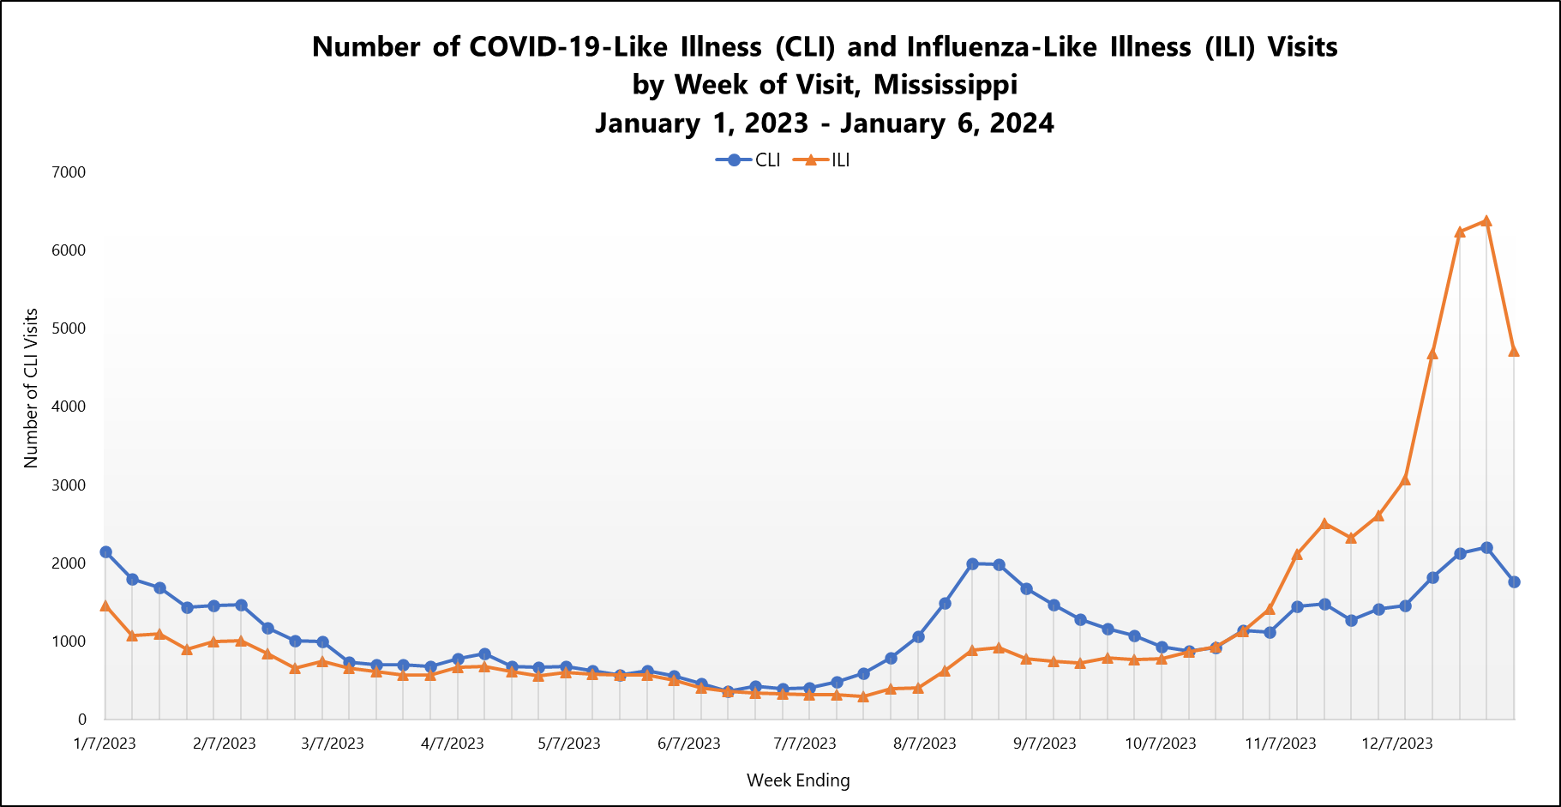

Slide 3
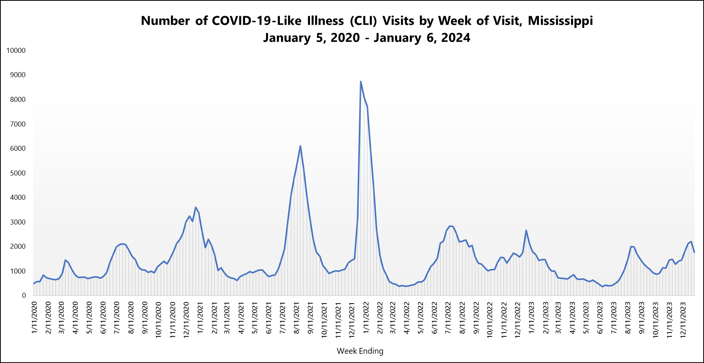

Slide 4
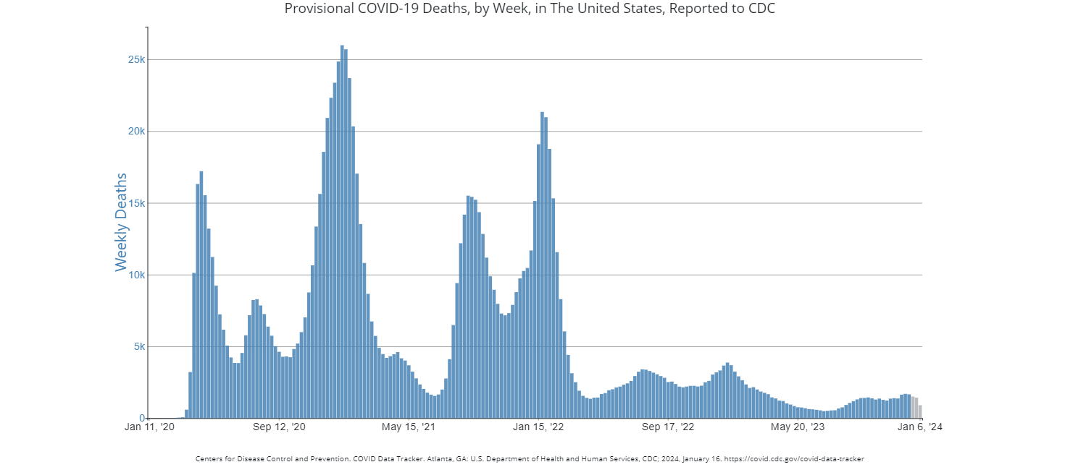

Slide 5
COVID Deaths - MS

Slide 6
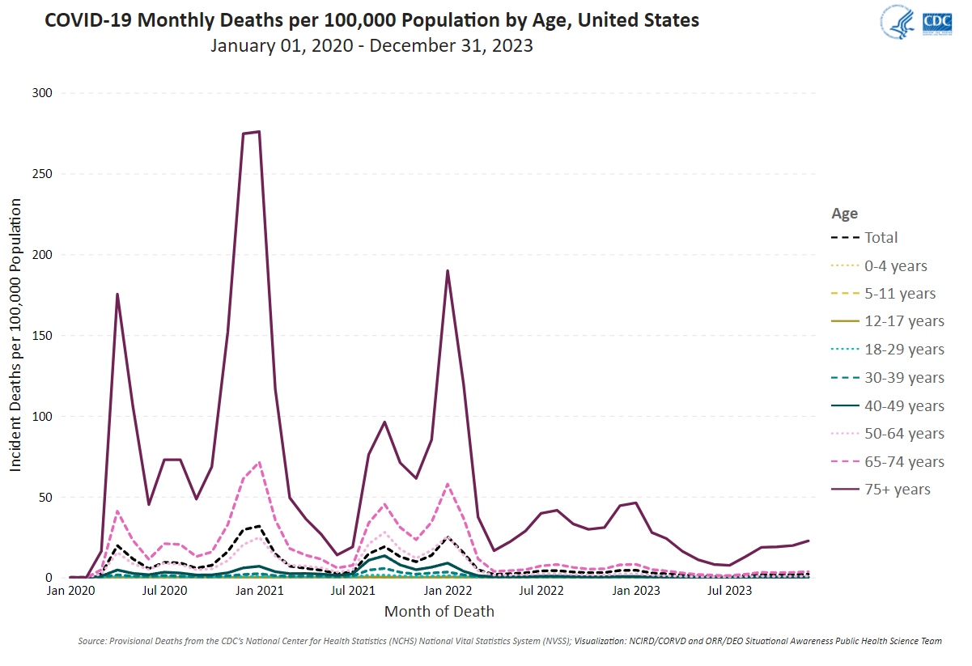

Slide 7
Key Messages
COVID is still here
Vaccination Everyone > 4 years of age recommended
> 11 years old
1 updated vaccine (Pfizer, Moderna)
1 updated Novavax (2 if never vaccinated before)
Updated vaccines available since Sept 12, 2023. So if you haven’t gotten the vaccine since Sept… you are due

Slide 8
What is Novavax
Novavax COVID-19 vaccine is a protein subunit vaccine.
Protein subunit vaccines contain pieces (spike proteins) of the virus that causes COVID-19.
This is a similar approach to the current annual flu vaccines
After learning how to respond to the spike protein, the immune system will be able to respond quickly to the actual virus spike protein and protect you against COVID-19.

Slide 9
If you get COVID???
People > 50, unvaccinated, or with chronic medical conditions are at higher risk from COVID
Physicians or providers can prescribe anti-COVID antiviral medications
Paxlovid
Remdesivir (infusion)
Molnupiravir
Must take early - < 5 days after symptoms and the sooner the better!

