Slide 1

Diabetes 2023
Juliette Sandifer Kum-Nji MD
Endocrinologist at Capital City Endocrine Clinic

Slide 2
Disclosures
None

Slide 3
Outline
Incidence and Prevalence
Cost of Care to treat diabetes
Screening/Who is at risk?
Diagnosis
Approach to treatment
Roles of community stakeholders

Slide 4
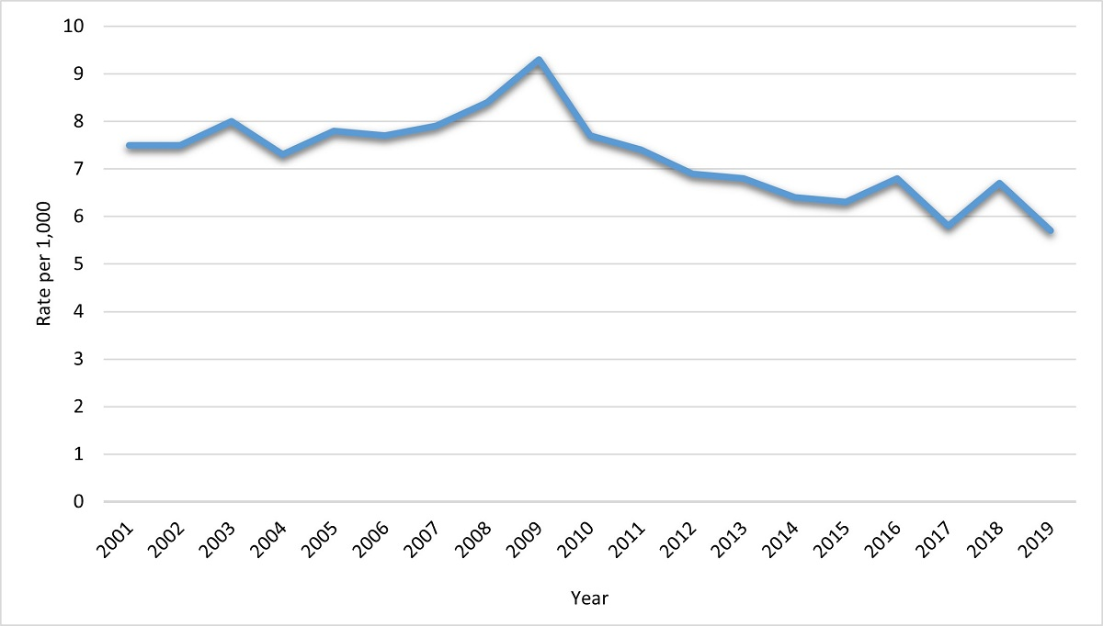
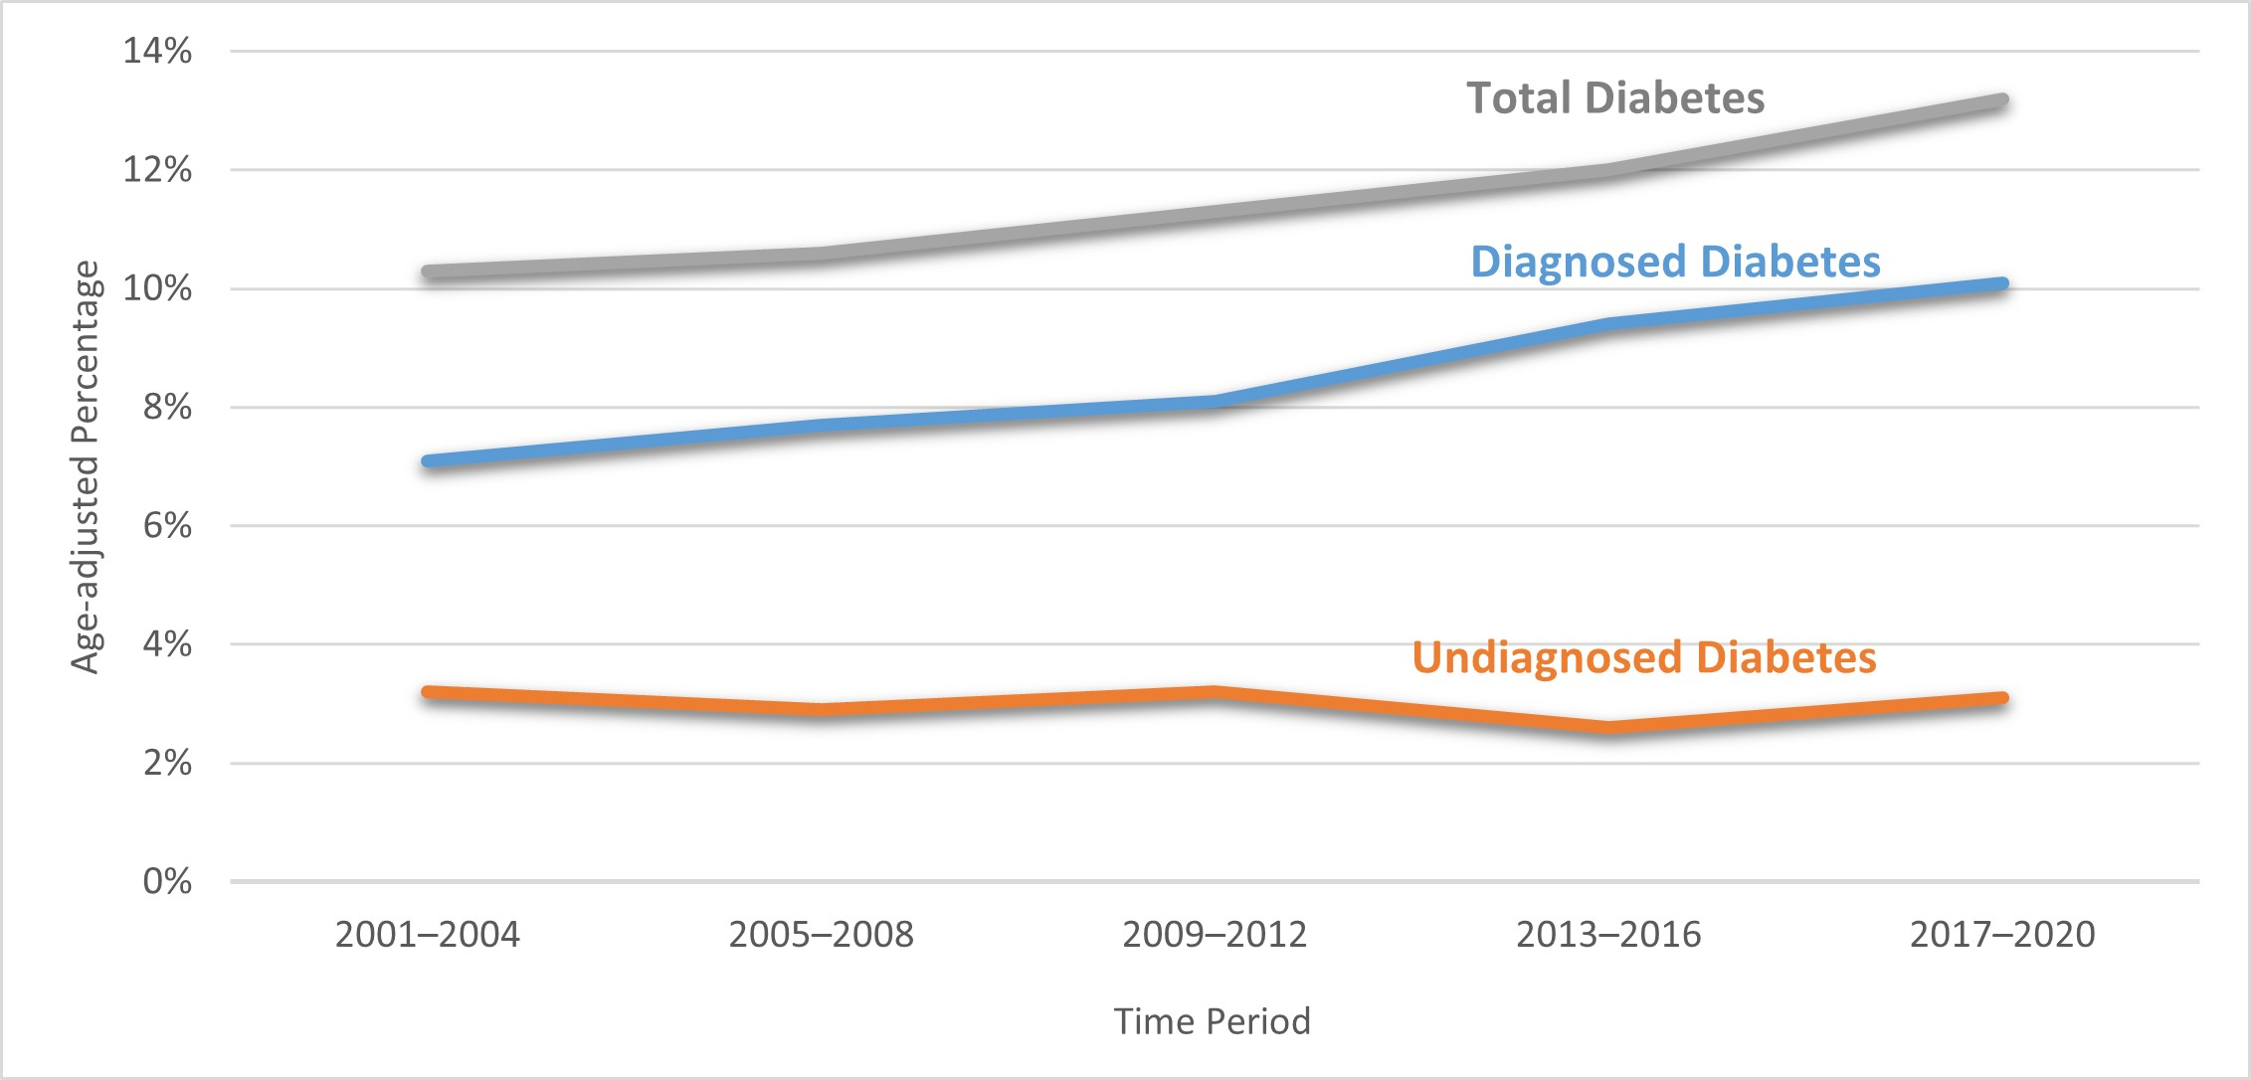
TREnds in Incidence AND PREVELANCE of Diagnosed Diabetes Among Adults Aged 18 Years or Older, United States
Notes: Rates are age-adjusted to the 2000 US Census standard population. Figure adapted from CDC’s National Diabetes Statistics Report.
Data source: National Health Interview Survey, Centers for Disease Control and Prevention.
Notes: Percentages are age-adjusted to the 2000 US Census standard population. Diagnosed diabetes was based on self-report.
Undiagnosed diabetes was based on fasting plasma glucose and A1C levels among people self-reporting no diabetes.
Figure adapted from CDC’s National Diabetes Statistics Report.
Data source: National Health and Nutrition Examination Surveys, Centers for Disease Control and Prevention.

Slide 5
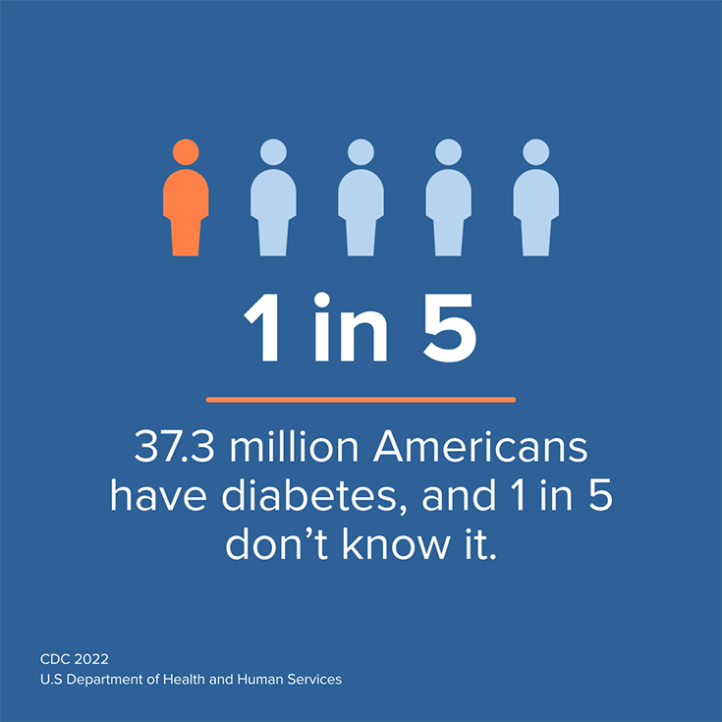
Prevalence of Diabetes
Total Diabetes
From 2001 to 2020, diabetes prevalence significantly increased among US adults 18 or older.
37.3 million people have diabetes—that’s 11.3% of the US population.
28.7 million people have been diagnosed with diabetes.
8.5 million people who have diabetes have not been diagnosed and do not know they have it.

Slide 6
Diabetes by race/ethnicity
The rates of diagnosed diabetes in adults by race/ethnic background are:
14.5% of American Indians/Alaskan Natives
12.1% of non-Hispanic blacks
11.8% of Hispanics
9.5% of Asian Americans
7.4% of non-Hispanic whites
https://diabetes.org/about-diabetes/statistics/about-diabetes

Slide 7
The Burden of Diabetes in Mississippi
Approximately 326,420 people in Mississippi or 14.4% of the adult population have diagnosed diabetes
An additional 75,000 people in Mississippi have diabetes but don’t know it
There are 814,000 people in Mississippi, 35.6% of the adult population, who have prediabetes.
Every year an estimated 20,433 people in Mississippi are diagnosed with diabetes.
People with diabetes have medical expenses approximately 2.3 times higher that those who do not have diabetes.
https://www2.diabetes.org/sites/default/files/2021-10/ADV_2021_State_Fact_sheets_MIssissippi.pdf

Slide 8

The High Cost of diabetes
Diabetes is the most expensive chronic condition in our nation.
$1 out of every $4 in US health care costs is spent on caring for people with diabetes.
$237 billion^{‡(a)} is spent each year on direct medical costs and another $90 billion^{‡(a)} on reduced productivity.⁵
61% of diabetes costs are for adults aged 65 or older, which is mainly paid by Medicare.
  Among Medicare beneficiaries aged 65 or older with type 2 diabetes, the estimated median costs associated with diabetes complications is $5,876 per person each year.
  Majority of complications are related to diabetes, such as heart disease and stroke.⁸
$327 BILLION^{‡(a)}
total annual cost of diabetes⁵
Source: National Center for Chronic Disease Prevention and Health Promotion

Slide 9
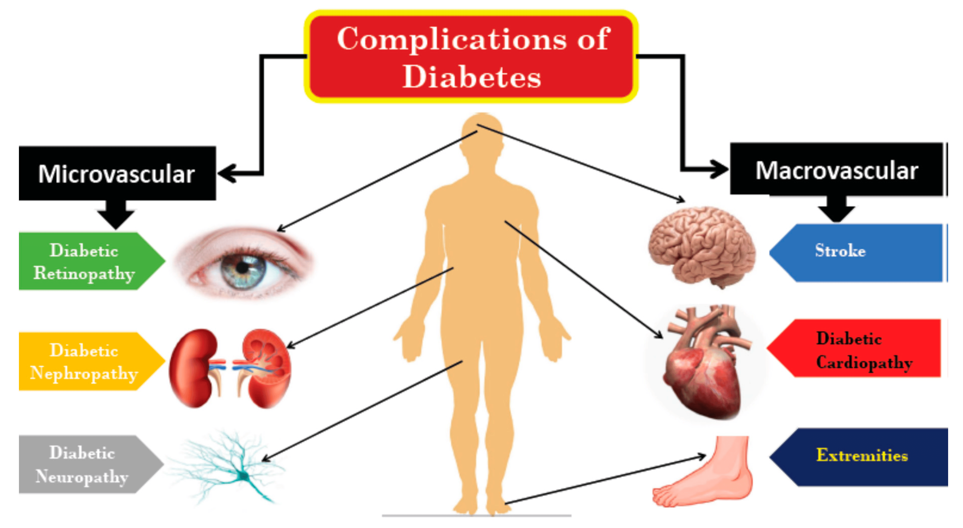

Slide 10
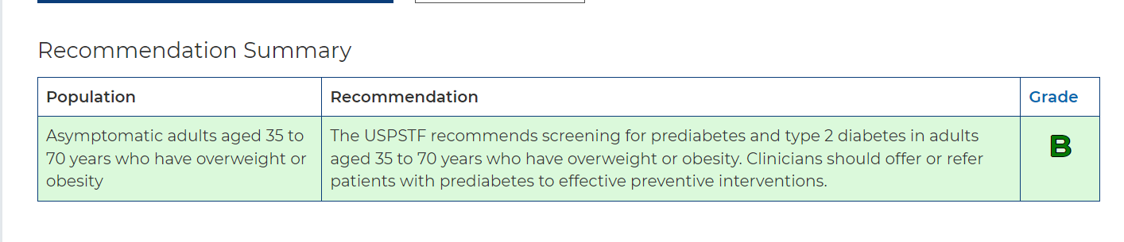
Screening
U.S. Preventive Services Task Force. https://www.uspreventiveservicestaskforce.org/uspstf/recommendation
-topics/uspstf-a-and-b-recommendations

Slide 11
Prediabetes and Type 2 Diabetes
Classification and Diagnosis of Diabetes
2.7 Screening for prediabetes and type 2 diabetes with an informal assessment of risk factors or validated risk calculator should be done in asymptomatic adults. B
2.8 Testing for prediabetes and/or type 2 diabetes in asymptomatic people should be considered in adults of any age with overweight or obesity (BMI ≥25 kg/m2 or ≥23 kg/m2 in Asian American individuals) who have one or more risk factors (Table 2.3). B
2.9 For all people, screening should begin at age 35 years. B
Classification and Diagnosis of Diabetes: Standards of Care in Diabetes - 2023. Diabetes Care 2023

Slide 12
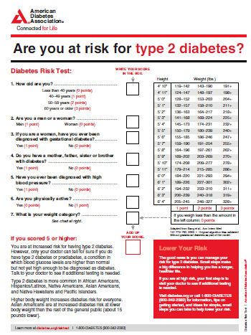
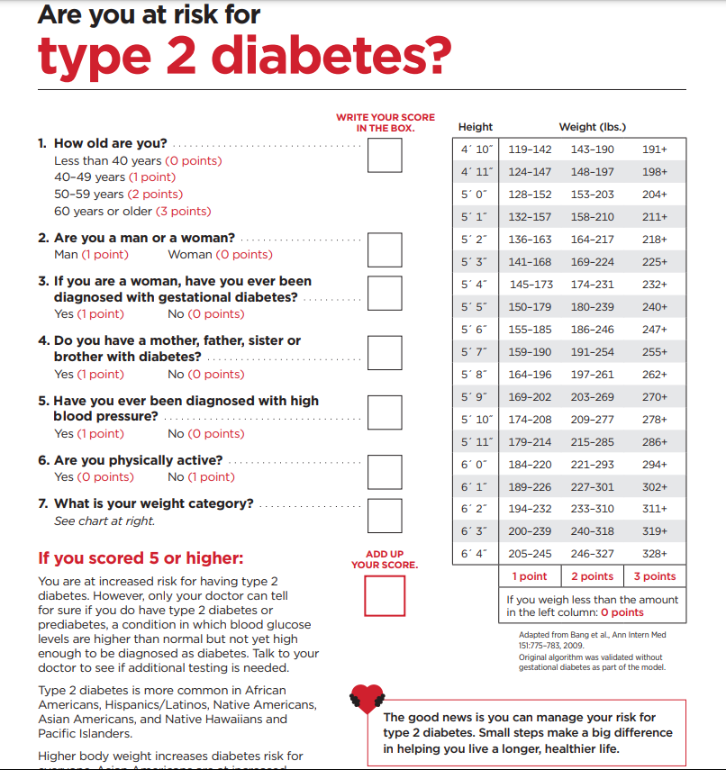
Classification and Diagnosis of Diabetes:
Standards of Care in Diabetes - 2023. Diabetes Care 2023;46(Suppl. 1):S19-S40
diabetes.org/socrisktest

Slide 13
Prediabetes and Type 2 Diabetes
Classification and Diagnosis of Diabetes
2.7 Screening for prediabetes and type 2 diabetes with an informal assessment of risk factors or validated risk calculator should be done in asymptomatic adults. B
2.8 Testing for prediabetes and/or type 2 diabetes in asymptomatic people should be considered in adults of any age with overweight or obesity (BMI ≥25 kg/m2 or ≥23 kg/m2 in Asian American individuals) who have one or more risk factors (Table 2.3). B
2.9 For all people, screening should begin at age 35 years. B
Classification and Diagnosis of Diabetes: Standards of Care in Diabetes - 2023. Diabetes Care 2023

Slide 14
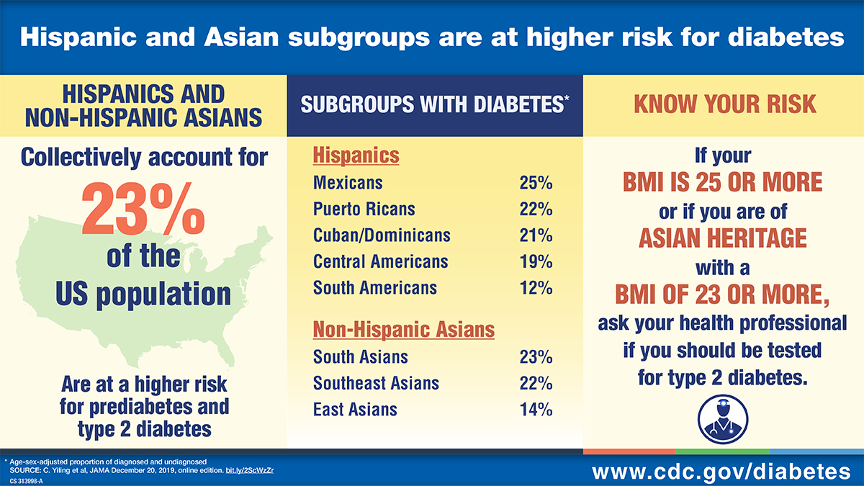

Slide 15
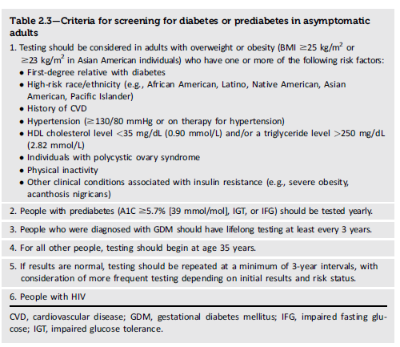
Classification and Diagnosis of Diabetes: Standards of Care in Diabetes - 2023. Diabetes Care 2023

Slide 16
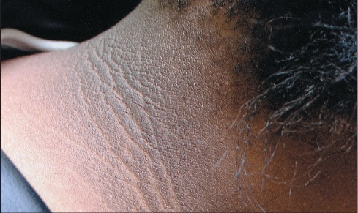


Slide 17
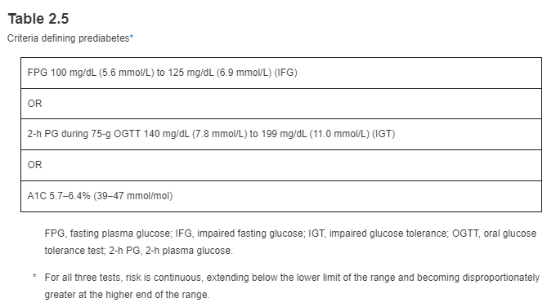

Criteria for the diagnosis of Prediabetes and diabetes
Prediabetes
Diabetes
Classification and Diagnosis of Diabetes: Standards of Care in Diabetes - 2023. Diabetes Care 2023

Slide 18
Classification
Classification and Diagnosis of Diabetes
Diabetes can be classified into the following general categories:
Type 1 diabetes (due to autoimmune ß-cell destruction, usually leading to absolute insulin deficiency, including latent autoimmune diabetes of adulthood)
Type 2 diabetes (due to a non-autoimmune progressive loss of adequate ß-cell insulin secretion frequently on the background of insulin resistance and metabolic syndrome)
Specific types of diabetes due to other causes, e.g., monogenic diabetes syndromes (such as neonatal diabetes and maturity-onset diabetes of the young), diseases of the exocrine pancreas (such as cystic fibrosis and pancreatitis), and drug- or chemical-induced diabetes (such as with glucocorticoid use, in the treatment of HIV/AIDS, or after organ transplantation)
Gestational diabetes mellitus (diabetes diagnosed in the second or third trimester of pregnancy that was not clearly overt diabetes prior to gestation)
Classification and Diagnosis of Diabetes: Standards of Care in Diabetes - 2023. Diabetes Care 2023

Slide 19
A1C and Microvascular Complications
Diabetes Control and Complications Trial (DCCT)
Kumamoto Study and UK Prospective Diabetes Study (UKPDS)
prospective randomized controlled trial
intensive (mean A1C about 7% [53 mmol/mol]) versus standard (mean A1C about 9% [75 mmol/mol]) glycemic control in people with type 1 diabetes
showed definitively that better glycemic control is associated with 50–76% reductions in rates of development and progression of microvascular (retinopathy, neuropathy, and diabetic kidney disease) complications.
confirmed that intensive glycemic control significantly decreased rates of microvascular complications in people with short-duration type 2 diabetes.
Long-term follow-up of the UKPDS cohorts showed enduring effects of early glycemic control on most microvascular complications
DCCT cohorts in the Epidemiology of Diabetes Interventions and Complications (EDIC) study demonstrated persistence of these microvascular benefits over two decades despite the fact that the glycemic separation between the treatment groups diminished and disappeared during follow-up.

Slide 20
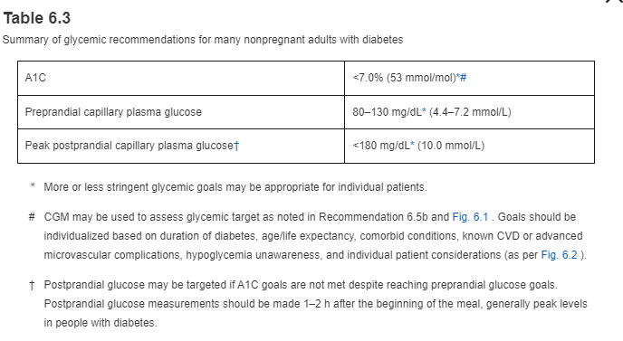

Slide 21

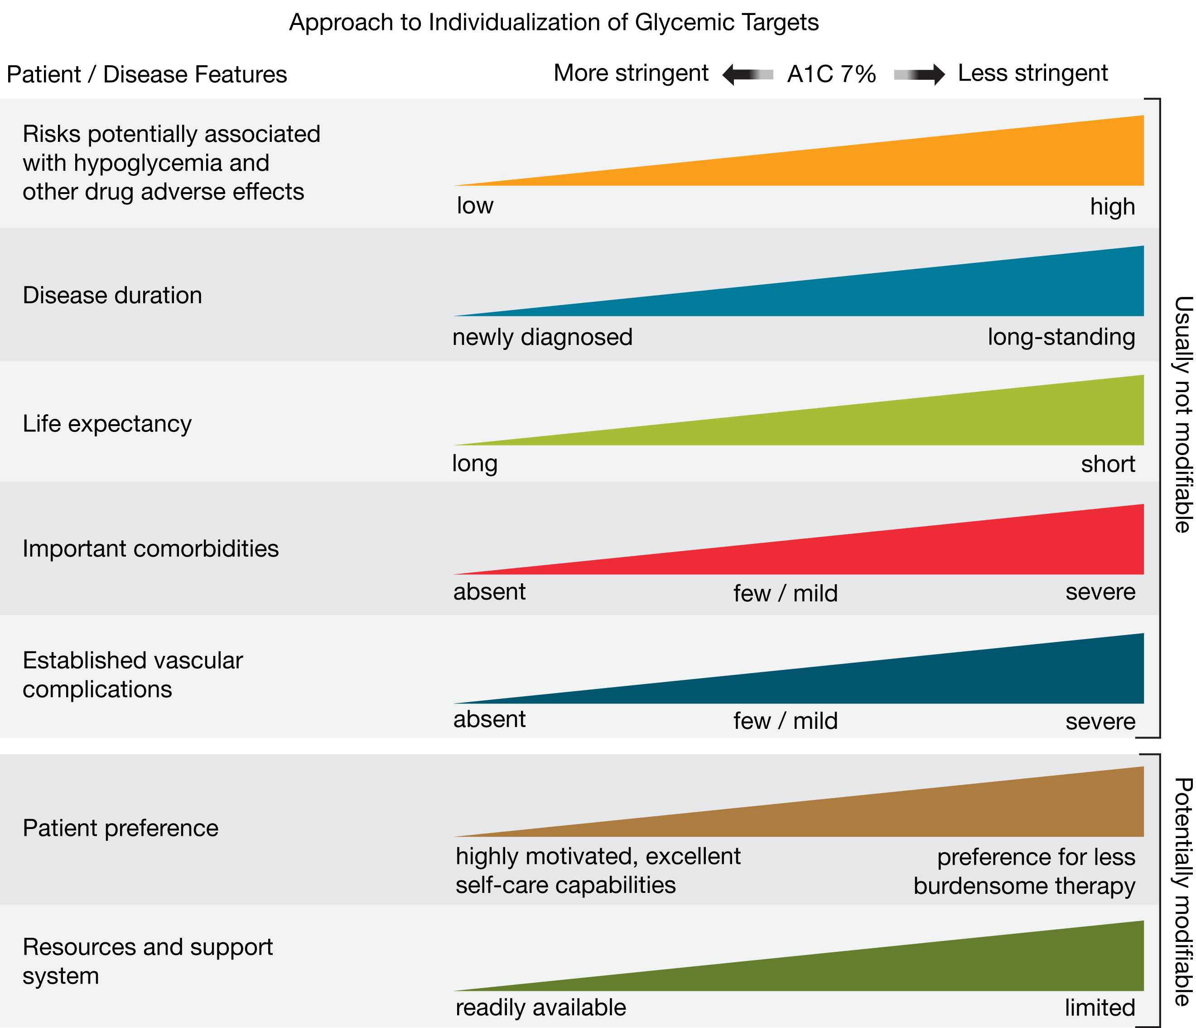
6. Glycemic Targets: Standards of Care in Diabetes—2023
Diabetes Care. 2022;46(Supplement_1):S97-S110. doi:10.2337/dc23-S006
Figure Legend:
Patient and disease factors used to determine optimal glycemic targets. Characteristics and predicaments toward the left justify more stringent efforts to lower A1C; those toward the right suggest less stringent efforts. A1C 7% = 53 mmol/mol. Adapted with permission from Inzucchi et al. (71).
Date of Download: 11/10/2023
Copyright © 2023 American Diabetes Association. All rights reserved.

Slide 22
Community stakeholders should encourage interventions that engage community health workers to help patients manage their diabetes. These interventions have been shown to improve patients’ glycemic and lipid control and reduce their healthcare use. Economic evidence indicates these interventions are cost-effective.
The Diabetes Prevention Program has been shown to be effective in reducing the risk of developing type 2 diabetes among individuals with prediabetes. Research from the original DPP trial demonstrated that lifestyle interventions can lead to a significant decrease in the development of diabetes, sometimes even outperforming medication in certain cases.
  CDC Diabetes Prevention Program or other structured lifestyle intervention program.
https://www.thecommunityguide.org/findings/diabetes-management-interventions-engaging-community-health-workers.html

Slide 23
Summary
Incidence of diabetes is decreasing. Should continue to educate patients and bring about awareness in our communities.
Diabetes is a huge economic burden.
Screen patients when appropriate.
Patient centered diabetes care.
Refer to prevention/education programs which are cost effective, improve health, reduce health disparities, and enhance health equity.

