Slide 1
Brief COVID-19 Update
Paul Byers, MD
Department of Preventive Medicine
UMMC
December 14, 2023

Slide 2
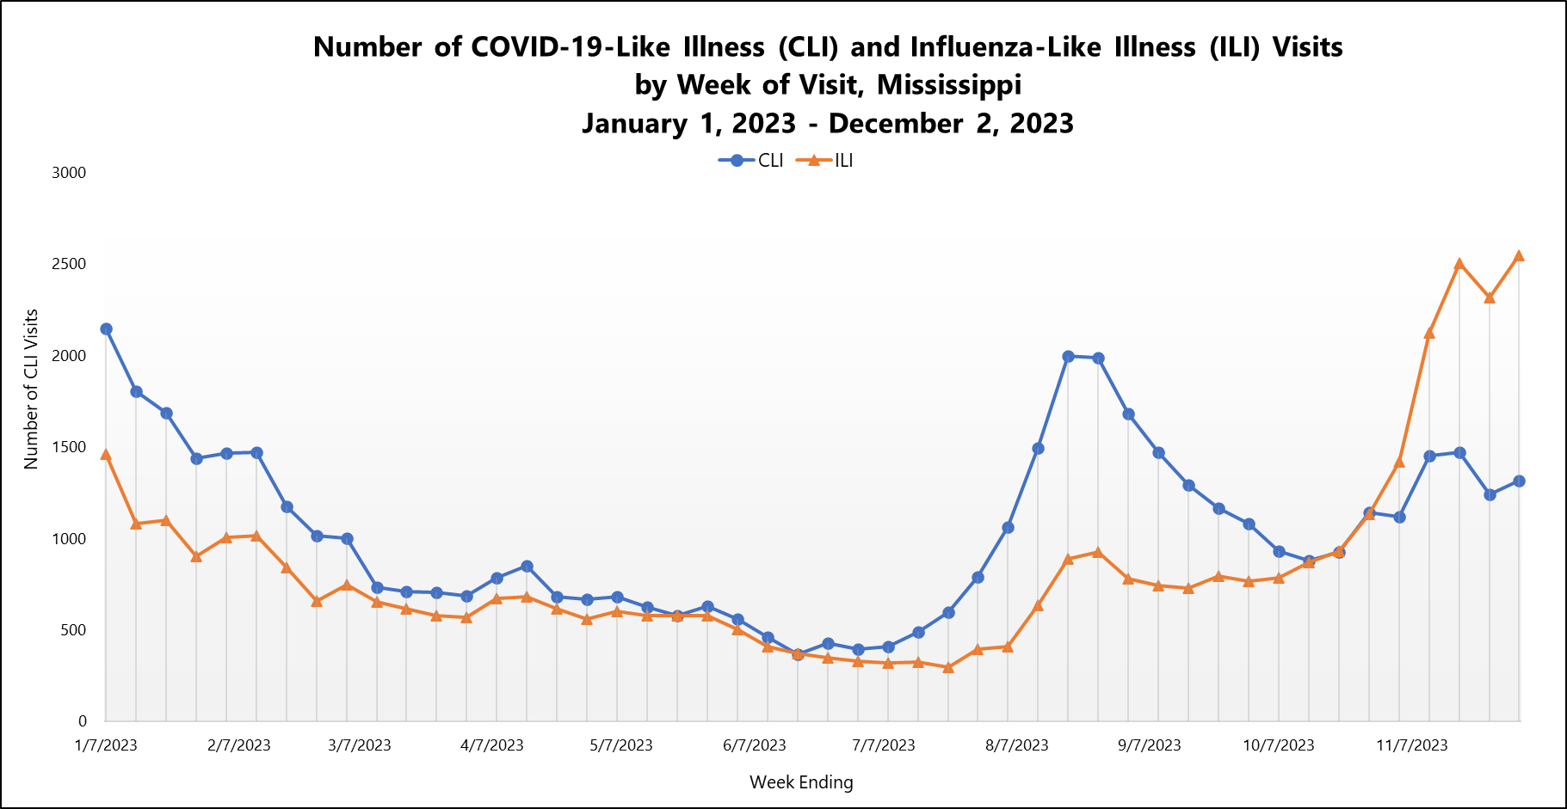
Current Year Data (syndromic surveillance)

Slide 3
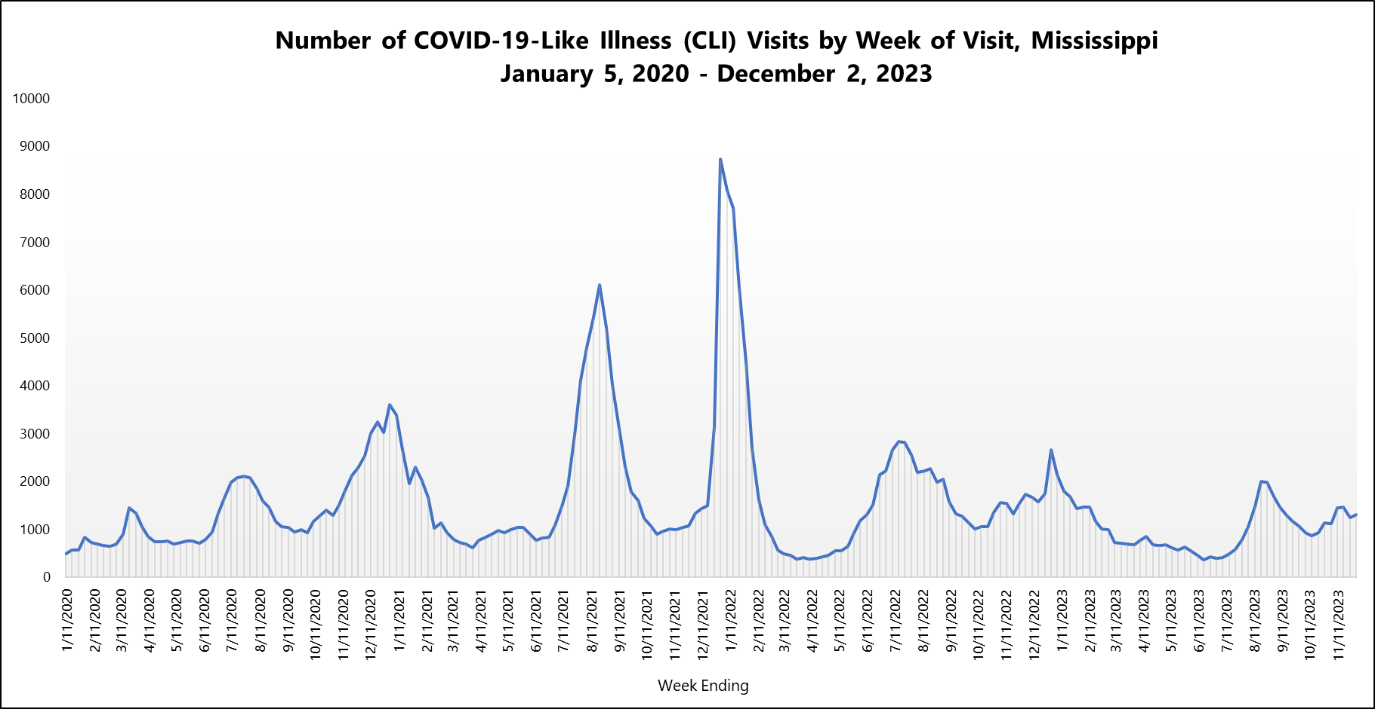
Trend to Date (syndromic surveillance)

Slide 4
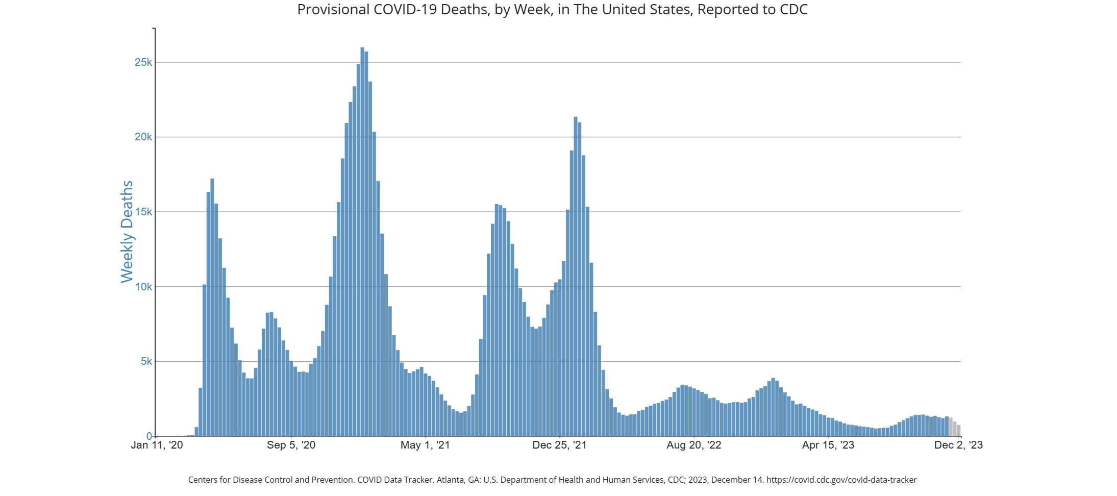

Slide 5
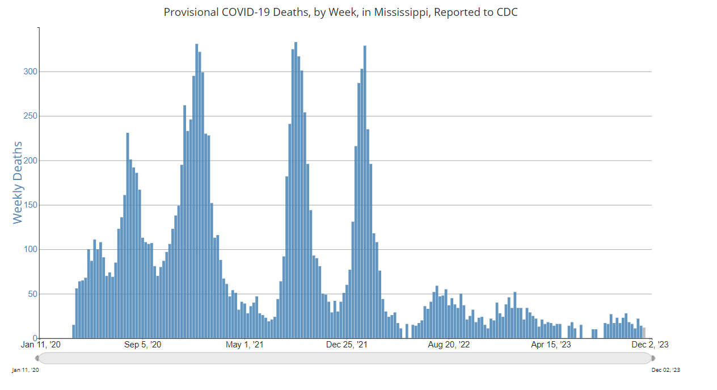

Slide 6
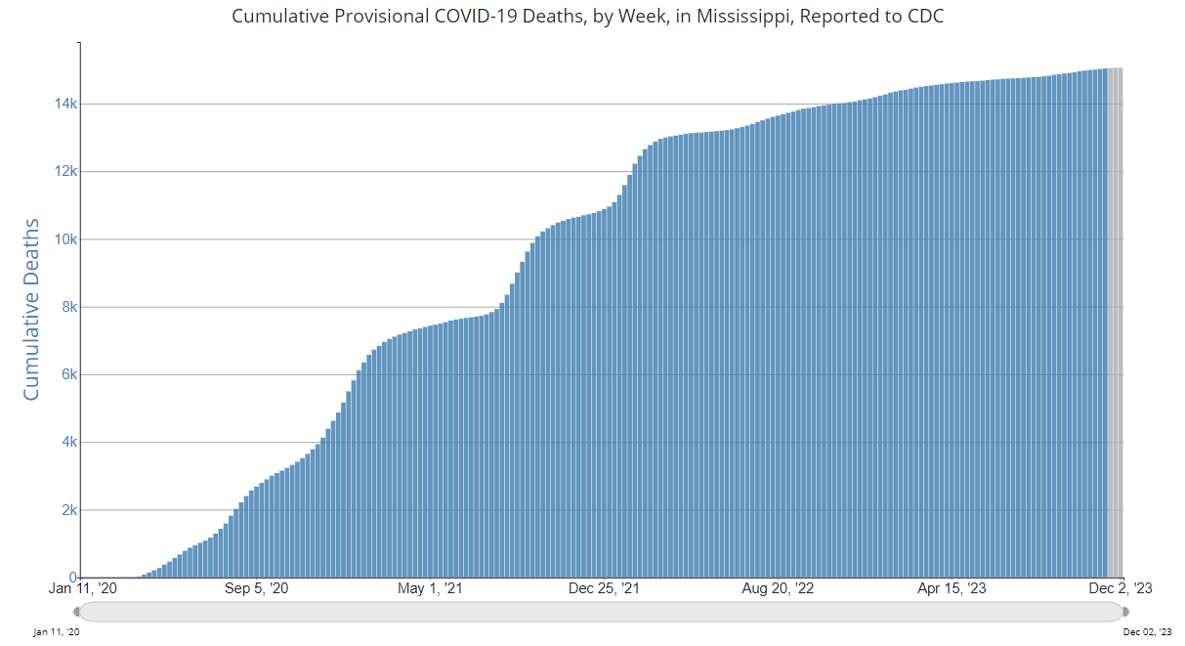

Slide 7
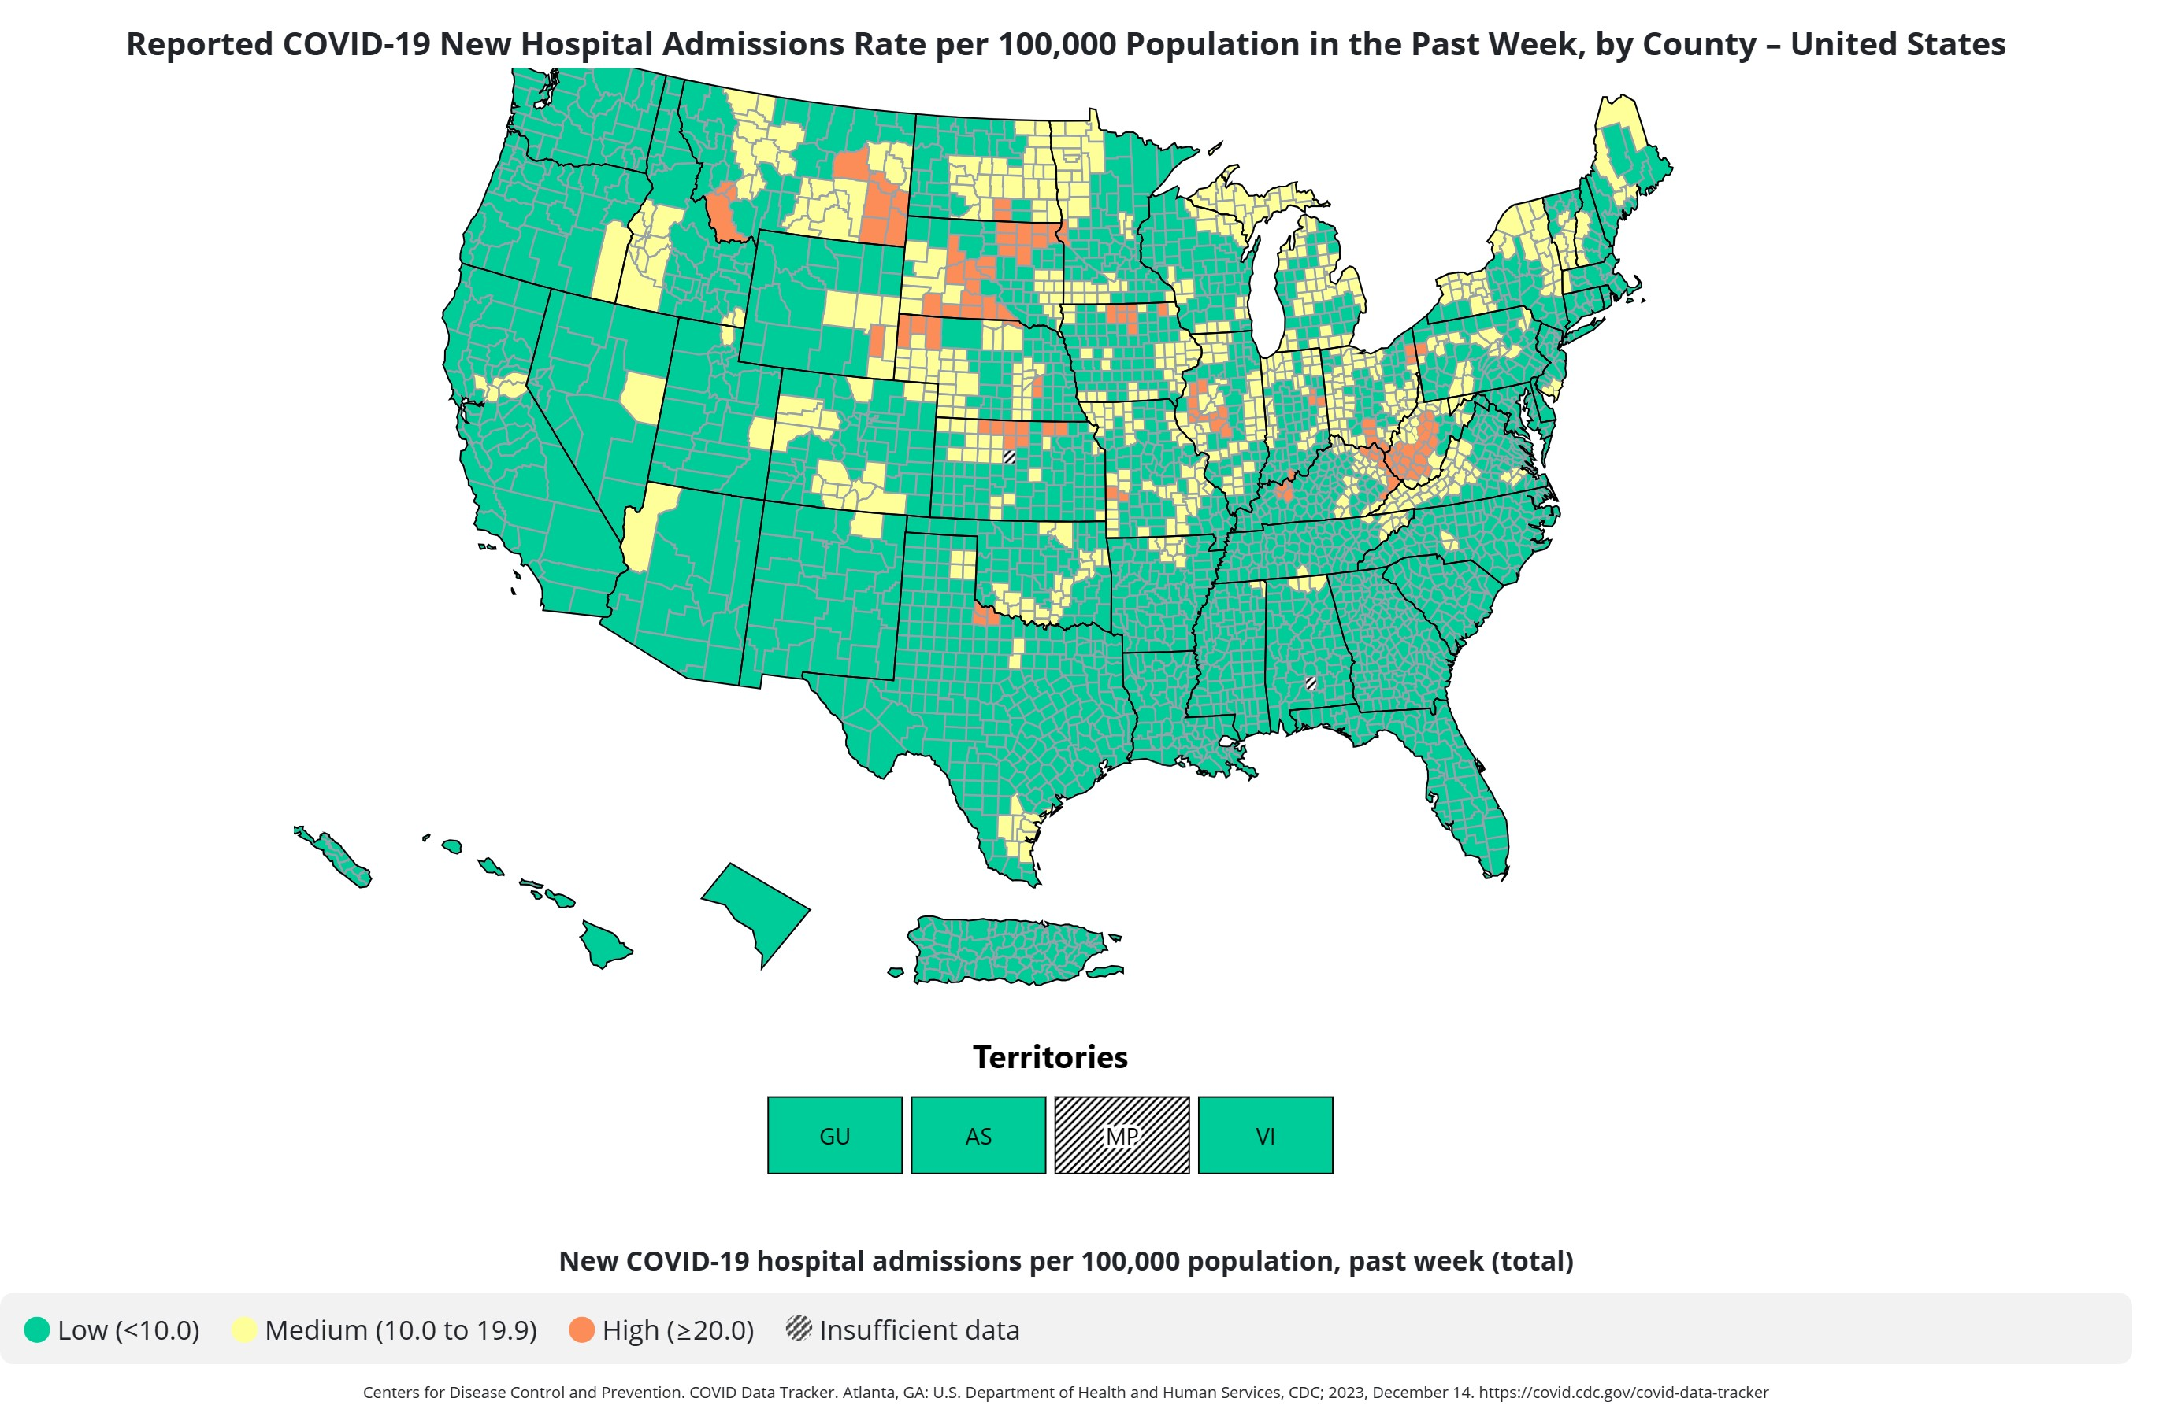

Slide 8
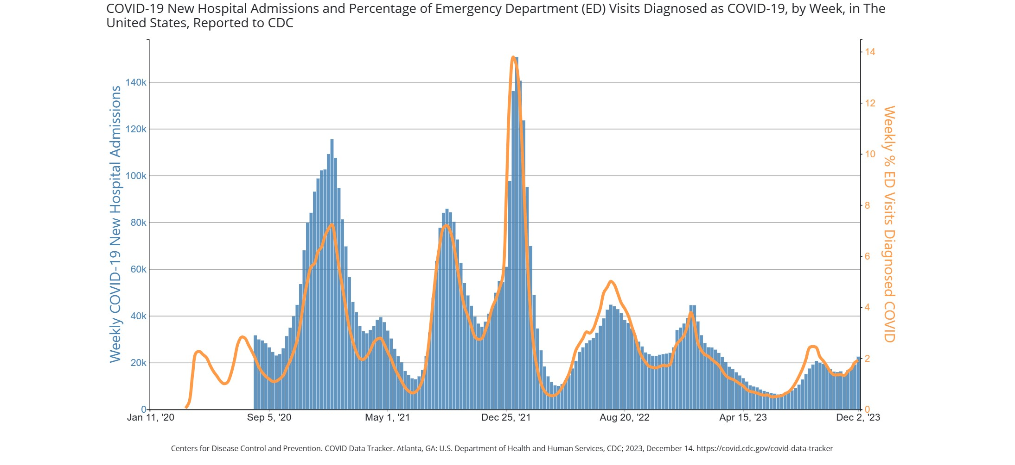

Slide 9
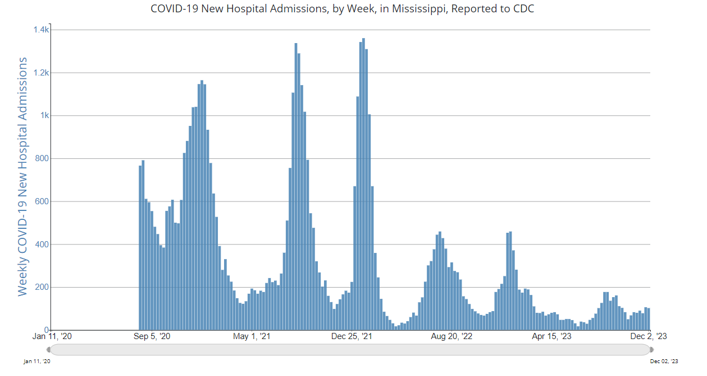

Slide 10
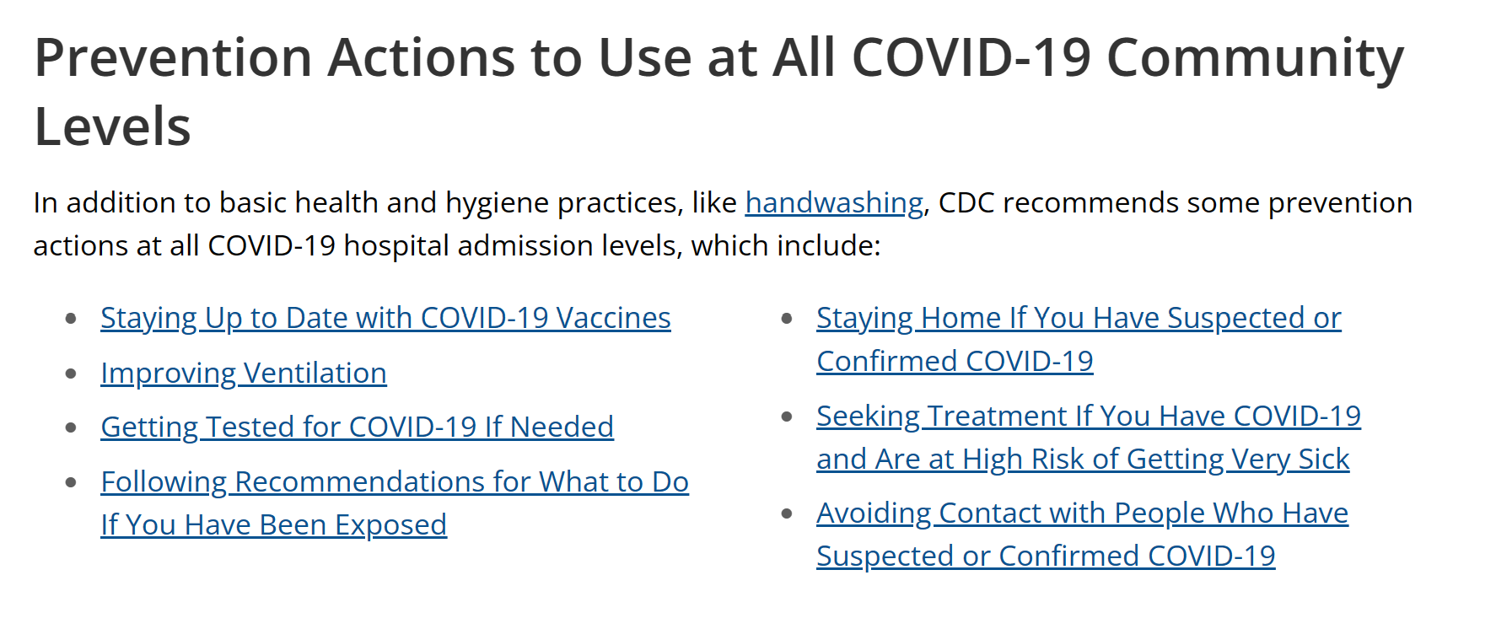
Prevention

Slide 11
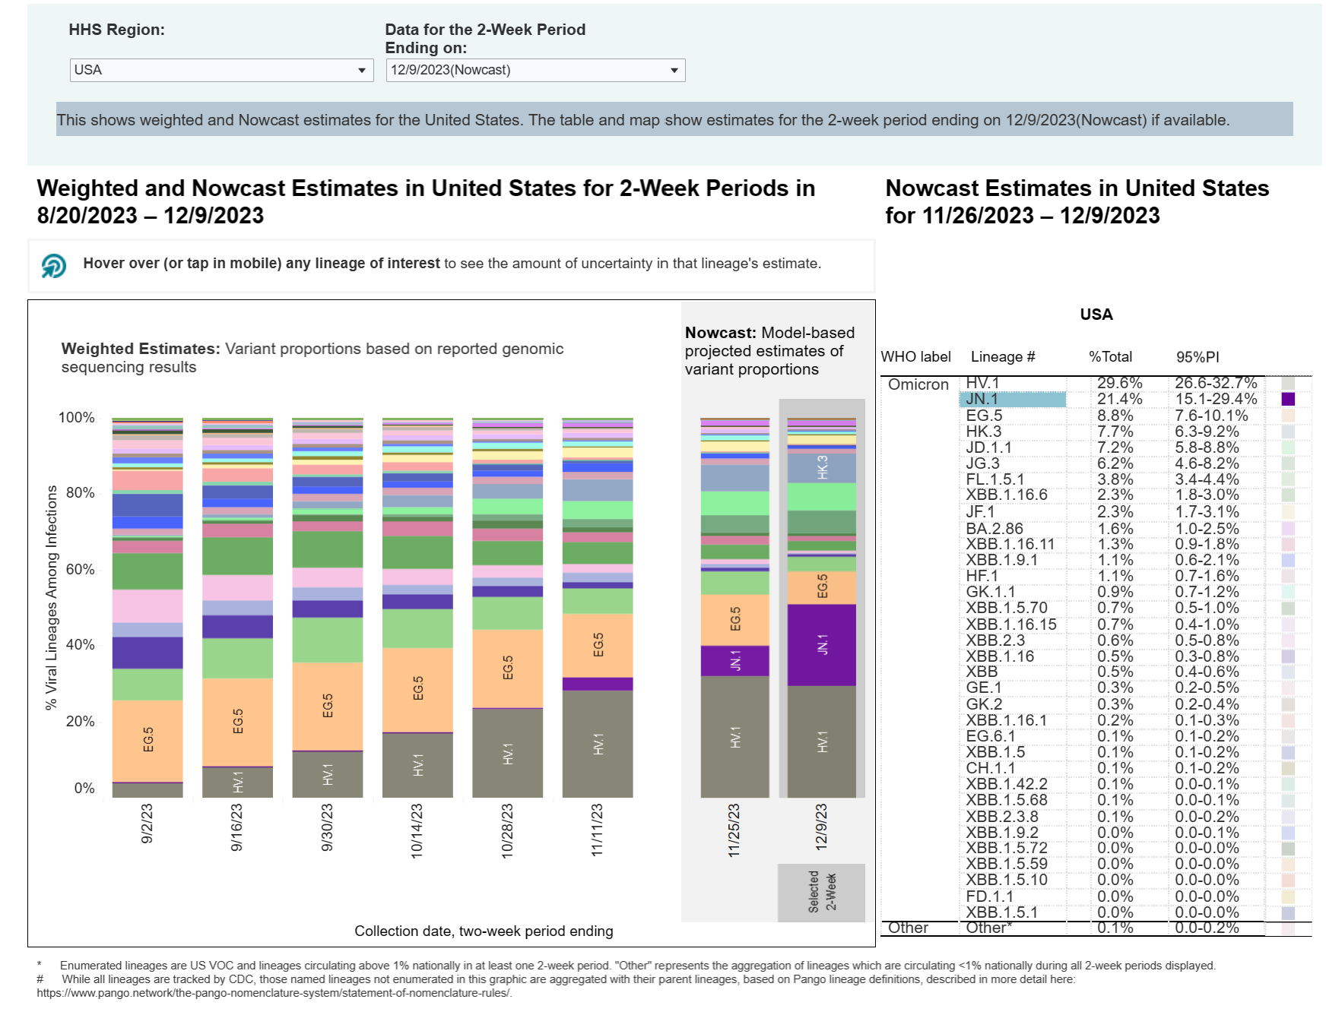
Variants

Slide 12
Questions

