Slide 1
COVID-19 Update
Thomas Dobbs, MD, MPH
11/16/2023

Slide 2
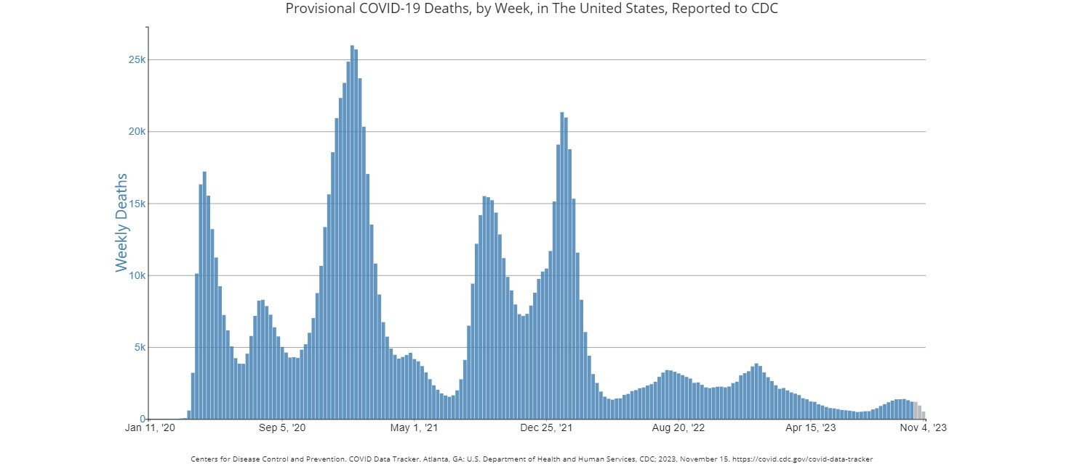

Slide 3
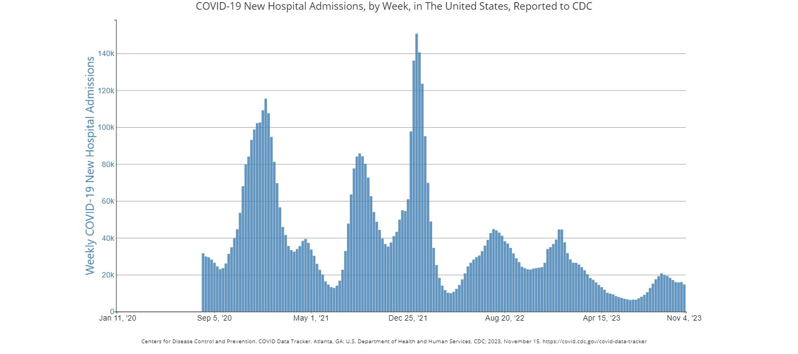

Slide 4
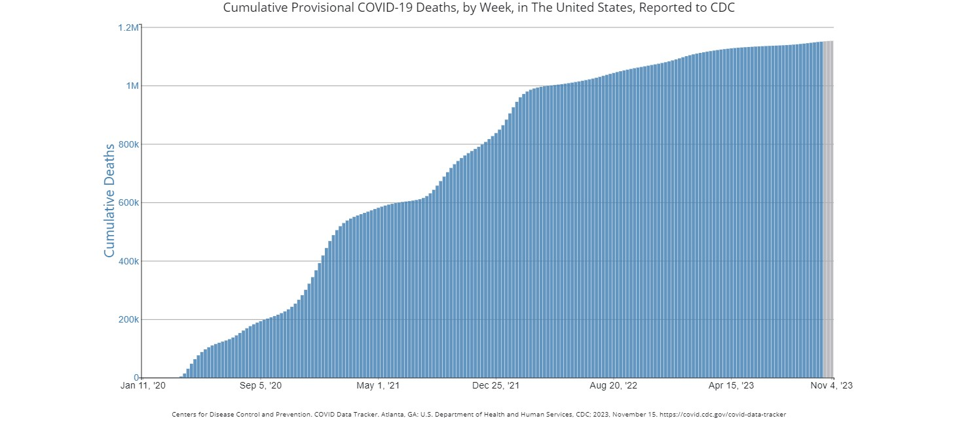

Slide 5
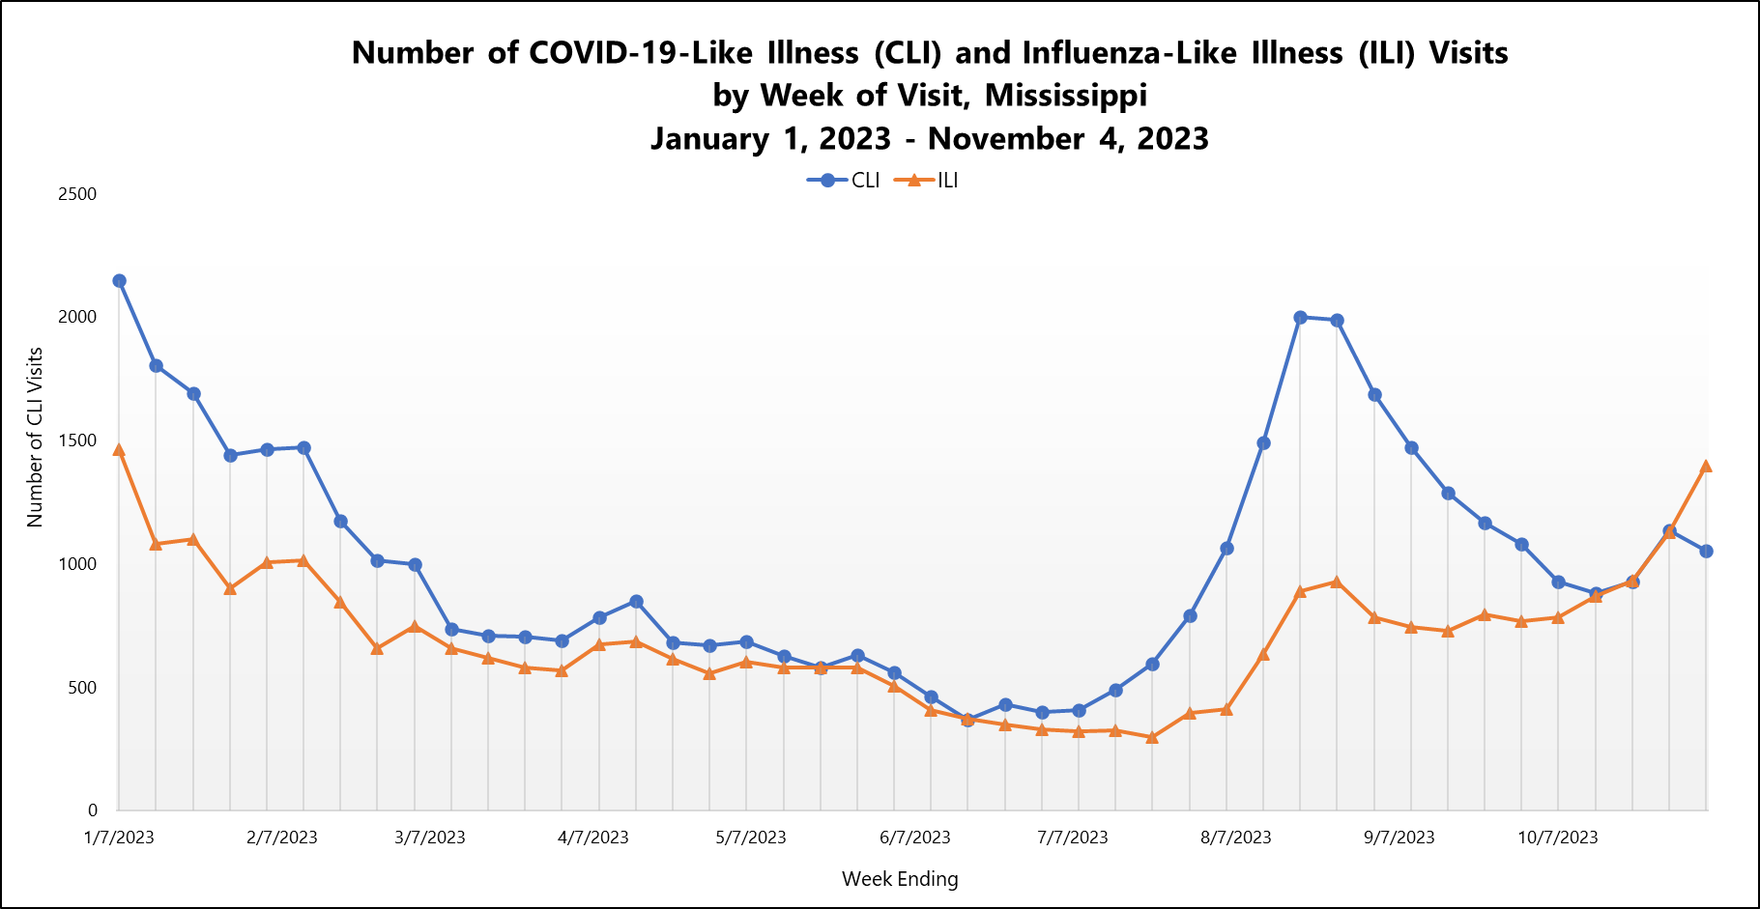

Slide 6
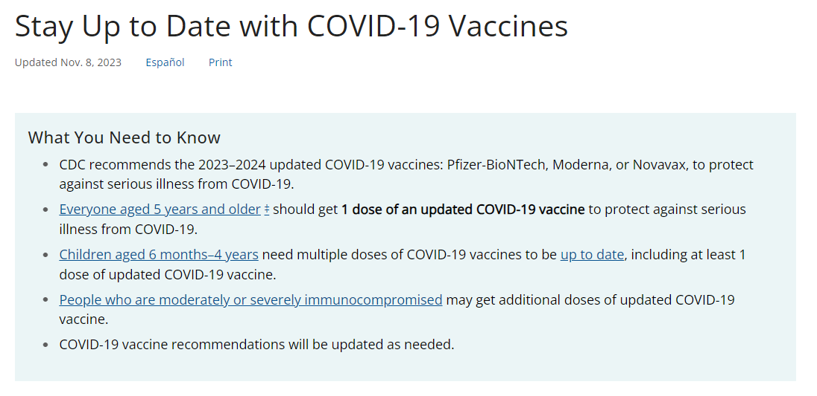

Slide 7
