Slide 1
COVID-19 Update

Slide 2
Respiratory Virus Season
3 significant respiratory viruses to watch
  COVID-19
  Influenza
  RSV (respiratory syncytial virus)
Vaccinations
Other prevention measures

Slide 3
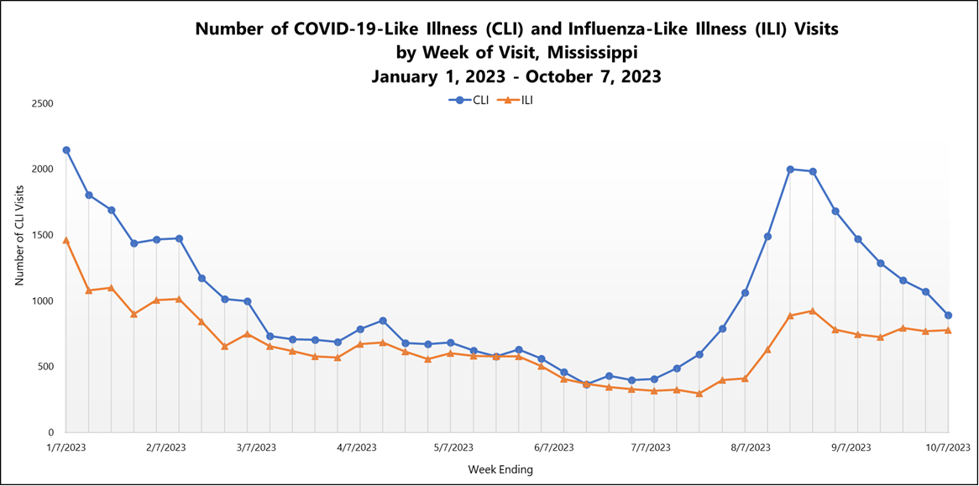

Slide 4
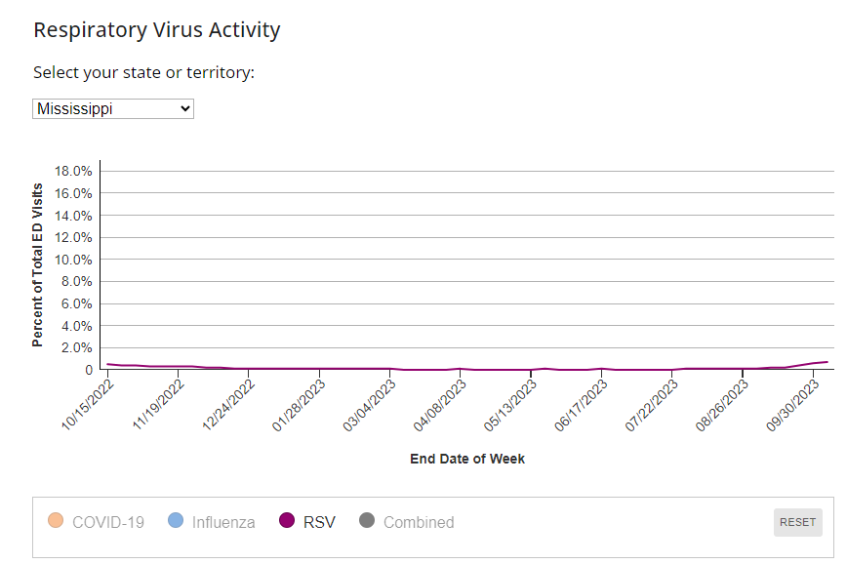
Protect yourself from COVID-19, Flu, and RSV (cdc.gov)

Slide 5
Vaccines
Updated 2023-2024 COVID-19 vaccine
  Recommended for anyone 6 months of age and older
    Vaccines.gov - Find COVID‑19 vaccine locations near you
  For most individuals aged 5 and older one dose is recommended
    Younger children, immunocompromised, and individuals requesting Novavax may have alternative recommendations.
    Interim Clinical Considerations for Use of COVID-19 Vaccines | CDC
Updated influenza vaccine
  Recommended for anyone 6 months of age and older
New RSV prevention options
  Vaccine for adults 60 and older
  Vaccine for pregnant individuals at 32-36 weeks gestation
  Monoclonal antibody product for infants 8 months or less (with possible second dose recommended for up to 19 months if at high risk)

Slide 6
Respiratory Virus Prevention
Stay home when sick
Seek evaluation, testing, and treatment when indicated
Cover your cough (use elbow/sleeve rather than hand)
Frequent handwashing or use of hand sanitizer
For COVID-19, follow guidance for isolation and masking if positive

