Slide 1
Lung Cancer Screening
Pierre de Delva MD, FACS
Thoracic Oncology Program
UMMC
I have no financial disclosures

Slide 2
Who develops lung cancer?
Tobacco Use
  80-90% of lung cancer deaths are directly linked to cigarette smoking
  The more you smoke the higher the risk
Secondhand exposure
  Around 7,000 deaths per year related to secondhand exposure
Asbestos, radon exposure, exposure to carcinogens in the workplace, and cigars/pipes
3. Lung Cancer Risk Factors | Smoking & Lung Cancer [Internet]. Cancer.org. 2021 [cited 12 May 2021]. Available from: https://www.cancer.org/cancer/lung-cancer/causes-risks-prevention/risk-factors.html

Slide 3
142,670 Deaths

Slide 4
Lung Cancer is a Lethal

Slide 5
Lung Cancer is a Lethal

Slide 6
1,810

Slide 7
1,810
Deaths

Slide 8
Lung Cancer is a very Lethal in Mississippi

Slide 9
Why is Lung Cancer so Lethal?
Tumor biology
Survival is stage dependent
Majority of patients present in advanced stage

Slide 10
Prevention and Early Detection are the Keys to Reduces Deaths
Smoking cessation programs
  Education
  Regulation and taxation of tobacco products
  Effective cessation programs
Identification of high risk populations
Screening

Slide 12
Screening Test
Testing of a population who is at risk for a disease, but who does not exhibit signs or symptoms to make the diagnosis
The goal is to detect the disease when cure is possible or treatment will decrease the long term morbidity attributable to the disease

Slide 13
Ideal Screening Tool
Simple
Low Risk
High sensitivity and specificity
  Low number of false positives and high positive predictive
Cost effective
Convenient for the patient
SAVES LIVES!

Slide 14
Evaluation a Cancer Screening Tool- Metrics
More Cancers Detected
Early Stage Cancer Detected
Better Five Year Survival
Reduced Cancer Mortality-Yes!
  Can only really be determined in a randomized trial

Slide 15
Lung Cancer Screening: NOT CXR!

Slide 17
Low-Dose CT Scan Screening:
National Lung Screening Trial
NCI funded, multi-institutional (33), randomized trial
Low-Dose CT vs Chest Radiograph
Eligibility Criteria
  55-74 years of age
  At least 30 pack-year history of smoking
  If former smoker, quite less than 15 years prior
Exclusion Criteria
  Previous Lung Cancer within 18 months
  Sings and Symptoms of lung cancer

Slide 18
Low-Dose CT Scan Screening:
National Lung Screening Trial
55,454 enrolled from 8/2002 to 4/2005
  59% male 41% female
  90% White 4.5% Black 2.1% Asian and 1.8% Latino
Screening:
  Screening Occurred at Enrollment, Year 1 and Year 2
    Low Dose CT 1.5 mSv versus 8mSv in routine CT
    Conventional Chest x-ray

Slide 19
Low-Dose CT Scan Screening:
National Lung Screening Trial
Positive CT Results was 24.2% and defined as:
  Non calcified nodule at least 4 mm in diameter
  Adenopathy or effusion
No prescribed diagnostic or therapeutic protocol for positive result-standard practice
  93% had diagnostic follow up (less with each subsequent screening)
    58 % had a CT, CXR or PET
    1.8% Biopsy
    5% Surgical Procedure

Slide 20
Low-Dose CT Scan Screening:
National Lung Screening Trial
Primary End Point:
  Lung Cancer Mortality between the two arms
Powered 90% to detect a 21% difference
Follow up was 7 years
95% adherence with screening
Low percentage of incidental cross over in chest screening arm 4.3%

Slide 21
Low-Dose CT Scan Screening:
National Lung Screening Trial
Low Dose CT detected more lung cancers : 3.6%
High False Positive Rate 96.4%
Number need to screen: 320
A 20% mortality risk reduction with low dose CT p-value 0.004
  Due to the high cure rate of early cancers detected by screening

Slide 22
Nelson Trial
Sought to confirm NLST results supporting use of LDCT, but without CXR
Enrolled 15,789 patients over ten years
Screened at year 1, year 3, and year 5.5 or no screening
Followed participants for ten years

Slide 23
Enrollment Criteria
Ages 50-74
At least 15 pack years
Former smokers that quit within ten years
Excluded those with moderate or severe health problems and an inability to climb two flights of stairs; a body weight of more than 140kg; current or past renal cancer, melanoma, or breast cancer; a diagnosis of lung cancer or treatment related to lung cancer within the past 5 years; or a chest CT scan within the past year.

Slide 24
Findings: Published in 2020
Rate of adherence 90%
Staging: 50% in screening arm were early stage with 65-70% stages IA to II. In contrast, 70% in the control arm were stage III/IV.
  Mortality reduction of 24% in men and 33% in females
  5. Reduced Lung-Cancer Mortality with Volume CT Screening in a Randomized Trial | NEJM [Internet]. New England Journal of Medicine. 2021 [cited 12 May 2021]. Available from: https://www.nejm.org/doi/full/10.1056/NEJMoa1911793

Slide 25
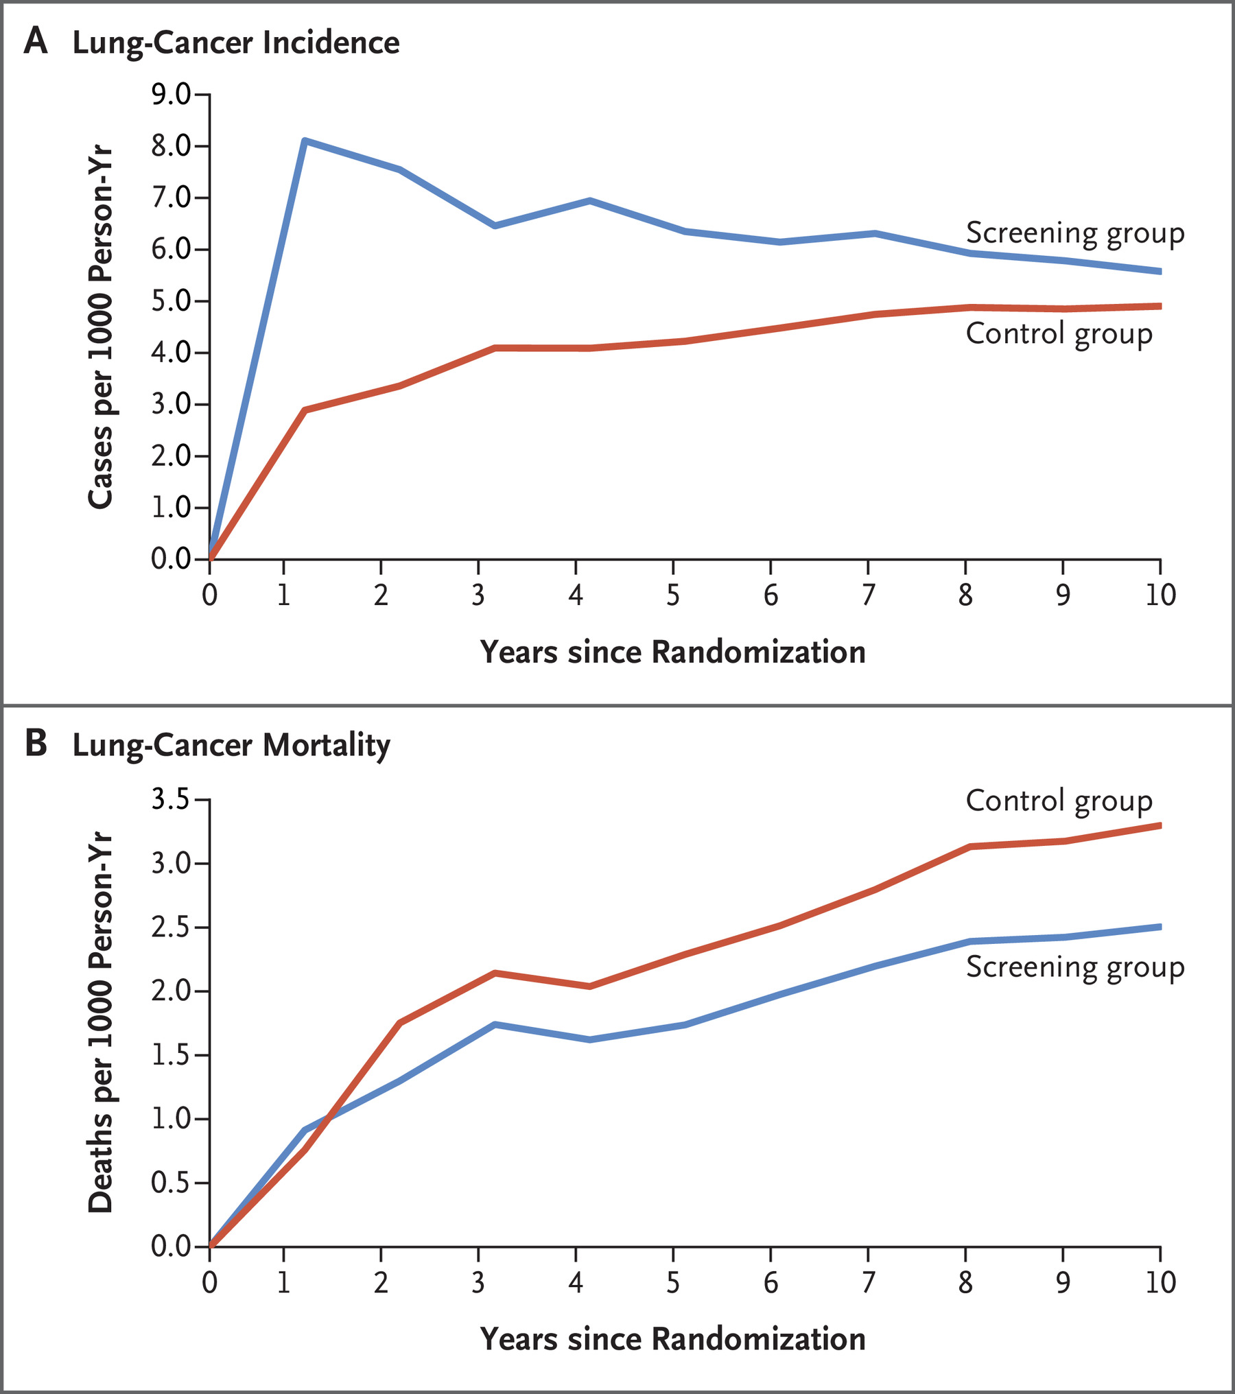

Slide 26
U.S. Preventive Task Force
In 2013, a B recommendation was issued for annual lung cancer screening in those aged 55-80 with at least 30 pack years that are current smokers or have quit within the past 15 years.
In 2021, this was re-visited with the new determination issuing a B recommendation, but updated the eligibility criteria: Ages 50-80 with 20 pack years in current smokers or former that have quit within 15 years
  14 million at high risk with new guidelines increasing eligibility of populations with disparate outcomes.

Slide 27
Coverage
Medicare
  Covers ages 50-77 with 20 pack years or who are former smokers that quit within 15 years. Patients must be asymptomatic.
  Requires shared-decision making visit for initial screening
    Discuss risks/benefits, determine eligibility, use of decision-making-aid, counseling on smoking cessation, and counseling on the importance of adhering to annual screening
    All components must be documented for coverage. Billable code is: G0296
    No longer requires uploading of certain criteria to the ACR’s LCSR
  Not subject to co-pay, deductible, or other. 100% coverage.
  Z87.891 for former smokers and F17.21 for current
Medicaid
  Sporadic coverage. Expansion states required to cover and do, but states that did not expand are hit or miss. MS does cover.
Private Insurers
  Most do cover, but may have different eligibility criteria and CPT codes
  BCBS uses z12.2
  7. Decision Memo for Screening for Lung Cancer with Low Dose Computed Tomography (LDCT) (CAG-00439N) [Internet]. Cms.gov. 2021 [cited 12 May 2021]. Available from: https://www.cms.gov/medicare-coverage-database/details/nca-decision-memo.aspx?NCAId=274

Slide 28
Uptake
Nationally, only 4.4% of the more than 7.6 million eligible per USPTF guidelines underwent LDCT screening in 2016. Current uptake still less than 6%.
  Compared to 65% of those eligible for mammography
  8. Uptake of lung cancer screening is exceedingly low [Internet]. Mdedge.com. 2021 [cited 12 May 2021]. Available from: https://www.mdedge.com/chestphysician/article/166457/lung-cancer/uptake-lung-cancer-screening-exceedingly-low#:~:text=Uptake%20of%20lung%20cancer%20screening%20is%20exceedingly%20low.,meeting%20of%20the%20American%20Society%20of%20Clinical%20Oncology.

Slide 29
Barriers-Individual level
Sociodemographic Characteristics
  Current smokers show less adherence
Financial Cost
  Lack of health insurance
  Lack of knowledge surrounding coverage of LDCT or work-up of potential findings
Lack of Knowledge
  Most individuals have never heard of lung cancer screening
  Inaccurate knowledge related to lung cancer screening and its procedures
Inaccurate beliefs
  Low value of lung cancer screening
  Not knowing the risk associated with smoking
  Not knowing early detection leads to good prognosis
  Fearing CT scans

Slide 30
Barriers-Individual level
Distrust of medical system
  Insurance companies and providers work together to scam patients
  Providers do not have time to care for their problems
  LDCT is a scam that does not detect early
Stigma surrounding smoking and lung cancer
  Patients feel as though they are blamed for their problems due to being a smoker
  Feel like social outcasts
  Feel “stupid”
    This is particularly prevalent amongst patients that see younger providers
Negative attitudes about outcomes
  Worry about radiation exposure
  False-positive results
  Incidental findings
  Unfavorable cost-benefit ratio
  Over-diagnosis
  Anxiety related to procedure and/or potential findings
Inconvenience
  Lack of transportation
  Time constraints
  Appointment conflicts

Slide 31
Barriers-Health System
Lack of information from primary care providers
  Lack of PCP recommendation and inadequate patient education about LDCT
  More than 50% of high-risk smokers had never received a recommendation about lung cancer screening from their provider.
    Over 50% of providers polled revealed they had never recommended lung screening to their patients.
    31% of polled providers were unable to correctly answer questions surrounding eligibility criteria for age and smoking status
Why?
  Limited education surrounding use of lung screening
  Time constraints
  Distrust of the guidelines (64% of PCPs believed current guidelines were at least moderately effective)
  9. Lei F, Lee E. Barriers to Lung Cancer Screening With Low-Dose Computed Tomography. Oncology Nursing Forum. 2019;:E60-E71.

Slide 32
By the Numbers…
142,670 Dead in US
1810 Dead in MS
20% mortality reduction with screening
4.4% of eligible are being screened
28,534 lives could be saved in the US but at current rate of screening only 1255
362 lives could be saved in MS but at current rate of screening only 16

