Slide 1
Updates on Covid-19
7/20/23

Slide 2
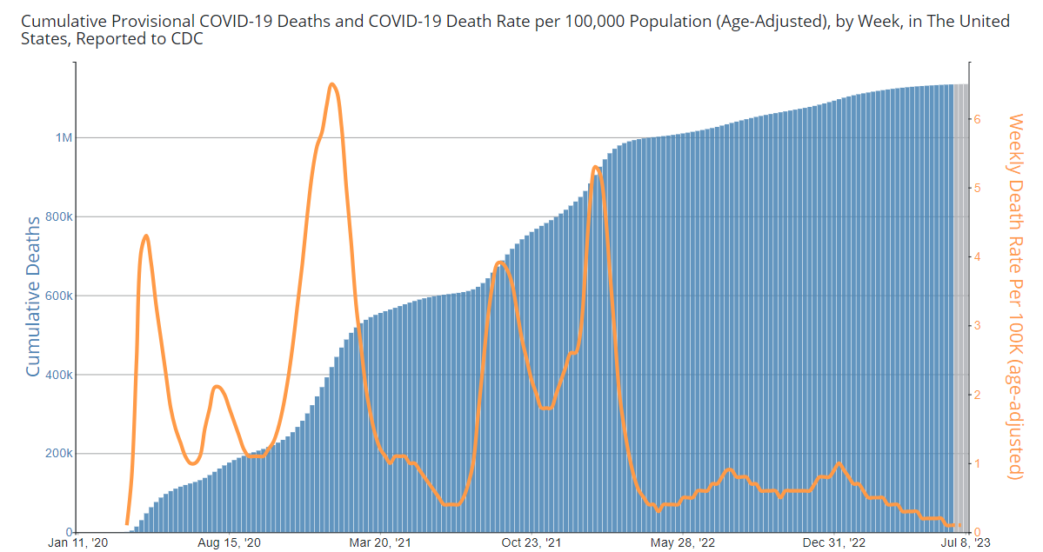

Slide 3
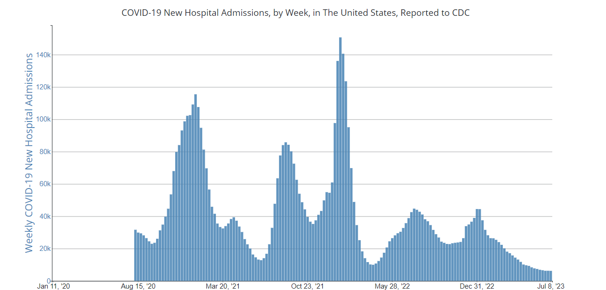

Slide 4
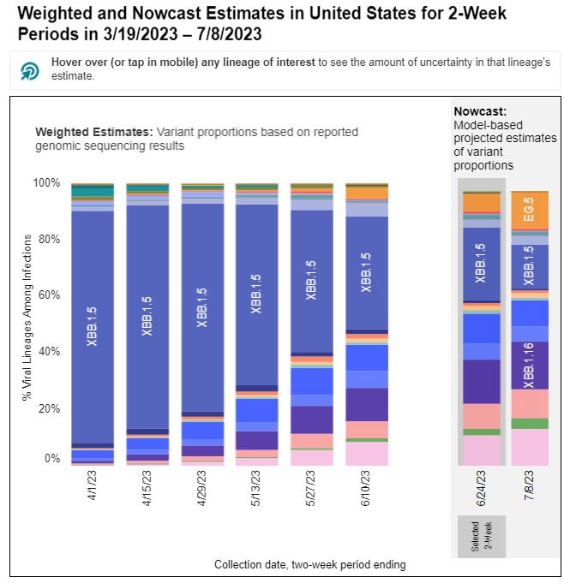
Current Variants

Slide 5
Vaccine Recommendations
6 – 64 years old
One Bivalent Dose
65 and older
Bivalent dose
Repeat Bivalent dose 4 months
Immune Compromised
Bivalent dose
Repeat 6 months
Repeat 2 months

Slide 6
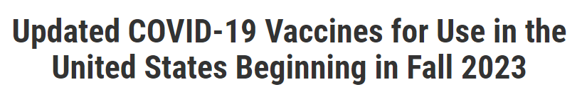
What's Next
Omicron variant XBB.1.5 for use as early as fall of 2023 (monovalent)
Pfizer (mRNA)
Moderna (mRNA)
Novavax (Protein)

