Slide 1
Men’s Health Matters
Health Promotion and Disease Prevention
6/14/2023

Slide 2


Slide 3
Stats
Percent of men aged 18 and over in fair or poor health: 12.4%
Percent of men aged 18 and over who had five or more drinks in 1 day at least once in the past year: 31.6%
Percent of men aged 18 and over who met the 2008 federal physical activity guidelines for aerobic activity through leisure-time aerobic activity: 55.6%

Slide 4
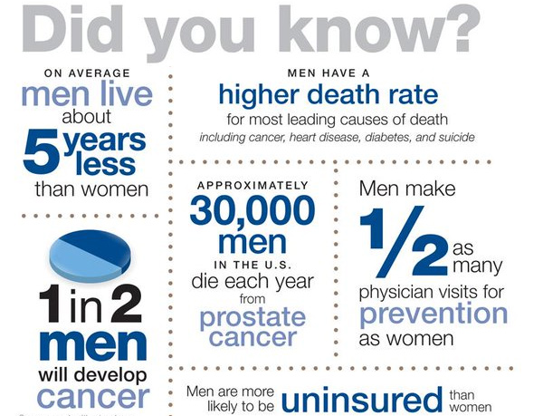

Slide 5
Stats
Women are 100% more likely than men to visit a doctor for annual exams
Lack of preventative care means men die on average almost 5 years earlier than women.
Masculinity is negatively correlated with a willingness to take medication to improve mental health.

Slide 6
Stats
Percent of men aged 18 and over who currently smoke cigarettes: 17.8%
Percent of men aged 20 and over with obesity: 34.5% (2011-2014)
Percent of men aged 20 and over with hypertension (measured high blood pressure and/or taking antihypertensive medication): 32.6% (2011-2014)

Slide 7
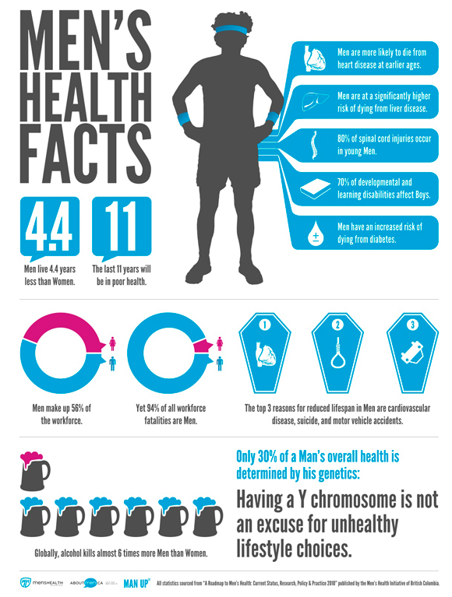

Slide 8
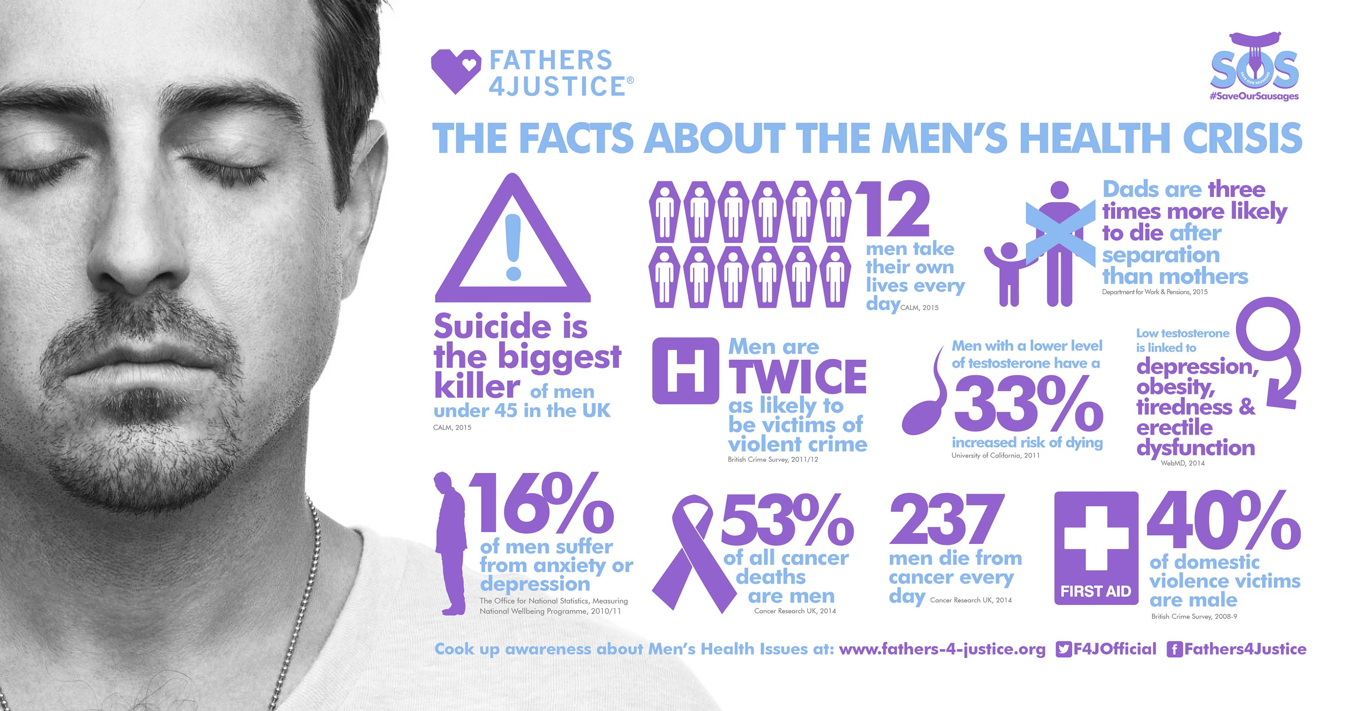

Slide 9
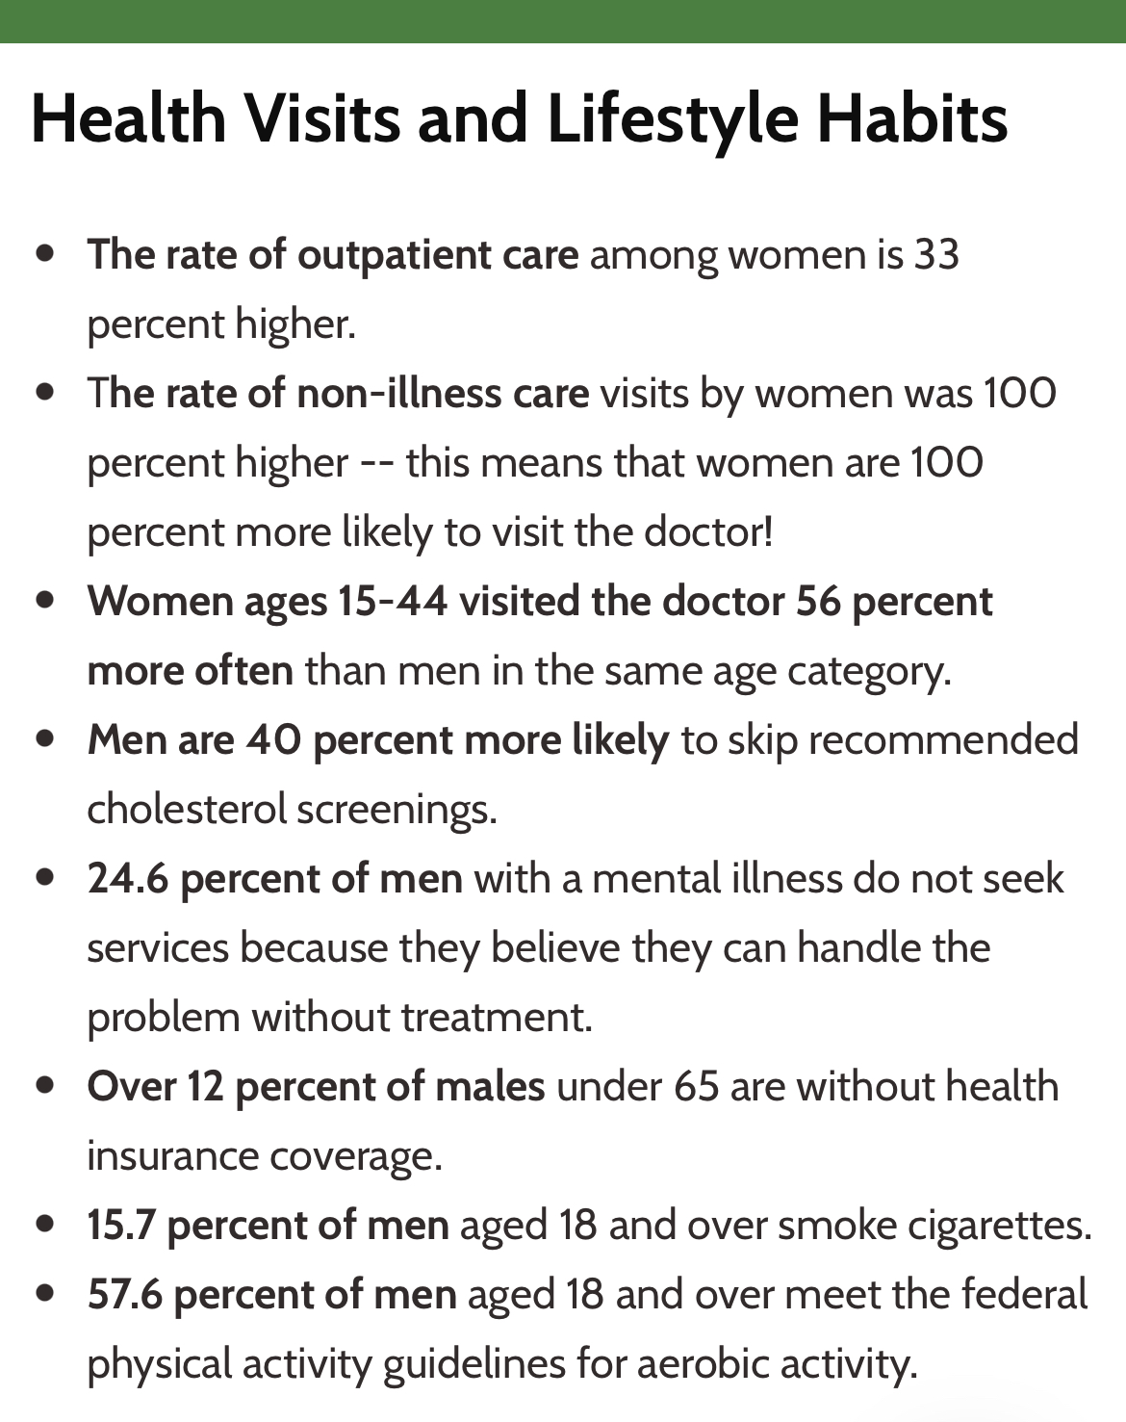

Slide 10
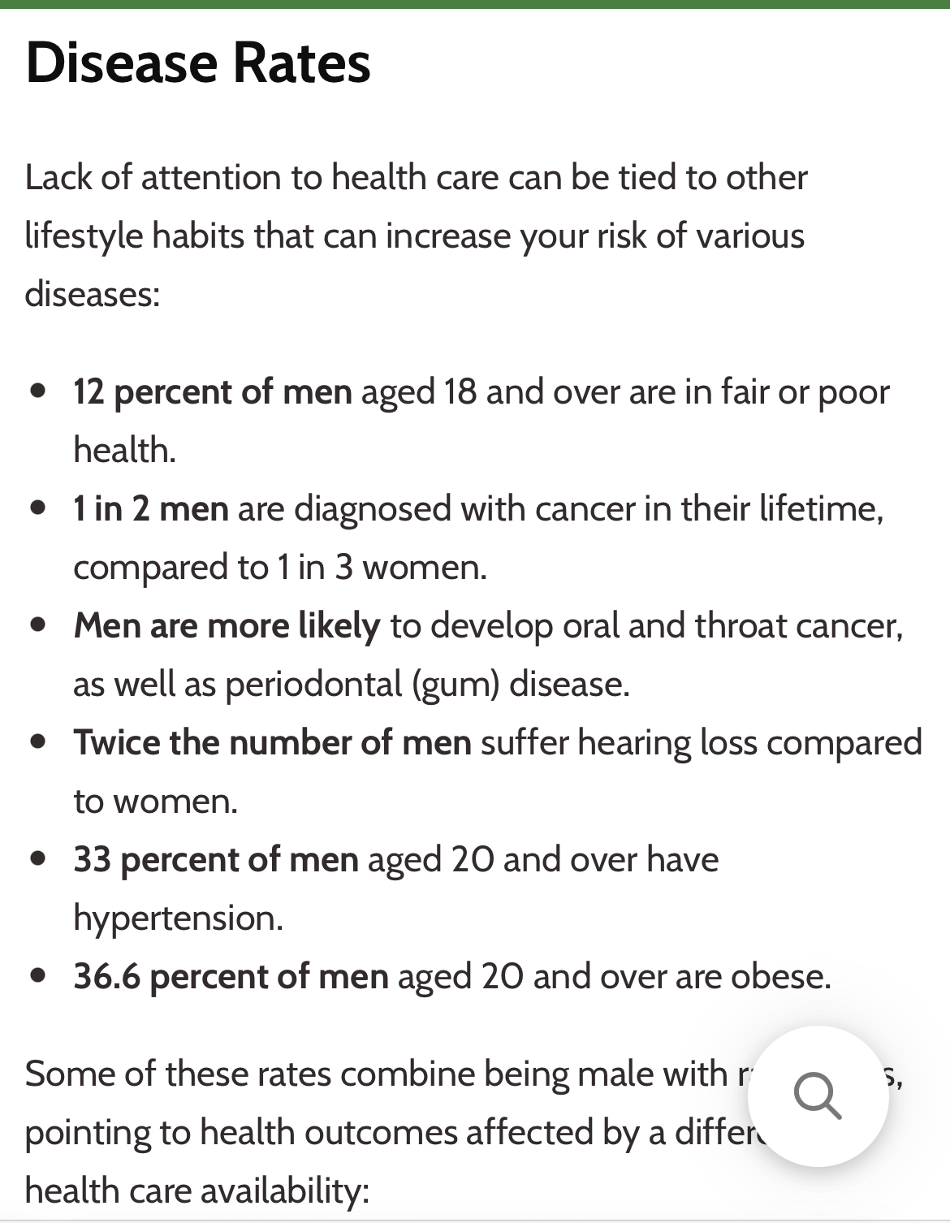

Slide 11
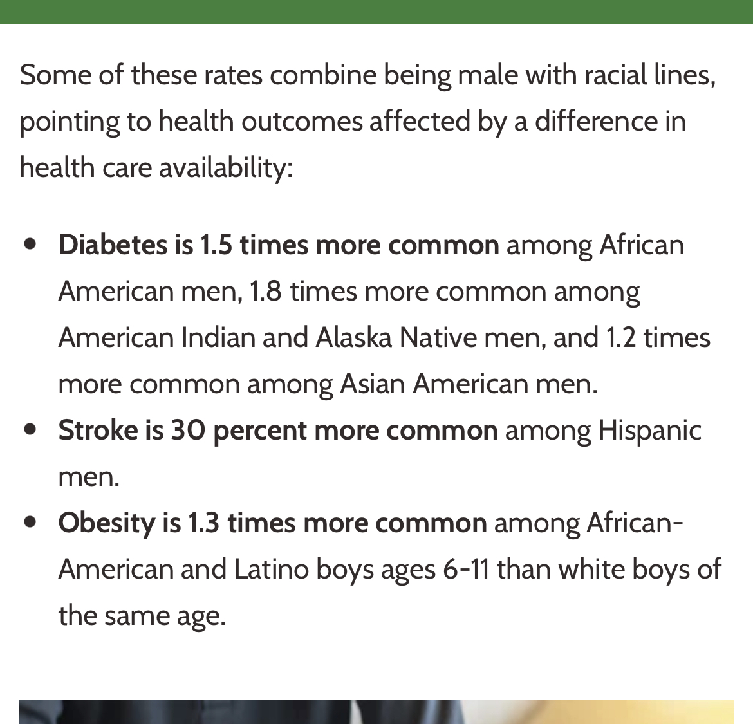

Slide 12
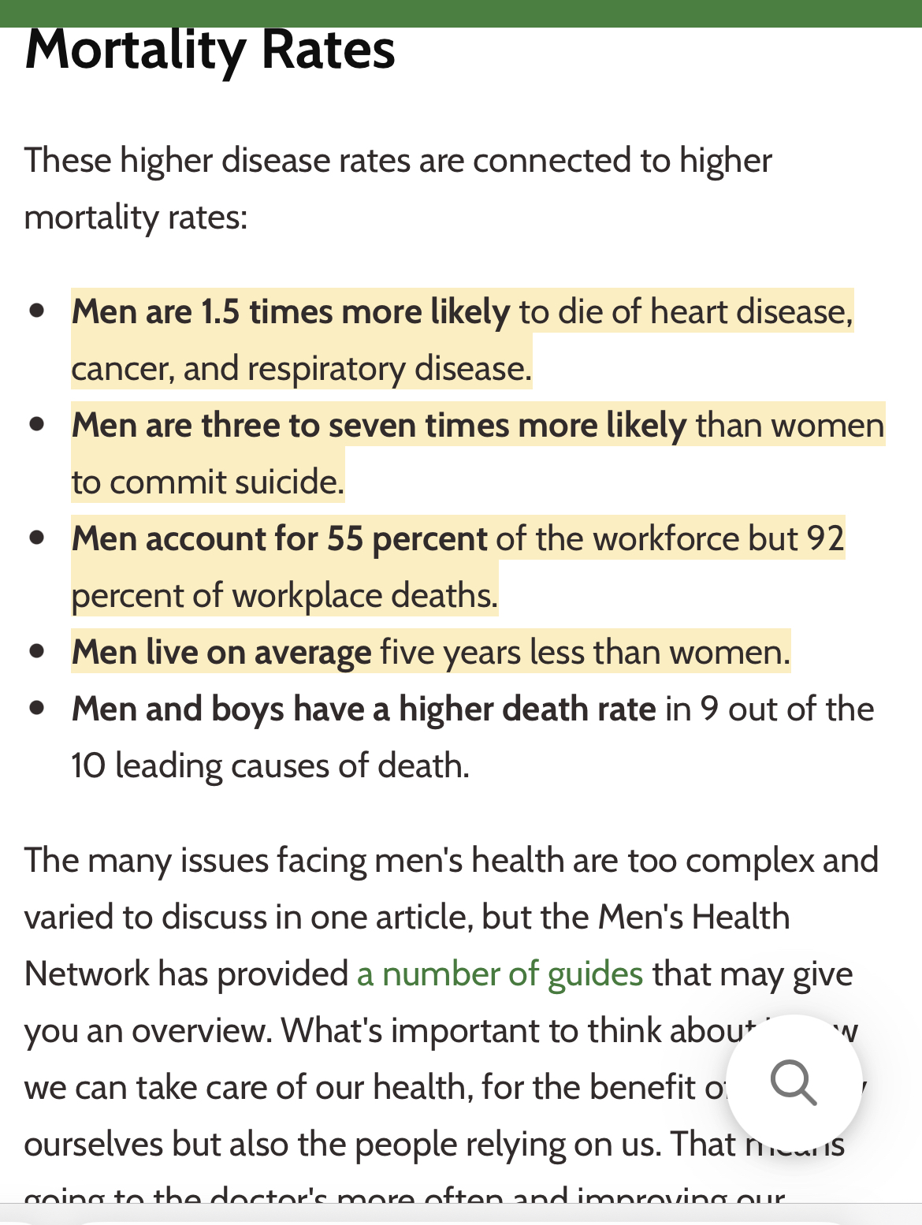

Slide 13
Leading causes of deaths
Heart disease
Cancer
Covid
Accidents (unintentional injuries)

Slide 14


Slide 15
Why men don’t go to doctor?
They can handle it
Makes them weak
Lack of trust
Lack of access
Wives don’t force them.

Slide 16
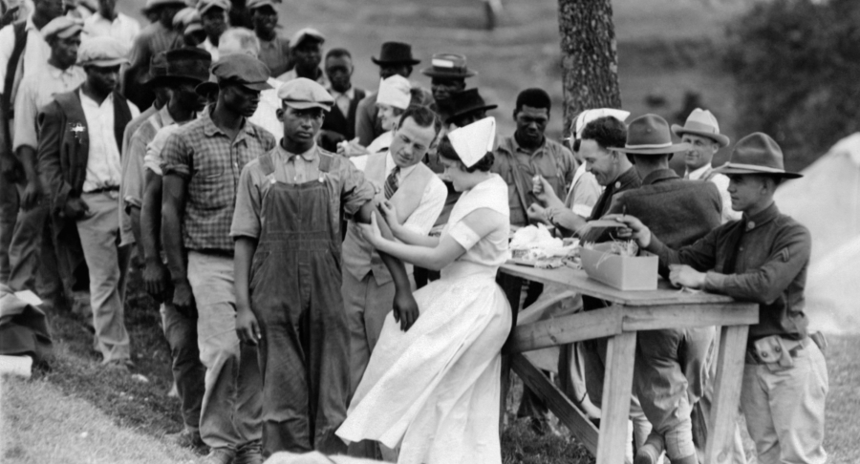
Tuskegee “Experiment”

Slide 17


Slide 18
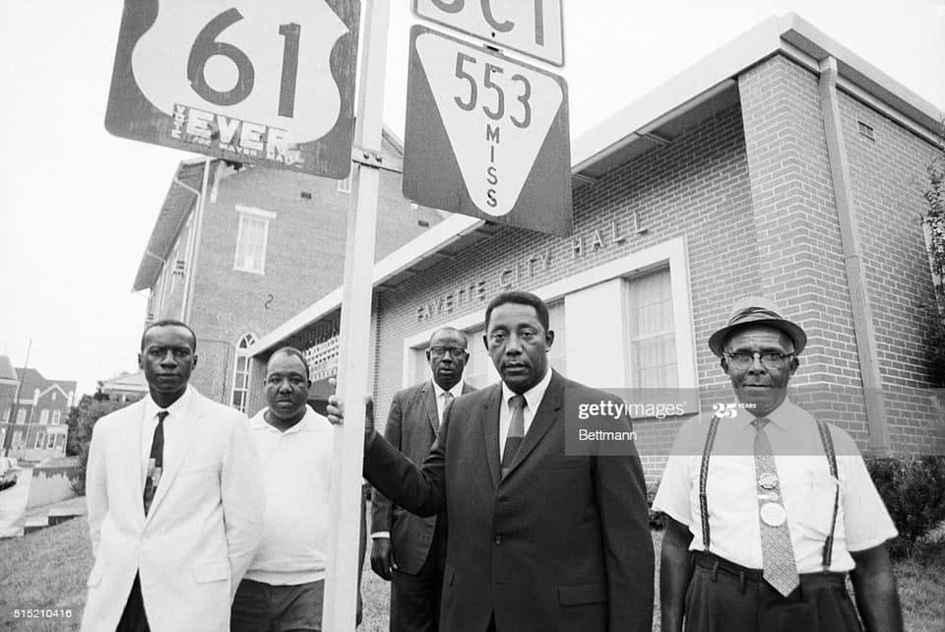

Slide 19
Sleep Apnea
22 million Americans w/ OSA
80% of mod to severe cases undx’d
Does snoring = sleep apnea?
Leads to
  Heart Disease
  HTN
  Diabetes
  Low T

Slide 20
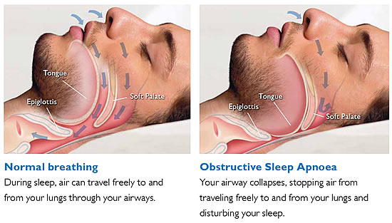
Sleep Apnea

Slide 21
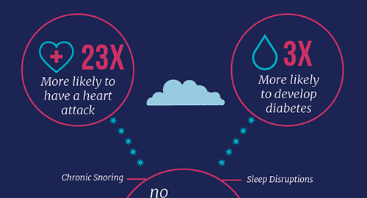
Sleep Apnea

Slide 22
Fatigue
OSA
Vit D deficiency
Hypothyroidism
Anemia
Depression

Slide 23
Obesity
Obesity
  1 out of 3 Americans
Childhood Obesity
  1 out of 5 Americans
Mississippi
  Top 3 in Nation 10 years in a row

Slide 24
Exercise
Being physically active is important to prevent heart disease and stroke, the nation’s #1 and #5 Killer
To improve overall cardiovascular health, we suggest at least
  150 minutes per week of moderate exercise or
  75 minutes per week of vigorous exercise (or a combination of moderate and vigorous activity).

Slide 25
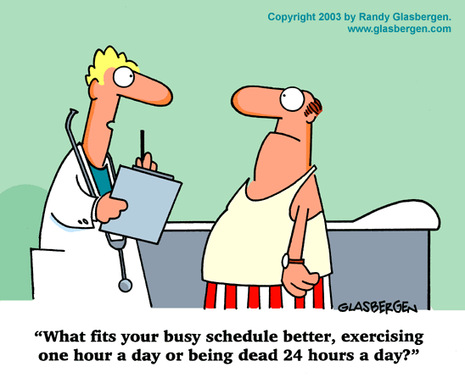

Slide 26
Nutrition
What percentage does
nutrition play?
  %20
  %40
  %80

Slide 27
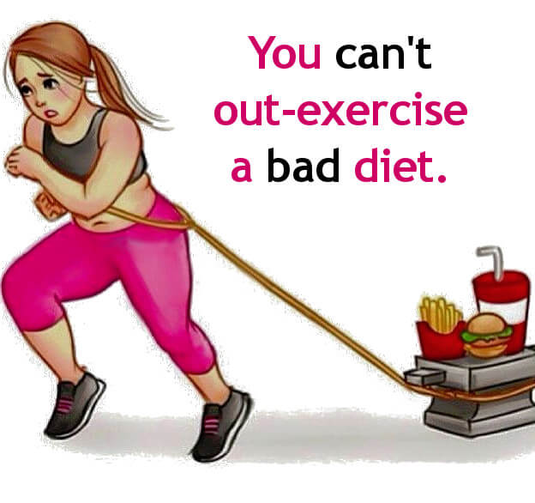

Slide 28
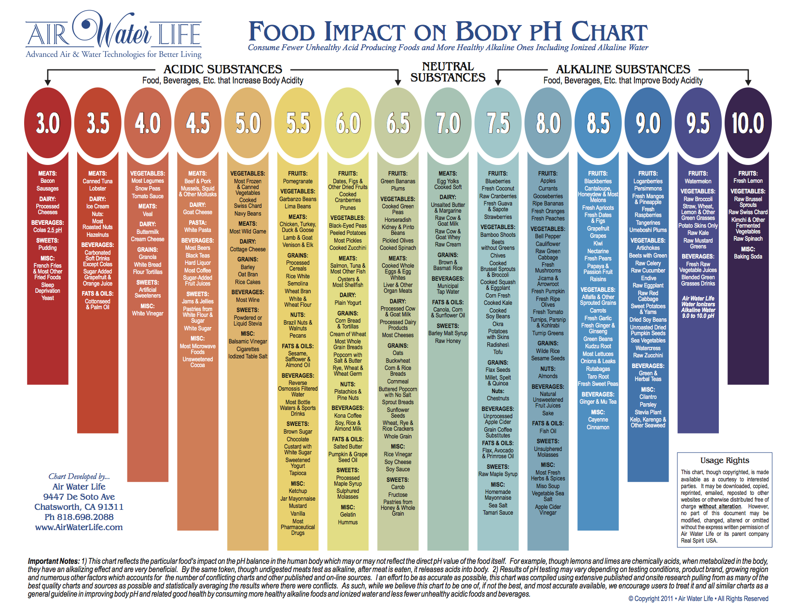

Slide 29
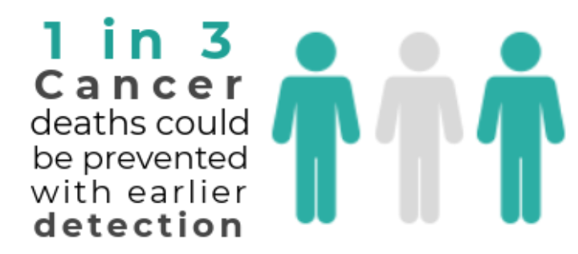
Cancer

Slide 30

Colon Cancer

Slide 31
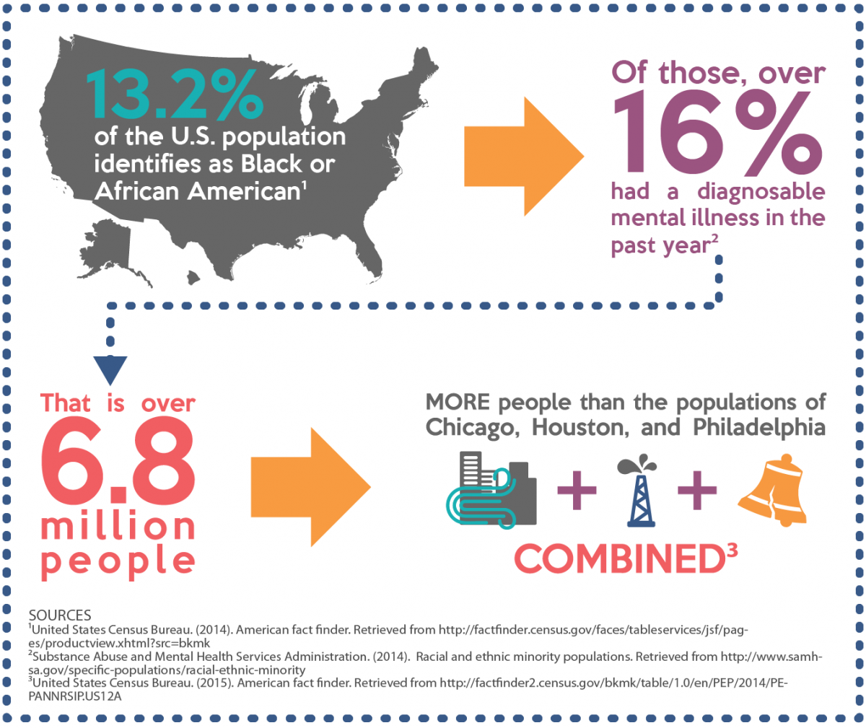
Mental Health

Slide 32
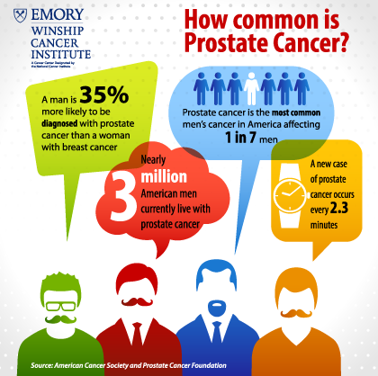

Slide 33

Statistics

Slide 34


Slide 35
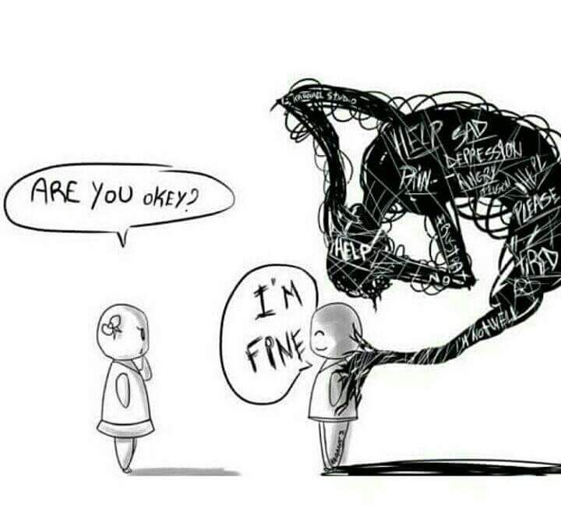
Identifiers

Slide 36
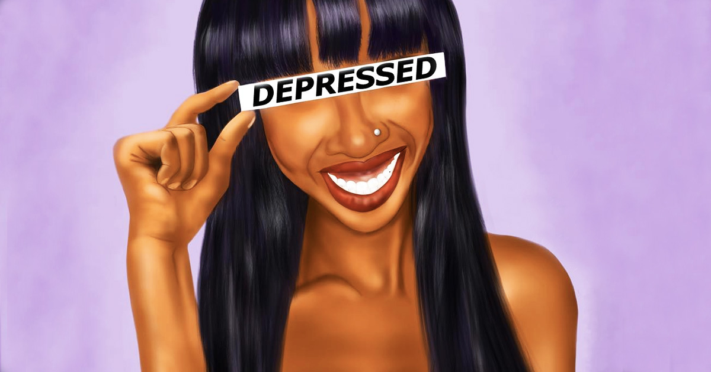
Mental Health

Slide 37
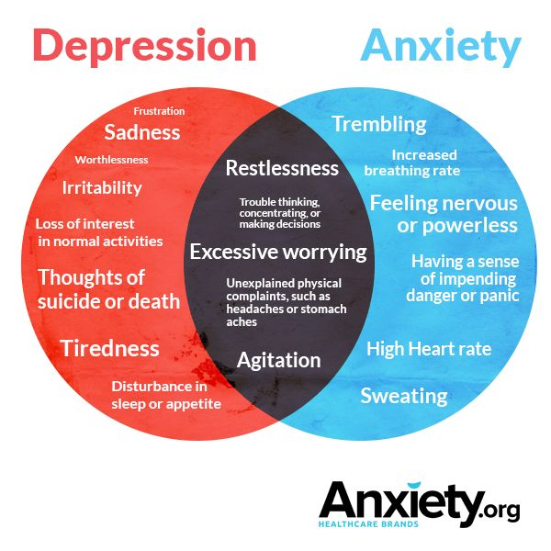

Slide 38
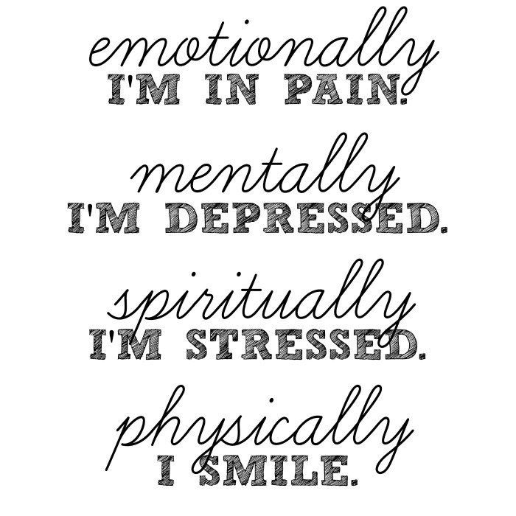

Slide 39


