Slide 1
Women’s Health:
What we ALL need to know
Elizabeth Lutz, MD MPH FACOG
University of MS Medical Center
Department of OBGYN
Notes:
Thank you so much for coming today. My name is Elizabeth Lutz and I am so excited to share a little bit of my passion for women’s health. Today, we will not be able to cover ALL we need to know. Instead, I would like to focus on what we ALL need to know. What are the facts that we all need to know!

Slide 2
Objectives
The case for women’s health
Women’s Health Exam
Pregnancy Prevention
Prenatal Care

Slide 3
Why do we care about women’s health?
Mother’s health impacts the health of the family
  and the community
Women who are caregivers are at greater risk for poor physical and mental health
Notes:
This has been shown across cultures and across continents. It applies to physical health, mental health, even dental health. For us to have healthy babies, we need healthy mothers. Additionally, when we do not care for the women in our society, they are not able to care for their families and their communities. The CDC reports that Women who are caregivers are at greater risk for poor physical and mental health, including depression and anxiety. So Women’s health is important to all of us. Not just the women themselves. And

Slide 4
Annual Women’s Health Exam
Why is this suddenly controversial?
  Screening Guidelines have Changed!
Notes:
For decades, women were encouraged to go to see their Women’s health physician for an annual check-up, but now, there is a lot of talk about “the annual exam”
So why the sudden controversy?
Well, our screening guidelines have changed. And that has let to a lot of confusion over whether women need annual exams

Slide 5

Screening Guidelines
Pap Smears
  Every 3 years starting at age 21
  Every 3-5 years age 30-65 WITH HPV testing
Mammograms
  IT DEPENDS!
  ACOG Recommends Annually starting at 40
Notes:
So what are the screening guidelines for the 2 tests women use to prevent cancer?
Pap smears are the test we perform to prevent cervical cancer. They are performed at the time of pelvic exam. We always were told they needed to be done every year. But cervical cancer takes a LONG time to develop. So maybe, not everyone needs one every year. Typical screening patterns are here. BUT – there are many risk factors that make cervical cancer speed up- medications and medical conditions. So a physician should work with their patient to determine the optimum screening pattern for each individual patient.
Screening Mammograms are performed to detect early breast cancer in those women who don’t have a lump or bump. There are many organizations that publish screening mammogram recommendations. I am a gynecologist, so I follow ACOG and recommend annual mammograms starting at age 40.

Slide 6
Women’s Annual Exam
Physical Exam
  Vital signs
  Breast exam
  Pelvic exam
Review Medical History
  Including Family History
Screening for various conditions
Immunizations
Annual Women’s Health Visits should be performed!

Slide 7
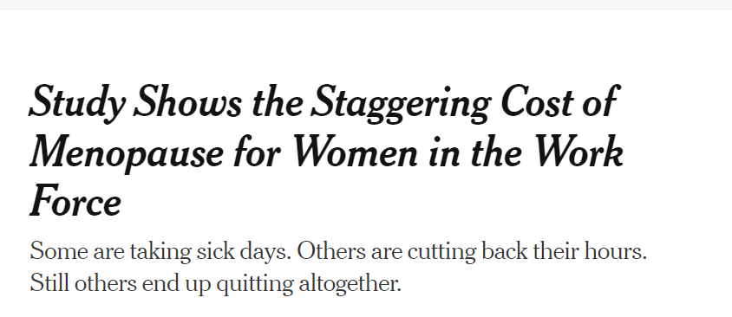
Menopause
Menopause
  12 months no menses
  3 categories of symptoms
    Vasomotor
    Vaginal dryness
    Psychological
Notes:
Menopause is one of the most common issues addressed at a woman’s wellness visit. Menopause is defined as 12 months without menses. There are 3 common symptom categories for menopause- vasomotor, vaginal dryness, and psychological. Now – I give entire lectures on these, but I am happy to talk about any of this. But there was a question about menopause and cost. That was highlighted recently be this new York times article. This article referenced a mayo clinic study estimated $1.8 billion annually in the US – the majority of which is work time lost due to menopausal symptoms. Lots of discrepancies.

Slide 8

Pregnancy Prevention
49% of pregnancies in the US are Planned
Newer birth control
  Safer
  More effective
Notes:
One way that we can make families healthy, is making sure families happen when people are ready for them! Only 49% of pregnancies in the united states are planned – with the rest being mistimed or unwanted. We can empower women by helping them prevent pregnancy until they are ready. And We can really help families by preventing pregnancy when a family is complete. Here is a picture of my kids on Easter morning. They are cute – but let me ASSURE you- my family is complete. And I benefit from being able to control that
While birth control pills are still available and widely used, newer methods are both Safer and more reliable.

Slide 9
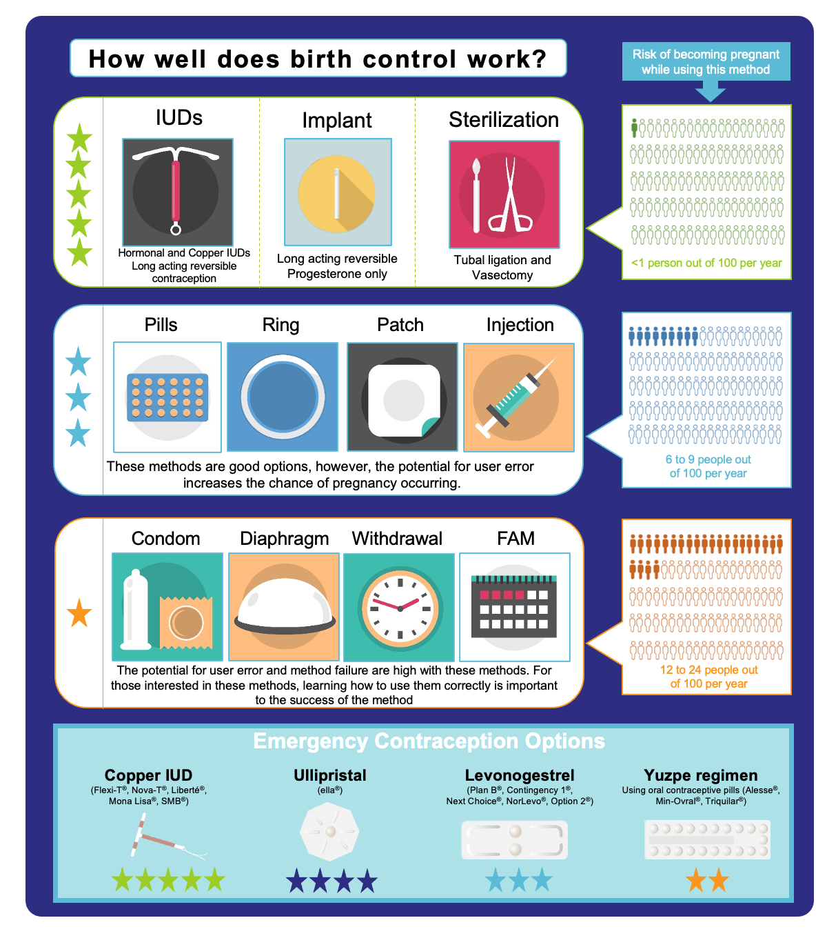
Pregnancy Prevention

Slide 10
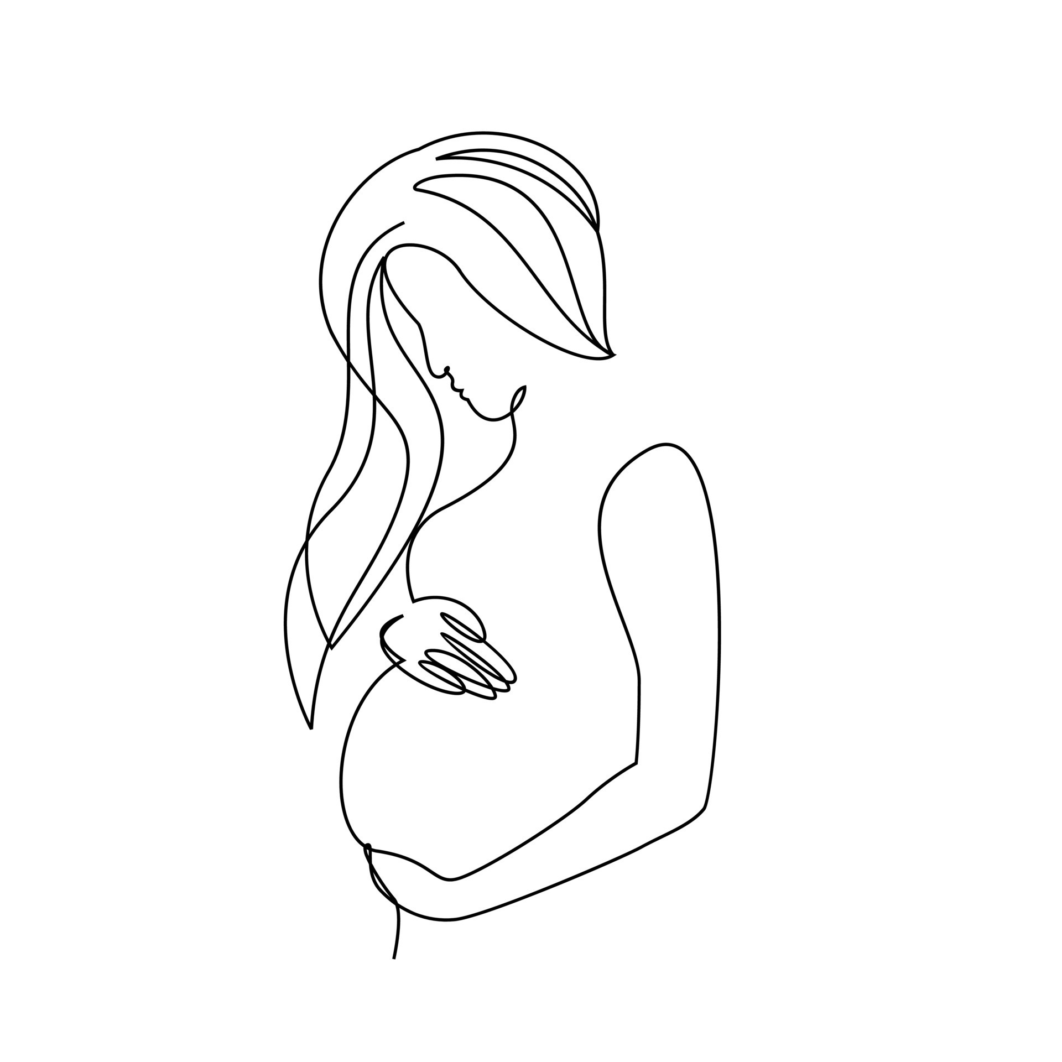
Prenatal Care is KEY!
Why is prenatal care important?
  Maternal and Fetal assessment
  Screening, diagnosis, and treatment
  Risk assessment
Prenatal Care is associated with Improved Maternal and Neonatal outcomes.
Notes:
So why is prenatal care important? It allows for maternal and fetal assessment. We are able to screen, diagnosis, and treat many conditions in pregnancy. It also assists with risk assessment – meaning helping to determine WHERE and HOW women should give birth. For example, if you are at risk for a hemorrhage, you don’t need to deliver in a place that is unable to perform a blood transfusion.
And for these reasons and MANY more, prenatal care is associated with improved maternal and neonatal outcomes.

Slide 11
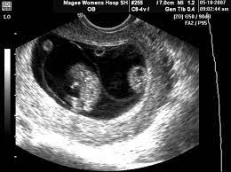
EARLY Prenatal Care is KEY!
Not just prenatal care, but EARLY prenatal care
  Before 12 weeks
Early Detection and treatment
Improved control of chronic illness
Early Diagnosis
BETTER PREGNANCY OUTCOMES
Notes:
So we are going to add 1 word – EARLY prenatal care is Key.
It is recommended that prenatal care start in the first trimester. This allows for early detection of treatable diseases, like syphilis, that affect pregnancy.
It is also an important opportunity for improved control of chronic illnesses that have serious pregnancy complications, like hypertension and diabetes.
Additionally, new testing allows for prenatal diagnosis of MANY conditions, and what we can actually do something about during the pregnancy – and it is just amazing. For example, early diagnosis of certain types of twin pregnancies necessitates complex in-utero procedures, but with these procedures, we can save lives.

Slide 12
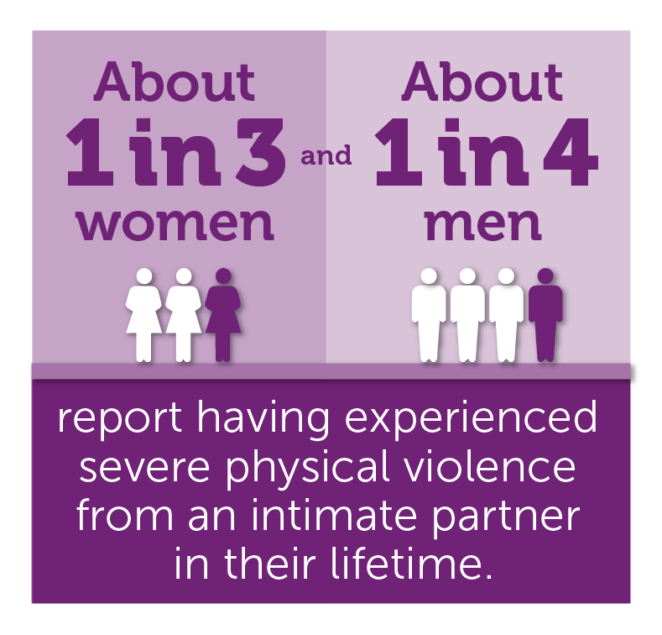
Intimate Partner Violence
Notes:
The last topic I would like to briefly discuss is intimate partner violence. About 1/3 women experience severe physical violence. And I would like to tell you a story from my team. A patient came to WUC repeatedly – always vague complaints. I saw her at one point. I called the social worker, we asked repeatedly if she was safe, but she would not open up. 12hours after leaving WUC, she was shot 37 times. Emergency surgery could not save her or the baby. During the trauma, the baby was noted to have 6 bullet holes. The reason I bring this topic up, is because there is a lot of evidence that communities MAKE A DIFFERENCE with IPV – we cannot tolerate violence against one another.

Slide 13
THANK YOU!
References:
https://www.cdc.gov/healthequity/features/7facts-womens-health/index.html
ACOG CO 755 Well-Woman Visit
US DHHS Office on Women’s Health
Guttmacher Institute
https://www.cdc.gov/violenceprevention/intimatepartnerviolence/fastfact.html
If you need to reach me at UMMC: elutz@umc.edu
OBGYN at UMMC: 601-984-5325

