Slide 1

Brief COVID-19 Update
Paul Byers, MD
State Epidemiologist

Slide 2
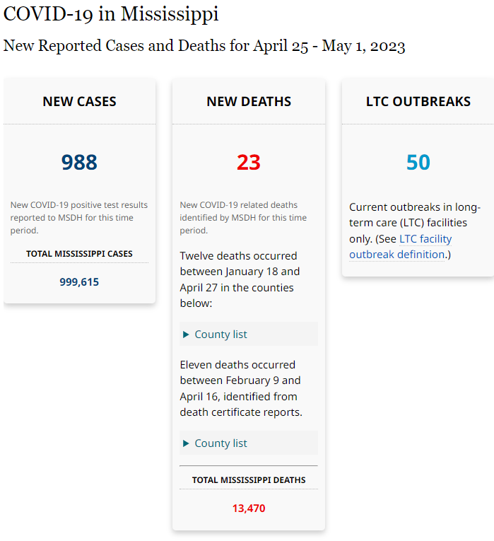
Ending US Public Health Emergency May 11, 2023

Slide 3
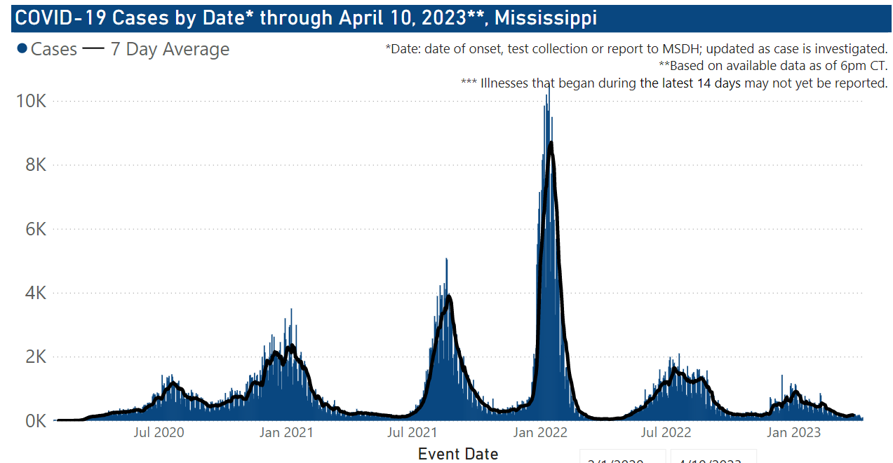

Slide 4
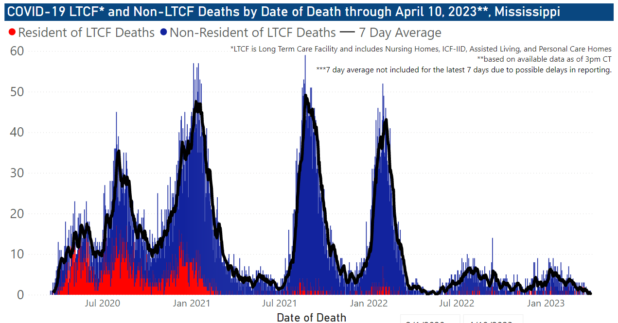

Slide 5
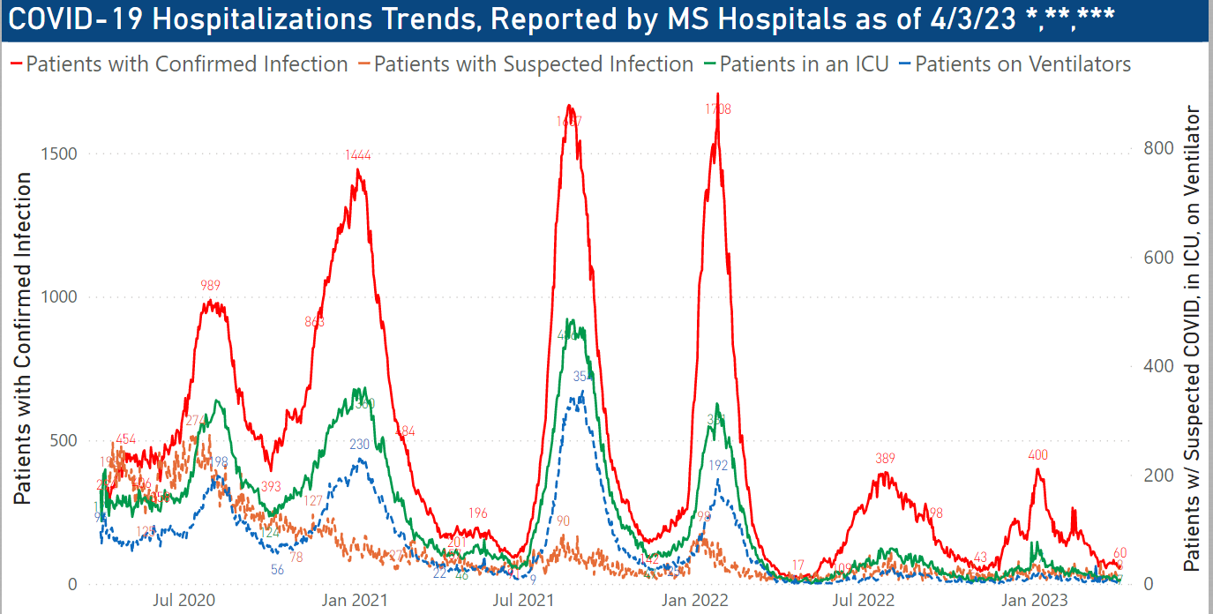

Slide 6
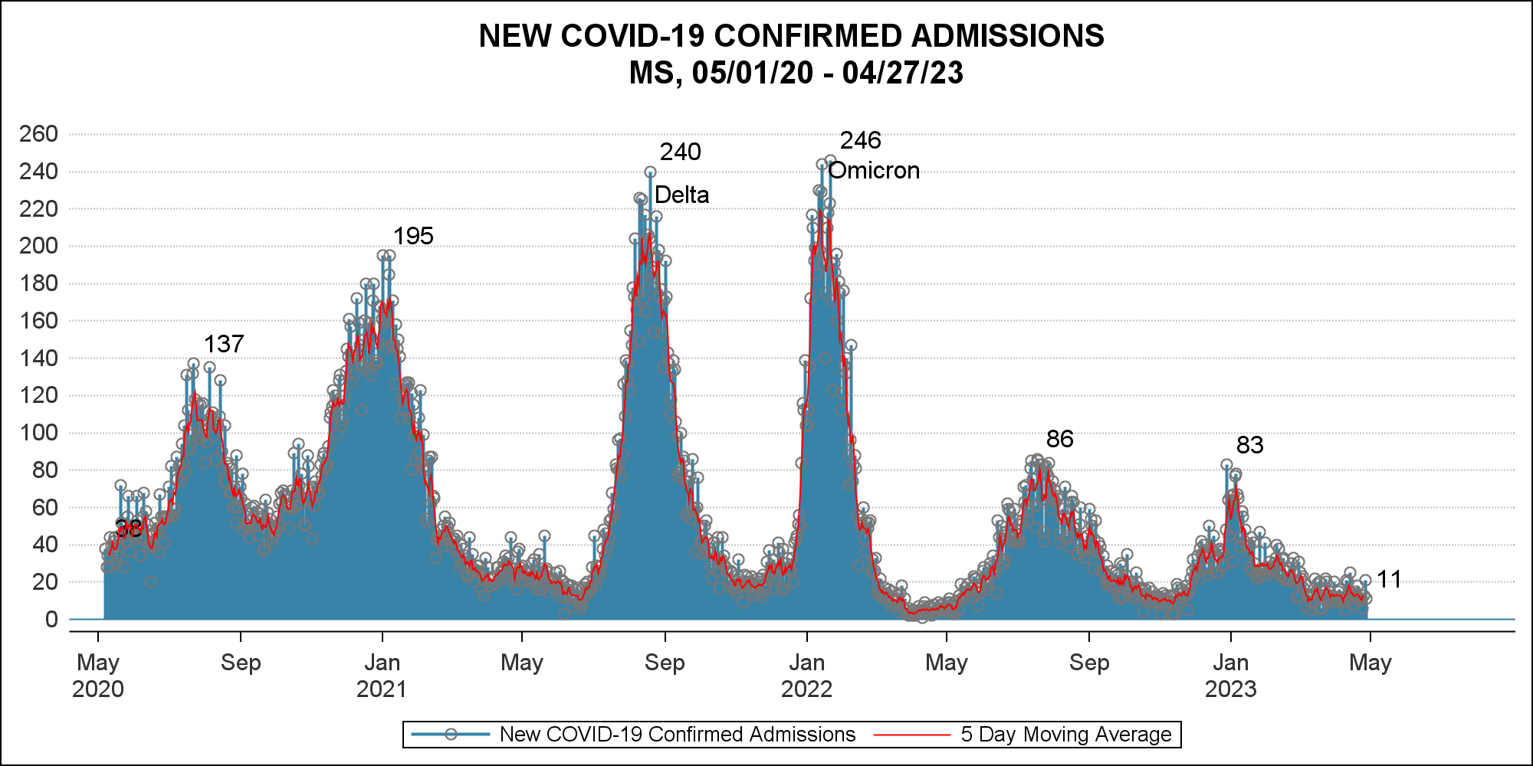
New Admissions

Slide 7
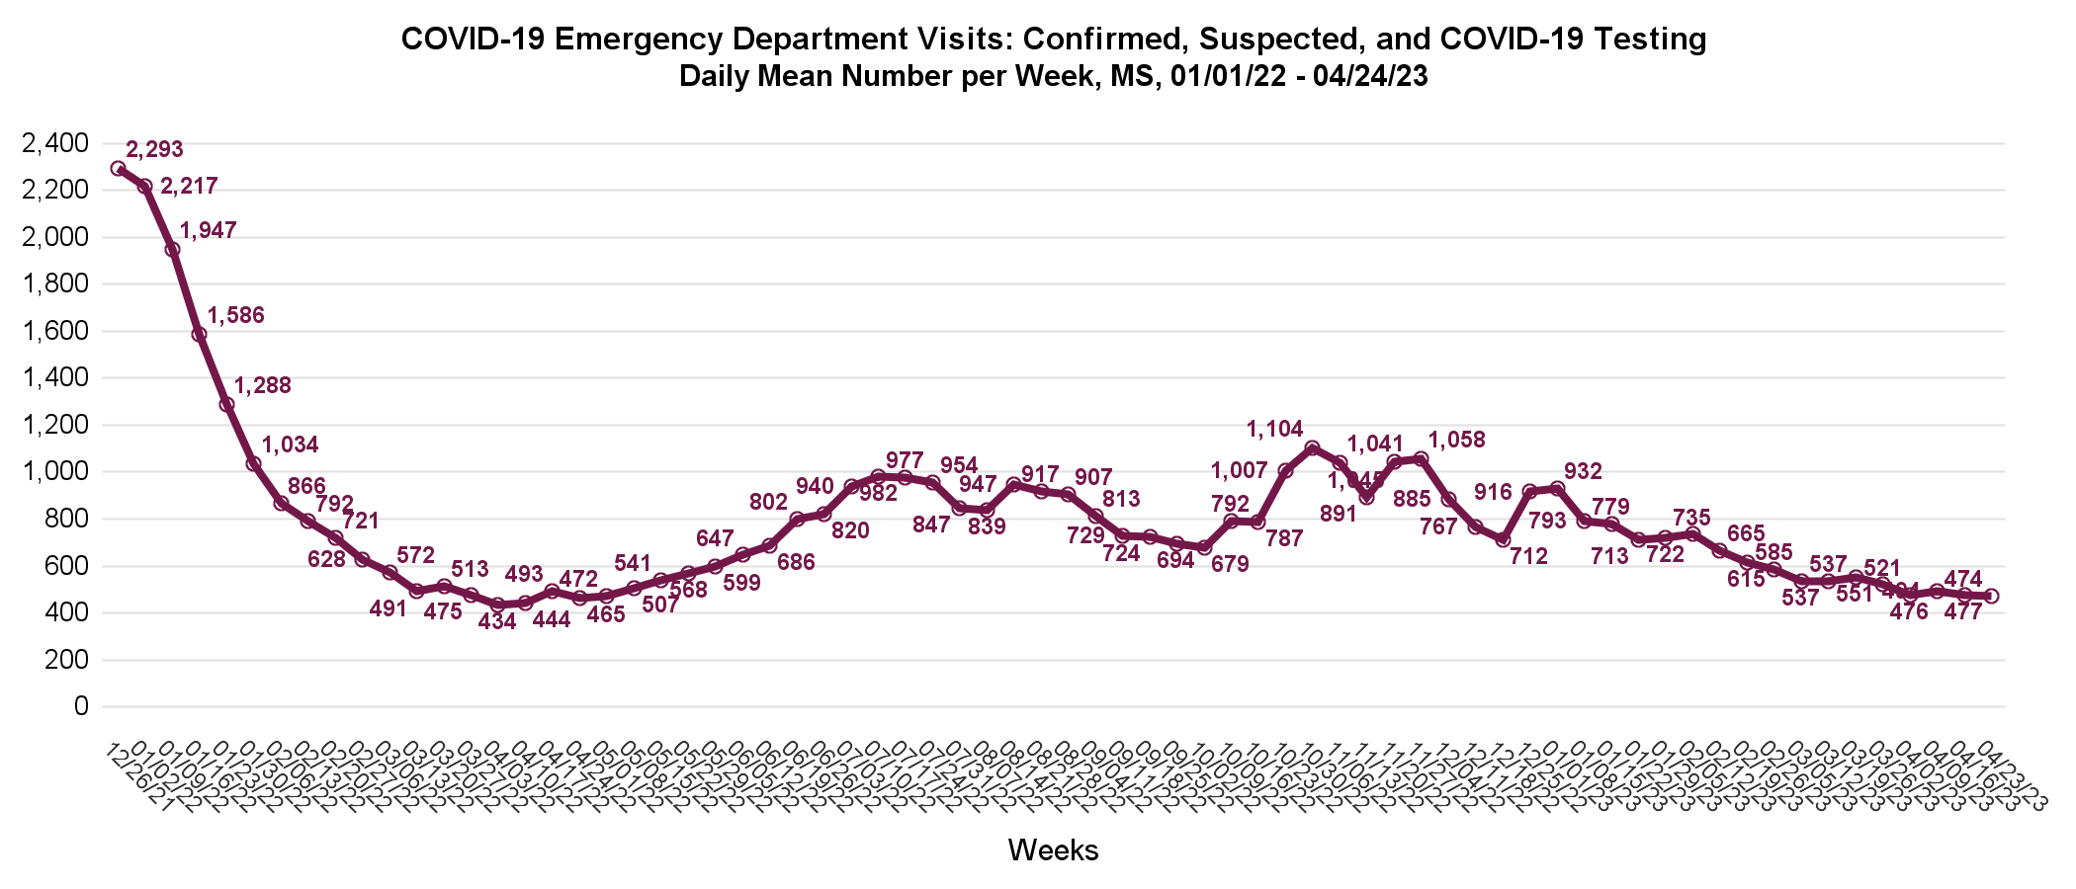
ED Visits – Average per Week

Slide 9
Vaccination-Stay Up to Date
You are up to date with COVID-19 vaccines when you receive one dose of the updated bivalent Pfizer or Moderna COVID-19 vaccine. See Stay Up to Date with COVID-19 Vaccines | CDC
All individuals should receive at least one dose of the updated bivalent Pfizer or Moderna COVID-19 vaccine to be up to date with COVID-19 vaccines.
Individuals aged 65 years and older are eligible to receive an additional dose of the updated bivalent Pfizer or Moderna COVID-19 vaccine if it’s been at least 4 months after the last dose of bivalent vaccine.
Persons who are moderately or severely immunocompromised are eligible to receive an additional dose of updated bivalent Pfizer or Moderna COVID-19 vaccine if it’s been at least 2 months after the last dose of bivalent vaccine.

Slide 10

Questions?

