Slide 1


Slide 2
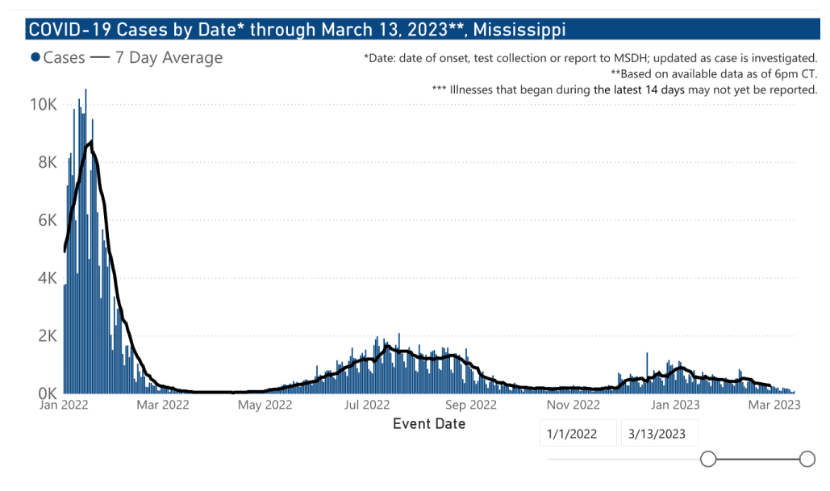
But first... an update on COVID

Slide 3
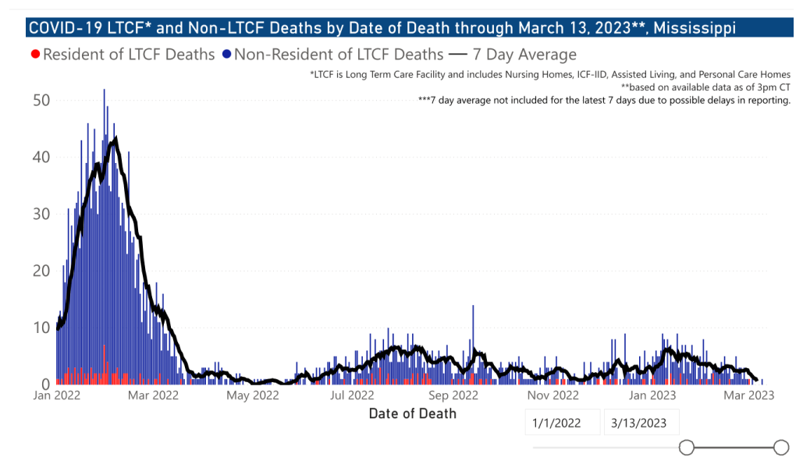
Deaths

Slide 4
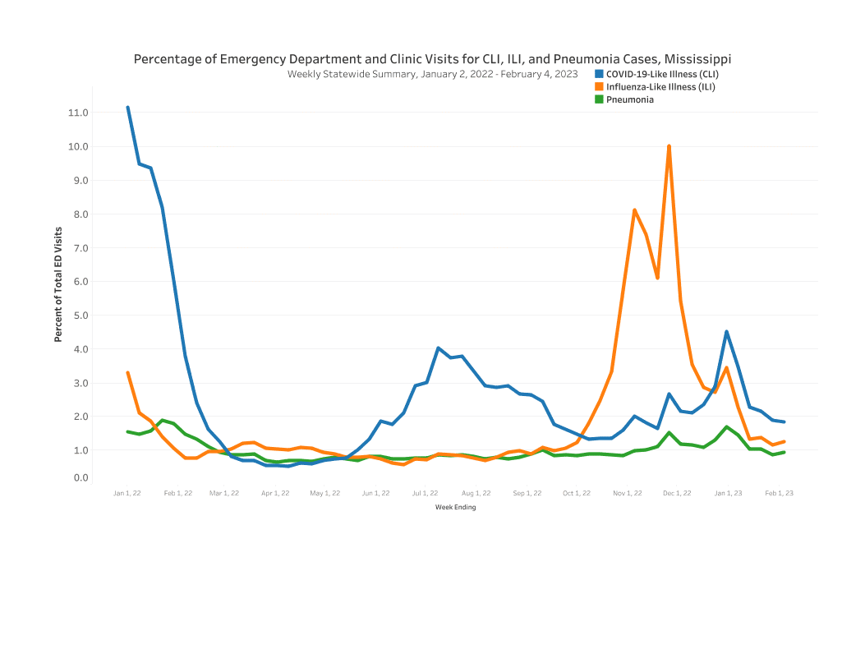
Syndromic Surveillance

Slide 5
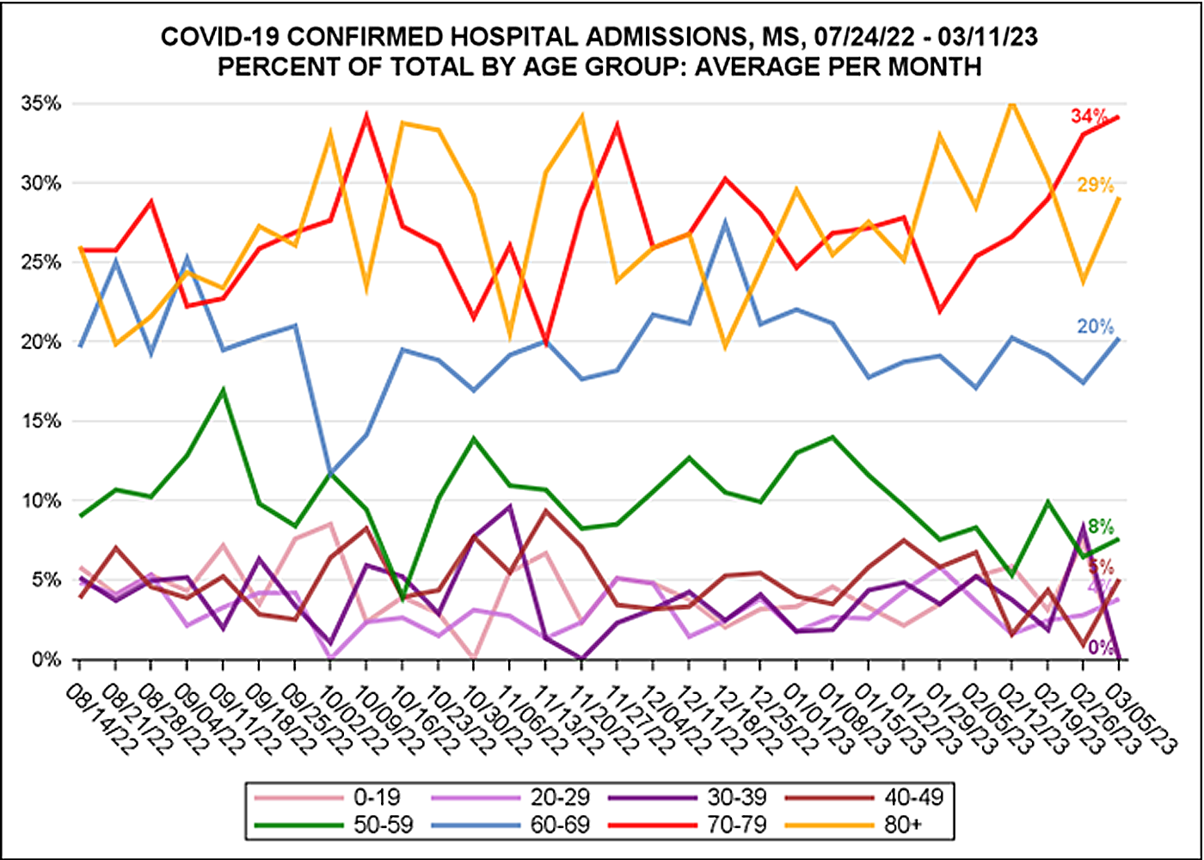
Hospitalizations by Age Group

Slide 6
Key Messages
COVID is still around but not with a high prevalence
Most severe impacts in older Mississippians
Prevent Disease – Bivalent Booster Dose
If you are ill...
  Get tested
  Get treated

Slide 7
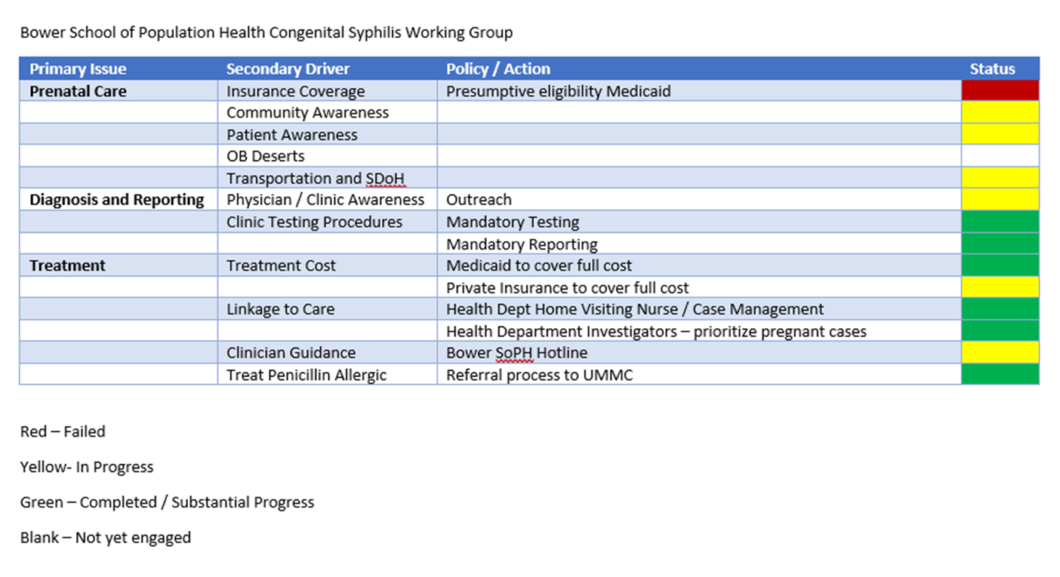
Update on Efforts to Fight Congenital Syphilis

Slide 8
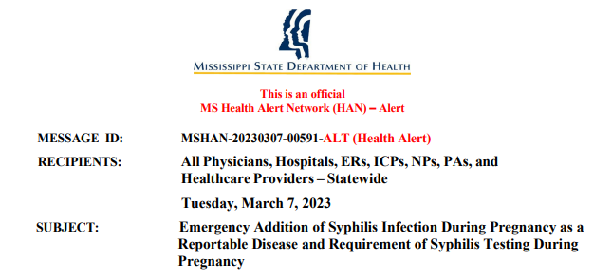
https://msdh.ms.gov/msdhsite/index.cfm/23,19717,386,pdf/Syphillis_Testing_During_Pregnancy_Required.pdf

Slide 9
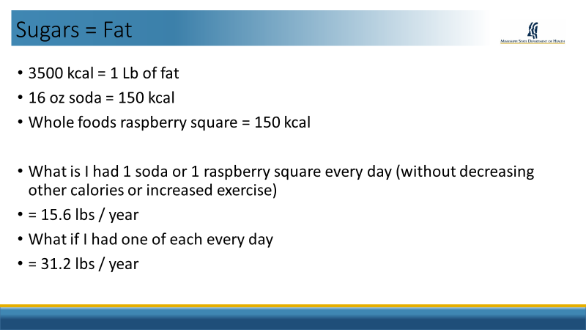
Health in MS: Nutrition and Fitness

Slide 10
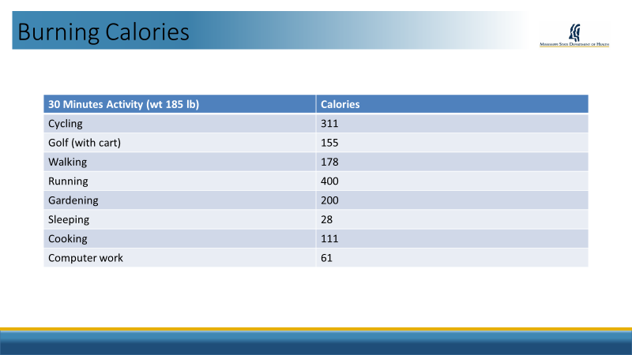

Slide 11
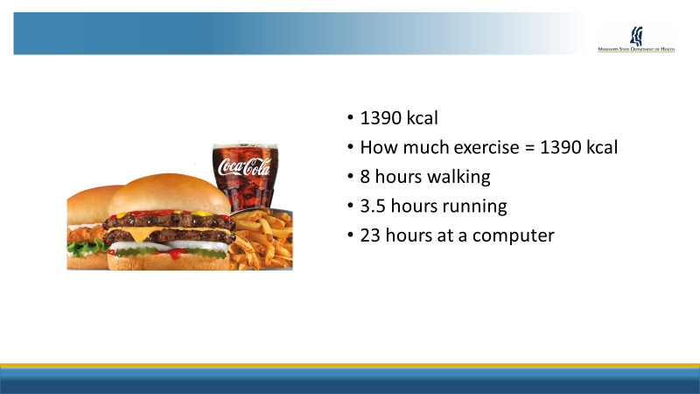

Slide 12
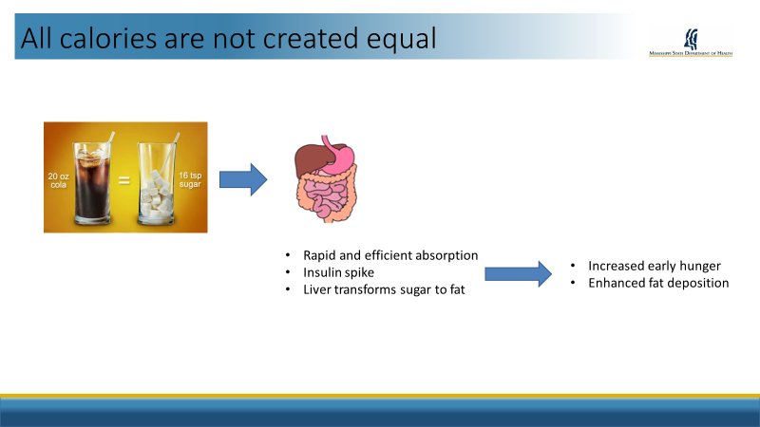

Slide 13
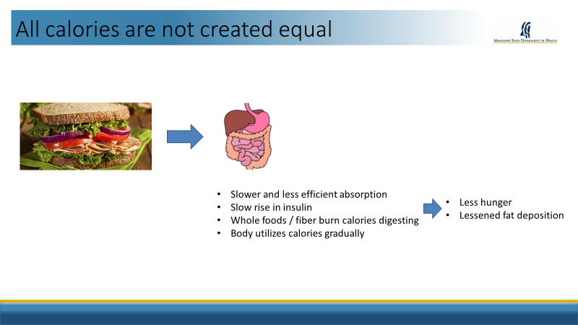

Slide 14
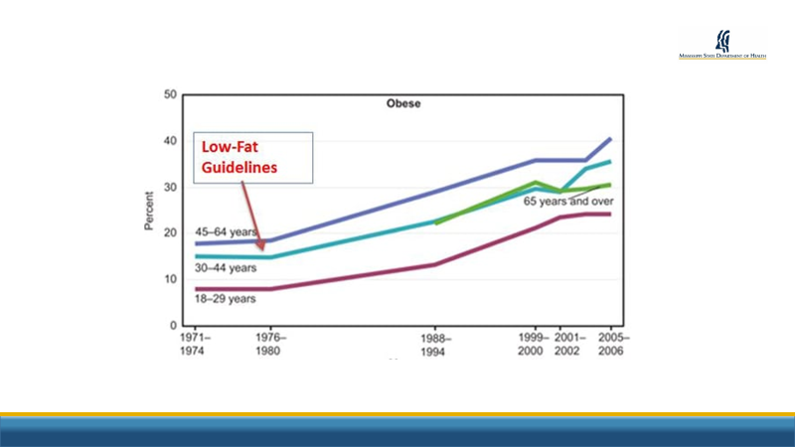


Slide 15
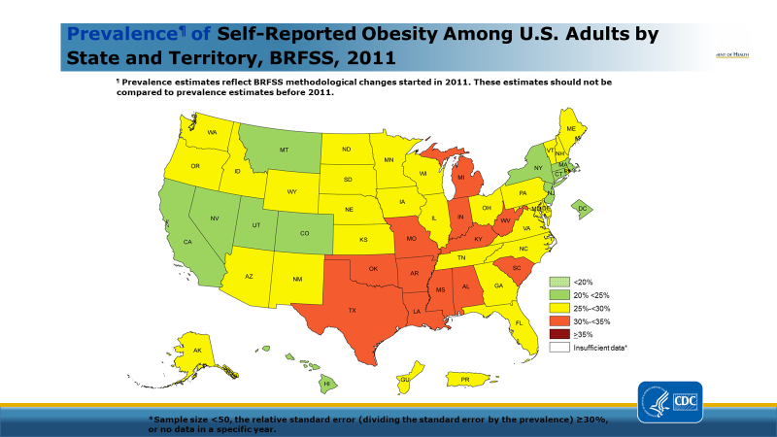

Slide 16
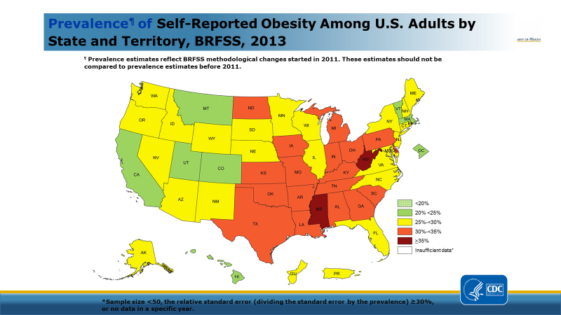

Slide 17
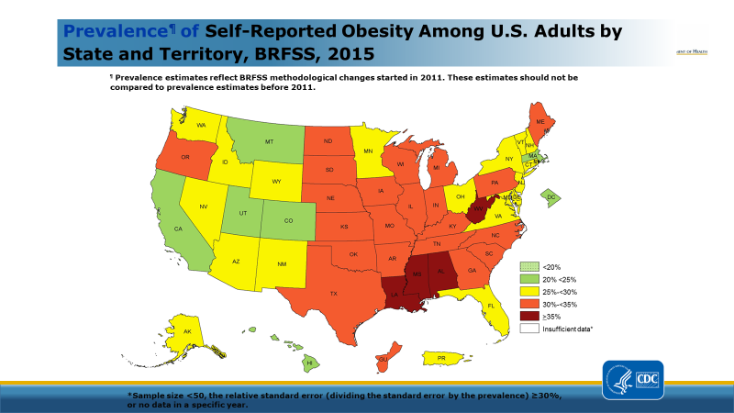

Slide 18
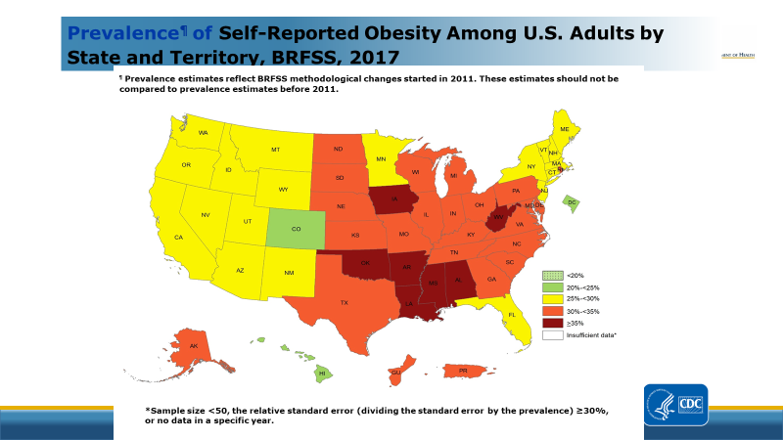

Slide 19
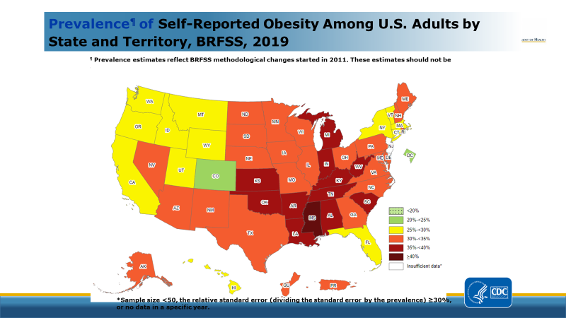

Slide 20
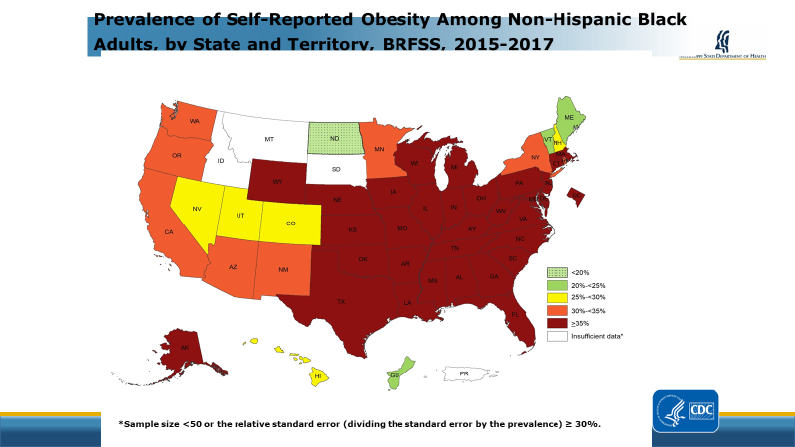

Slide 21
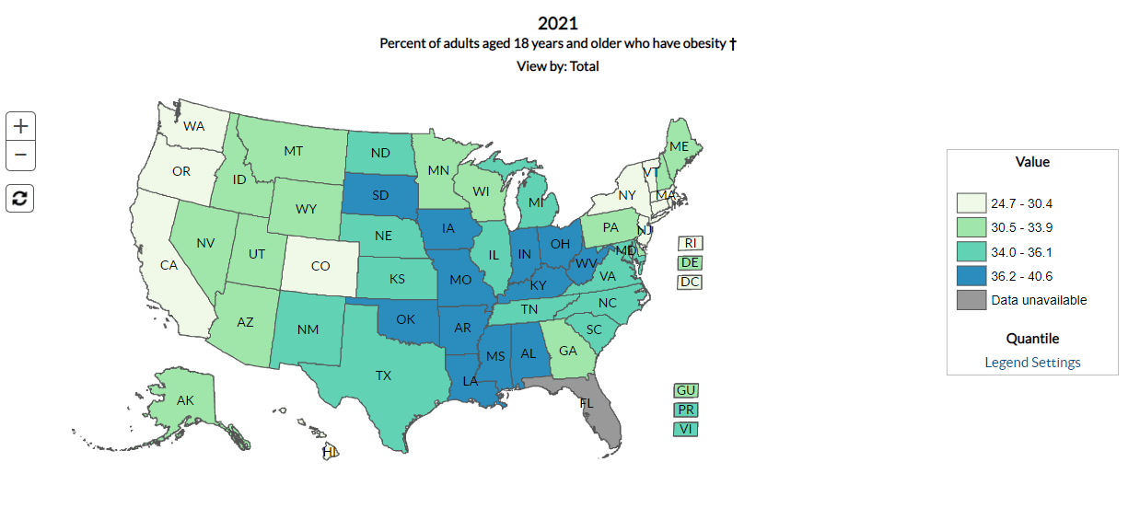

Slide 22
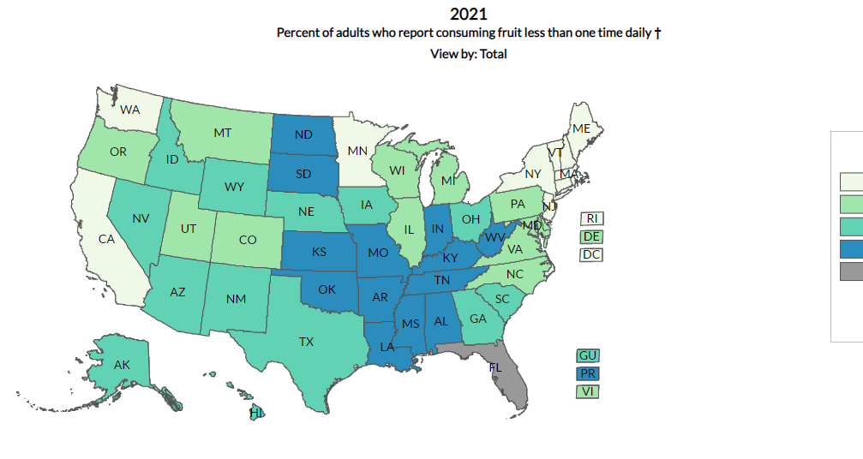

Slide 23
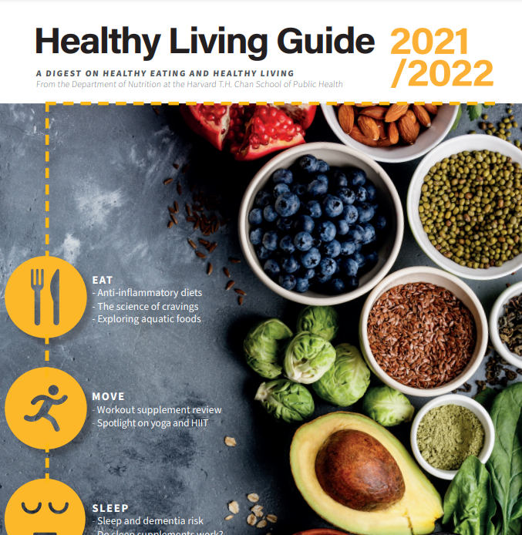
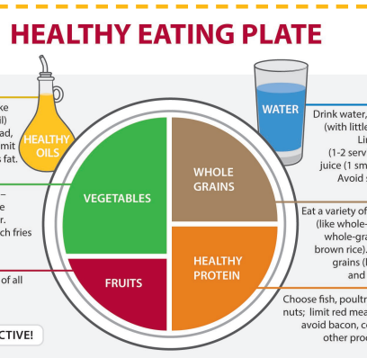
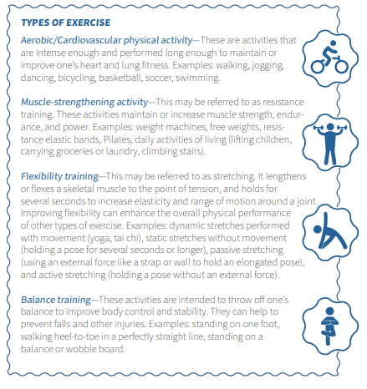

Healthy Living Guide
https://www.hsph.harvard.edu/nutritionsource/wp-content/uploads/sites/30/2022/01/HealthyLivingGuide21-22.pdf

Slide 24
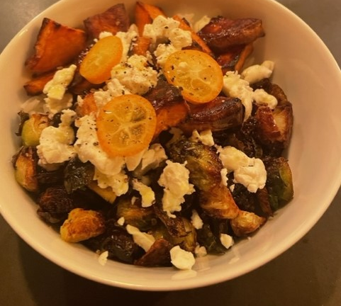
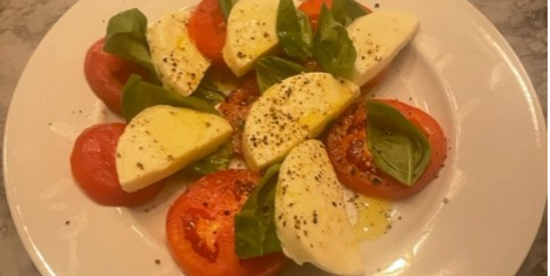
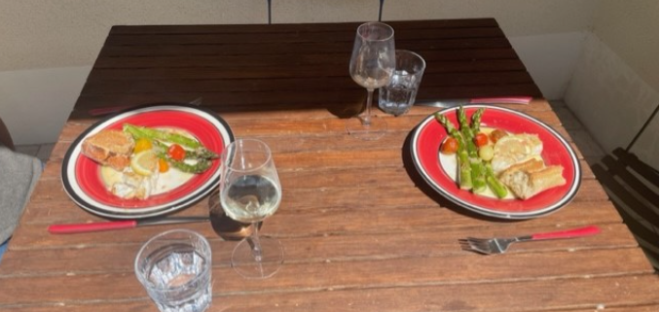
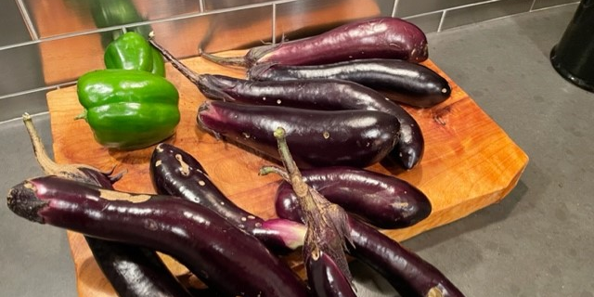
Good Food
These are a few of my favorite things...

Slide 25
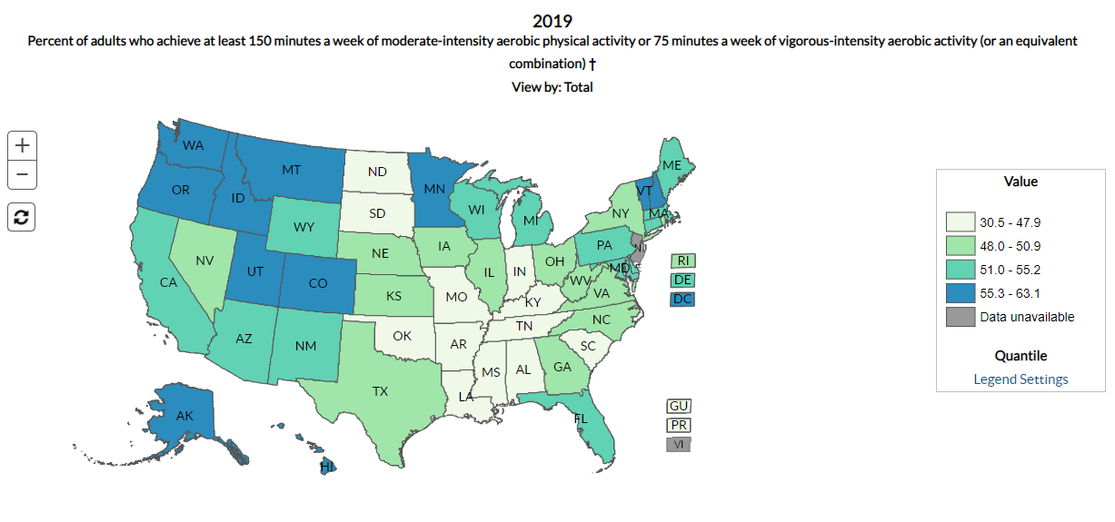

Slide 26
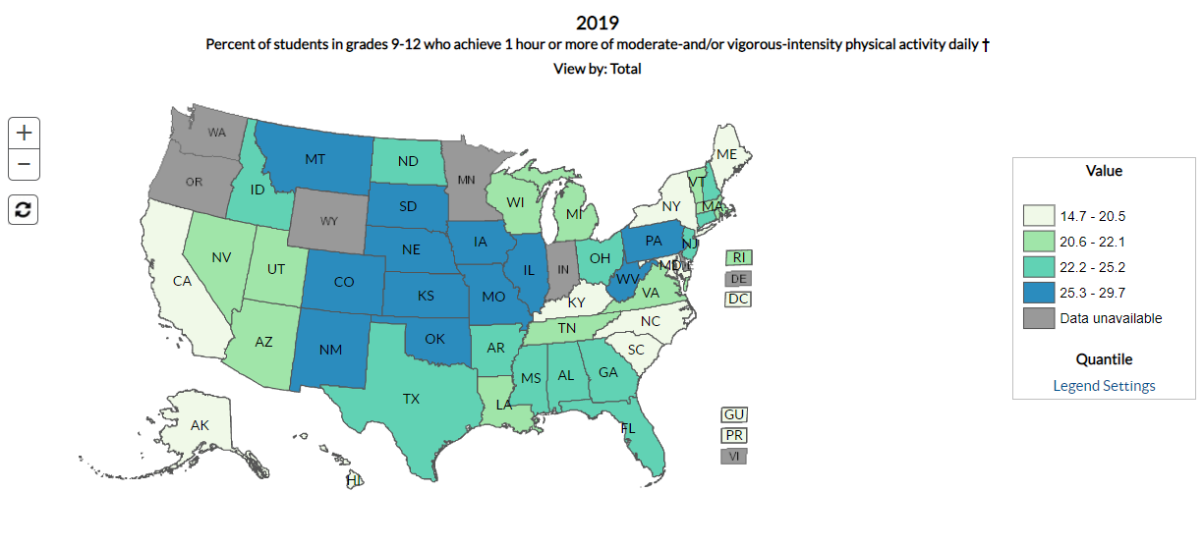

Slide 27
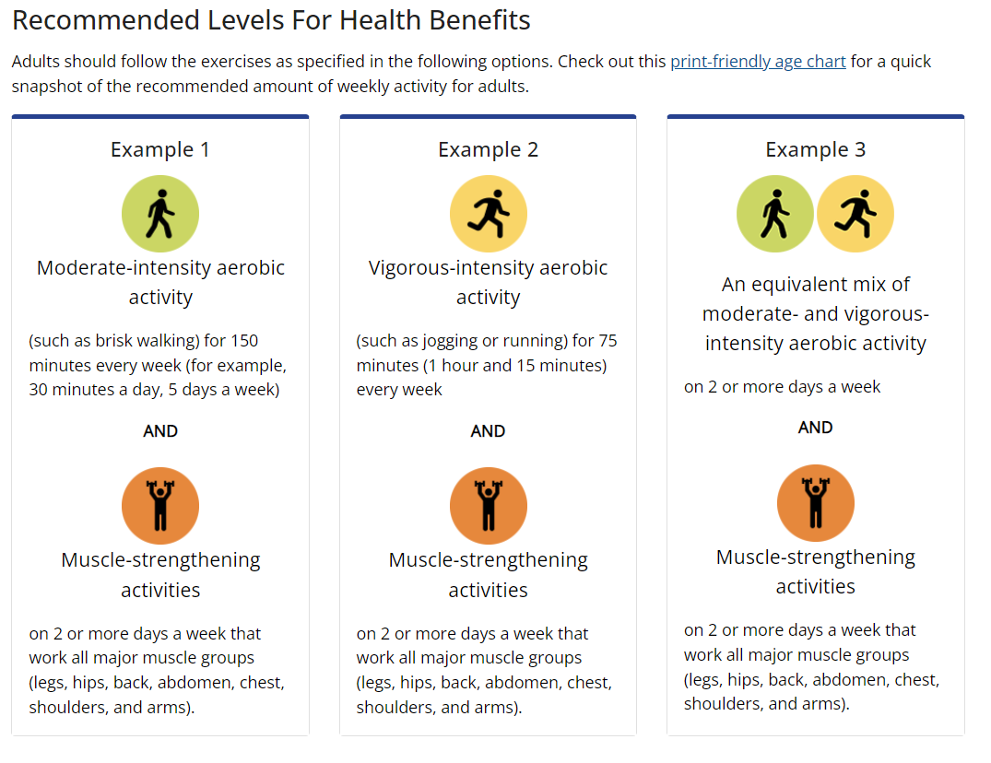

Slide 28
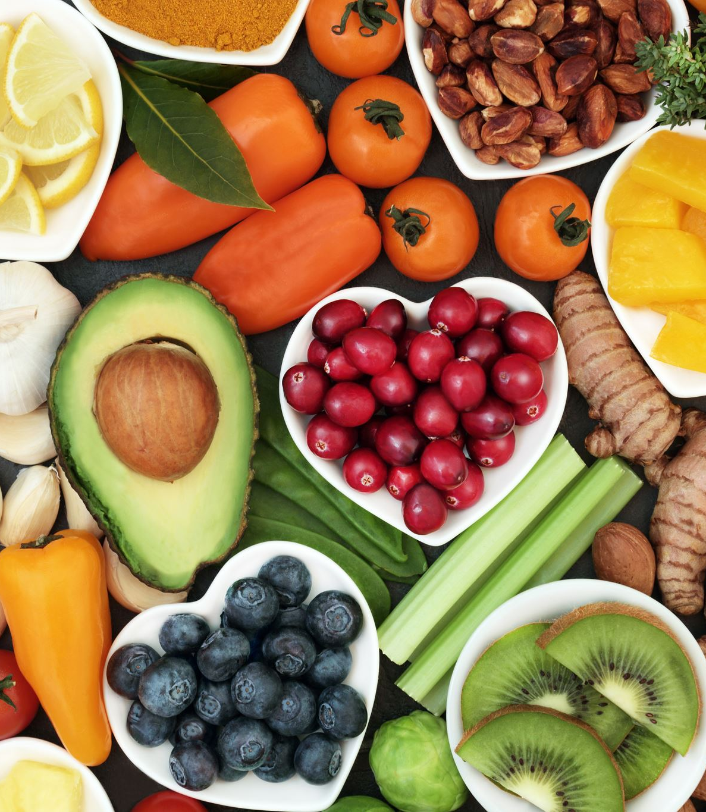
General Guidelines
Eat real food / mostly vegetables (avoid sugar sweetened drinks)
Exercise regularly / be active
Watch the sweets / snacks

Slide 29
