Slide 1



Mississippi Health Ambassadors
1/19/2023

Slide 2

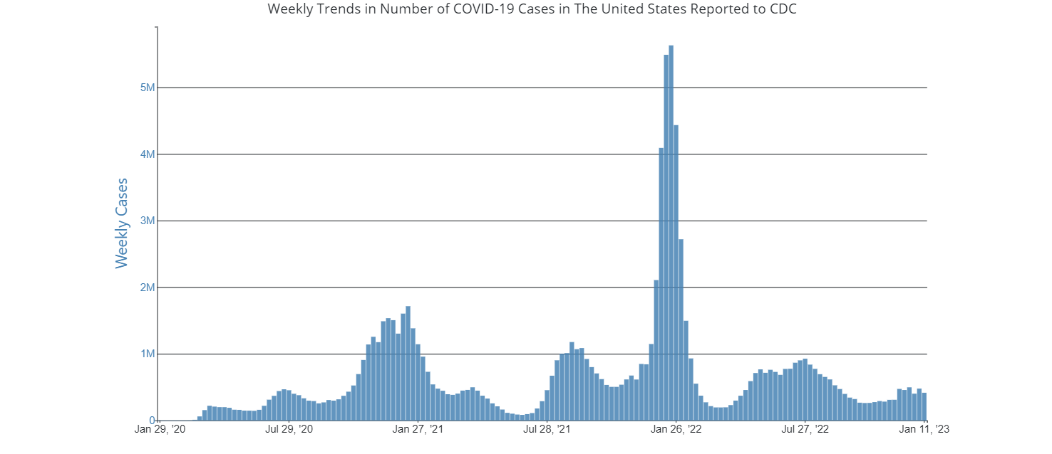
Trends in covid

Slide 3
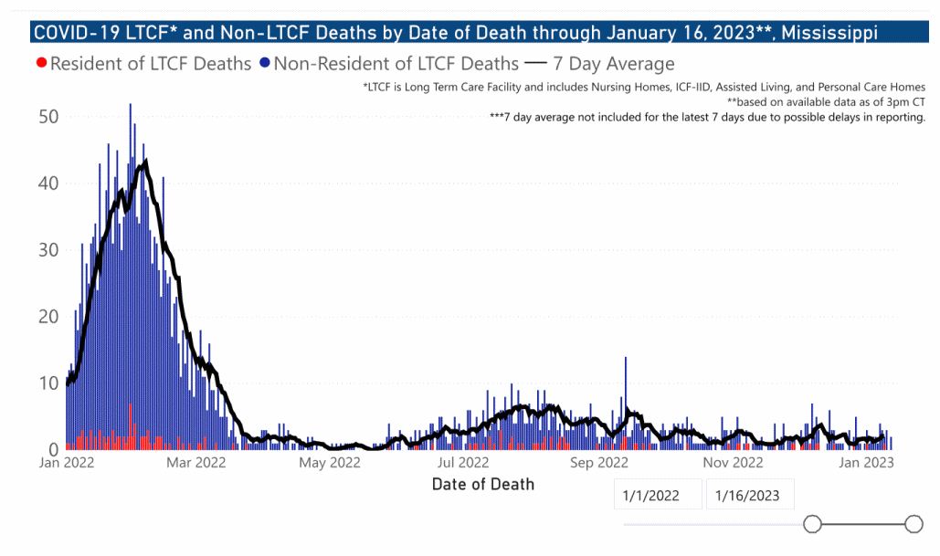
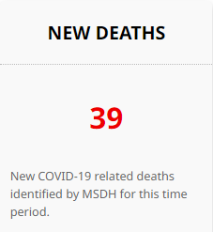
39 COVID Deaths past 14 days

Slide 4
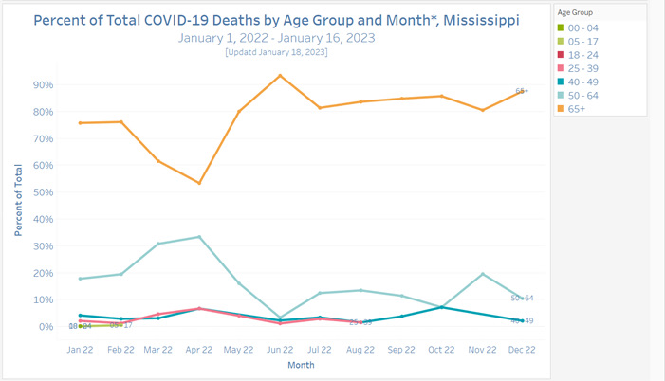

Slide 5
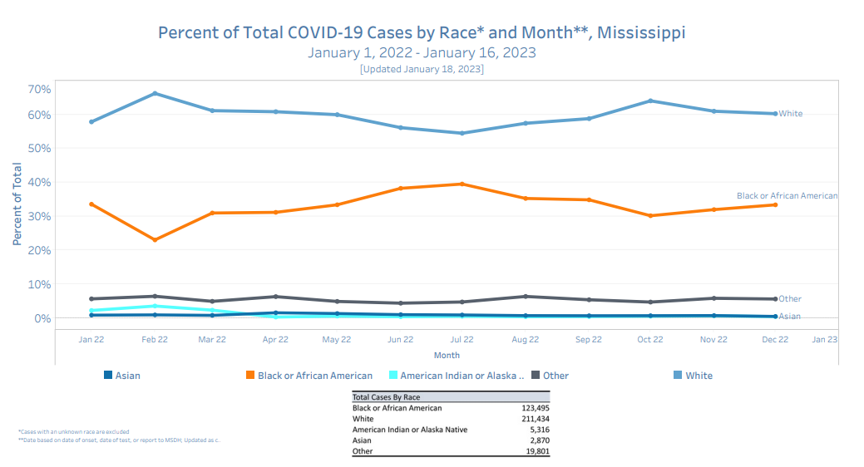

Slide 6
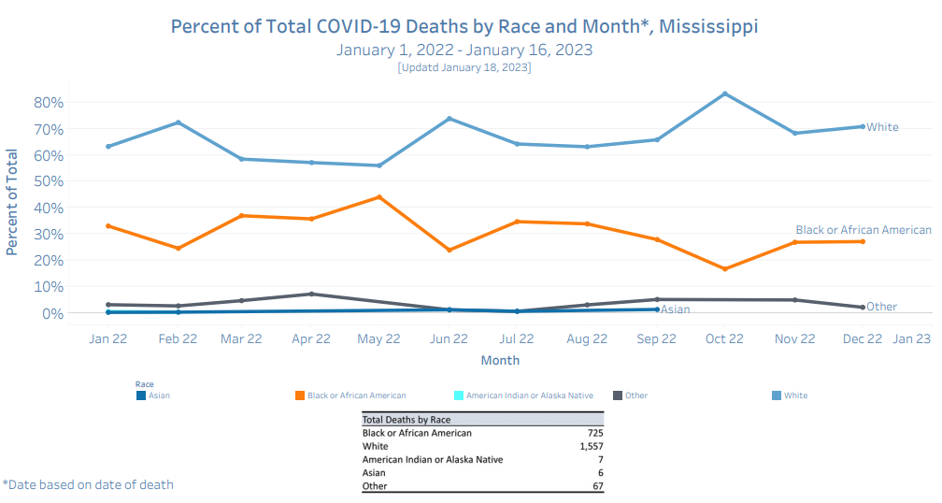

Slide 7
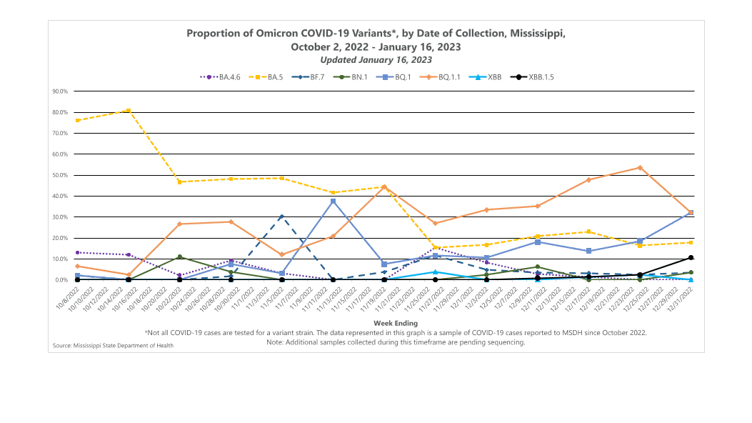

Slide 8
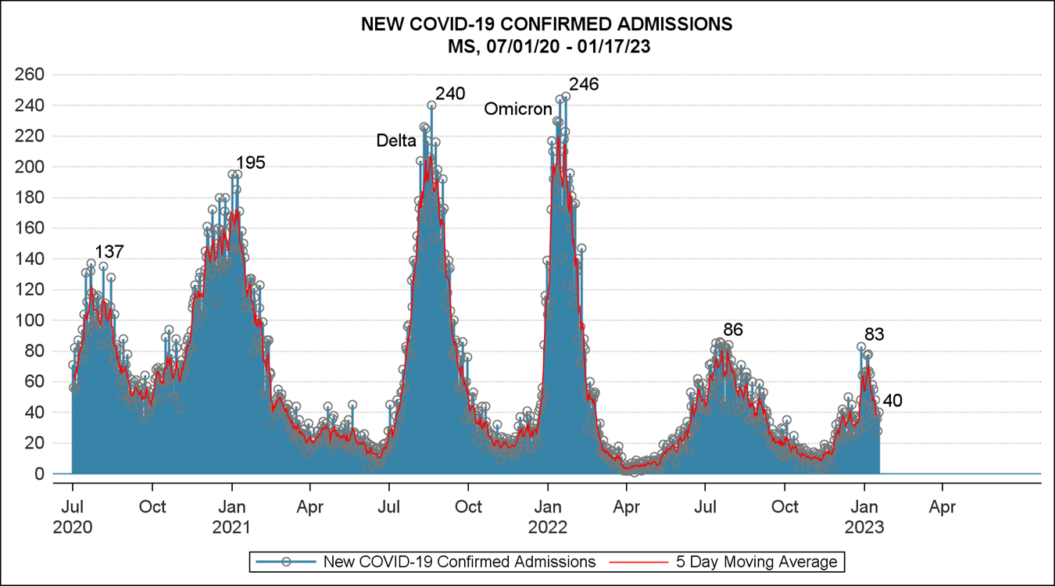

Slide 9
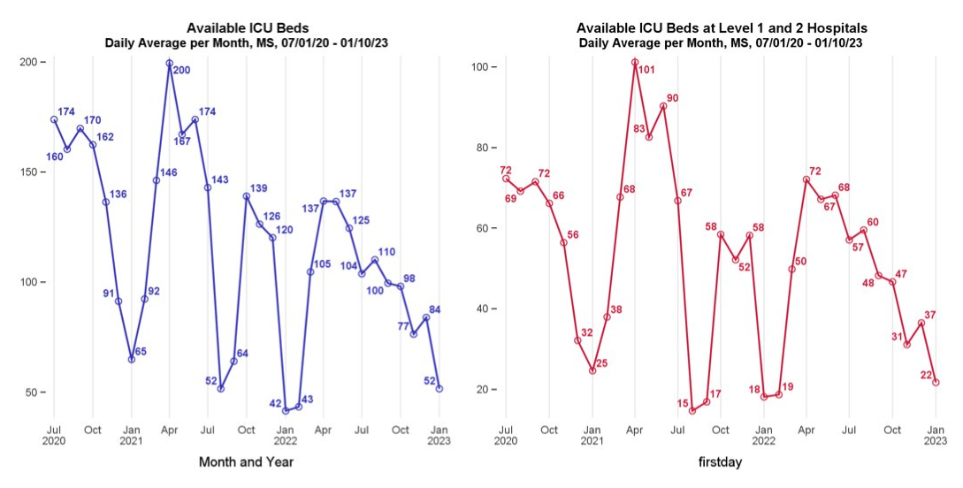

Slide 10
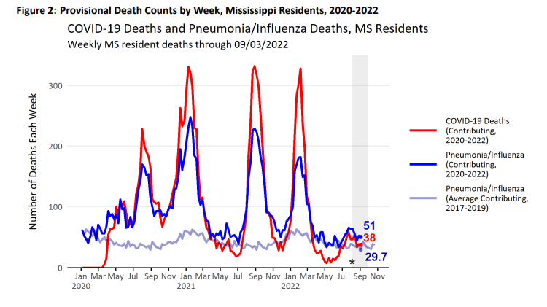

Slide 11
New ISSUES
? Increased risk of Stroke in people > 65 with Pfizer (but not moderna) bivalent (2 strain) booster
Efficacy of bivalent booster vs "normal" vaccine

Slide 12




Slide 13
Key points
Covid transmission ongoing
New variants likely to come and go
Deaths continuing but at lower rate
Vaccines still effective at preventing severe disease
Medications effective – paxlovid
Monoclonal antibodies not currently effective

Slide 14
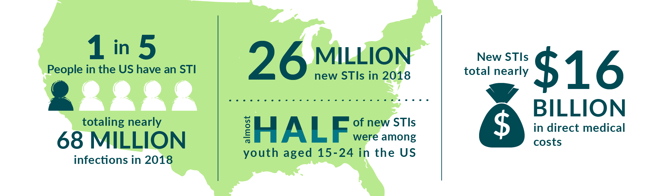

Slide 15
STDs in MS
Mississippi Ranks #1 (in a bad way) for Gonorrhea and chlamydia
Mississippi is tied for #1 with nevada in syphilis

Slide 16
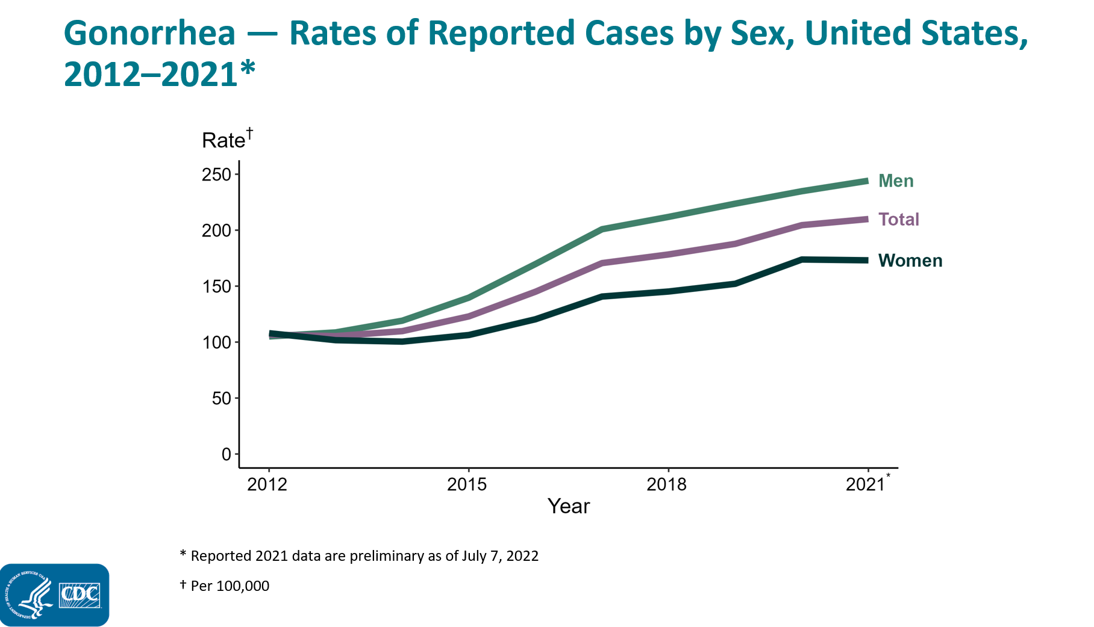

Slide 17
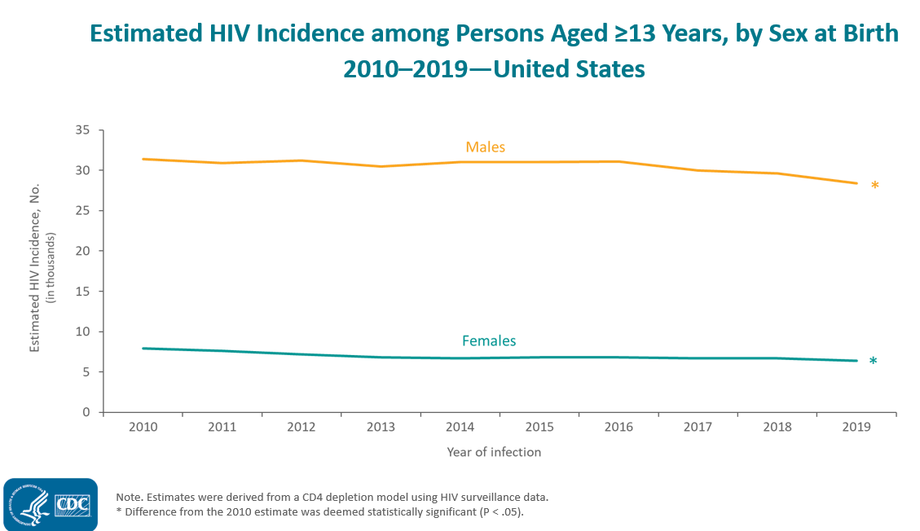

Slide 18
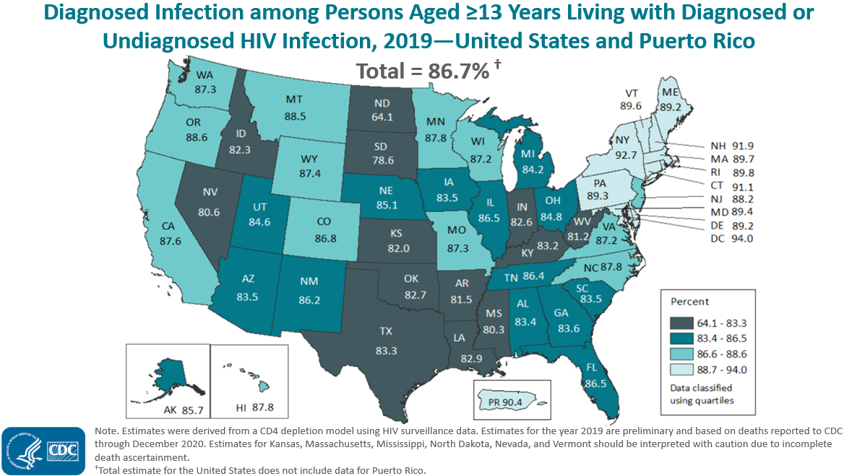

Slide 19
HIV Basics
Chronic viral infection that weakens immune system over years
Transmission via sexual contact, blood transmission, mother-child in utero
Early Treatment leads to ~normal life span
treatment leads to non-contagiousness
Maternal transmission ~1/3 of the time, reduced to ~0% with treatment
Pre-exposure prophylaxis (daily medication prevention) ~97% effective

Slide 20
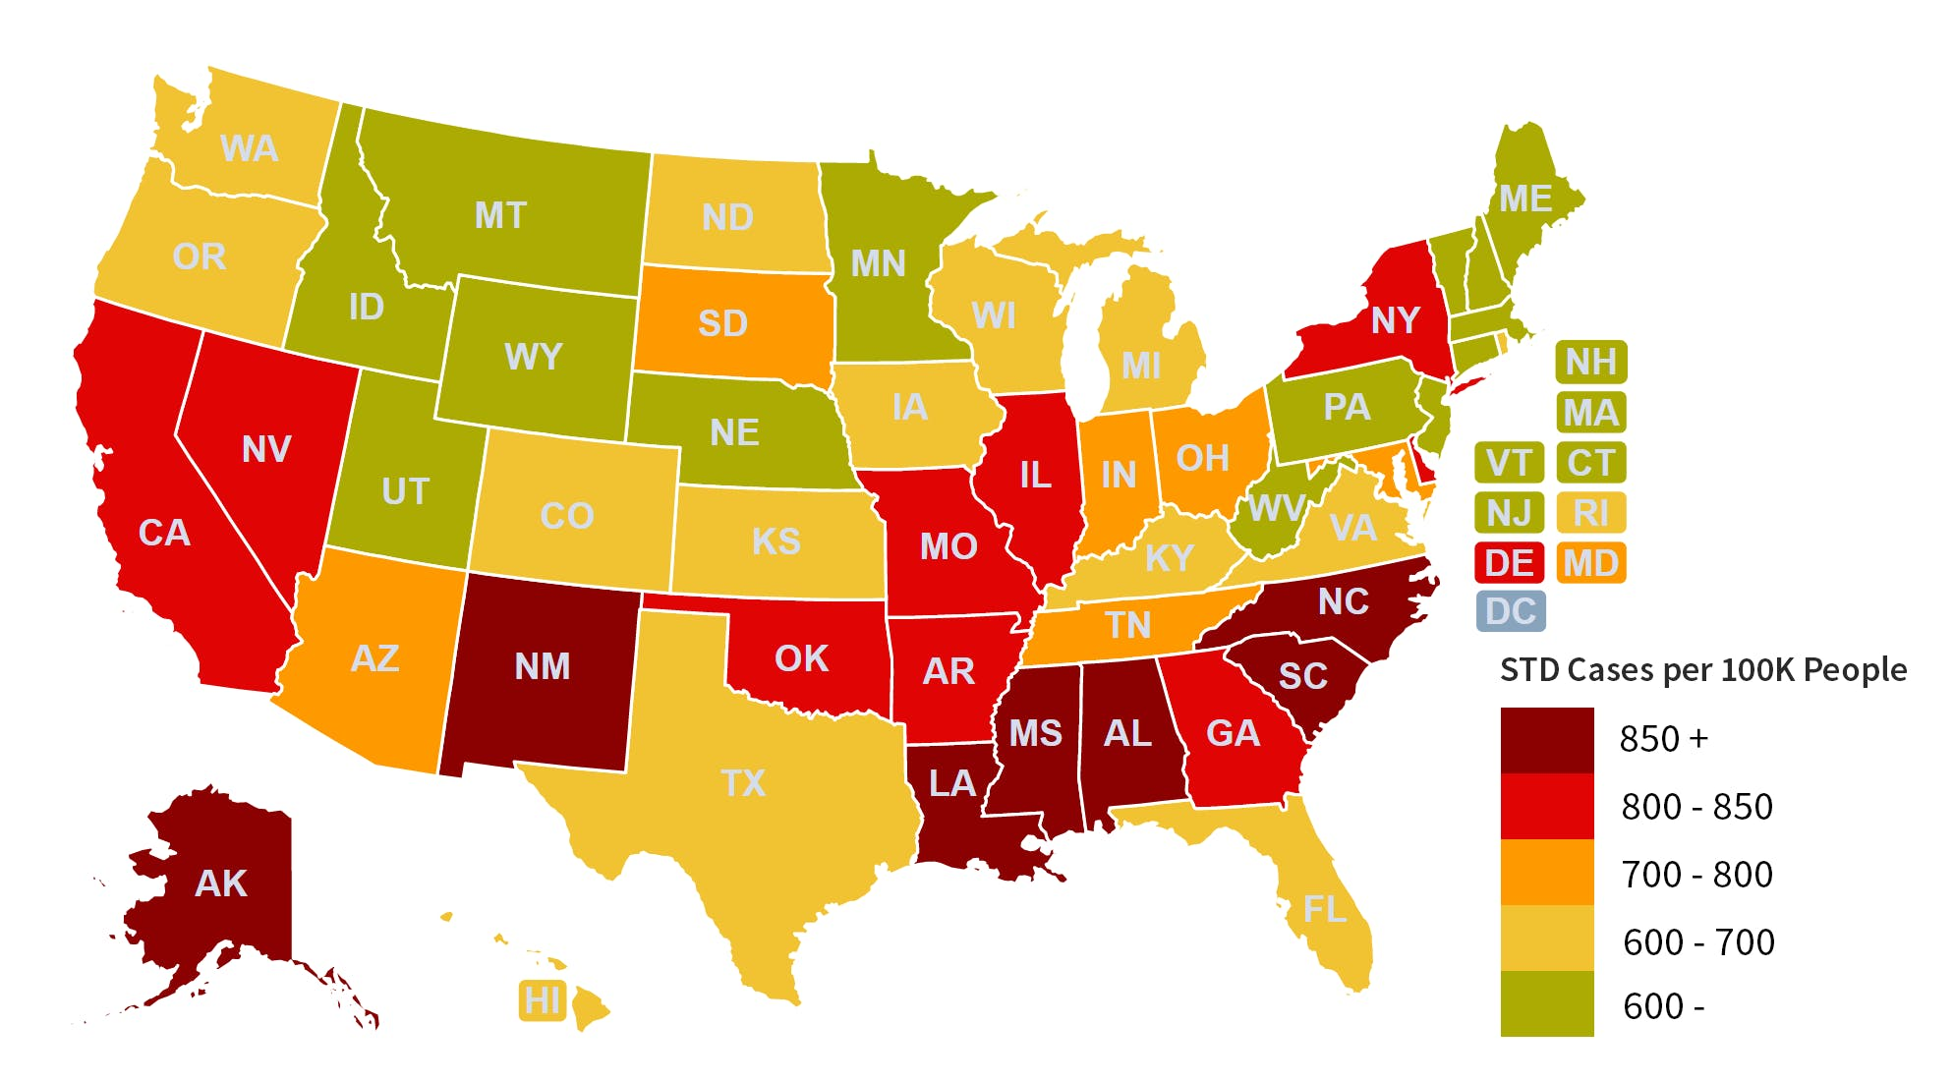
STD's in MS
Mississippi has the highest rate of gonorrhea and chlamydia in the US by a wide margin
Mississippi is toed for #1 in syphilis with nevada

Slide 21
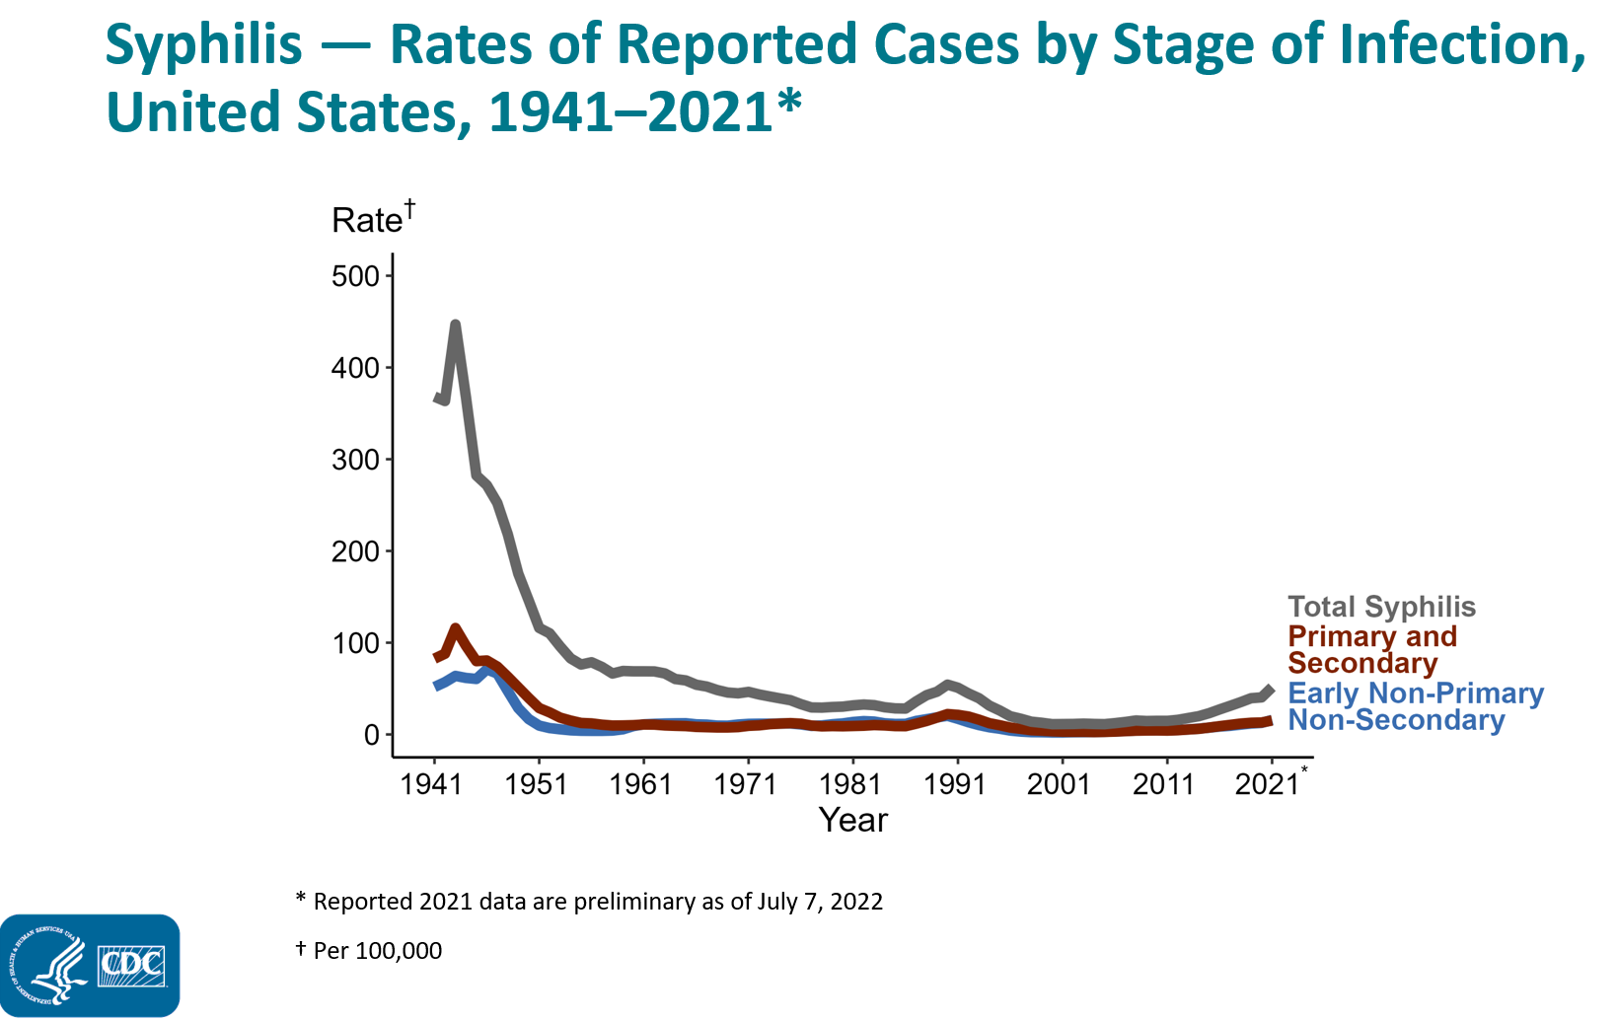

Slide 22
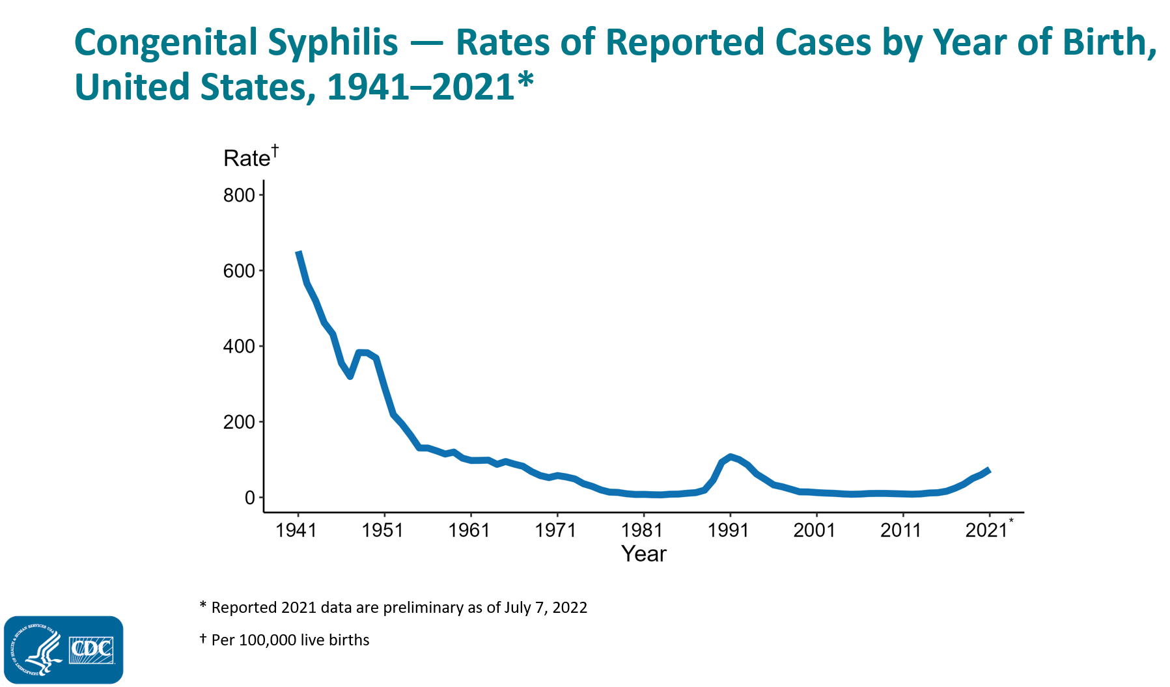

Slide 23
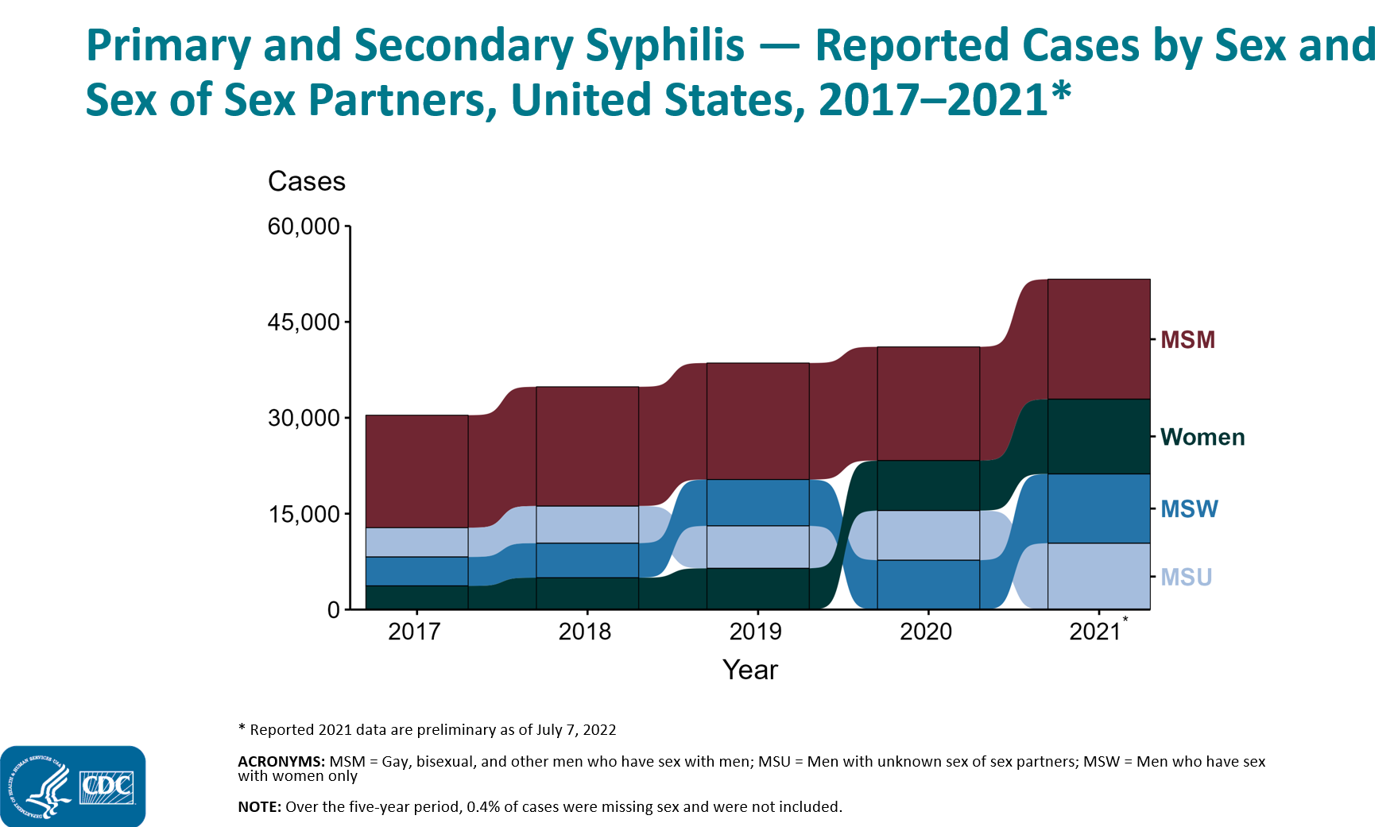

Slide 24
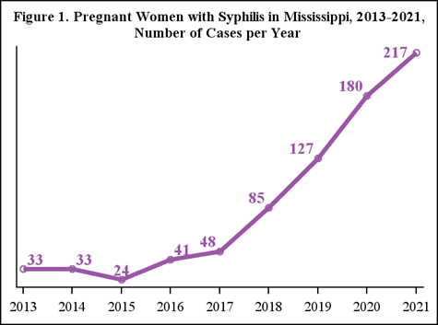

Slide 25

What is Syphilis
Bacterial Infection
Acute illness – ulcers
Untreated – chronic infection
Transmission – primarily sexual contact with infectious lesions
Mother – Child transmission in utero

Slide 26
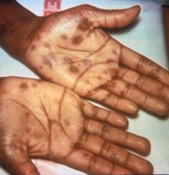
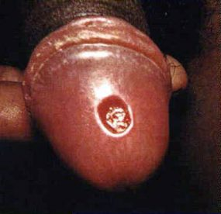
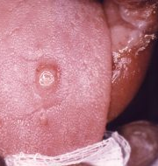
Early Lesions

Slide 27

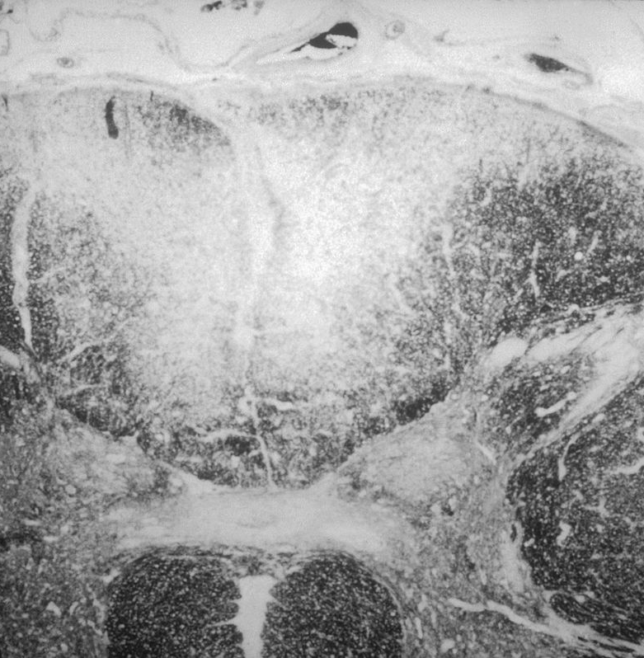
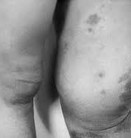
Chronic Syphilis

Slide 28
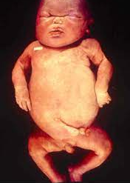
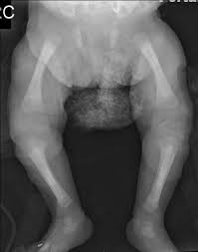
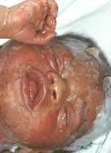
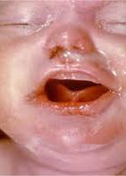
Congenital Syphilis

Slide 29
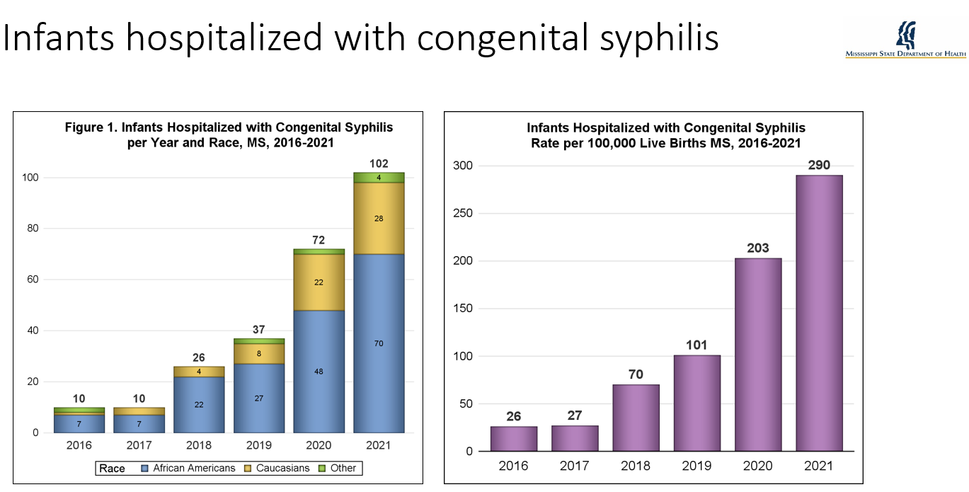

Slide 30
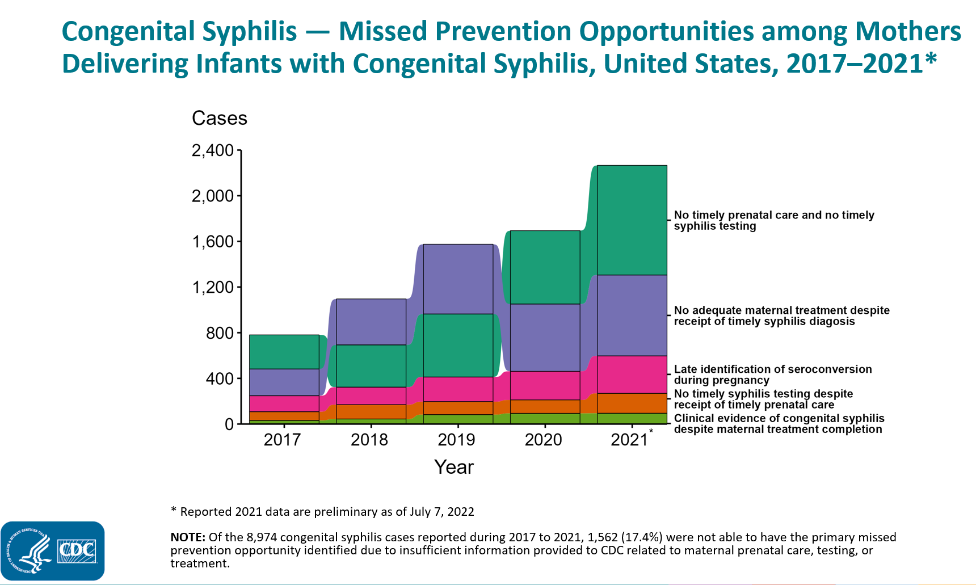

Slide 31
Key components of the MS congenital syphilis crisis
Patients
Awareness of risk
Understand need of early prenatal care
Doctors/Providers
Awareness of risk
Appropriate testing and treatment
Engaging in early prenatal care
Insurance Providers
Eligibility barriers (Medicaid)
Reimbursement for treatment
Department of Health
Rapid engagement of new cases
Contact tracing
Ensure treatment completion

Slide 32
What does MS need to do?
Women need prenatal care
Women need access to insurance coverage
  Medicaid primary insurance for pregnant women in ms
  Most clinics will not see women prior to medicaid approval (which take > 4-6 weeks)
Docs/clinics need to test early and repeat later in pregnancy
Rapid treatment of syphilis
  Penicillin used is expensive / unavailable in most clinics
  Many Docs/providers do not know how to treat

Slide 33
Presumptive eligibility
Most states have expanded medicaid or have presumptive eligibility
Presumptive eligibility allows clinics to care for women immediately with medicaid coverage
Delays in medicaid approval delay prenatal care
Presumptive eligibility saves money for the state

