Slide 1

The Mississippi Department of Mental Health provides hope by supporting a continuum of care for people with mental illness, alcohol and drug addiction, and intellectual or developmental disabilities.
The Time is Right…For HOPE
Mississippi Health Ambassador Program

Slide 2


Slide 3

Providing Hope Through Services and Supports – Children and Youth
Navigate - assists Mississippians, 15-30 years of age, who have experienced their first episode of psychosis.
Wraparound Facilitation - family and youth guided and provides intensive services to allow children and youth to remain in their homes and community.
Juvenile Outreach Programs - improve behavioral and emotional symptoms, and to prevent future contacts between youth and the youth courts.
Youth/Young Adult Peer Support Specialists - a person between the ages of 18‐26 with lived experience with a behavioral health or substance use diagnosis.
Intensive Community Support - coordination of appropriate services and the provision of constant and on-going support as needed by the child or youth and their family.
Early Intervention and Training – Mental Health First Aid, suicide prevention efforts, and SEL pilots in Mississippi schools.
Notes:
Navigate is an evidence-based program that assists Mississippians, 15-30 years of age, who have experienced their first episode of psychosis. Through Navigate, Coordinated Specialty Care Teams provide early intervention and recovery-oriented services shown to improve outcomes in youth and young adults who are at risk for serious mental illness. This recovery-oriented approach bridges existing resources for this population and eliminates gaps between child, adolescent, and adult mental health programs. DMH funds the program at Life Help, Hinds Behavioral Health Services, Warren-Yazoo Behavioral Health, Gulf Coast Mental Health Center, and Region 8 Mental Health Services. Added Regions 2, 4, 7, and 14 in FY22. Interventions include intensive case management, individual or group therapy, supported employment, education services, family education and support, medication management, and peer support services. This approach bridges existing resources and eliminates gaps between adolescent, and adult programs. In FY22, the program served 83 youth/young adults.
In partnership with the Division of Medicaid and the University of Southern Mississippi’s School of Social Work, DMH created the Mississippi Wraparound Initiative to train, support, and sustain high-fidelity Wraparound in the state. The Institute facilitates all monthly trainings, develops guidelines and processes for Wraparound Facilitation, provides technical assistance, coaching sessions, and collects data for continued quality improvement. In FY22, 559 individuals were trained, and 15 providers were certified to provide Wraparound Facilitation. In FY22, 1,887 unduplicated children and youth received Wraparound Facilitation and 495 received it as an alternative to a more restrictive environment.
What began as an effort to develop a collaborative partnership for Juvenile Outreach Programs (JOP) in 2010 has turned into a sustained program that Served 2,150 youth in FY22. The programs provide assessments, community support, wraparound facilitation, and a number of other services to youth with serious emotional disorders and/or mental illnesses who are in detention centers or the juvenile justice system.
Mississippi’s CPSS training is an intensive, 34-hour course followed by a written exam. CPSSs are individuals who self-identify as a family member or an individual who received or is currently receiving mental health services. Upon completion of the training, successfully passing the CPSS examinations, and obtaining employment by a DMH certified provider, participants become CPSSs. The training and certification process prepares CPSSs to promote hope, personal responsibility, empowerment, education, and self-determination in the communities in which they serve. The first CPSSs with a designation of a Parent/Caregiver completed their training at DMH in March 2017. The Parent/Caregiver designation is an expansion of the CPSS Program. This designation of peers focuses on those who will be working with children with behavioral health issues. The training is a customized, two-day block within the current CPSS training program. In June 2019, DMH completed the first training for people with a designation of Youth and Youth Adult CPSS. A Youth/Young Adult Peer Support Specialist is a person between the ages of 18‐26 with lived experience with a behavioral health or substance use diagnosis. The Youth and Young Adult training is a 2.5‐day block in the CPSS training that consists of several youth‐specific modules.
In response to the School Safety Act of 2019 passed by the Mississippi Legislature, DMH and the Mississippi Department of Education have worked to implement a pilot project that consists of a Social Emotional Learning (SEL) curriculum that was under development during FY20. Due to the COVID-19 pandemic, the schools participating in the pilot program will implement their chosen curriculum no later than October 1, 2020. Ten school districts applied to participate in the SEL curriculum pilot program and all 10 were chosen and will participate. The program will include 23 schools from the following districts: Cleveland School District, Jackson Public School District, MS Achievement School District, Meridian Public School District, Natchez-Adams School District, Pontotoc School District, Rankin County School District, Vicksburg-Warren School District, West Tallahatchie School District, and Western Line School District. In November 2019, DMH used a focus group to also review and select refresher trainings on mental health and suicide prevention that will be required every two years for all school employees and personnel.
DMH is offering Youth Mental Health First Aid training at no cost to educators, school resource officers, parents, caregivers, and others who regularly work with young people through a federal grant that is enabling the Mental Health Awareness Training Project, or MHAT, to increase mental health literacy in the state’s school districts. Through the project, DMH is also partnering with the Mississippi Department of Education’s Office of Safe and Orderly Schools to reach the approximately 400 school resource officers in the state.

Slide 4


Notes:
Over the last year, we at DMH have focused many of our messages around the topic of hope.

Slide 5
Providing Hope Through Services and Supports – Adults
PACT – intensive, mobile, team-based service for people who have the most severe and persistent mental illness.
ICORT – modeled from PACT for rural areas.
ICSS – intensive community support specialist who provides services to prevent higher levels of care.
Supported Employment - IPS and expansion models to provide employment for people with SMI.
Peer Support – people use their lived experience and skills training to support people with similar experiences.
Housing – CHOICE provides assistance to make hosing affordable and CMHCs provide appropriate services for the person to live successfully in the community.
Notes:
PACT - Mississippi has 10 PACT Teams that are operated by the following Community Mental Health Centers (CMHCs): Warren-Yazoo Behavioral Health, Life Help, Pine Belt Mental Healthcare Resources (operates one in Hattiesburg and one on the Gulf Coast), Hinds Behavioral Health, Weems Community Mental Health Center, Life Core Health Group, Region 8 Mental Health Center, and Timber Hills Mental Health Services (operates one in Desoto and one in Corinth).
A PACT Team is staffed with a psychiatrist/psychiatric nurse practitioner, two registered nurses, a team leader, a Master’s level Mental Health Therapist, a Substance Abuse Specialist, an Employment Specialist, and a Certified Peer Support Specialist. PACT served 760 in FY 22 compared to 674 in FY21; 31 readmissions
ICORT – Mobile and deliver services in the community to enable an individual to live in his or her own residence. Fewer staffing requirements and higher staff client ratios than a traditional PACT Team. Staffed with registered nurse, Master’s level Mental Health Therapist, a Certified Peer Support Specialist and an administrative assistant. Able to target more rural areas where there may be staffing issues and clients are spread out over the geographical area. Services are provided 24-hours per day, 7-days a week just like PACT. ICORTs served 610 in FY22 compared to 425 in FY21; 39 readmissions. Each team can serve up to 45 people.
ICSS - Intensive Community Support Services (ICSS) is a community‐based service for adults with severe and persistent mental illness. The support services are person‐centered and focus on the individual’s recovery and ability to succeed in the community and prevent the need for a higher level of service. This service is available in all CMHCs. With funding in FY21, DMH added 12 additional Intensive Community Support Specialists at CMHCs around the state. Of the 35 total ICSS specialists, 18 of them are in counties without access to PACT or ICORT. In FY22, 1,054 served compared to 938 in FY21. 79 readmissions
Supported Employment - Began in 2015 with four pilot sites (Regions 2, 7, 10 and 12) $100,000 each. Researched best practices and chose Supported Employment Programs of Individual Placement and Support (IPS). Dartmouth Model. February 2019 offered $40,000 grant for an Employment Specialist to all remaining CMHCs. 7 of them applied and were awarded. 11 out of 14 have programs (Regions 3, 4, 8, 9, 11, 14 and 15) Three more IPS(Regions 4, 8, 9) added in FY22. Total 219 employed in FY22 compared to 177 in FY21.
Peer Support - CPSSs have been included on Mobile Crisis Response Teams, PACT Teams, Supported Employment pilot sites, and other areas throughout the public mental health system. These individuals use their lived experiences in combination with skills training to support peers and/ or family members with similar experiences. CPSSs are employed at all DMH operated behavioral health programs for adults. Mississippi’s CPSS training is an intensive, 34-hour course followed by a written exam. At end of FY21, 287 CPSSs in state.
Housing - Creating Housing Options in Communities for Everyone. The program began after the Mississippi Home Corporation received funding from the Mississippi Legislature in 2015 to partner with DMH to develop an integrated permanent supported housing project, and the program began implementation in March 2016. A partnership between DMH, Mississippi United to End Homelessness, Open Doors Homeless Coalition, Mississippi Home Corporation, and CMHCs. In FY22, 239 people served compared to 215 in FY21.
283 served in supervised and supported living
Readmission rates at hospitals below national trends.

Slide 6
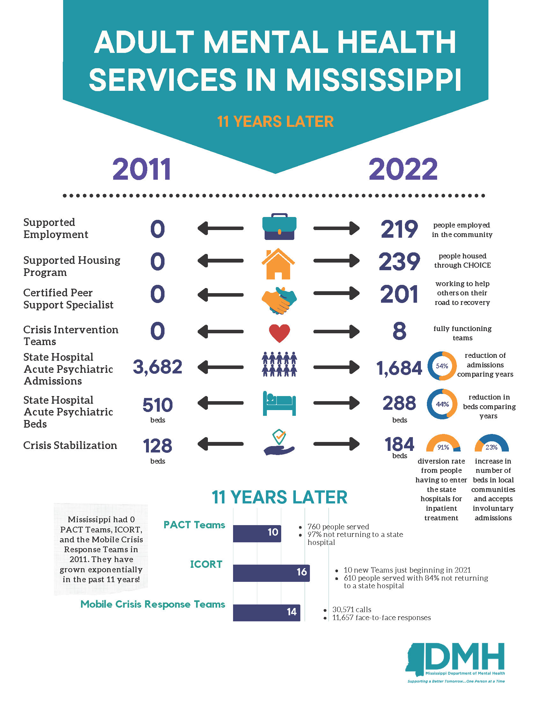

Slide 7


Slide 8
Providing Hope Through Services and Supports – Addiction Services
Residential Treatment – 646 beds in the community for safe and stable group living for substance use services.
Intensive Outpatient Programs – 10-week outpatient program for people who need treatment but still able to maintain job or school responsibilities.
Congregational Outreach – faith-based initiative launched in partnership with MPHI, Hinds Behavioral Health Services and three churches in Jackson to train faith-leaders.
Substance Use Disorder Units – 50 beds at MS State Hospital and 50 beds at East MS State Hospital
Stand Up, Mississippi - statewide initiative to combat the opioid epidemic focusing on workplace awareness, connection to treatment, naloxone distribution, and recovery stories.
Notes:
478/646 residential treatment beds
3,960 community residential treatment
574 SUD compared to 275 in FY21
821 trained in Narcan and over 9,000 doses of Narcan distributed

Slide 9


Slide 10
Providing Hope Through Services and Supports – Crisis Services
988 – three number call system for National Suicide Prevention lifeline that will serve as a behavioral health crisis line launching July 16.
Mobile Crisis Response Teams – 24/7 crisis teams that respond where the person is located to assess and stabilize a crisis situation.
Crisis Stabilization Units – time-limited residential treatment to serve adults with severe mental health episodes that if not addressed would likely result in the need for inpatient treatment.
Crisis Intervention Training - evidence-based, 40-hour training for law enforcement officers to train how to deescalate a behavioral health situation.
Notes:
MCeRTs work hand-in-hand with local law enforcement, Chancery Judges and Clerks, and the Crisis Stabilization Units to promote a seamless process. The Teams ensure an individual has a follow-up appointment with his or her preferred provider and monitor the individual until the appointment takes place. Without mobile crisis intervention, an individual experiencing a crisis may be inappropriately and unnecessarily placed in a jail, holding facility, hospital, or inpatient treatment program. A MCeRT is staffed with a Master’s level Mental Health Therapist, Community Support Specialist and Peer Support Specialist. •In FY22: Total of 30,571 contacts; Total of 11,657 face-to-face responses; Total of 9,332 referred to CMHC for appointment; Total of 4,929 needed higher level of care.
In FY19, the shift in funds from DMH’s inpatient programs to the Service Budget allowed for the opening of 44 additional crisis stabilization beds. Previously, Mississippi had eight, 16-bed Crisis Stabilization Units across the state. There are now 14 Crisis Stabilization Units and 184 beds. Beds offer time-limited residential treatment to serve adults with severe mental health episodes that if not addressed would likely result in the need for inpatient treatment.
3,108 served; 90% diversion rate; 12 days LOS;
CIT enhances communication, identifies mental health resources for assisting people in crisis and ensures that officers get the training and support they need. CIT programs provide officers with 40 hours of intensive training. Mental health experts give approximately 18-20 hours of lectures on a wide array of mental health issues. There are 11-12 hours of de-escalation instruction and role play that must be conducted by trainers certified by the University of Memphis CIT Center. 197 trained - 13 trainings representing 67 different law enforcement agencies

Slide 11
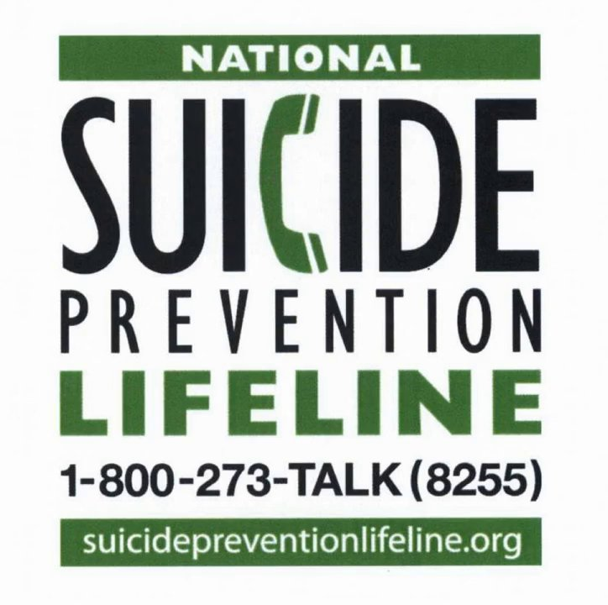
988
In October 2020, the National Suicide Hotline Designation Act, HR 4194, was signed by the president and directed the FCC to designate a three-digit telephone number, 988, as a national universal number to serve as a suicide prevention and mental health crisis line
988 replaced the previous National Suicide Prevention Lifeline phone number – 1-800-273-8255
988 went live July 16, 2022
The intent is to serve as the 911 for suicide prevention and mental health crisis services

Slide 12
Implementing Behavioral Health Crisis Care
SAMHSA’s National Guidelines for Behavioral Health Crisis Care
Defines Core Services and Guidelines for Care
Someone to Talk To – Crisis Lines
Someone to Respond – Mobile Crisis Response Teams
Somewhere to Go – CSUs, Diversion Centers, Peer Respite, appointments

Slide 13
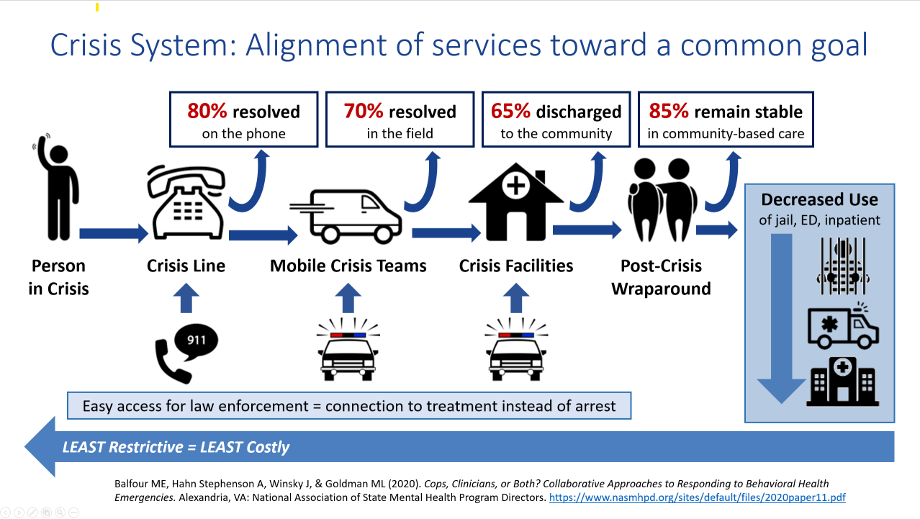
Implementing Behavioral Health Crisis Care

Slide 14


Slide 15
Providing Hope Through Words and Actions
Demonstrate love and care. We all need to feel that we are loved and cared for.
Make someone feel they deserve happiness.
Show acceptance.
Offer help.
Show appreciation.
Help someone find their passion.
Stay connected.
Notes:
Things we can do not only with the clients we serve, but ourselves, our families and our teams at work.

Slide 16

Future Goals for FY23 and FY24
Increase Crisis Stabilization bed availability.
Coordinate 988 in Mississippi for behavioral health crisis.
Expand access to addiction treatment services.
Increase availability of crisis services for people with IDD.
Increase access to intensive/crisis services for children and youth.
Utilize court/hospital liaisons for diversion from state hospitals.
Expand Home and Community Based Services to prevent institutionalization for people with IDD.
Statewide outreach campaign for service availability.
Expand mental health law enforcement training.
Develop three peer respite programs.
Build 83-bed Forensic Services Unit at MSH.
Notes:
These are just a few of the goals and strategies we have for the next 24 months to improve access to care, improve the continuum of care, and enhance community education to raise awareness.

Slide 17

To Find Services Near You
Visit Mental Health Mississippi
Online at www.mentalhealthms.com
Find local services
Includes crisis services
Call the DMH Helpline
1-877-210-8513
Find local services
Register a concern
Notes:
Two quick and easy ways to find services are the Mental Health Mississippi web site and the DMH Helpline.
Through Mental Health Mississippi, you can find local services, including crisis services. The site also has a glossary so you can understand what some of these services are and learn more about them. It also shares some recovery stories as a reminder that hope is always out there and people do recover.
You can also call the DMH Helpline at 1-877-210-8513. You can find out information about services near you through the Helpline as well, but you can also register a concern or grievance related to a DMH certified provider.

Slide 18
Resources
Mental Health Mississippi
Behind the Mask
Mobile Crisis Response Teams
Crisis Lifelines
DMH Helpline
DMH Website
Notes:
Mississippi recently launched Mental Health Mississippi, a website created to help you easily access mental health services for children and adults in Mississippi. You can search mentalhealthms.com for services and resources in your local area. Visit the site to also to find COVID-19 resources,
Mobile Crisis Response Teams , Crisis Lifelines , and the DMH Helpline , all of which are available 24 hours a day, 7 days a week to help.
You can also contact the Substance Abuse and Mental Health Services Administration’s (SAMHSA) Disaster Distress Helpline at 1-800-985-5990, the National Suicide Prevention Lifeline at 1-800-273-8255 or text “Home” to 741741 to text with a Crisis Text Line counselor.

Slide 19


Notes:
The past year has been difficult. Things are getting better, but we don’t know when they will be back to what we would have called normal at this time last year. It’s more important than ever to focus on our health. Let’s remember that our health includes our mental health, get help when we need it, and maybe most importantly, encourage others to do the same.

Slide 20
Notes:
Thank you for the opportunity to share and I can answer any questions.

