Slide 1
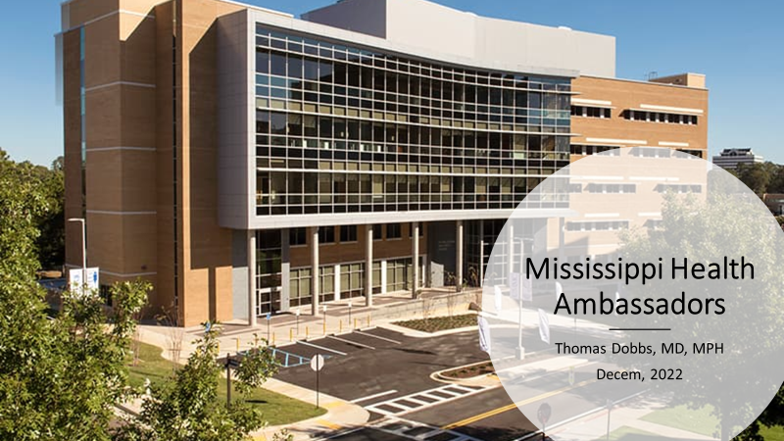

Slide 2

COVID Update
Increasing number of cases (not as bad as before)
Increasing number of hospitalizations
Severity of illness less than seen with Delta and Omicron waves
New booster vaccine effective against current strains
Monoclonal antibodies do not work for existing variants
Paxlovid – pill to treat COVID still works and is recommended for patients at higher risk

Slide 3
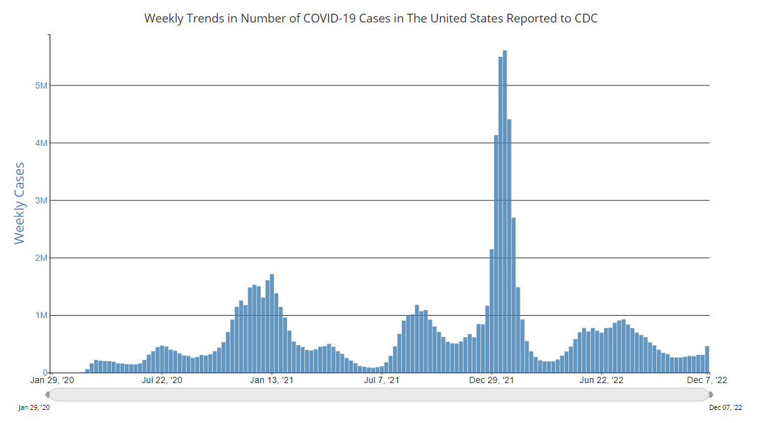

Slide 4
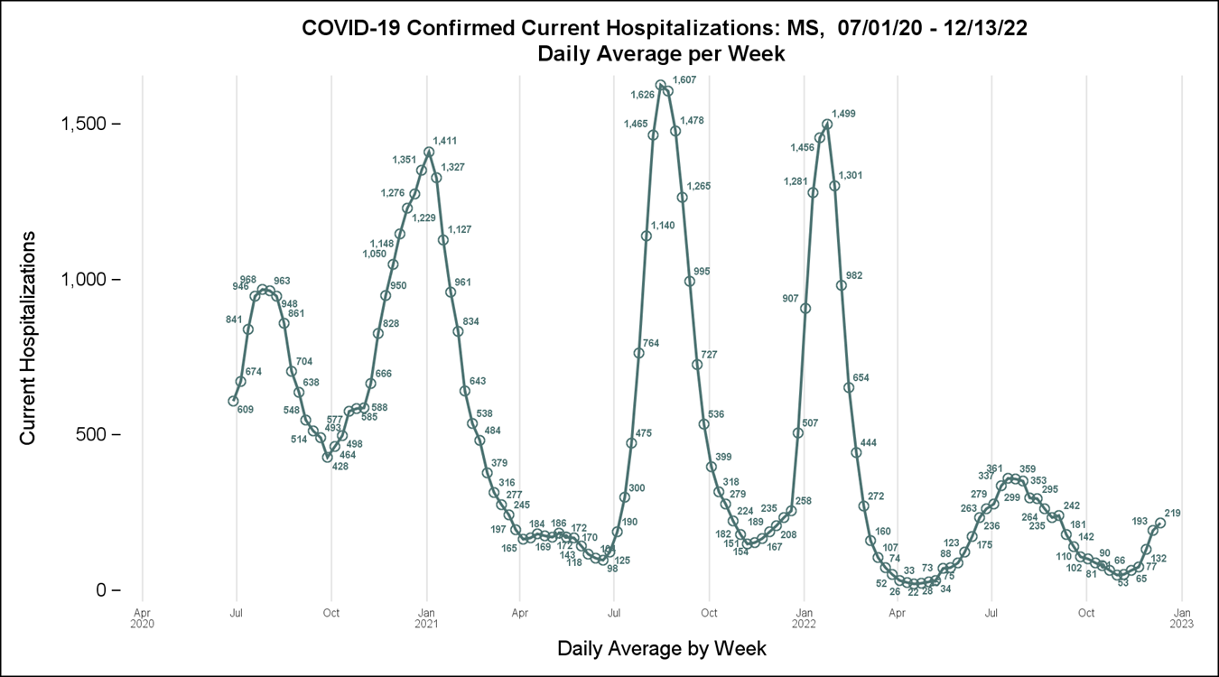

Slide 5
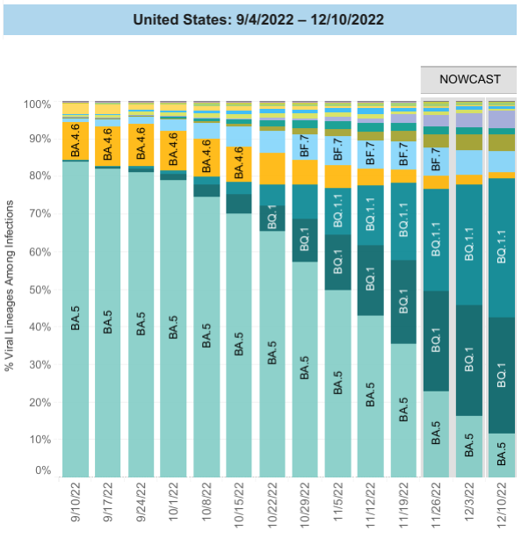
Covid Variants in Circulation

Slide 6
Main Messages
COVID Booster is effective against current strains
  https://www.cdc.gov/mmwr/volumes/71/wr/mm7148e1.htm
Get tested if you are ill
Call your doctor or clinic if you get COVID – you may need treatment

Slide 7
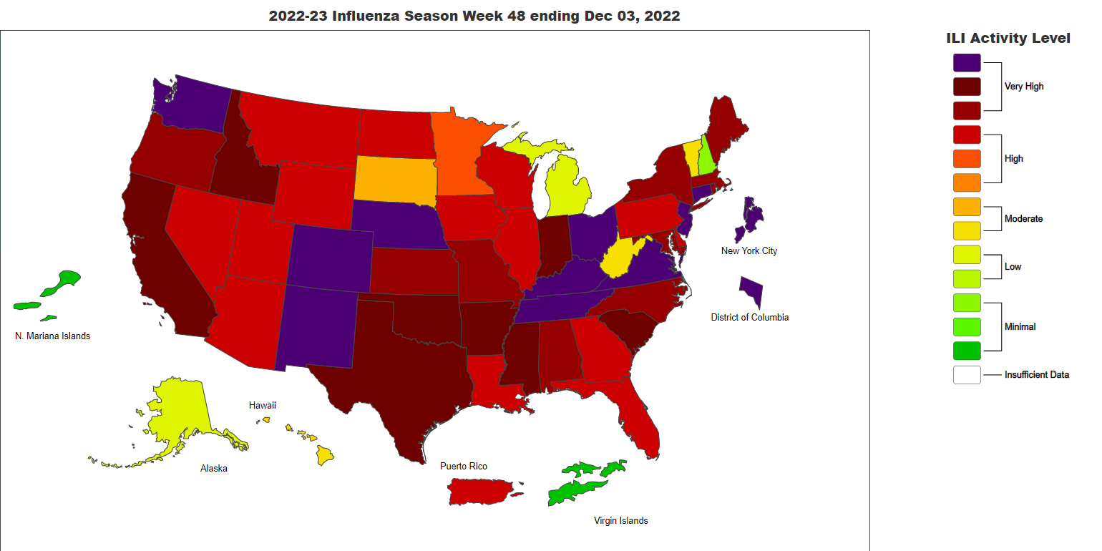
Influenza

Slide 8
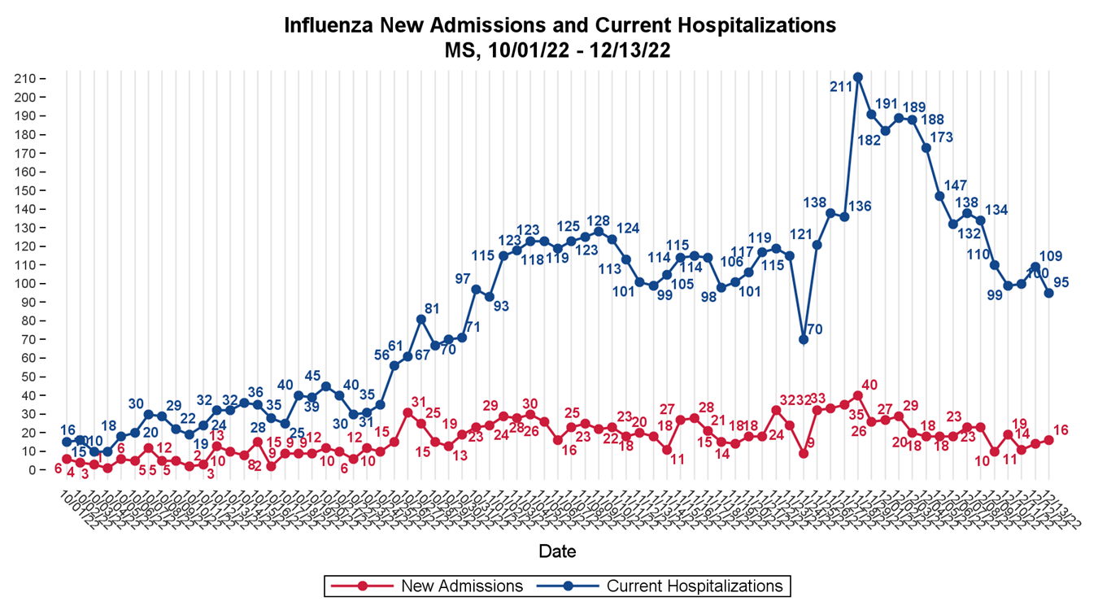

Slide 9
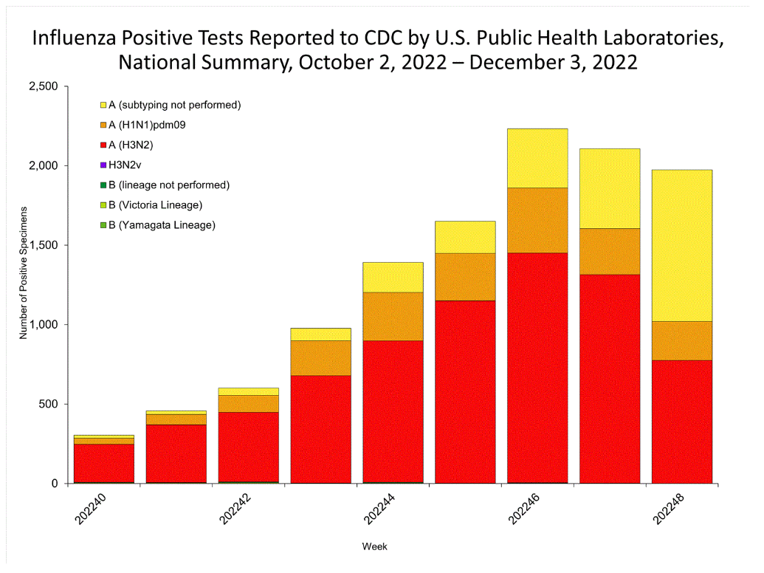

Slide 10
Influenza – Main Messages
Flu activity is high and will lead to hospitalizations and deaths
Flu vaccine appear to be a good "match" so far this year
If you are ill – get tested
If you have flu – get treated
More Information:
  https://www.cdc.gov/flu/weekly/
  https://msdh.ms.gov/page/14,0,199.html
  https://www.cnn.com/2022/12/05/health/flu-vaccine-good-match/index.html

Slide 11
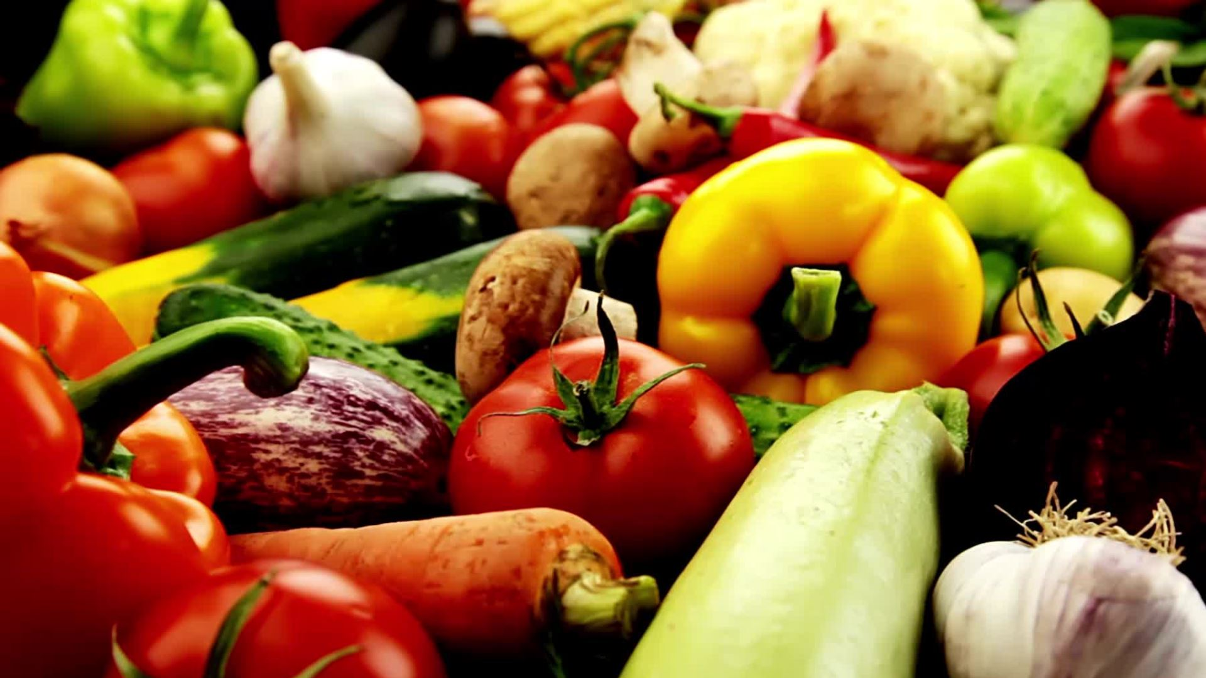
Food Insecurity
The USDA defines food insecurity as a lack of consistent access to enough food for every person in a household to live an active, healthy life.

Slide 12
What does food insecurity look like
Per USDA – 34 million Americans (9 million children) are food insecure
In 2021 – 53 Million American's turned to food banks and community programs for help
Rural communities have great challenges with food insecurity
20% of Black Americans live in a household with food insecurity
1 in 5 seniors (>65) are food insecure
Food insecurity makes access to healthy / nutritious foods more challenging

Slide 13
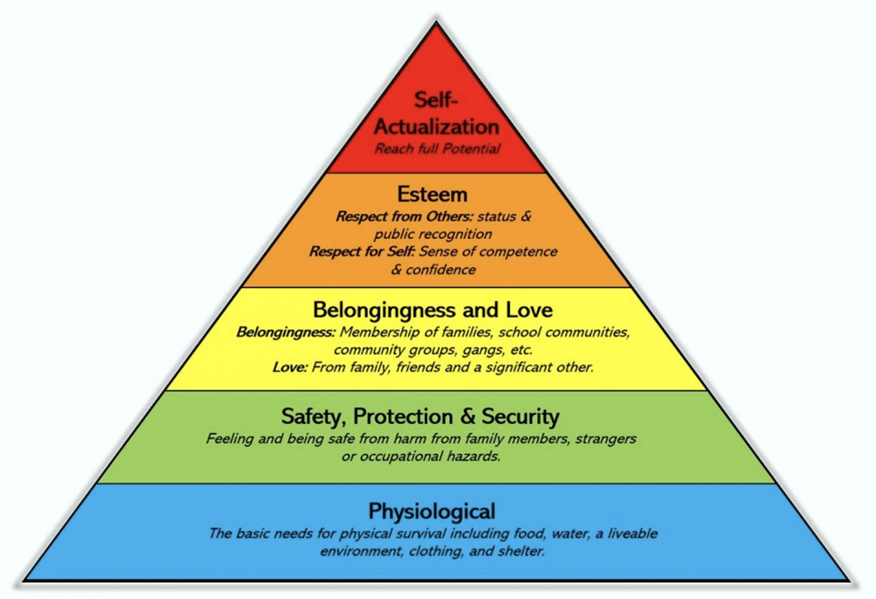
Maslow's Hierarchy

Slide 14
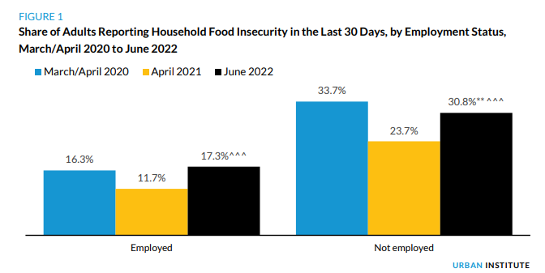

Slide 15
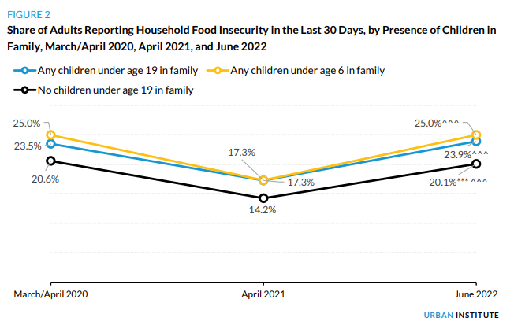

Slide 16
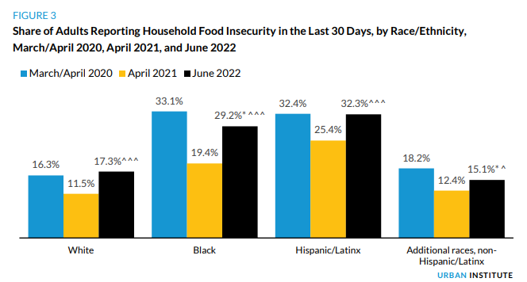

Slide 17
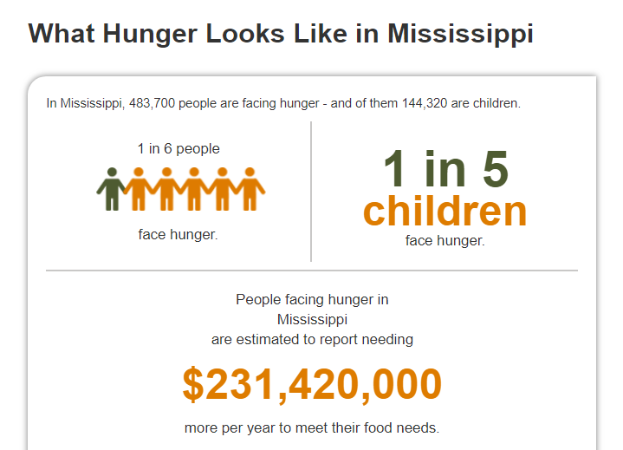
Hunger in MS

Slide 18
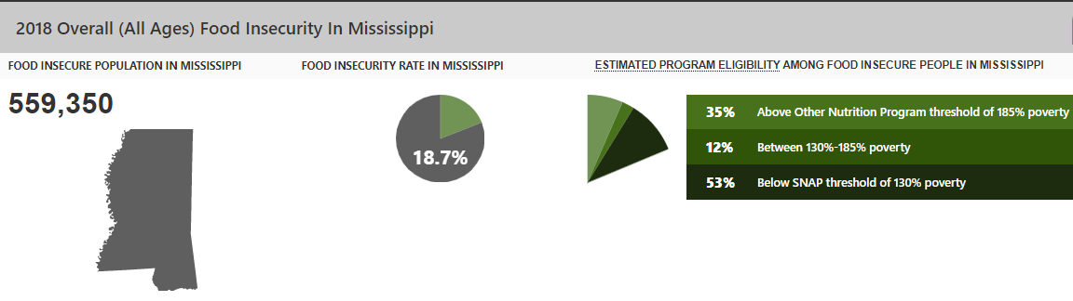

Slide 19
Drivers of Food Insecurity
Poverty
Unstable employment
Financial stressors
  Unexpected expenses (repairs, accidents, medical bills, etc...)

Slide 20
Potential Solutions
Economic stability
Access to high quality / affordable foods
Governmental food assistance programs
  Supplemental Nutrition Assistance for Program (SNAP)
  Women Infants Children (WIC)
  School Lunches
  Free Food Program for Seniors
  D-SNAP (Disasters)
Charitable/Community Resources

Slide 21
SNAP Qualifications
Vary somewhat by state
< Poverty Income Limit
Minimal assets
In MS – must work or be willing to work
3 month limit for single males 18-50 every 3 years

Slide 22
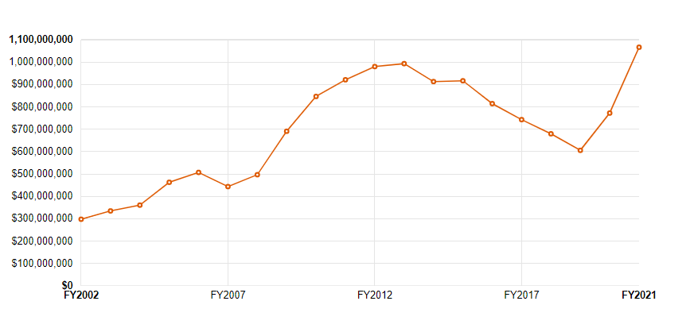
SNAP Utilization in MS

Slide 23
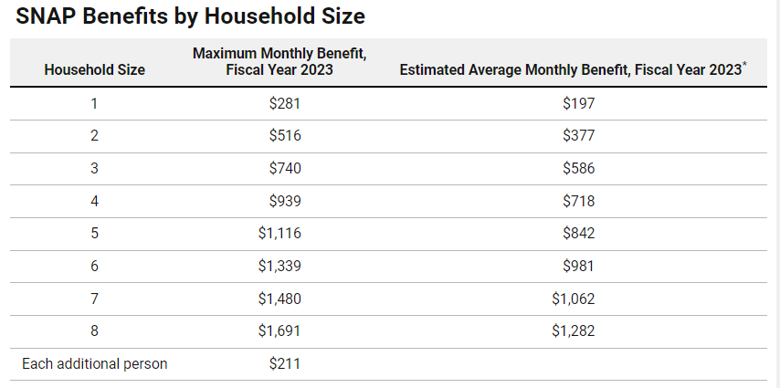
Monthly Benefit

Slide 24

The Root of the Problem...
POVERTY

Slide 25
Drivers of Poverty (starts before birth)
Predatory Lending
Trauma
Lack of good job
Poor financial resources
Unhealthy birth or childhood
Lack of early childhood development and education
Lack of good schools
Lack of safe and healthy environment
Lack of supportive social structure
Lack of supportive family
No Health Insurance
Structural Racism
Addiction
Legal Problems
Systemic And Structural Racism: Definitions, Examples, Health Damages, And Approaches To Dismantling (healthaffairs.org)
https://www.healthaffairs.org/doi/pdf/10.1377/hlthaff.2021.01394

Slide 26
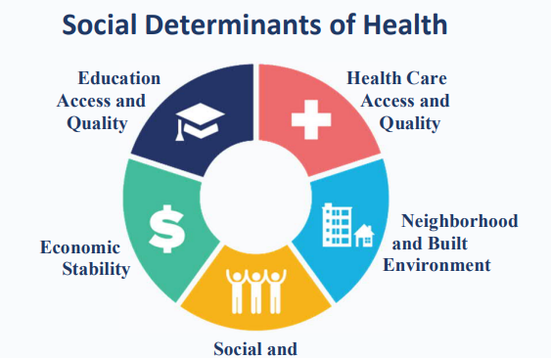

Slide 27
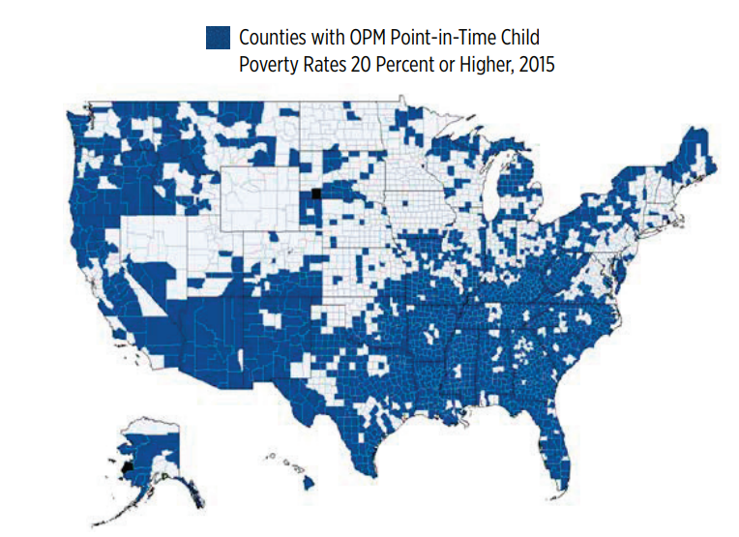

Slide 28
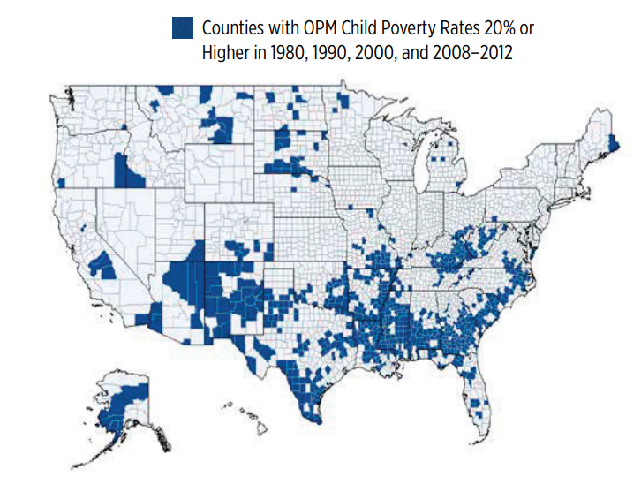

Slide 29
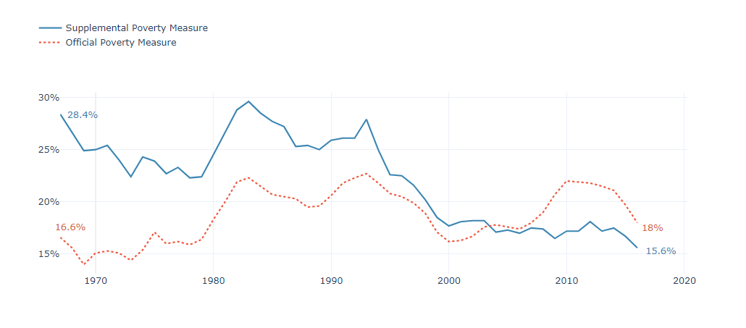

Slide 30
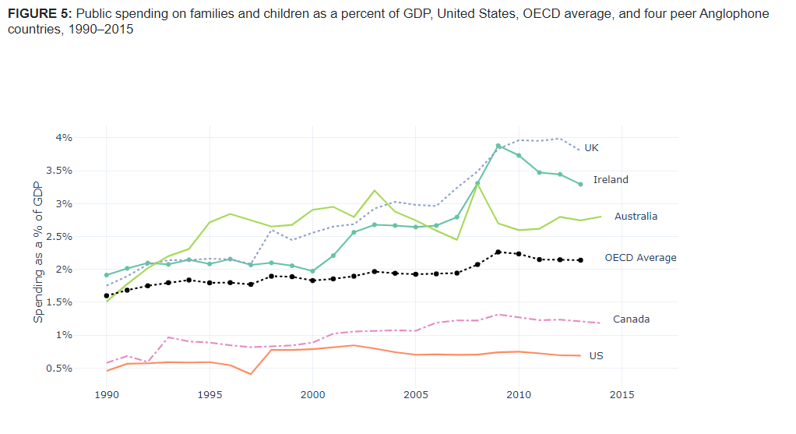

Slide 31
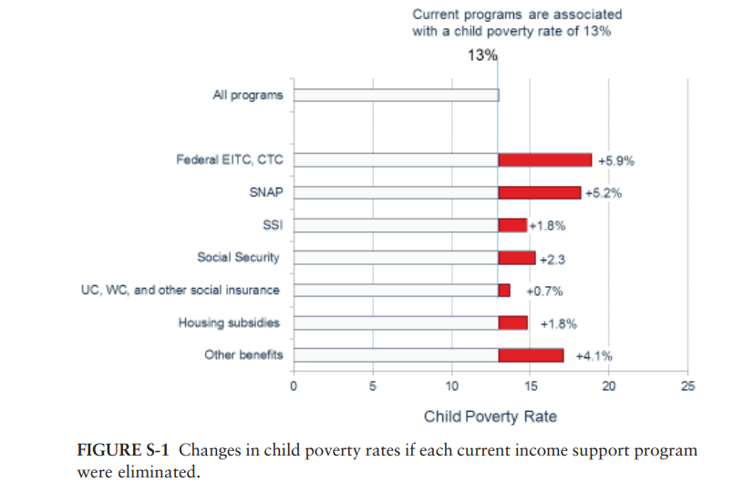

Slide 32
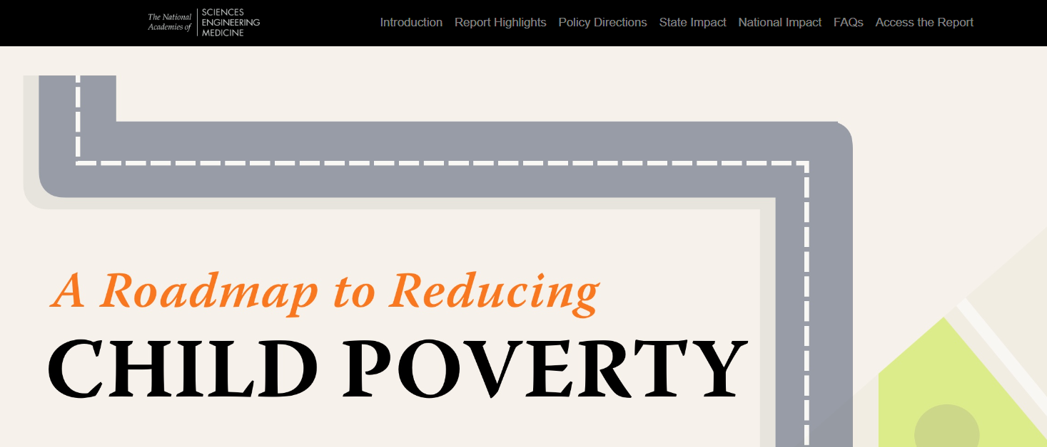
The National Academies Press | A Roadmap to Reduce Child Poverty - Data Explorer https://nap.nationalacademies.org/child-poverty/

Slide 33
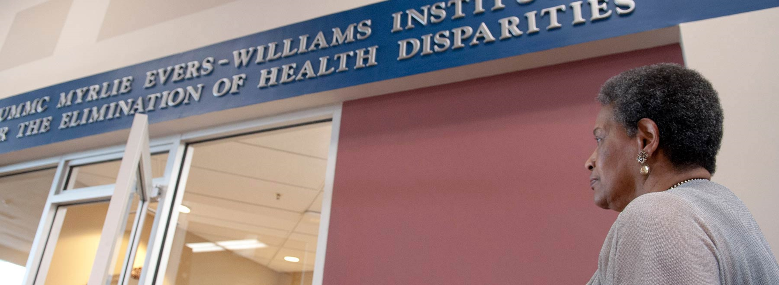

Slide 34
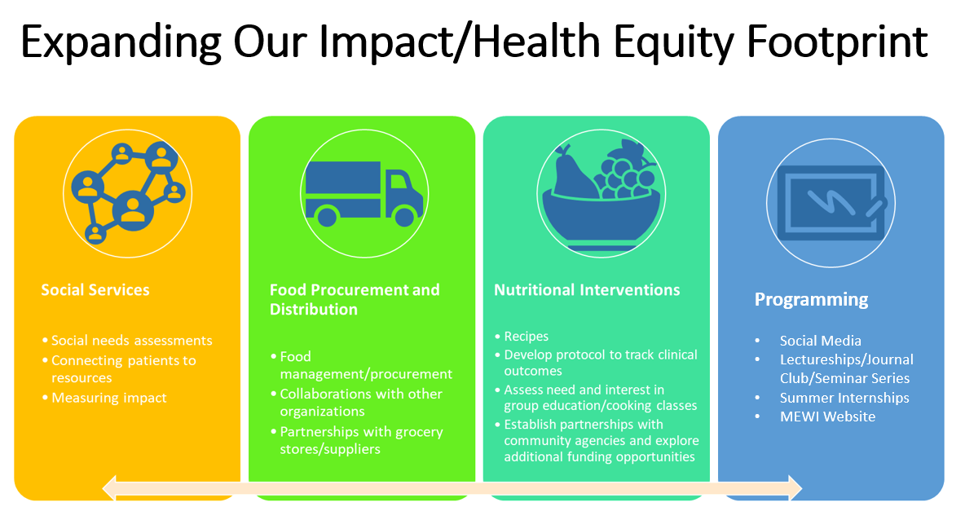

Slide 35
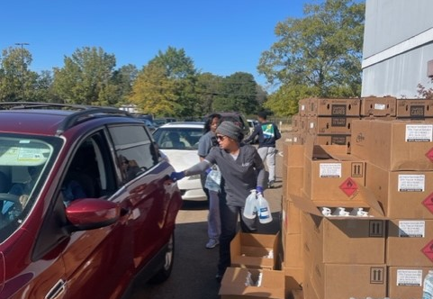
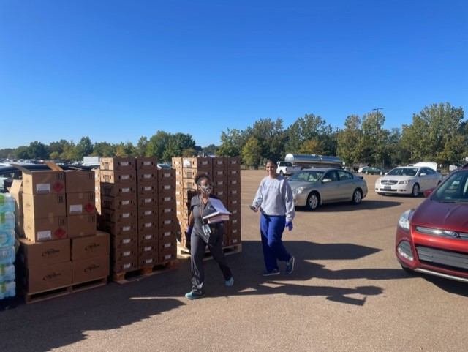
MEWI Team at Work!

