Slide 1
Skin Health 101
BROOKE Edwards, DCNP
Brookhaven SkiN and Med Spa

Slide 2
Skin cancer
1 in 5 Americans will develop skin cancer by the age of 70.
More than 2 people die of skin cancer in the U.S. every hour.
Having 5 or more sunburns doubles your risk for melanoma.
When detected early, the 5-year survival rate for melanoma is 99 percent.

Slide 3
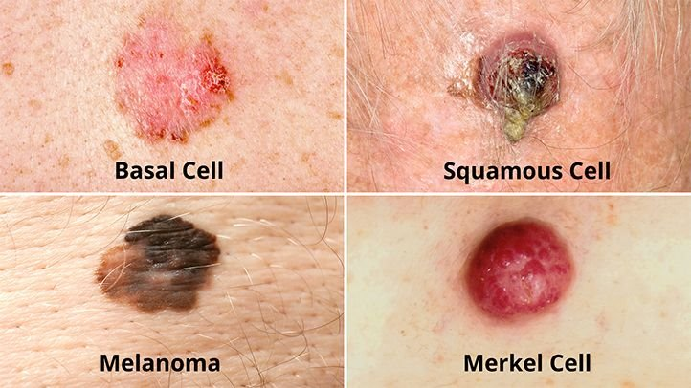
Types of skin cancer
Basal cell carcinoma (BCC) is the most common form of skin cancer. An estimated 3.6 million cases of BCC are diagnosed in the U.S. each year.^{8,1}
Squamous cell carcinoma (SCC) is the second most common form of skin cancer. An estimated 1.8 million cases of SCC are diagnosed in the U.S. each year.^{8,1}

Slide 4
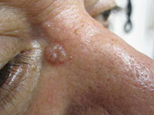
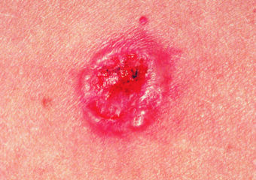
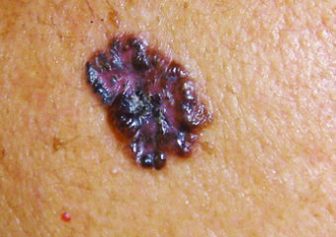
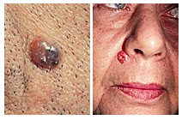
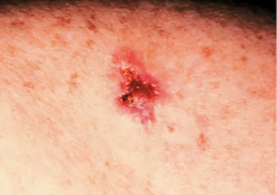
Basal cell carcinoma

Slide 5
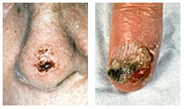
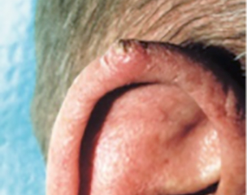
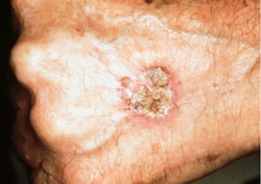
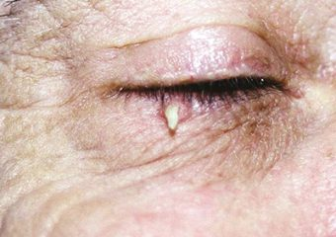
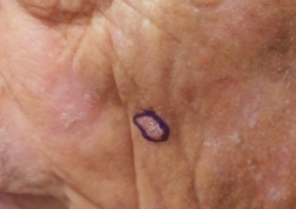
Squamous cell carcinoma

Slide 6
Melanoma
It’s estimated that the number of new melanoma cases diagnosed in 2024 will increase by 7.3 percent.²
The number of melanoma deaths is expected to increase by 3.8 percent in 2024. ²
In the past decade (2014 – 2024), the number of new invasive melanoma cases diagnosed annually increased by 32 percent.^{2,40}
An estimated 8,290 people will die of melanoma in 2024. Of those, 5,430 will be men and 2,860 will be women.²
The vast majority of melanomas are caused by the sun. In fact, one UK study found that about 86 percent of melanomas can be attributed to exposure to ultraviolet (UV) radiation from the sun.¹²

Slide 7
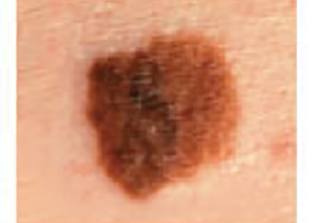
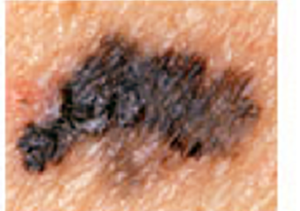
melanoma

Slide 8
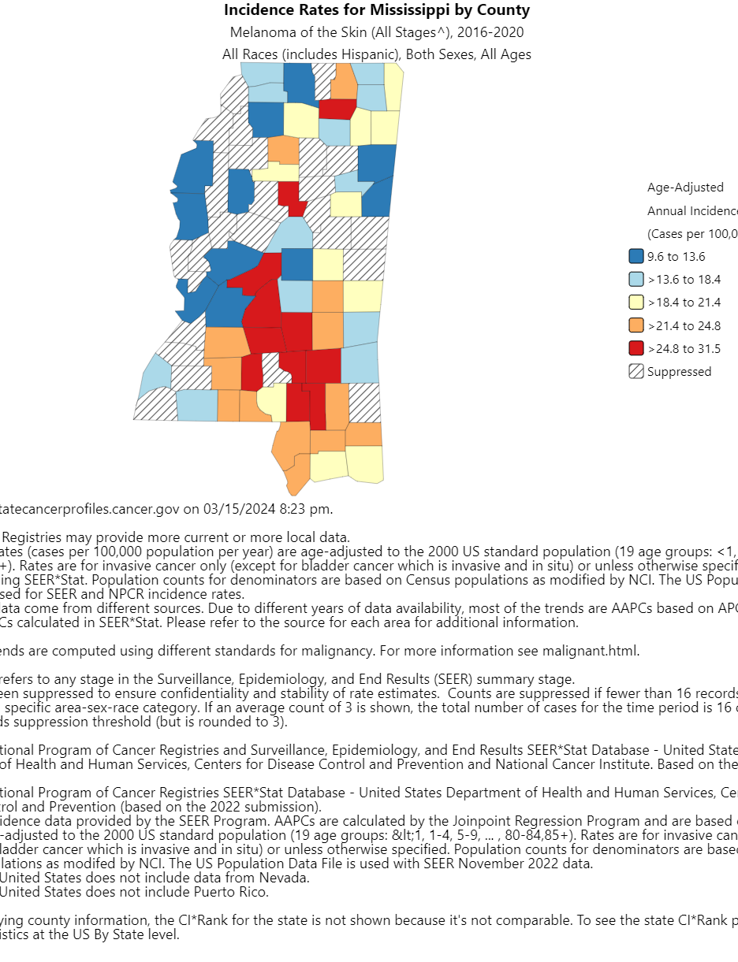
Mississippi Statistics
500 new cases of melanoma of the skin are diagnosed in Mississippi each year.
On average, 70 Mississippi residents will die each year from melanoma.

Slide 9
Risk Factors for Melanoma
Tanning
Sunburn
Atypical moles
UV Radiation
Photosensitivity
Skin Type

Slide 10
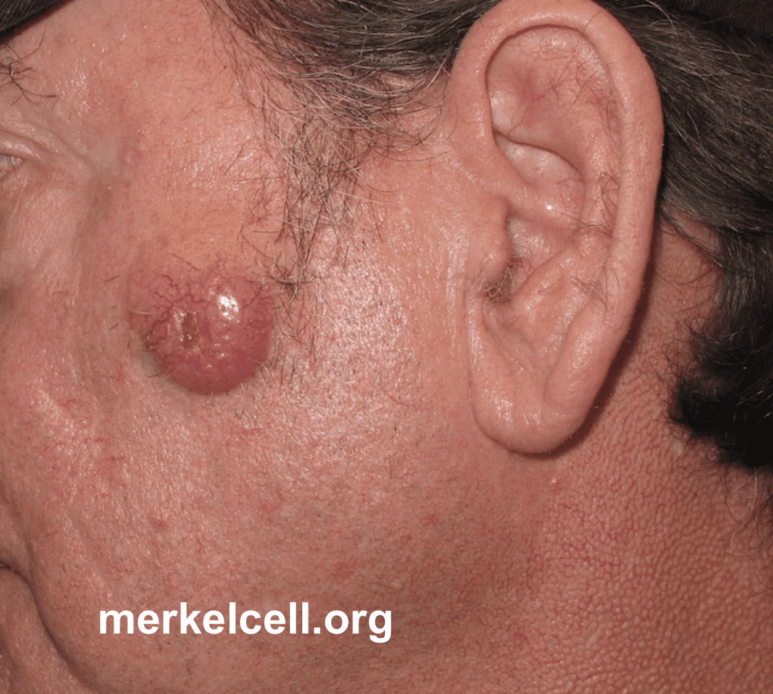
Merkel Cell Carcinoma
Merkel cell carcinoma (MCC) is a rare, aggressive form of skin cancer with a high risk for returning (recurring) and spreading (metastasizing), often within two to three years after initial diagnosis.
40 times more rare than melanoma with an estimated one case per 130,000 people in the US
Risk factors: sun exposure, fair skin, over 50 and weakened immune system

Slide 11
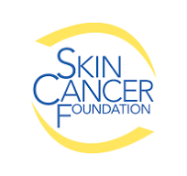
This Photo by Unknown author is licensed under CC BY-NC-ND.

Slide 12
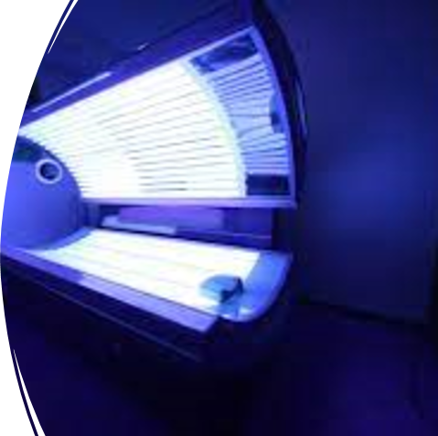
Tanning Beds
75% increased risk of developing melanoma if indoor tanning before the age of 35
In fact, a 2016 study published in the JAMA Dermatology found that of 63 women diagnosed with melanoma before age 30, 61 of them — 97 percent — used tanning beds.

Slide 13
Sign the petition to ban tanning beds for minors
https://www.skincancer.org/risk-factors/tanning/#facts:~:text=Sign%20the%20Petition%3A%20Tell%20the%20FDA%20to%20Ban%20Teen%20Tanning!
Indoor tanning legislation in Mississippi 2023
Parent/guardian must accompany minor under 14 during the entire time that the minor uses a tanning device at the tanning facility. Requires in-person written consent for minors under 18. Valid for 1 year and must specify the number of sessions.
Many states ban tanning devices for minors 18 and under

Slide 14
prevention
Prevention is key
Sun protection: hats, sleeves, shade, sunscreen
Look for broad spectrum spf 30 or higher
Ingredients zinc oxide or titanium dioxide
Reapply every 2 hours
Use water resistant if sweating or swimming
Early detection-monthly self screenings and yearly skin exams with trained dermatology provider

Slide 15
Treatment
Standard excision
MOHS surgery
Image Guided Superficial Radiation Therapy (IG-SRT)
Referal to Surgical Oncologist depending on type of skin cancer

Slide 16
Common Skin disorders

Slide 17
Adult acne
Causes:
fluctuating hormone levels (menstrual cycle, pregnancy, perimenopause, menopause, starting or discontinuing birth control pills
Stress
Family history
Hair and skin care products
Medications
Undiagnosed medical condition

Slide 18
treatment
Many over the counter non-prescription medications available such as adapalene, benzoyl peroxide, salicylic acid and azelaic acid
Prescription medications to target the type of acne if no improvement with OTC after a few months.

Slide 19
Rosacea
Rosacea can cause more than redness. There are so many signs and symptoms that rosacea has four subtypes.
Erythematotelangiectatic rosacea Redness, flushing, visible blood vessels
Papulopustular rosacea Redness, swelling, and acne-like breakouts
Phymatous rosacea Skin thickens and has a bumpy texture
Ocular rosacea Eyes red and irritated, eyelids can be swollen, and the person may have what looks like a stye

Slide 20
Rosacea
Unknown causes
Many triggers including stress, heat, alcohol, foods, sunlight, caffeine, exercise, hormones, etc
Treatment: avoid triggers, good skin care, may need prescription strength medications aimed at treating inflammation, cosmetics (makeup, lasers), sun protection
Studies still needed to confirm the link associated with rosacea and higher risk of heart disease

Slide 21
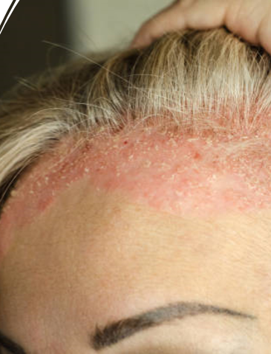
Seborrheic dermatitis (dandruff)
Cause unknown. Likely from overgrowth of yeast and sebum production
Red scaly rash can appear on the ears, eyebrows, beard, or skin around the nostrils. Sometimes, it appears on the chest, especially in men.
Use a dandruff shampoo, increase frequency of shampooing and rotate shampoos.
Prescription medications may be needed to help control, not cure, the condition.

Slide 22
Wrinkles
Wear sunscreen everyday
Moisturize
Avoid using too many skin care products that could potentially irritate the skin and causes the signs of aging to become more noticeable
Choose an anti-aging skin care product containing a retinoid which can stimulate collagen production and help reduce the appearance of fine lines and wrinkles over time.

Slide 23
Skin Care Must haves
SUNSCREEN (ingredients: zinc oxide and/or titanium dioxide)
Retinoid (vitamin A containing products such as retinol)
Vitamin C (antioxidant)
Consistency is key!

Slide 25
Tik Tok trends (adults and kids)
Your kids and grandkids do not need expensive skin care!
Largely driven by friends on social media and influencers
Parents are bringing in children as young as 7 yrs old at their request without any skin pathology (acne or eczema)
Early skin care can be a good routine to start as long as what is being used is age appropriate and not irritating to the skin.
Recommendation: gentle cleanser, gentle moisturizer and sunscreen all of which can be purchased at a reasonable cost over the counter

Slide 26
Hyperpigmentation
Melasma
Sun spots (lentigines)
Caused by hormones, sun induced, genetic or skin type
Treatment is challenging and improvement often short term with relapses
Bleaching creams OTC and RX, light therapy, lasers, resurfacing, chemical peels, tretinoin cream.
Strict sun protection is a must if pursuing treatment

Slide 27
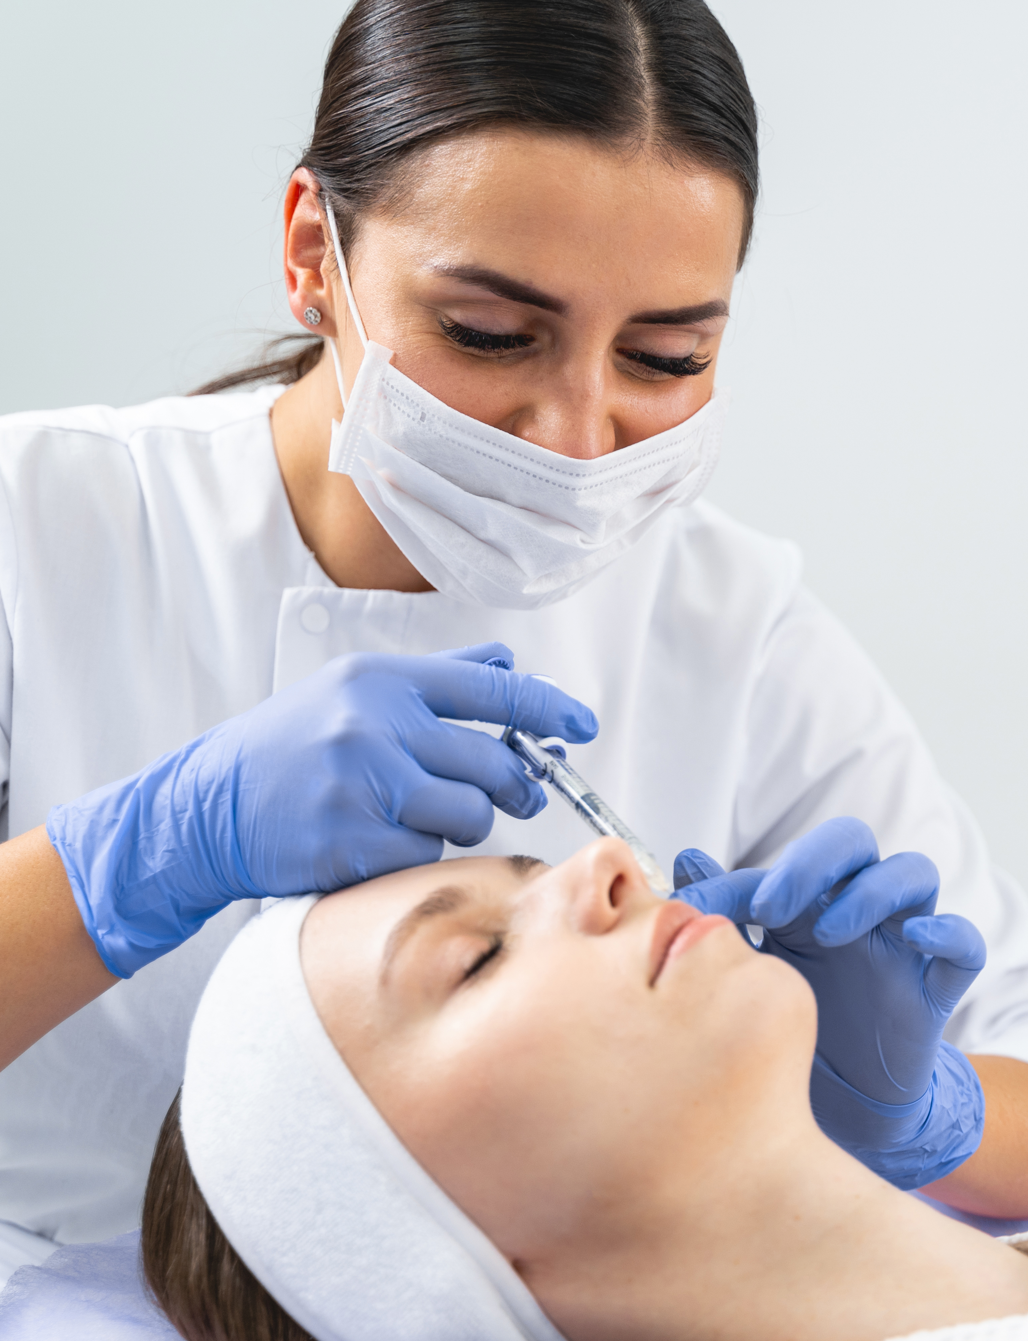
Other Cosmetic treatments
Neurotoxins (Botox, Dysport)
Hyaluronic acid fillers (Juvederm, Restylane)
Injectable poly-L-lactic acid (Sculptra)
Chemical peels
Resurfacing procedures (microneedling, microneedling with RF, CO2 resurfacing)
Surgery (face lift, blepharplasty, neck lift, etc)

Slide 28
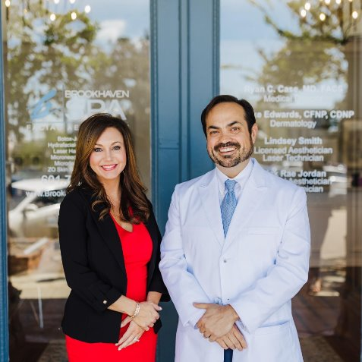
Questions????

Slide 29
References
Merkelcell.org, https://merkelcell.org/resources/pictures-of-merkel-cell-carcinoma/
Skin cancer foundation, https://www.skincancer.org/skin-cancer-information/
Mississippi State Department of Health
American Academy of Dermatology
CDC-State Cancer Profiles, https://statecancerprofiles.cancer.gov/map/map.withimage.php?28&county&001&053&00&0&02&0&1&5&0#results
Jama dermatology 2016, https://www.skincancer.org/get-involved/sign-the-petition/
Cheng, Carol, MD, UCLA Health https://www.uclahealth.org/news/kids-skincare-dermatologists-advice

