Slide 1
Brief COVID-19and Measles update
Paul Byers, MD Associate Professor, Department of Preventive Medicine, UMMC
March 21, 2024

Slide 2
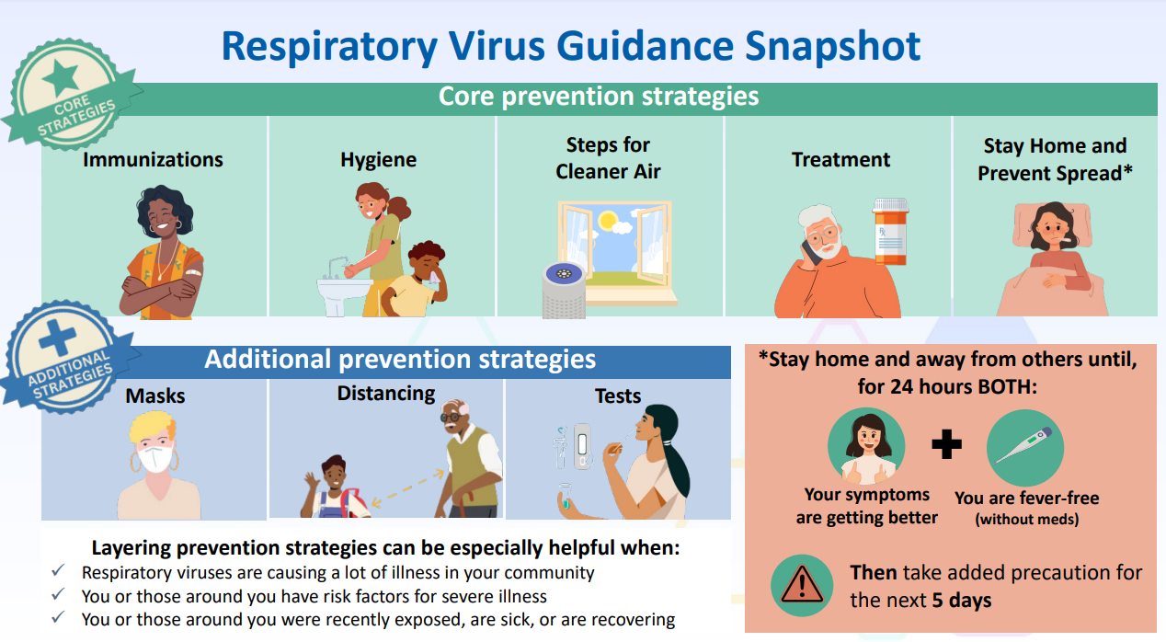
Updated guidance March 2024

Slide 4
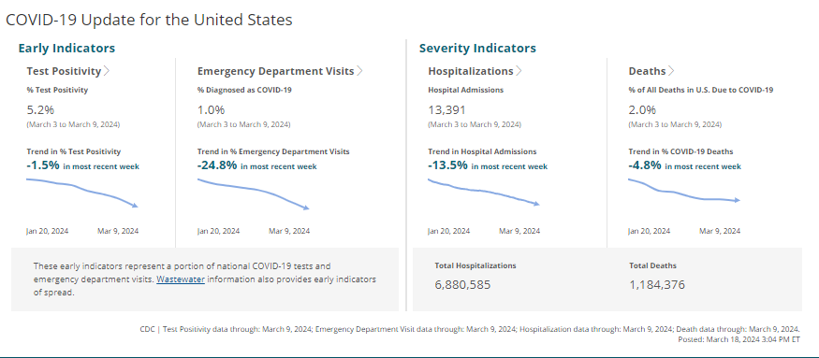

Slide 5
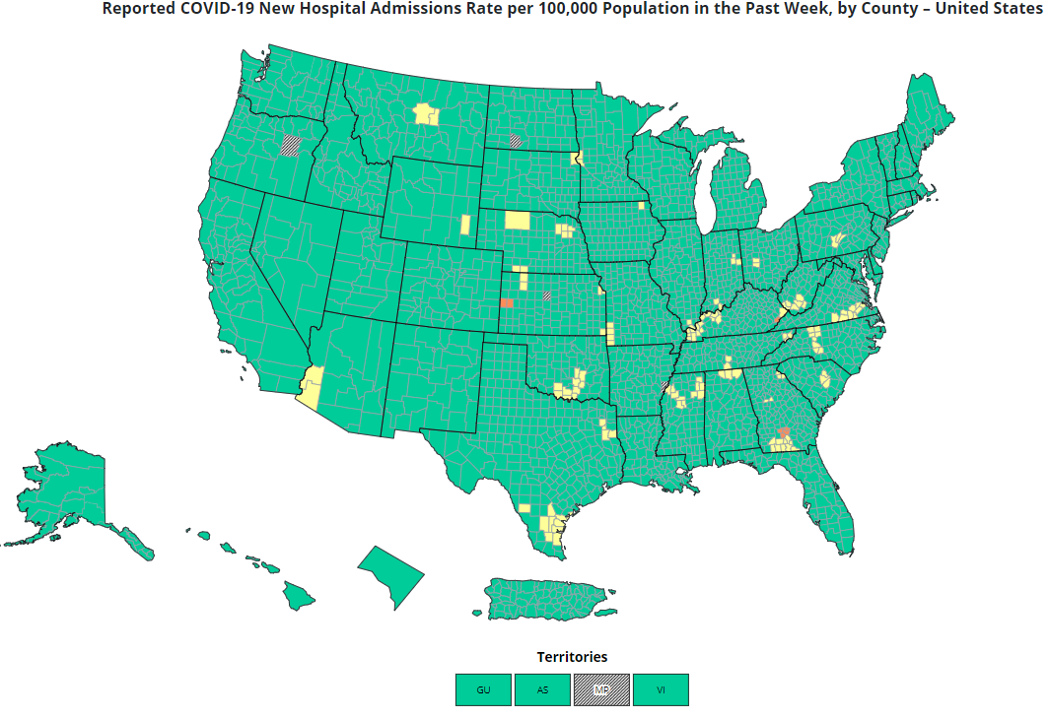

Slide 6
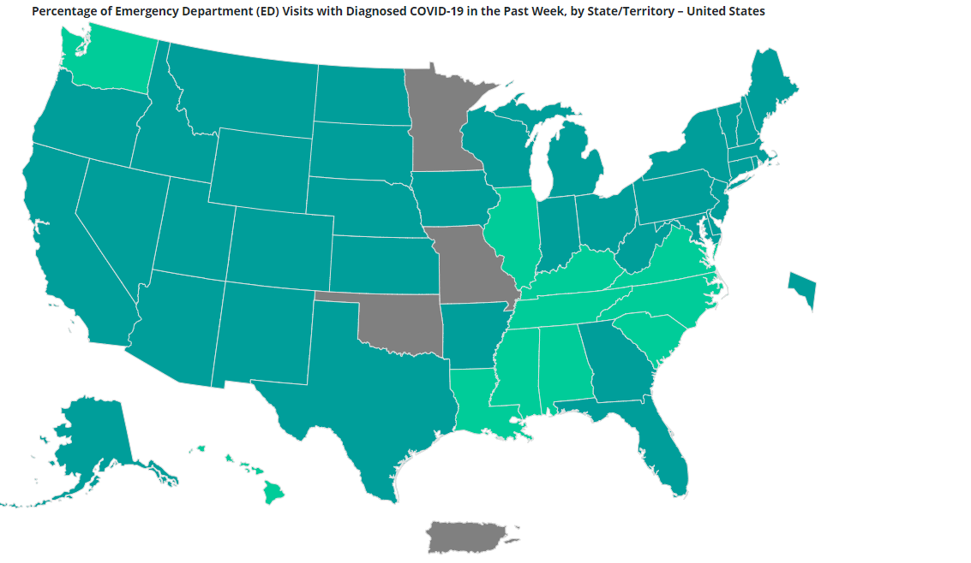

Slide 7
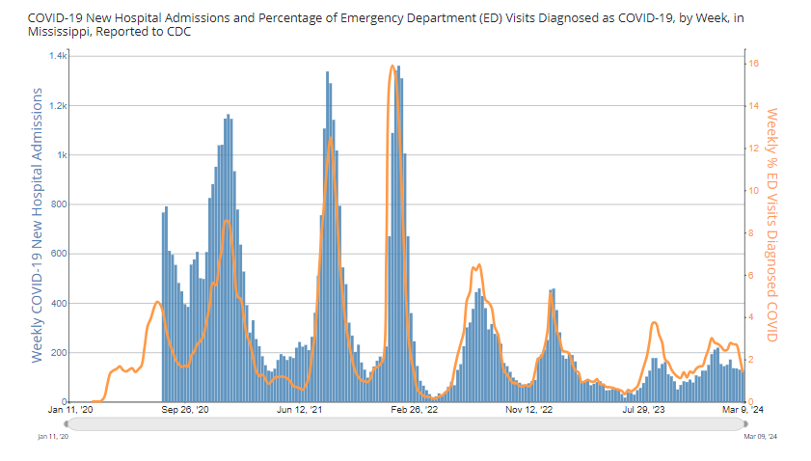

Slide 8
Current Vaccine Recommendations
All people ages 65 years and older should receive 1 additional dose of any updated (2023–2024 Formula) COVID-19 vaccine (i.e., Moderna, Novavax, Pfizer-BioNTech).

Slide 9
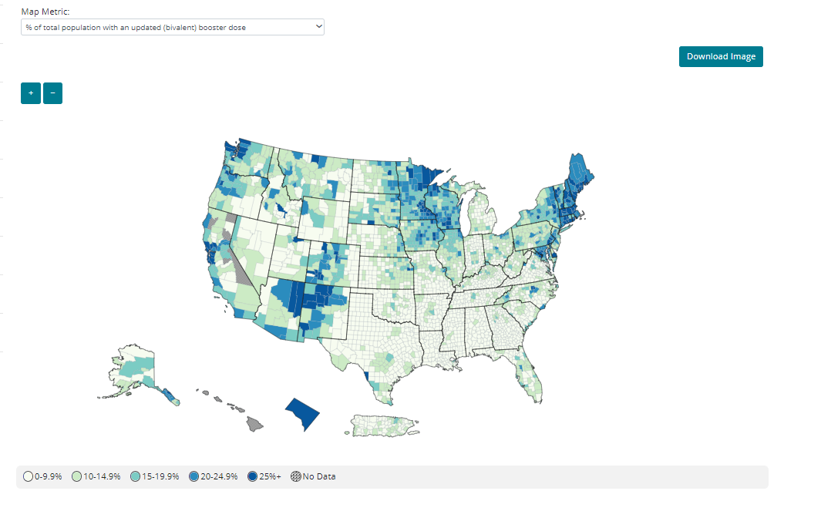

Slide 10
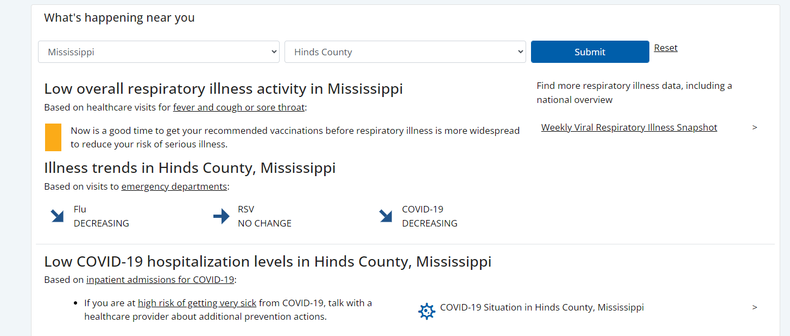
https://www.cdc.gov/respiratory-viruses/index.html

Slide 12
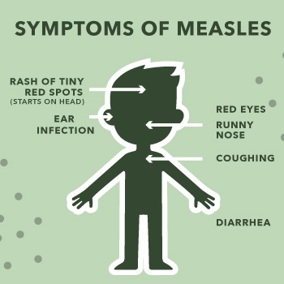
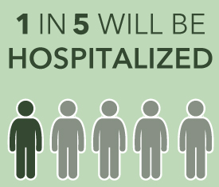
Measles
Vaccine Preventable viral infection
Febrile Rash illness—starts with fever, cough, runny nose, conjunctivitis, followed by rash in 2-4 days
Not benign—can lead to pneumonia, encephalitis, death
Highly infectious!!! One person can infect 9 out of 10 uninfected persons
Two doses of MMR vaccine extremely effective: 96-98% effective
Requires 95% of people in a community to be vaccinated to limit transmission

Slide 13
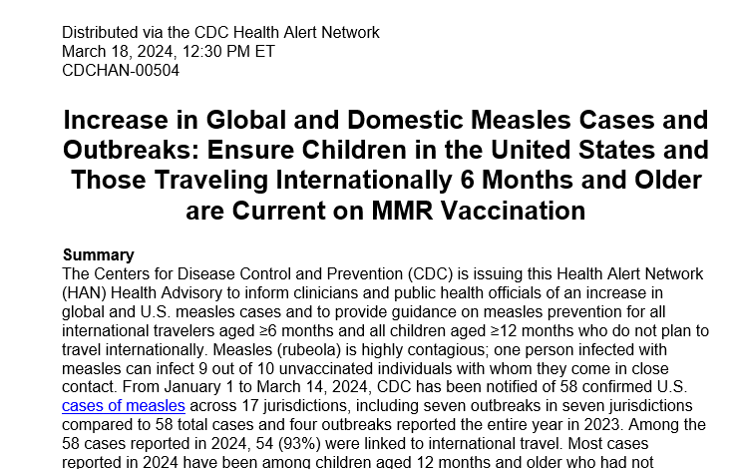

Slide 14
Measles Brief
45 total cases in 17 states in 2024 through March 7
58 cases in 20 jurisdictions in 2023
Variable cases over last several years since Measles declared eliminated in US in 2000.
High of >1200 cases in 2019 to a low of 13 in 2020
93% of cases this year linked to international travel

Slide 15
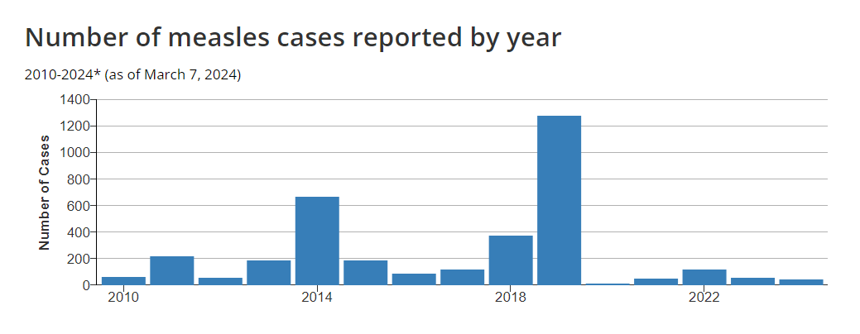

Slide 16
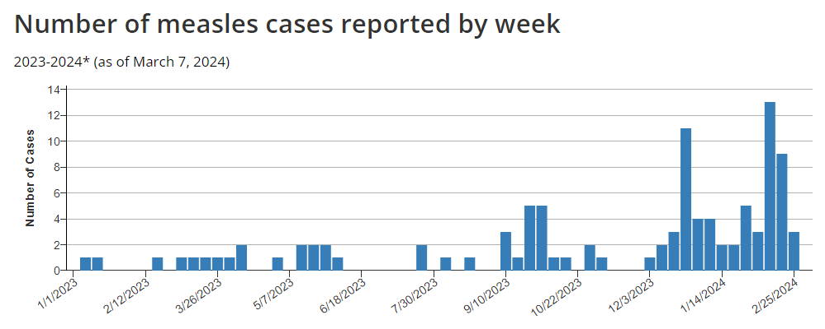

Slide 17
Outbreaks in US
Outbreaks typically occur due
an increase in the number of travelers who get measles abroad and bring it into the U.S., and/or
further spread of measles in U.S. communities with pockets of unvaccinated people.
In 2019, the majority of the cases were among unvaccinated persons (89%)
86% of cases associated with large outbreak in NY Orthodox Jewish communities that were under-immunized, allowing for rapid transmission once introduced

Slide 18
Vaccination is the KEY
Two doses MMR Vaccine required, at 12-15 months and a second dose 4-6 years
Children 6-11 months should receive one dose prior to international travelers
All international travelers should have at least one dose prior to traveling if no prior vaccine
Two doses 96-98% effective against measles
Need an estimated 95% population immunity (herd immunity) in a community to limit transmission once measles is introduced

Slide 19
Single case is an Outbreak!
Identifying cases promptly and appropriately isolating the case to limit further exposures
Contacts with no evidence of immunity (prior vaccine or infection) should receive at least one dose of MMR vaccine within 72 hours of exposure (may return to work, school, daycare, etc).
Contacts who have no immunity and don’t get vaccinated should be excluded from should be excluded from school until at least 21 days after the onset of rash in last case of measles
Quarantine

Slide 20
Recent Outbreaks
10 cases recently in Florida
9 cases in children 14 and under
Many associated with elementary school
Unimmunized children allowed to continue to attend school at parents discretion

Slide 21
Recent Outbreaks
During October 5–November 1, 2023, five measles cases occurred in unvaccinated, vaccine-eligible children aged 1–9 years who lived in the same apartment building but did not socialize with one another.
During the outbreak, approximately 400 persons were exposed to measles, including 13 children aged <1 year.
Transmission from unvaccinated 2 year old child several days after immigrating to US (parents report contact with measles prior to travel)
Response to measles cases: “These efforts are time-consuming and costly, with a median cost per measles patient of approximately $33,000 during 2004–2017”

Slide 22
Thank you
Questions?

