Slide 1
Mississippi Health Ambassadors 8/10/2023

Slide 2
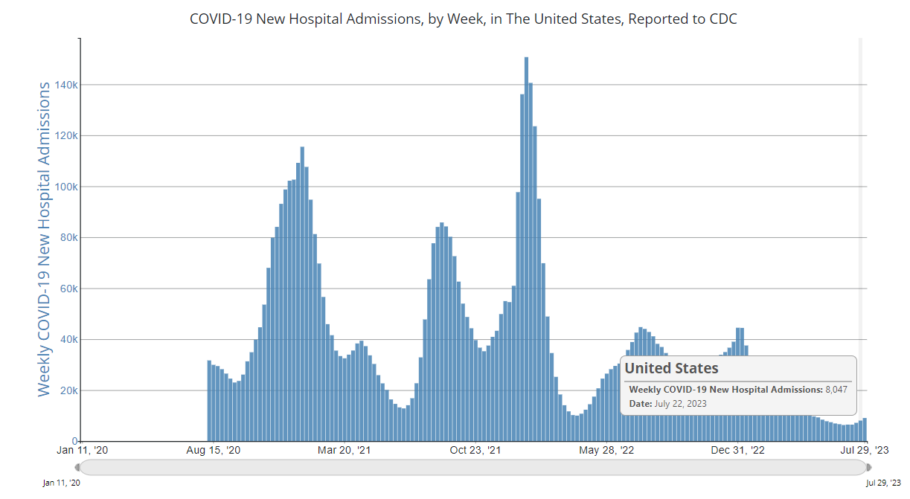

Slide 3
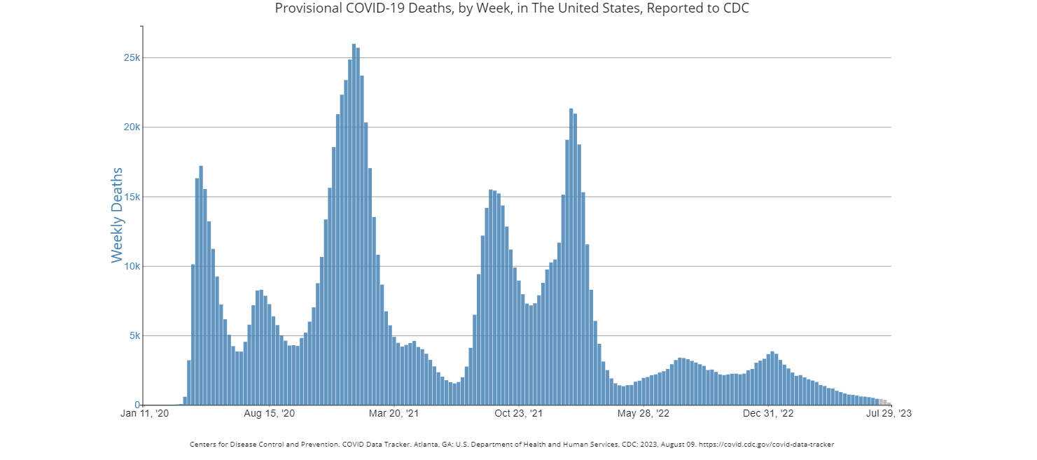

Slide 4
Vaccine Recommendations
6 – 64 years old
One Bivalent Dose
65 and older
Bivalent dose
Repeat Bivalent dose 4 months
Immune Compromised
Bivalent dose
Repeat 6 months
Repeat 2 months

Slide 5
What's Next
Omicron variant XBB.1.5 for use as early as fall of 2023 (monovalent)
Pfizer (mRNA)
Moderna (mRNA)
Novavax (Protein)

Slide 6
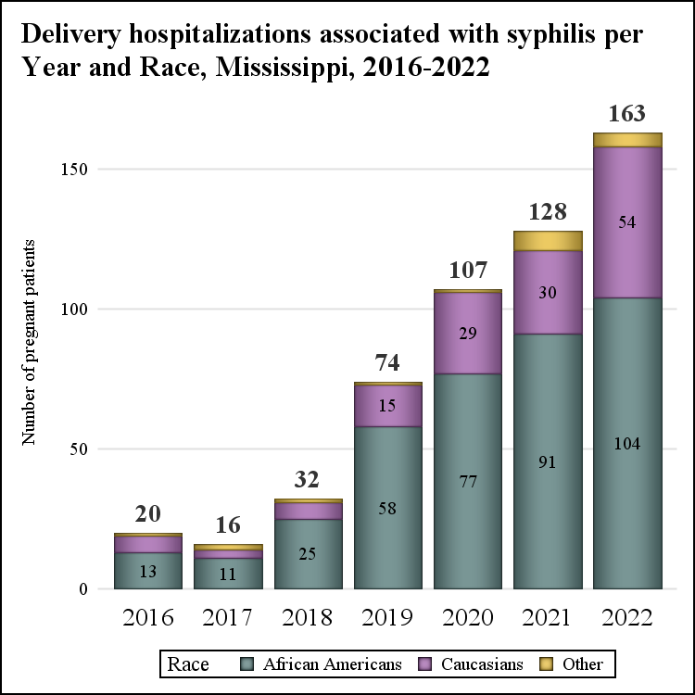
Congenital Syphilis in MS
1000% increase over 8 years
Congenital syphilis - ~40% mortality
Severe disability for many newborns that survive
~$50,000 in excess hospital charges at delivery

Slide 7
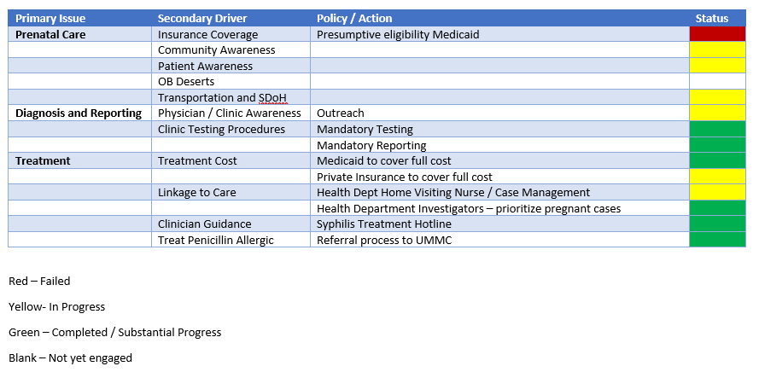

Slide 8
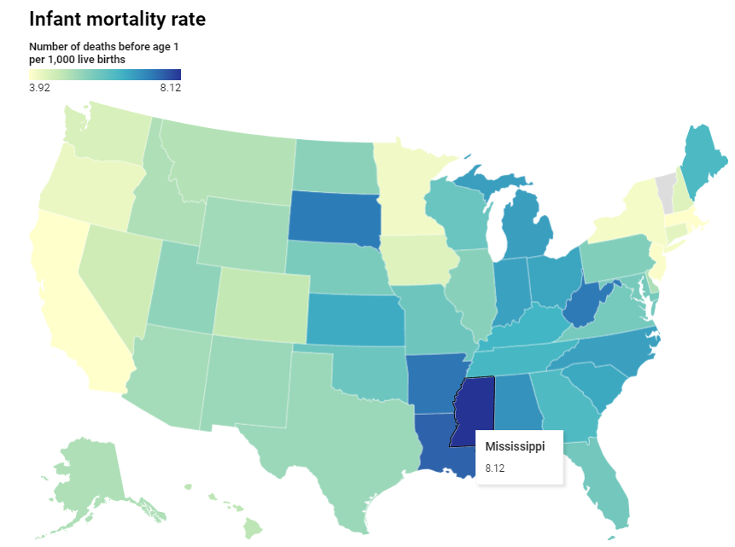
Infant Mortality MS
MS is #1 in infant mortality
Infant mortality ~2x higher in Black babies compared to White babies
~2.5x higher in Native Americans
If MS were a country – would rank higher than Argentina but lower than Turkey
In Black population – between Colombia and Ecuador

Slide 9
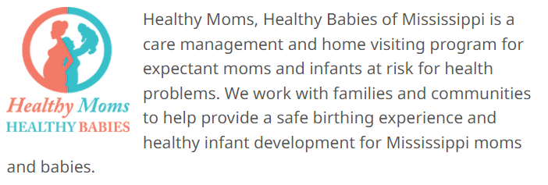
Health Mom
Early Prenatal Care
Maternal Support
Robust Healthcare System

Slide 10
https://msdh.ms.gov/page/41,0,106.html

