Slide 2
But first... an update on COVID

Slide 3
Deaths

Slide 4
Hospitalization

Slide 5
COVID-19 Vaccine Recommendations
CDC recommends an additional updated (bivalent) vaccine dose for adults ages 65 years and older and additional doses for people who are immunocompromised. Monovalent (original) COVID-19 mRNA COVID-19 vaccines will no longer be recommended for use in the United States.
CDC recommends that everyone ages 6 years and older receive an updated (bivalent) mRNA COVID-19 vaccine, regardless of whether they previously completed their (monovalent) primary series.

Slide 6
Key Messages
COVID is still around but not with a high prevalence
Most severe impacts in older Mississippians
Prevent Disease – Bivalent Booster Dose (new recommendation)
If you are ill...
Get tested
Get treated

Slide 7
Hospital/Emergency Care Crisis: MS

Slide 8
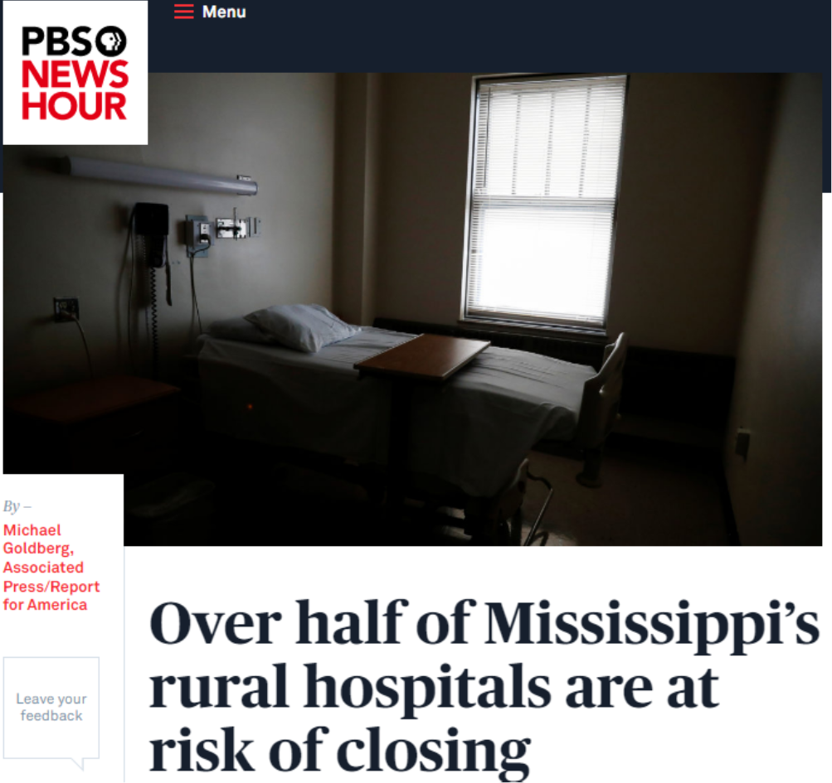

Slide 9
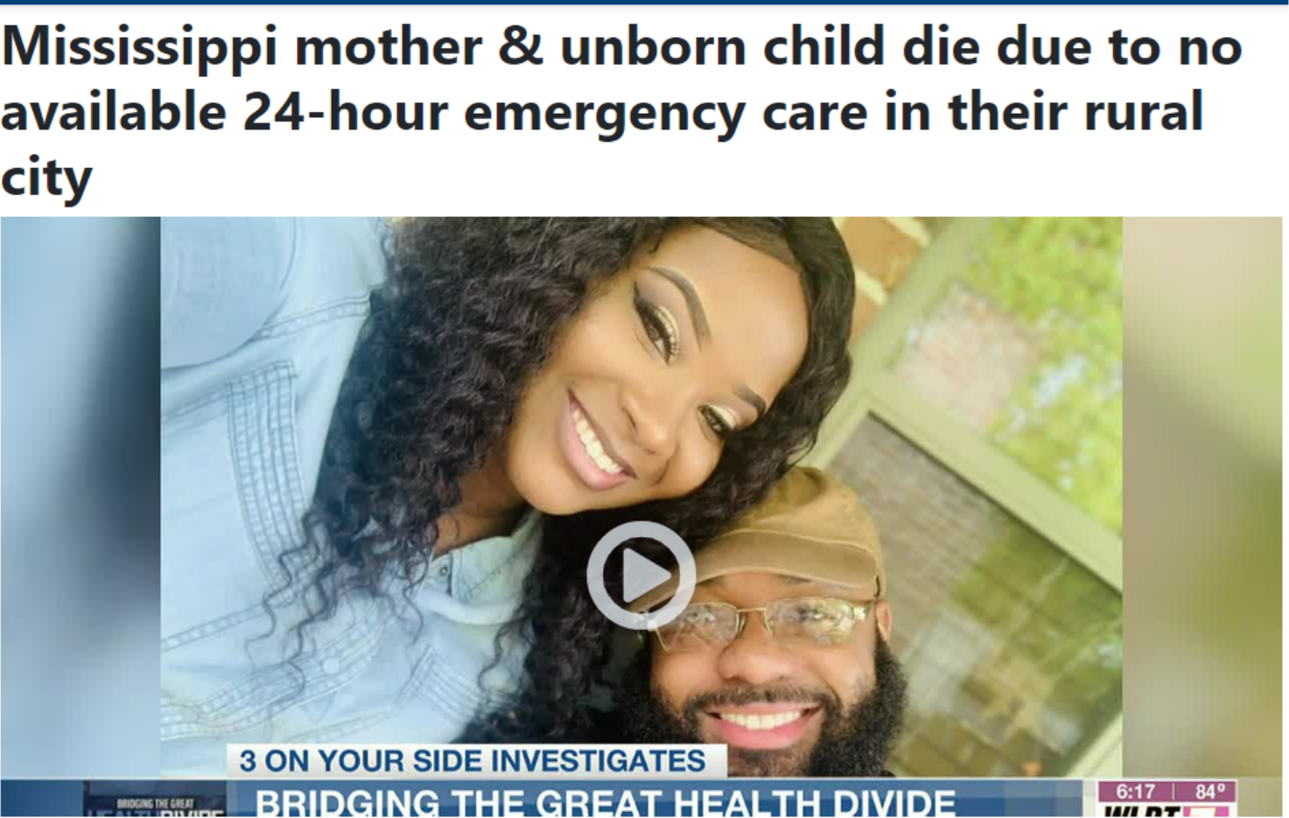

Slide 10
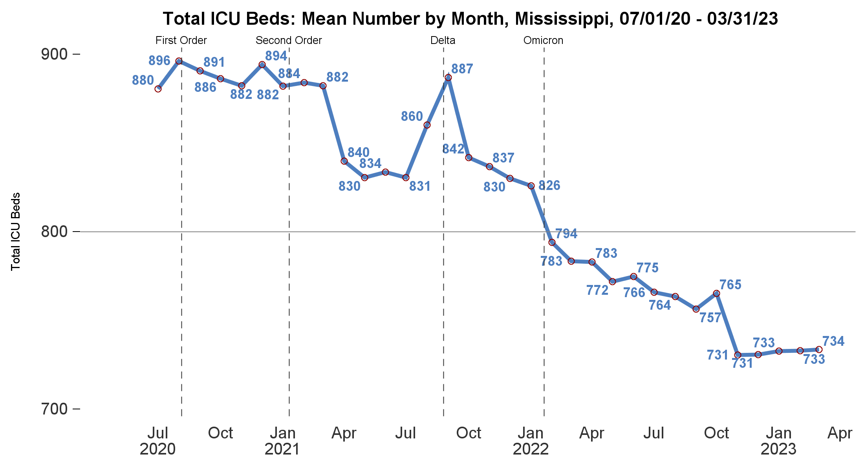
Total ICU Beds by Month

Slide 11
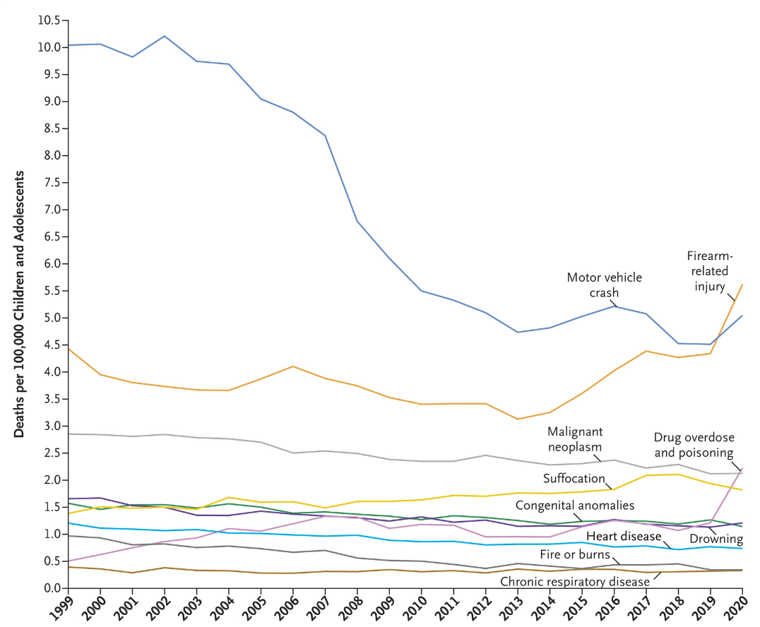
Violence Prevention

Slide 12
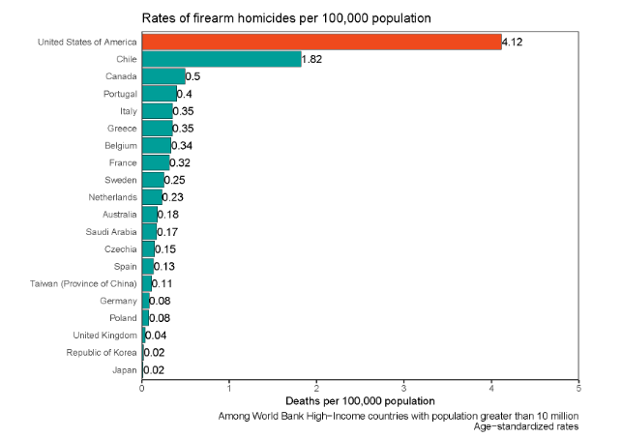

Slide 13
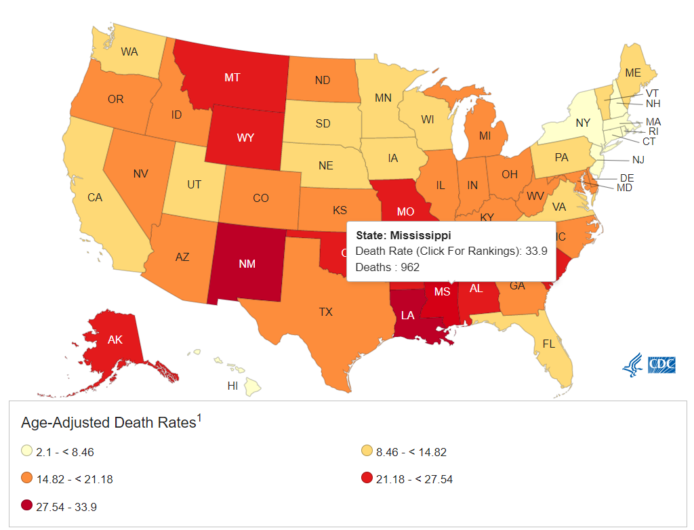

Slide 14
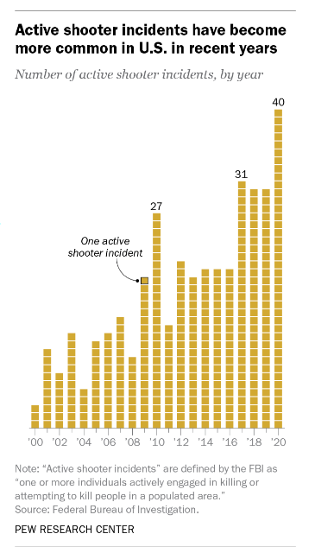

Slide 15
Firearm Mortality
79% of homicides are secondary to firearms
53% of all suicides due to firearms

Slide 19
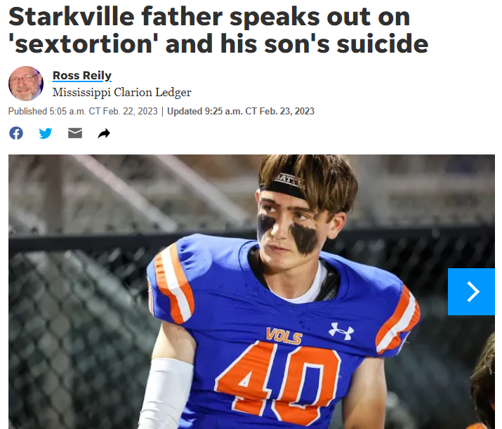

Slide 20
Gun Violence Prevention in Youth
Absence of guns in the household best protection for kids
Having a gun in the home increases the risk of homicide by family members or suicide
Kids > 3 times more likely to successfully commit suicide with a gun in the home
Especially dangerous if youth have mental health issues
Safety education of kids is ineffective
Keeping guns locked, unloaded and in areas unknown to youth
¾ of youth know where guns are in the household

Slide 21
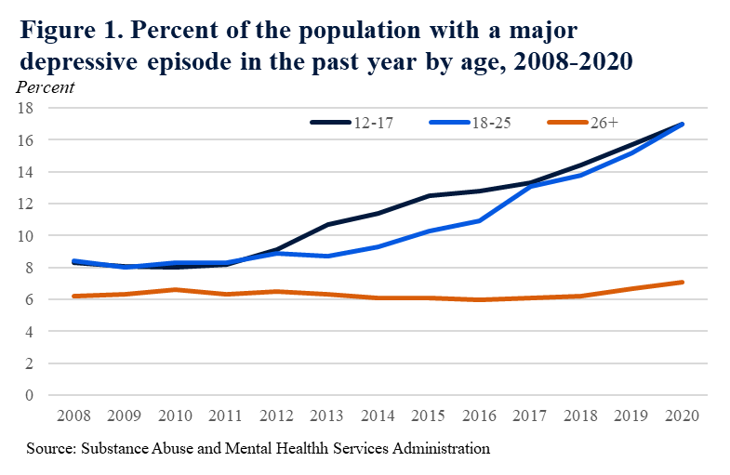

Slide 22
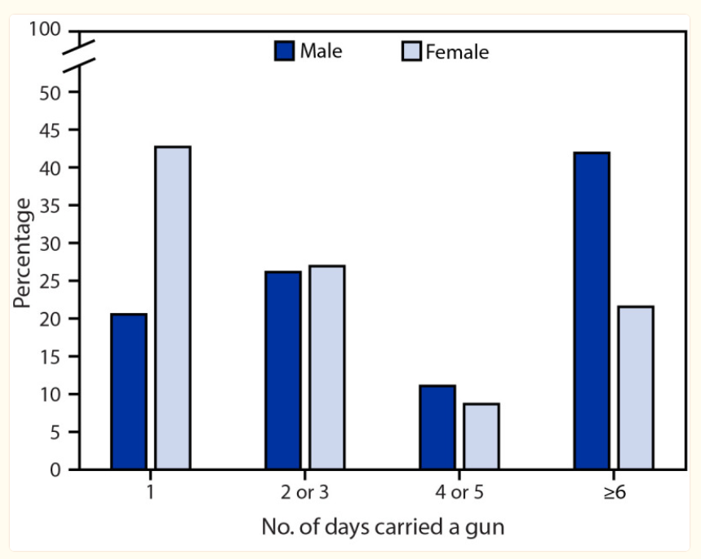
Gun’s and High School Students

Slide 23
Behaviors that Contribute to Violence Among Youth
Previous history of violence-related injury or perpetration
Male sex
Early childhood aggressive behavior, violent discipline
Access to firearms and/or obsession with weapons and death
Alcohol and other drug use
Gang involvement or social isolation
Exposure to intimate partner violence and child abuse
Media violence
Bullying

Slide 24
Community Based Interventions
Programs directed at reducing youth violence are largely based on the positive youth development model
Promote bonding and social, emotional, cognitive, behavioral, or moral competence
Foster resilience, self-determination, spirituality, self-efficacy, clear and positive identity, belief in the future, and prosocial norms
Provide recognition of positive behavior and opportunities for prosocial norms

Slide 25
Questions?

